Slide 1
Electromagnetic Field Theory BTEE-3504
Course Name: B.Tech. Electrical Engineering Semester: 5
Prepared by: Pragya Dhingra
education for life www.rimt.ac.in
Department of Computer Science & Engineering

Slide 2
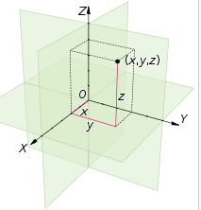
Cartesian, Cylindrical and spherical coordinates
A vector A in Cartesian (otherwise known as rectangular) coordinates can be written as
A=Ax i + Ay j + Az k
where i, j and k are unit vectors along the x-, y-, and z-directions
education for life www.rimt.ac.in
Department of Computer Science & Engineering

Slide 3
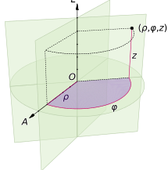
Cartesian, Cylindrical and spherical coordinates
Cylindrical Coordinate system:
A point P in cylindrical coordinates is represented as (ρ, φ, z)
The three coordinates (ρ, φ, z) of a point P are defined as:
The axial distance or radial distance ρ is the
Euclidean distance from the z-axis to the point P.
The azimuth φ is the angle between the reference direction on the chosen plane and the line from the origin to the projection of P on the plane.
The axial coordinate or height z is the signed distance from the chosen plane to the point P.
education for life www.rimt.ac.in
Department of Computer Science & Engineering

Slide 4
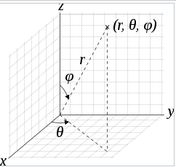
Cartesian, Cylindrical and spherical coordinates
Spherical coordinate system is a coordinate system for thee dimensional space where the position of a point is specified by three numbers: the radial distance of that point from a fixed origin r; its polar angle measured from a fixed polar axis or zenith direction ϴ; and the azimuthal angle ϕ
education for life www.rimt.ac.in
Department of Computer Science & Engineering

Slide 5
Summary
We did a review of Cartesian, cylindrical and spherical
co-ordinate syste.ms
education for life www.rimt.ac.in
Department of Computer Science & Engineering

