Slide 1
Water Resources
Importance of Water
Water is the basic component of every living cell.
It is the basic input required for agriculture.
Hydel power can be used for generating hydroelectricity.
It provides habitat to aquatic flora and fauna.
Common salt can be obtained from water.

Slide 2
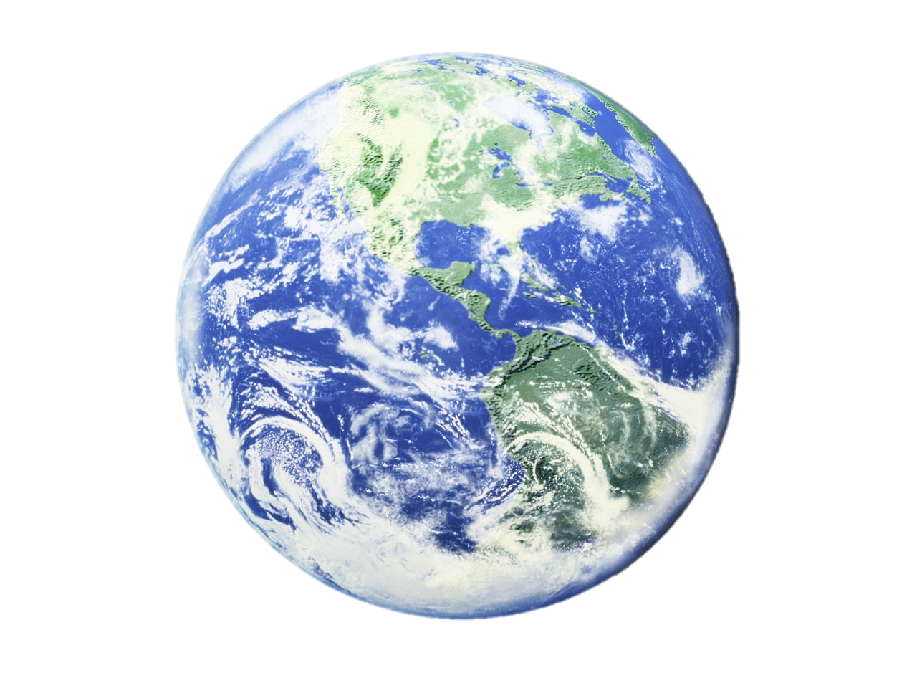
Earth: “Blue Planet”

Slide 4
Sources of Water
Ground Water
Water that is hidden underground in spaces between soil and rock particles is known as ground water. This ground water is the source of water for wells, springs, and even to rivers. Rainwater seeps into the ground, some are clings to particle or to the root of the plants. This moisture is provided to the plants for their growth. Most water moves deeper into ground. Most usable water is at depth of 750 m.
Surface Water
After precipitation, the amount of water that does not percolate down into the ground or does not return to the atmosphere by evaporation or transpiration and enters the rivers, streams, lakes, ponds, wetland, or artificial reservoirs constitutes surface water.
Ground water is purer than surface water, the chance of pollution is less in ground water.

Slide 5
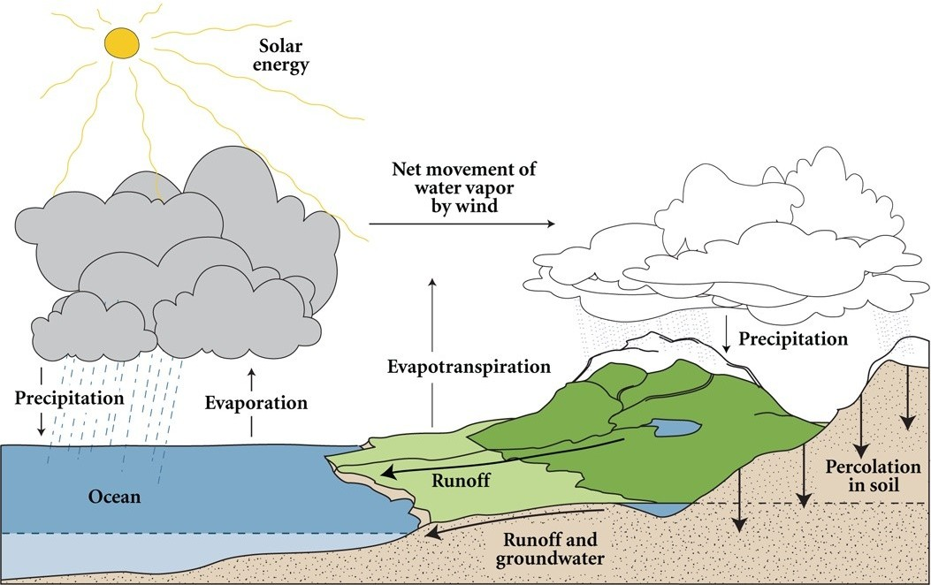
Water Cycle
Water never leaves the Earth. It is constantly being cycled through the atmosphere, ocean, and land.

Slide 6
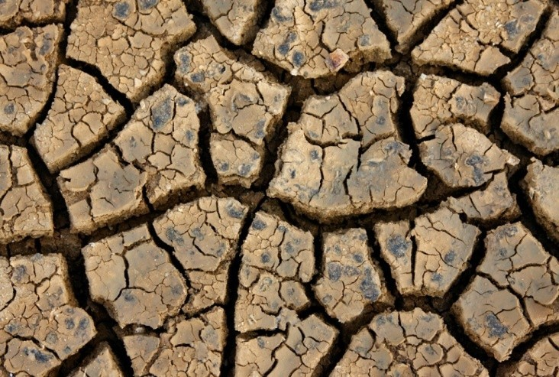
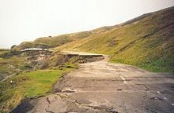
Effects of Over-utilization of Ground Water
Reduced flow of surface water
Lowering of water table
Water logging
(saturation of the soil by groundwater)
Subsidence
Degradation of water quality
Increased salt content
Increased power costs

Slide 7
Water Calamities: Floods and Droughts

Slide 8
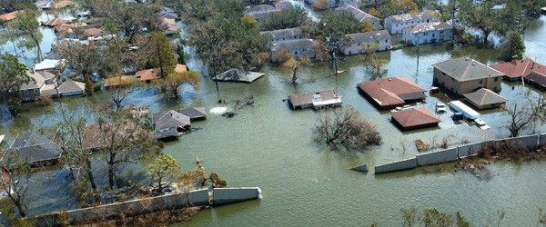
Floods
Floods refers to the presence of unusually large amount of water at any place or more water that can be handled by the drainage of the area. The various types of floods are

Slide 9
Flash Floods (due to sudden heavy rain fall, dam failure)
River floods (when rain over large the catchment area slowly, melting of snow)
Coastal Floods (due to cyclonic activity like hurricanes, tropical cyclones)

Slide 10
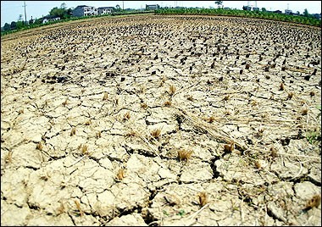
Drought
A drought is a condition in which a region suffers from a severe scarcity in its water availability.

Slide 11
Various kinds of drought
Meteorological Drought (Actual climatological mean of that area)
Hydrological Drought (Running
rainfall is less than
down of surface water
leading to a very low stream flow and drying of lakes, rivers.
Agricultural Drought (In adequate soil moisture result in fall in agricultural productivity)

Slide 12
Water Woes: Junagarh
Junagarh in Gujarat, indiscriminate consumption of ground water has caused an alarming decrease in the water table.
Reasons:
Person that can afford to dig a bore-well, did so without adhering to any limit regarding its depth.
Motors are used to withdrawn large amount of water.
Reduction of water tables by 20% in every summer.
Women have to move up to 4 km in search of water.
Ingress of sea water is the another problems faced by villagers, increases the salinity in ground water and soil, health issues are increased.
Hardness is increased in water.

