Slide 1

BASIC OF ELECTRICAL & ELECTRONICS ENGINEERING
Course Name: B.Tech (Applied Sciences)
Semester: 1st
Prepared by: Er. Komal Mehra
education for life www.rimt.ac.in
Department of Applied Sciences

Slide 2
AC CIRCUITS
education for life www.rimt.ac.in
Department of Applied Sciences

Slide 3


GENERATION OF AC
education for life www.rimt.ac.in
Department of Applied Sciences

Slide 4




DIFFERENT FORMS OF EMF EQUATION
education for life www.rimt.ac.in
Department of Applied Sciences

Slide 5

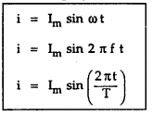
DIFFERENT FORMS OF CURRENT
education for life www.rimt.ac.in
Department of Applied Sciences

Slide 6
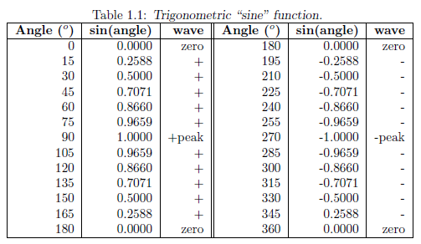
SINE VALUES AT DIFFERENT ANGLES
education for life www.rimt.ac.in
Department of Applied Sciences

Slide 7
SINUSOIDAL ALTERNATING CURRENT
education for life www.rimt.ac.in
Department of Applied Sciences

Slide 8
TYPES OF AC WAVEFORMS
education for life www.rimt.ac.in
Department of Applied Sciences

Slide 9
SINUSOIDAL ALTERNATING CURRENT
education for life www.rimt.ac.in
Department of Applied Sciences

Slide 10
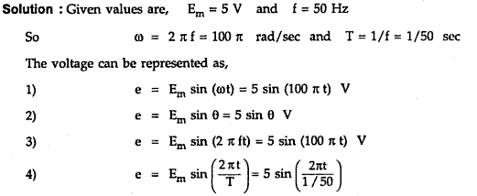
education for life www.rimt.ac.in
Department of Applied Sciences

Slide 11
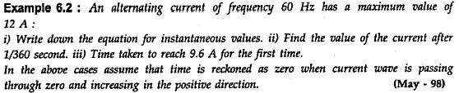

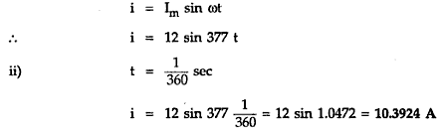
education for life www.rimt.ac.in
Department of Applied Sciences

Slide 12
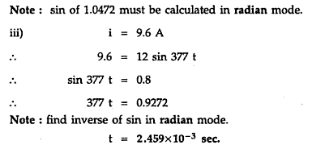
education for life www.rimt.ac.in
Department of Applied Sciences

Slide 13
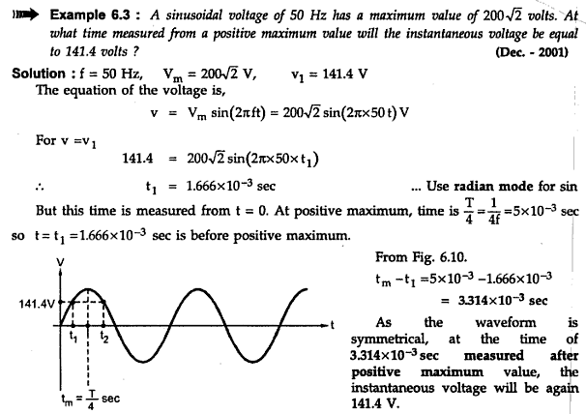
education for life www.rimt.ac.in

Slide 14
TERMINOLOGIES IN AC WAVEFORM
education for life www.rimt.ac.in

Slide 15
EFFECTIVE VALUE OR RMS VALUE
education for life www.rimt.ac.in
Department of Applied Sciences

Slide 16
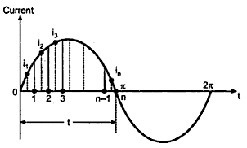
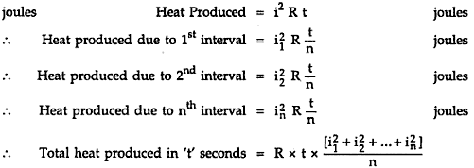
CALCULATION OF RMS VALUE BY USING GRAPHICAL METHOD
education for life www.rimt.ac.in

Slide 17
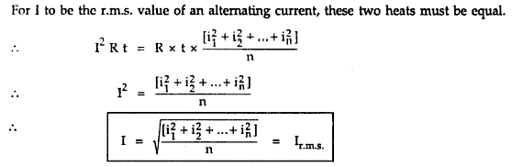



education for life www.rimt.ac.in

Slide 18

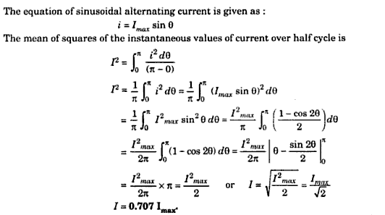
CALCULATION OF RMS VALUE BY USING ANALITICAL METHOD
education for life www.rimt.ac.in
Department of Applied Sciences

Slide 19

education for life www.rimt.ac.in
Department of Applied Sciences

Slide 20

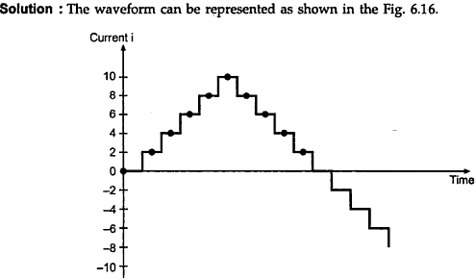




education for life www.rimt.ac.in
Department of Applied Sciences

Slide 21

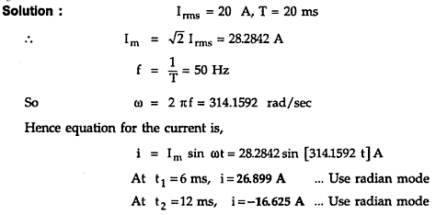
education for life www.rimt.ac.in
Department of Applied Sciences

Slide 22
AVERAGE VALUE OF ONE CYCLE
education for life www.rimt.ac.in

Slide 23
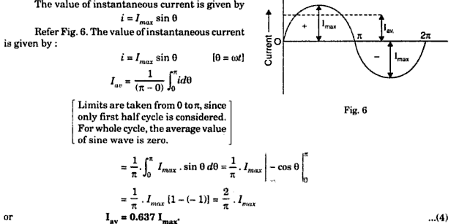
CALCULATION OF RMS VALUE BY USING ANALITICAL METHOD
education for life www.rimt.ac.in

Slide 24
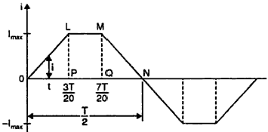
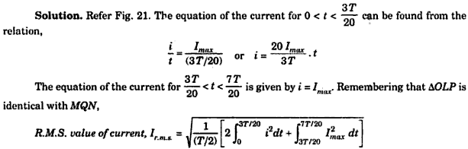
education for life www.rimt.ac.in
Department of Applied Sciences

Slide 25
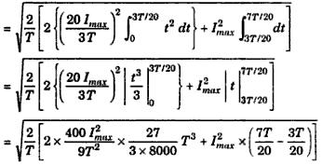

education for life www.rimt.ac.in
Department of Applied Sciences

Slide 26
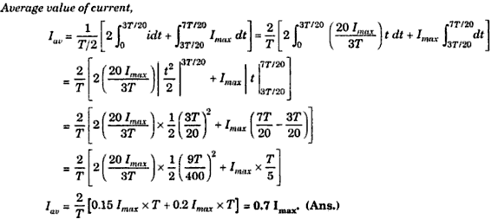
education for life www.rimt.ac.in
Department of Applied Sciences

Slide 27
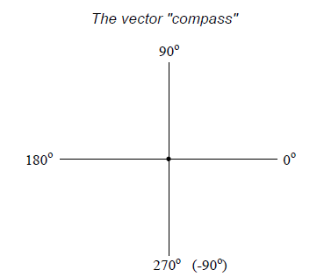
VECTOR COMPASS
education for life www.rimt.ac.in
Department of Applied Sciences

Slide 28
VECTOR REPRESENTATION
education for life www.rimt.ac.in
Department of Applied Sciences

Slide 29
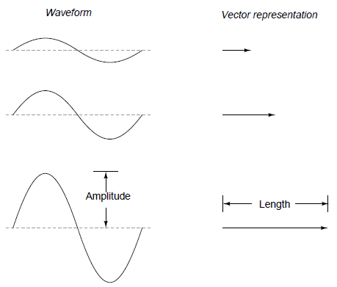
education for life www.rimt.ac.in
Department of Applied Sciences

Slide 30
PHASE SHIFT
education for life www.rimt.ac.in
Department of Applied Sciences

Slide 31
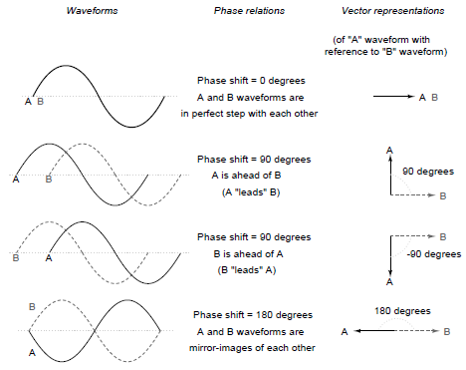
PHASE SHIFT REPRESENTATION
education for life www.rimt.ac.in
Department of Applied Sciences

Slide 32
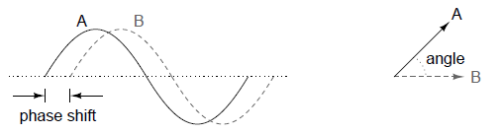
education for life www.rimt.ac.in
Department of Applied Sciences

Slide 33
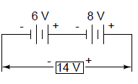
DC QUANTITY REPRESENTATION
education for life www.rimt.ac.in
Department of Applied Sciences

Slide 34
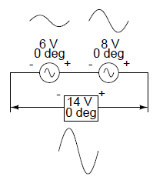


SIMPLE VECTOR ADDITION
education for life www.rimt.ac.in
Department of Applied Sciences

Slide 35


education for life www.rimt.ac.in
Department of Applied Sciences

Slide 36
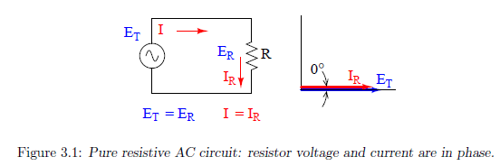
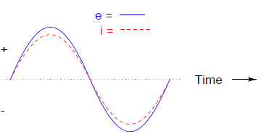
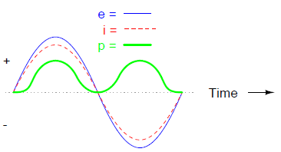
AC Voltage Source Connected Across Pure Resistor(R)
education for life www.rimt.ac.in
Department of Applied Sciences

Slide 37
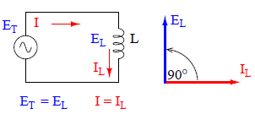
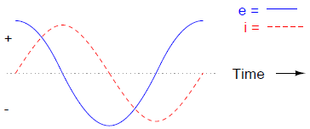
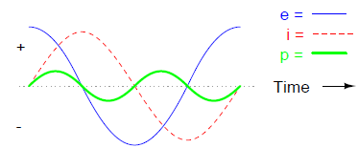
AC Voltage Source Connected Across Pure Inductor(L)
education for life www.rimt.ac.in
Department of Applied Sciences

Slide 38

education for life www.rimt.ac.in
Department of Applied Sciences

Slide 39
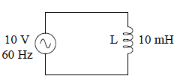
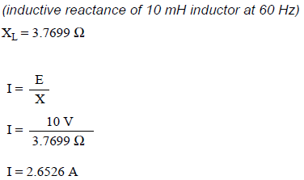
education for life www.rimt.ac.in
Department of Applied Sciences

Slide 40
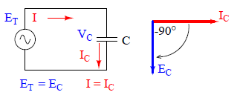
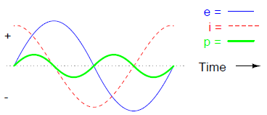
education for life www.rimt.ac.in
Department of Applied Sciences

Slide 41

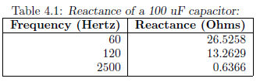
education for life www.rimt.ac.in
Department of Applied Sciences

Slide 42
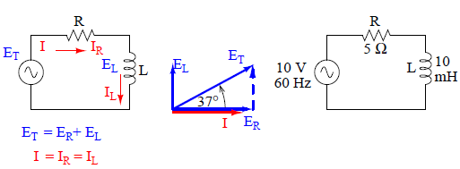
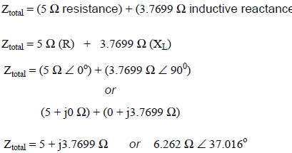
AC Source Connected in Across Series R-L Circuit
education for life www.rimt.ac.in
Department of Applied Sciences

Slide 43
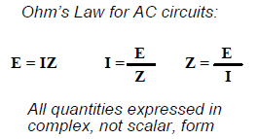
education for life www.rimt.ac.in
Department of Applied Sciences

