Slide 1

BASIC OF ELECTRICAL & ELECTRONICS ENGINEERING
Course Name: B.Tech (Applied Sciences)
Semester: 1st
Prepared by: Er. Komal Mehra
education for life www.rimt.ac.in
Department of Electrical, Electronics & Communication Engineering

Slide 2
STAR DELTA TRASFORMATION
education for life www.rimt.ac.in
Department of Electrical, Electronics & Communication Engineering

Slide 3
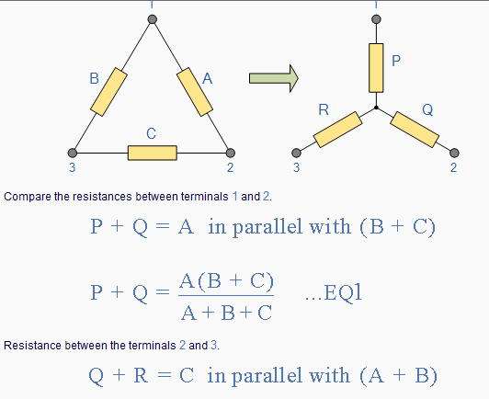
Delta to Star Transformation
To convert a delta network to an equivalent star network we need to derive a transformation formula for equating the various resistors to each other between the various terminals. Consider the circuit below.
Delta to Star Network.
education for life www.rimt.ac.in
Department of Electrical, Electronics & Communication Engineering

Slide 4
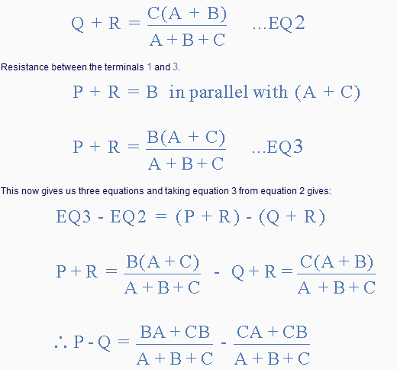
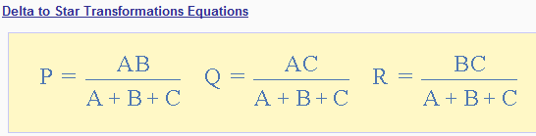
education for life www.rimt.ac.in
Department of Electrical, Electronics & Communication Engineering

Slide 5
Star Delta Transformation
We can now solve simple series, parallel or bridge type resistive networks using Kirchoff´s Circuit Laws, mesh current analysis or nodal voltage analysis techniques but in a balanced 3-phase circuit we can use different mathematical techniques to simplify the analysis of the circuit and thereby reduce the amount of math's involved which in itself is a good thing.
Standard 3-phase circuits or networks take on two major forms with names that represent the way in which the resistances are connected, a Star connected network which has the symbol of the letter, Υ (wye) and a Delta connected network which has the symbol of a triangle, Δ (delta). If a 3-phase, 3-wire supply or even a 3-phase load is connected in one type of configuration, it can be easily transformed or changed it into an equivalent configuration of the other type by using either the Star Delta Transformation or Delta Star Transformation process.
A resistive network consisting of three impedances can be connected together to form a T or "Tee" configuration but the network can also be redrawn to form a Star or Υ type network as shown below
education for life www.rimt.ac.in
Department of Electrical, Electronics & Communication Engineering

Slide 6
Star Delta Transformation
We have seen above that when converting from a delta network to an equivalent star network that the resistor connected to one terminal is the product of the two delta resistances connected to the same terminal, for example resistor P is the product of resistors A and B connected to terminal 1.
By rewriting the previous formulas a little we can also find the transformation formulas for converting a resistive star network to an equivalent delta network giving us a way of producing a star delta transformation as shown below.
education for life www.rimt.ac.in
Department of Electrical, Electronics & Communication Engineering

Slide 7
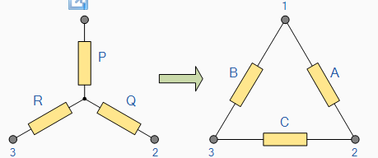
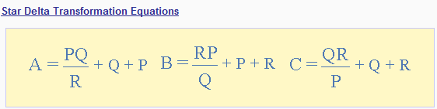
Star to Delta Network
education for life www.rimt.ac.in
Department of Electrical, Electronics & Communication Engineering

Slide 8
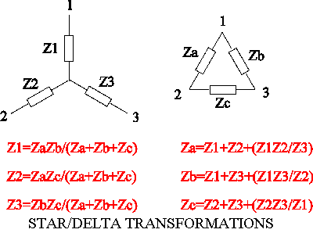
Star-Delta Transformation
education for life www.rimt.ac.in
Department of Electrical, Electronics & Communication Engineering

