Slide 1

COMMUNICATIVE ENGLISH / BENG-1101
Course Name: B.Tech (Common to all branches)
Semester: First
Prepared by: AMIT MOHAN
Head & Assistant Professor
education for life www.rimt.ac.in
Department of English

Slide 2

Topic Discussed
phonetics
education for life www.rimt.ac.in
Department of English

Slide 3
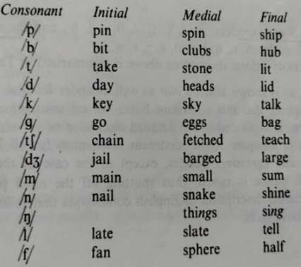
consonant
In RP (Received Pronunciation), there are twenty-four consonants sounds, which can be described in terms of -the nature of sound, vocal cords, airstream, the place of articulation, and the manner of articulation.
education for life www.rimt.ac.in
Department of English

Slide 4
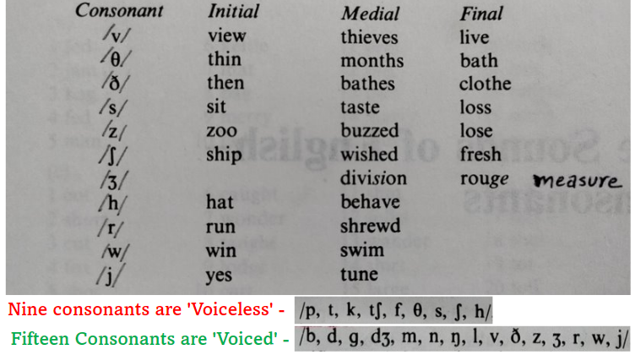
education for life www.rimt.ac.in
Department of English

Slide 5
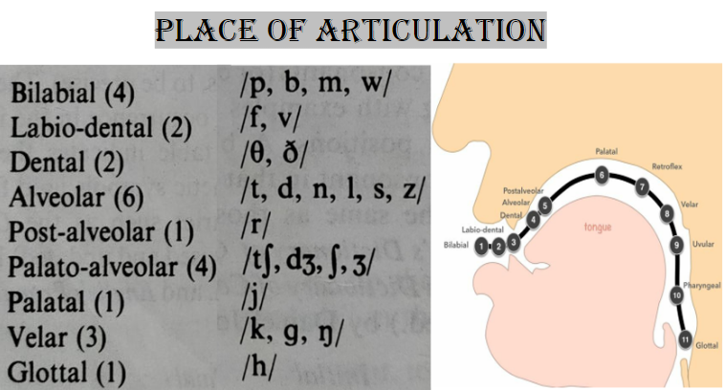
education for life www.rimt.ac.in
Department of English

Slide 6
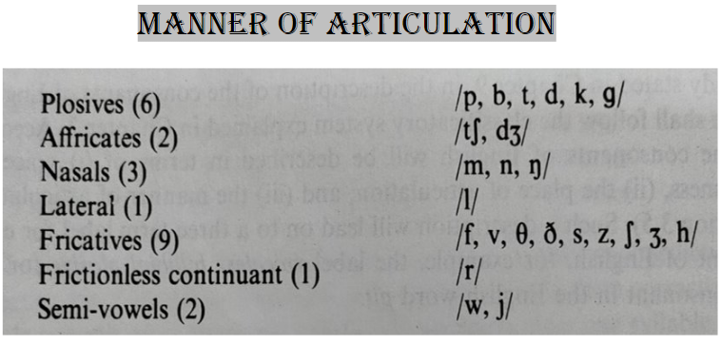
education for life www.rimt.ac.in
Department of English

Slide 7
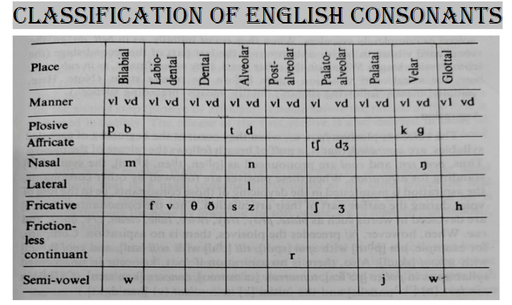
education for life www.rimt.ac.in
Department of English

Slide 8
Topics Discussed in Next Lecture
Phonetics
Graphical description of RP (Consonant) sounds
education for life www.rimt.ac.in
Department of English

