Slide 1

COMMUNICATIVE ENGLISH / BENG-1101
Course Name: B.Tech (Common to all branches)
Semester: First
Prepared by: AMIT MOHAN
Head & Assistant Professor
education for life www.rimt.ac.in
Department of English

Slide 2
Topic Discussed
Communication Skills
Types of Communication – Formal & Informal
education for life www.rimt.ac.in
Department of English

Slide 3

education for life www.rimt.ac.in
Department of English

Slide 4
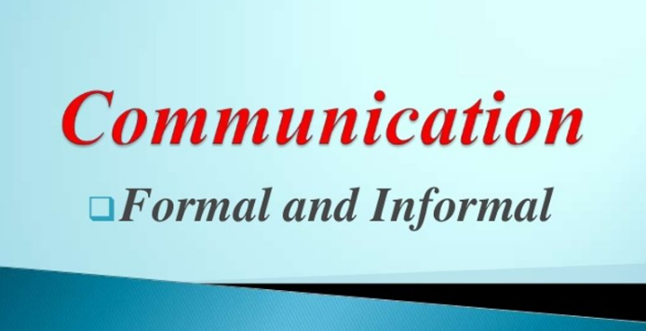
education for life www.rimt.ac.in
Department of English

Slide 5
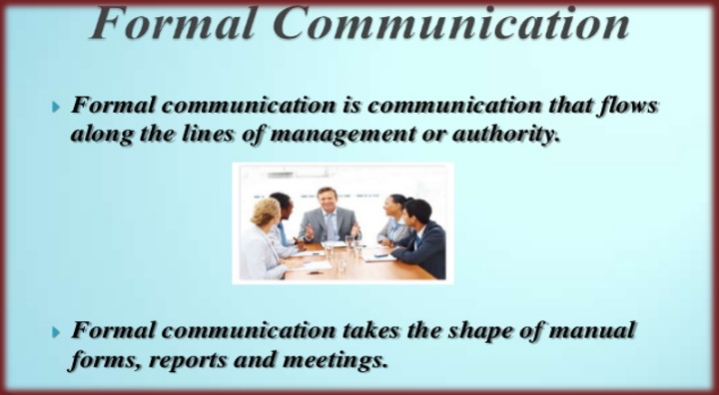
education for life www.rimt.ac.in
Department of English

Slide 6
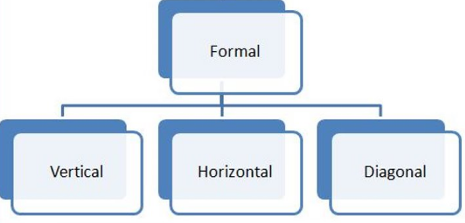
education for life www.rimt.ac.in
Department of English

Slide 7
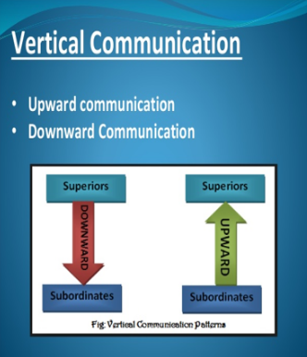
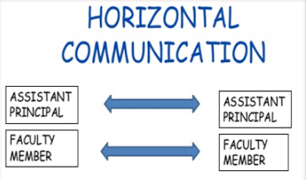
education for life www.rimt.ac.in
Department of English

Slide 8
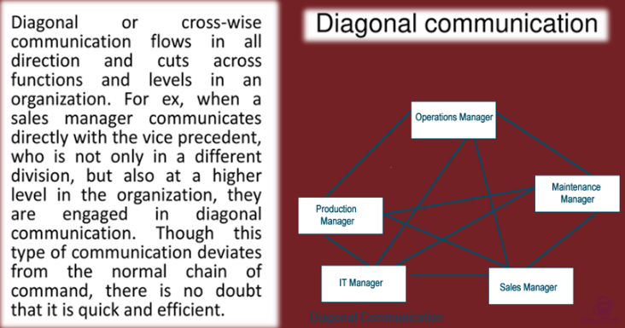
education for life www.rimt.ac.in
Department of English

Slide 9
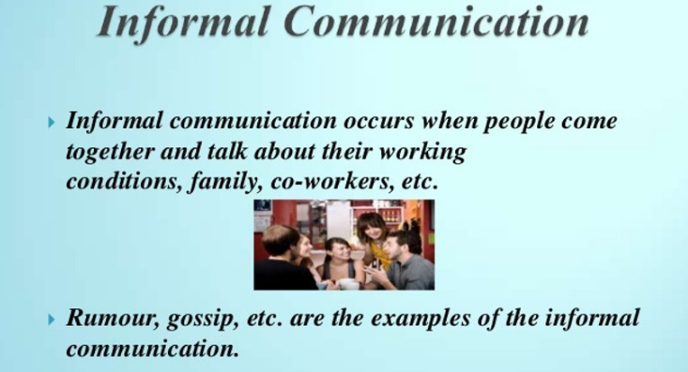
education for life www.rimt.ac.in
Department of English

Slide 10


Informal communication has two types : ​
Grapevine​
Consensus
education for life www.rimt.ac.in
Department of English

Slide 11
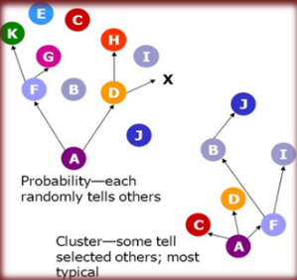
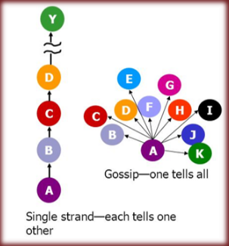
Grapevine is an informal type or channel of communication. It is unorganized and unofficial in nature. Personal and official matters are discussed in it during tea break and lunch hours.
education for life www.rimt.ac.in
Department of English

Slide 12
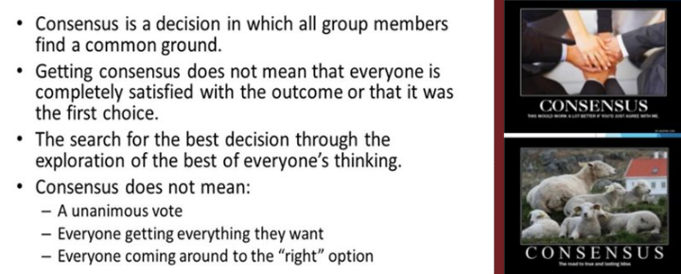
CONSENSUS
education for life www.rimt.ac.in
Department of English

Slide 13
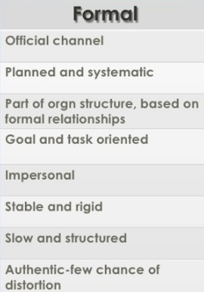
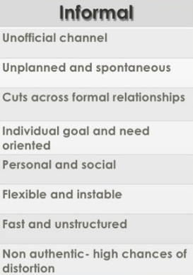
DIFFERENCE BETWEEN FORMAL AND INFORMAL COMMUNICATION
education for life www.rimt.ac.in
Department of English

Slide 14
Topics Discussed in Next Lecture
Communication
Barriers to Communication
education for life www.rimt.ac.in
Department of English

