Slide 1

Strength of Materials-I(BMEC-2301)
Course Name: B.Tech-Mechanical
Semester: 3rd
Prepared by: Ajay Singh Rana
education for life www.rimt.ac.in
Department of Mechanical Engineering

Slide 2
Topic Discussed
Introduction
Euler’s Theory
Strut with pinned ends
Column both end pinned
Column one end fixed and other end free
Column both end fixed
Column one end fixed and other end hinged
Effective length of Column
education for life www.rimt.ac.in
Department of Mechanical Engineering

Slide 3
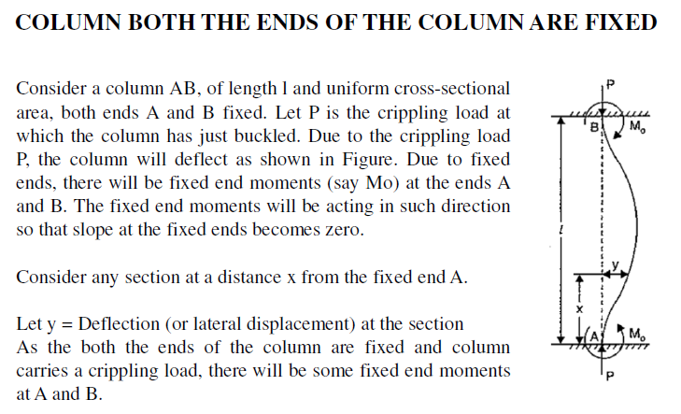
education for life www.rimt.ac.in
Department of Mechanical Engineering

Slide 4
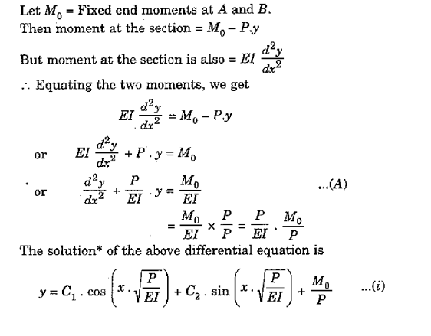
education for life www.rimt.ac.in
Department of Mechanical Engineering

Slide 5
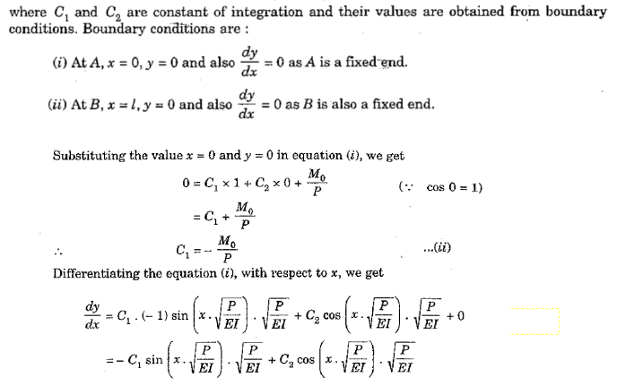
education for life www.rimt.ac.in
Department of Mechanical Engineering

Slide 6
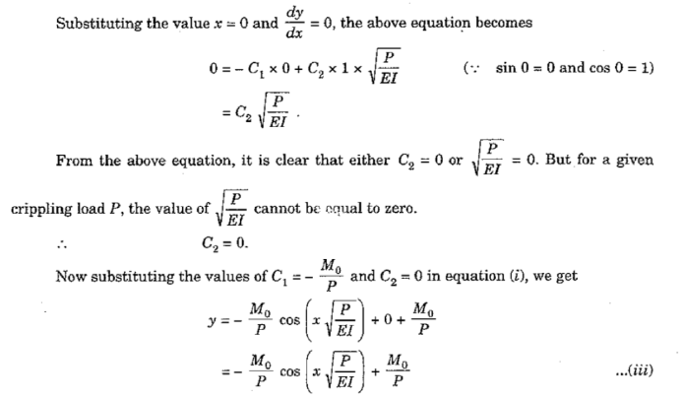
education for life www.rimt.ac.in
Department of Mechanical Engineering

Slide 7
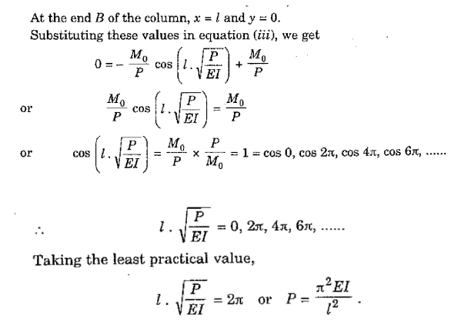
education for life www.rimt.ac.in
Department of Mechanical Engineering

Slide 8
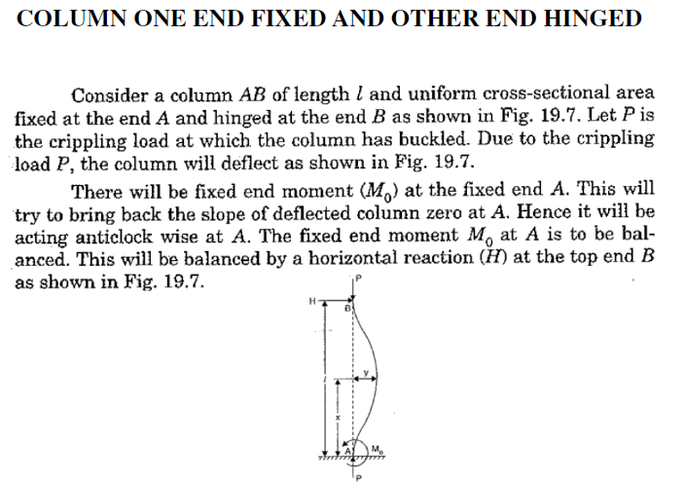
education for life www.rimt.ac.in
Department of Mechanical Engineering

Slide 9
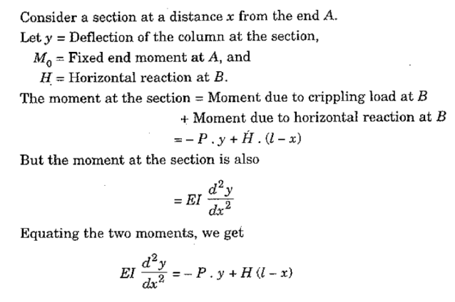
education for life www.rimt.ac.in
Department of Mechanical Engineering

Slide 10
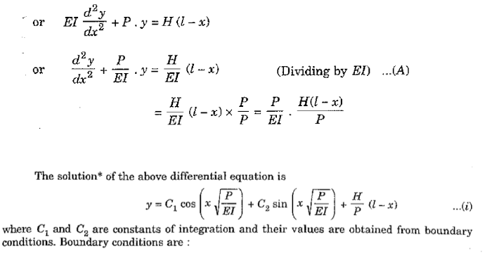
education for life www.rimt.ac.in
Department of Mechanical Engineering

Slide 11
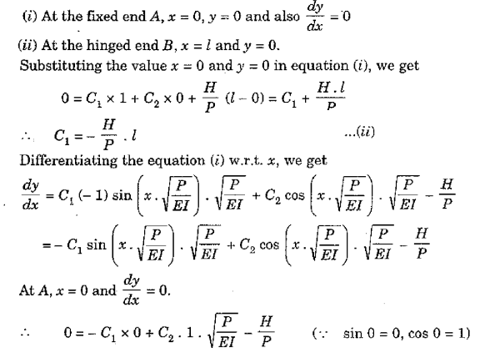
education for life www.rimt.ac.in
Department of Mechanical Engineering

Slide 12
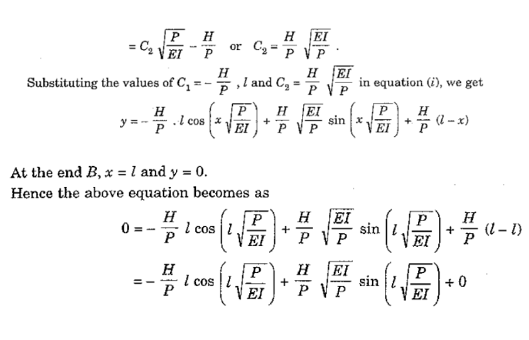
education for life www.rimt.ac.in
Department of Mechanical Engineering

Slide 13
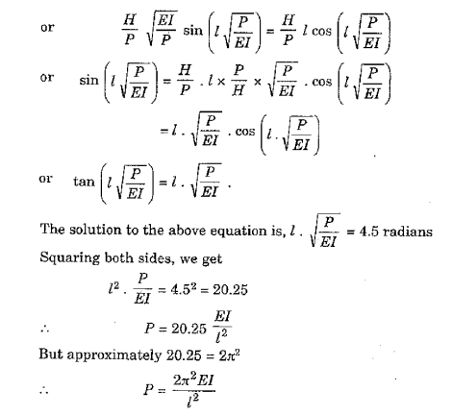
education for life www.rimt.ac.in
Department of Mechanical Engineering

Slide 14
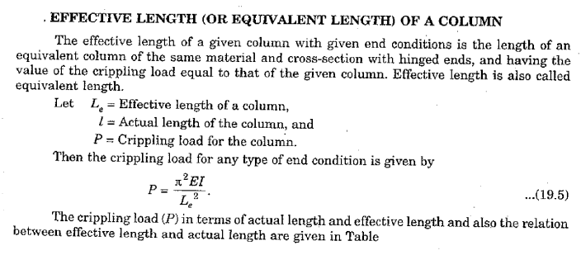
education for life www.rimt.ac.in
Department of Mechanical Engineering

Slide 15
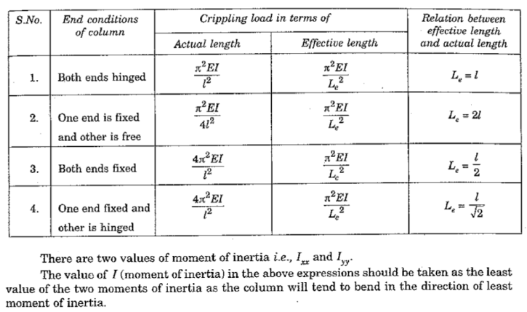
education for life www.rimt.ac.in
Department of Mechanical Engineering

Slide 16
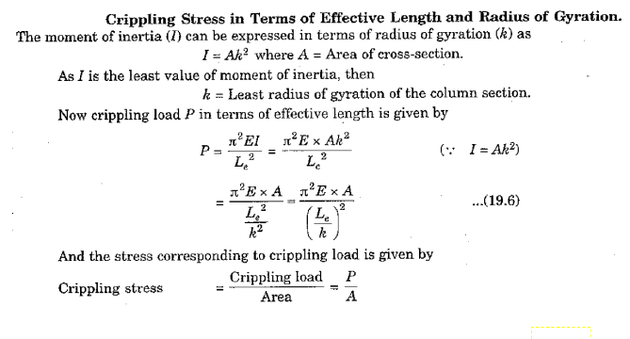
education for life www.rimt.ac.in
Department of Mechanical Engineering

Slide 17
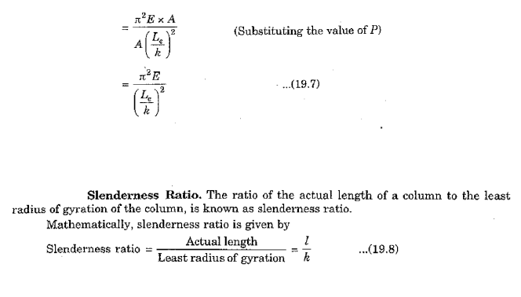
education for life www.rimt.ac.in
Department of Mechanical Engineering

