Slide 1

Strength of Materials-I(BMEC-2301)
Course Name: B.Tech-Mechanical
Semester: 3rd
Prepared by: Ajay Singh Rana
education for life www.rimt.ac.in
Department of Mechanical Engineering

Slide 2
Topic Discussed
Relationship of stress and strain in two dimensions
Relationship of stress and strain in three dimensions
Volumetric Strain
Volumetric strain of a rectangular bar
Volumetric strain of a cylindrical rod
Bulk Modulus
Analysis of bars of varying crossections
education for life www.rimt.ac.in
Department of Mechanical Engineering

Slide 3
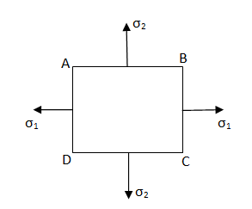
Relationship of stress and strain in two dimensions:
Consider a two-dimensional figure ABCD subjected to two mutually perpendicular stresses σ₁ and σ₂
Let σ₁ = Normal stress in x-direction
σ₂ = Normal stress in y-direction
education for life www.rimt.ac.in
Department of Mechanical Engineering

Slide 4


Consider the strain produced by σ₁:
The stress σ₁ will produce strain in the direction of x and also in direction of y. The strain in the direction of x will be longitudinal strain and will be equal to
whereas the strain in the direction of y will be lateral strain and will be equal to
education for life www.rimt.ac.in
Department of Mechanical Engineering

Slide 5

Now, consider the strain produced by σ₂:
The stress σ₂ will produce strain in the direction of y and also in direction of x. The strain in the direction of y will be longitudinal strain and will be equal to
whereas the strain in the direction of x will be lateral strain and will be equal to
education for life www.rimt.ac.in
Department of Mechanical Engineering

Slide 6
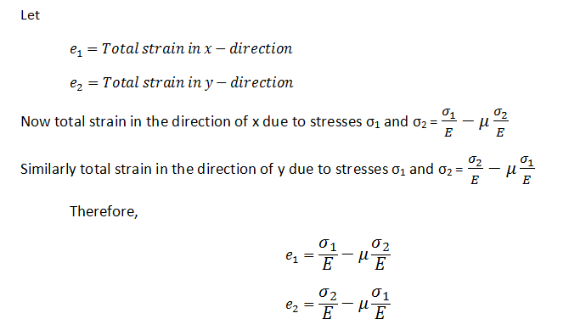
The above two equations gives the stress and strain relationship for two-dimensional stress system. In the above equations, tensile stress is taken to be positive, whereas the compressive stress negative.
education for life www.rimt.ac.in
Department of Mechanical Engineering

Slide 7
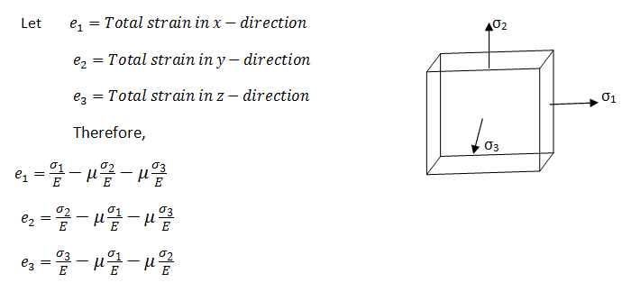
Relationship of stress and strain in three dimensions:
education for life www.rimt.ac.in
Department of Mechanical Engineering

Slide 8

Volumetric Strain:
When a body is subjected to a single force or a system of forces, then the ratio of change in volume to original volume of the body is called volumetric strain. It is denoted by e_{v}. Mathematically, volumetric strain is given by:
Where δV= change in volume,
V= original volume
education for life www.rimt.ac.in
Department of Mechanical Engineering

Slide 9
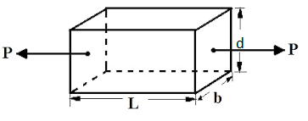
Volumetric strain of a rectangular bar which is subjected to an Axial load P in the direction of its length:
Consider a rectangular bar of length L, width b and depth d which is subjected to an axial load P in the direction of its length as shown:
Let δL = change in length
δb = change in width and
δd = change in depth.
education for life www.rimt.ac.in
Department of Mechanical Engineering

Slide 10
Therefore, Final length of the bar = L + δL
Final width of the bar = b + δb
Final depth of the bar = d + δd
Now original volume of the bar, V = L×b×d
Final volume of bar: (L + δL) × (b + δb) × (d + δd)
L.b.d + b.d. δL+L.b. δd+L.d. δb
Change in volume = Final Volume – Original volume
= (L.b.d + b.d. δL+L.b. δd+L.d. δb)-L.b.d
= b.d. δL+L.b. δd+L.d. δb
education for life www.rimt.ac.in
Department of Mechanical Engineering

Slide 11
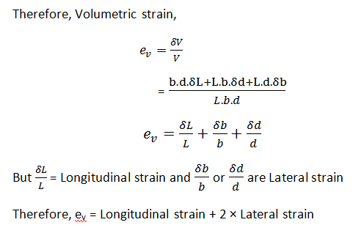
education for life www.rimt.ac.in
Department of Mechanical Engineering

Slide 12
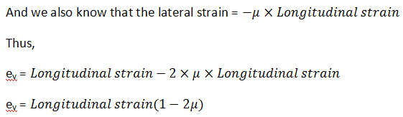
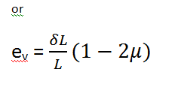
education for life www.rimt.ac.in
Department of Mechanical Engineering

Slide 13
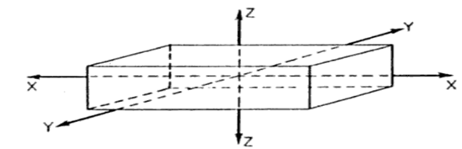
Volumetric strain of a rectangular bar which is subjected to three forces which are mutually perpendicular:
Consider a rectangular block of dimension x,y,z subjected to three direct tensile stresses along three mutually perpendicular axis as shown in fig.
education for life www.rimt.ac.in
Department of Mechanical Engineering

Slide 14
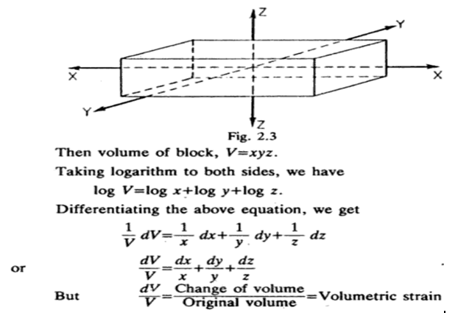
education for life www.rimt.ac.in
Department of Mechanical Engineering

Slide 15
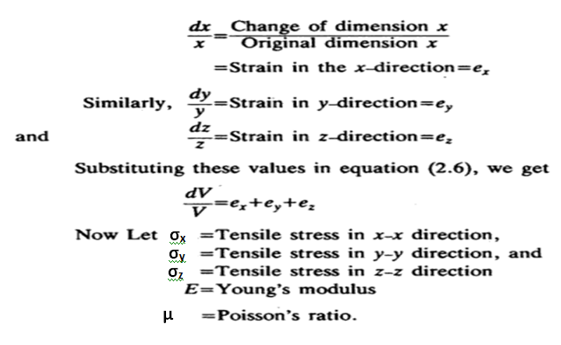
education for life www.rimt.ac.in
Department of Mechanical Engineering

Slide 16
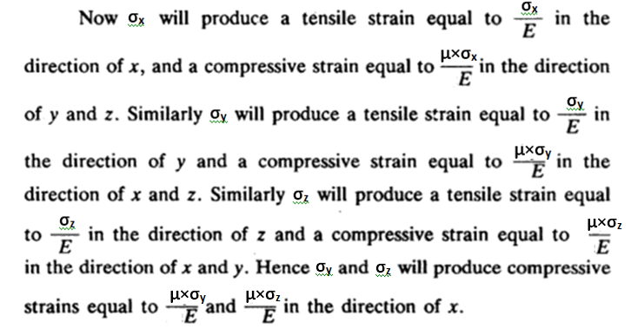
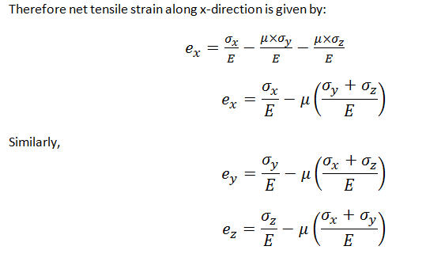
education for life www.rimt.ac.in
Department of Mechanical Engineering

Slide 17
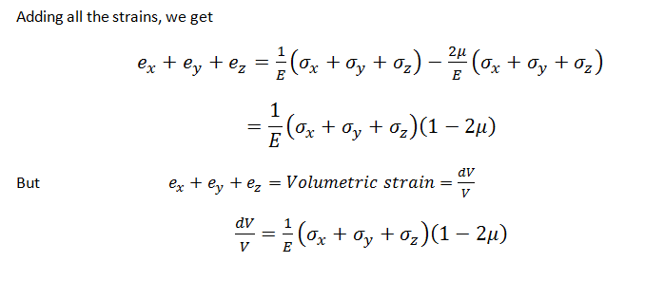
education for life www.rimt.ac.in
Department of Mechanical Engineering

Slide 18
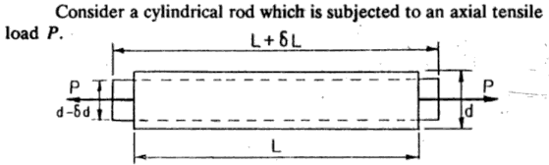
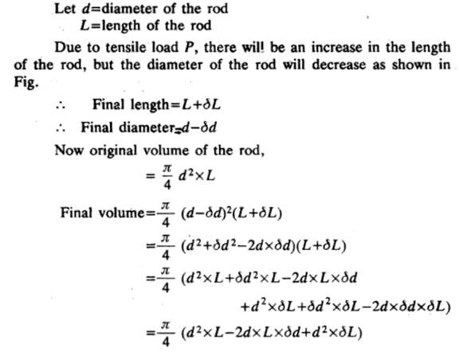
education for life www.rimt.ac.in
Department of Mechanical Engineering

Slide 19
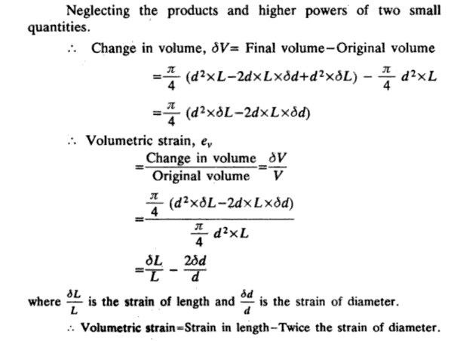
education for life www.rimt.ac.in
Department of Mechanical Engineering

Slide 20
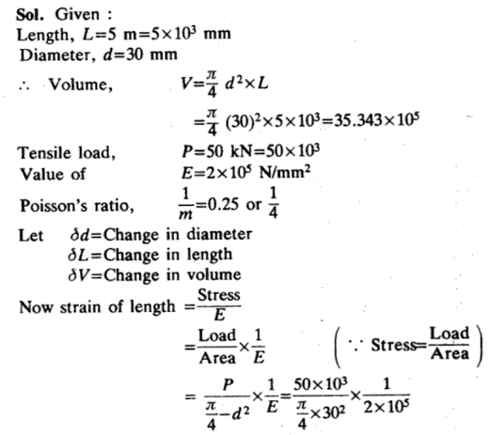
education for life www.rimt.ac.in
Department of Mechanical Engineering

Slide 21
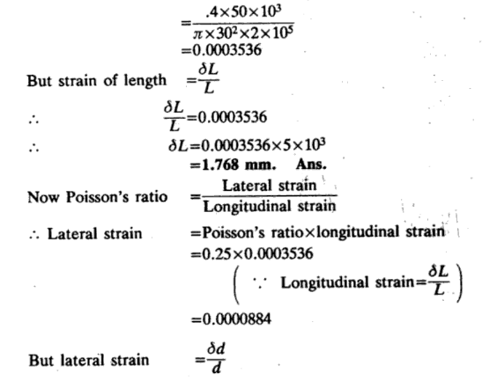
education for life www.rimt.ac.in
Department of Mechanical Engineering

Slide 22
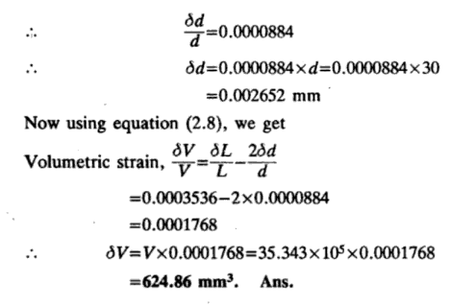
education for life www.rimt.ac.in
Department of Mechanical Engineering

Slide 23
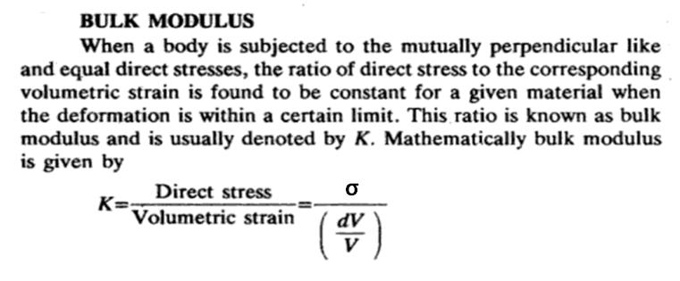
education for life www.rimt.ac.in
Department of Mechanical Engineering

Slide 24
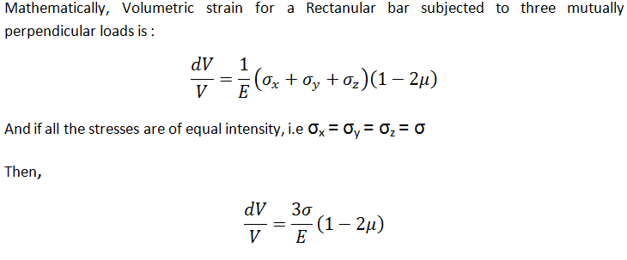
Relationship of Bulk modulus, Moudulus of Elasticity and Poisson’s ratio:
education for life www.rimt.ac.in
Department of Mechanical Engineering

Slide 25
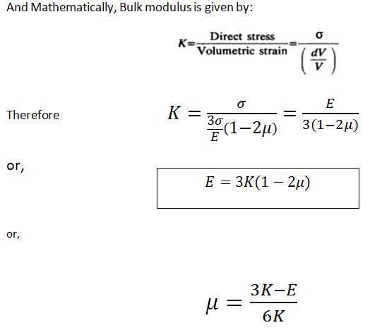
education for life www.rimt.ac.in
Department of Mechanical Engineering

Slide 26

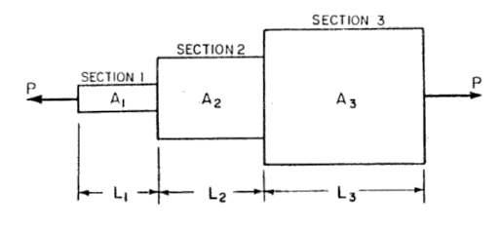
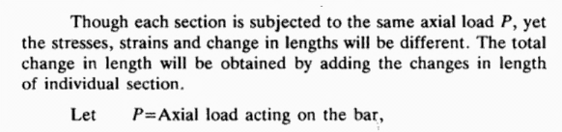
education for life www.rimt.ac.in
Department of Mechanical Engineering

Slide 27
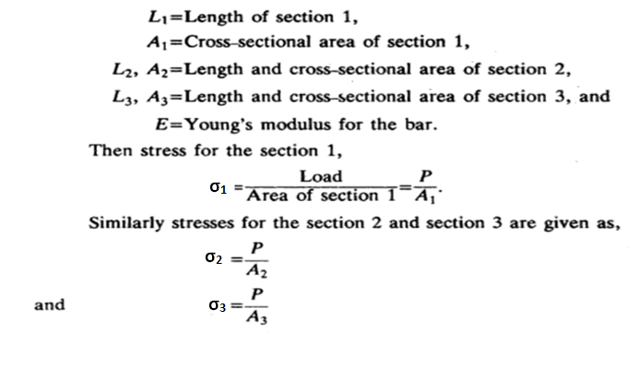
education for life www.rimt.ac.in
Department of Mechanical Engineering

Slide 28
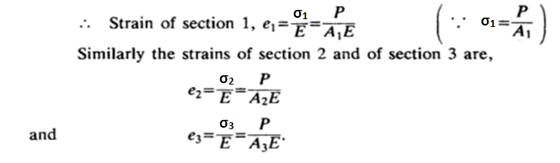
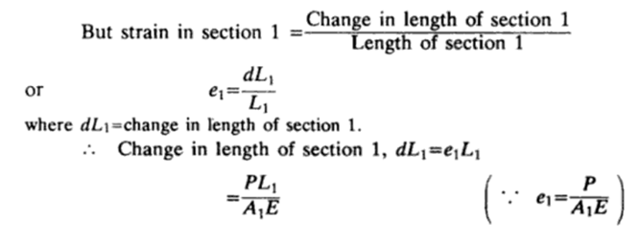
education for life www.rimt.ac.in
Department of Mechanical Engineering

Slide 29
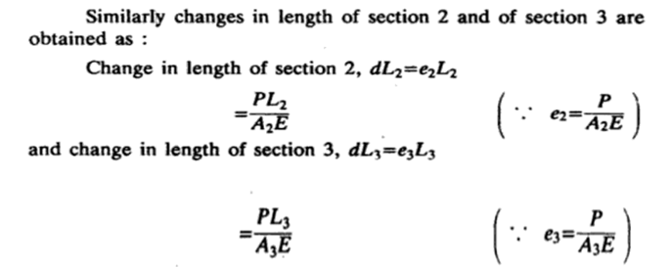
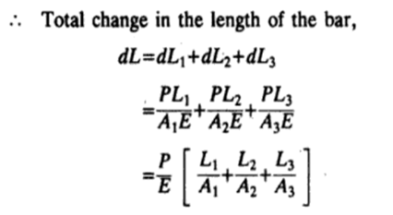
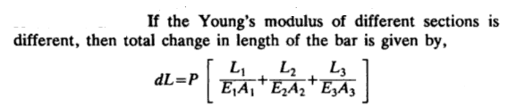
education for life www.rimt.ac.in
Department of Mechanical Engineering

Slide 30
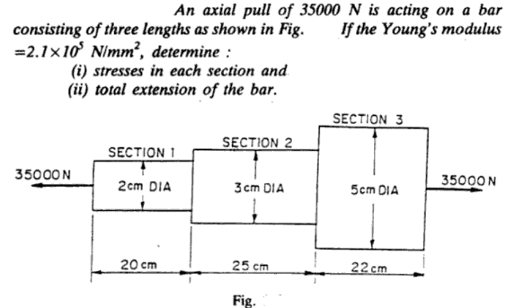
education for life www.rimt.ac.in
Department of Mechanical Engineering

Slide 31
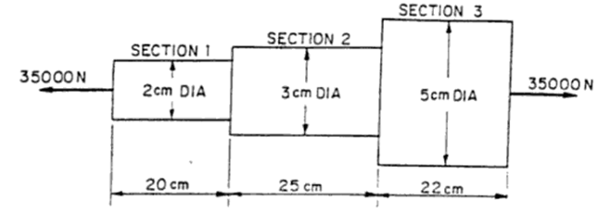
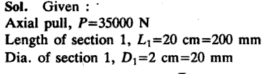
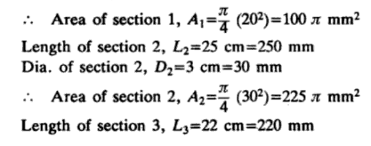
education for life www.rimt.ac.in
Department of Mechanical Engineering

Slide 32
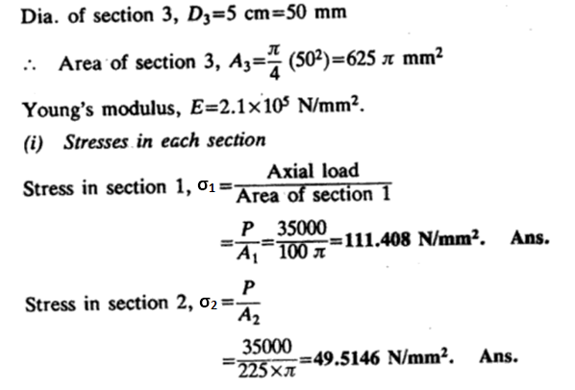
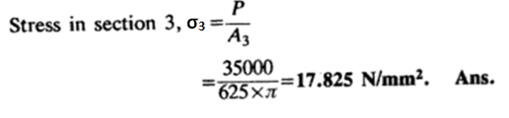
education for life www.rimt.ac.in
Department of Mechanical Engineering

Slide 33
