Slide 1

Applied Thermodynamics(BMEC-2304)
Course Name: B.Tech- Mechanical Engineering
Semester: 3rd
Prepared by: Ajay Singh Rana
education for life www.rimt.ac.in
Department of Mechanical Engineering

Slide 2
Topic Discussed
  Introduction
  Classifications of Steam Turbine
  Advantage of Steam Turbine over steam engine
  Compounding of Turbine
  Impulse Turbine
  Velocity Diagram of Impulse Turbine
  Reaction Turbine
  Velocity Diagram of Reaction Turbine
  Governing of Turbine
education for life www.rimt.ac.in
Department of Mechanical Engineering

Slide 3
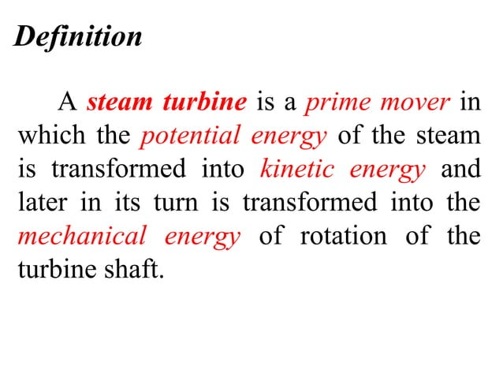

education for life www.rimt.ac.in
Department of Mechanical Engineering

Slide 4
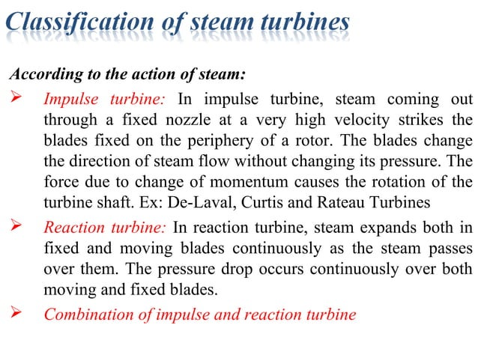
education for life www.rimt.ac.in
Department of Mechanical Engineering

Slide 5
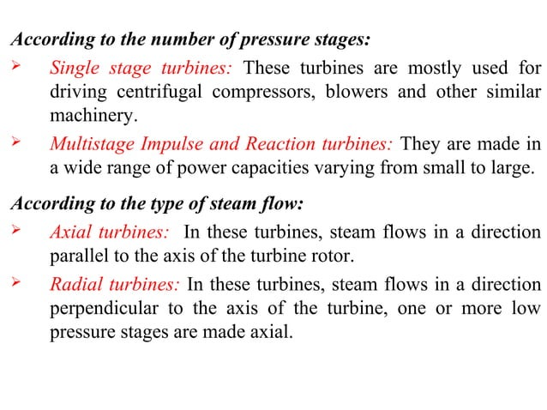
education for life www.rimt.ac.in
Department of Mechanical Engineering

Slide 6
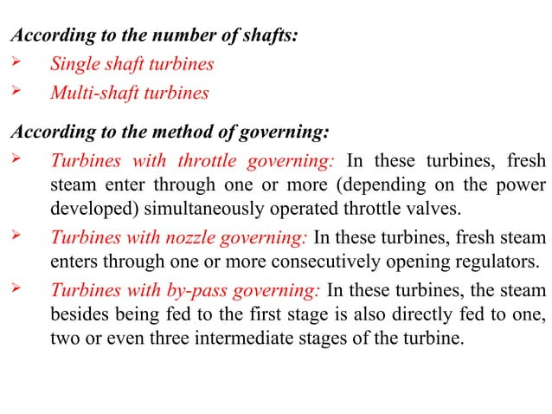
education for life www.rimt.ac.in
Department of Mechanical Engineering

Slide 7
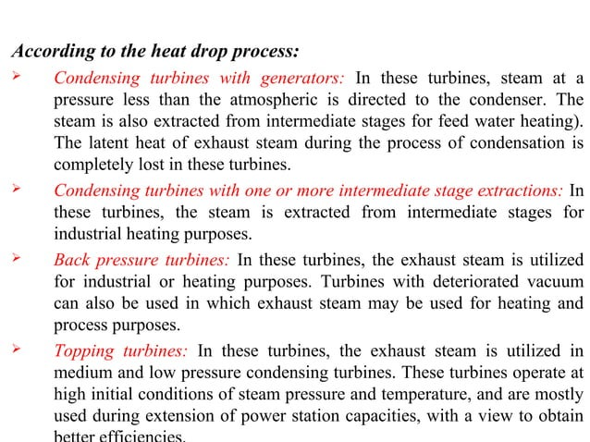
education for life www.rimt.ac.in
Department of Mechanical Engineering

Slide 8
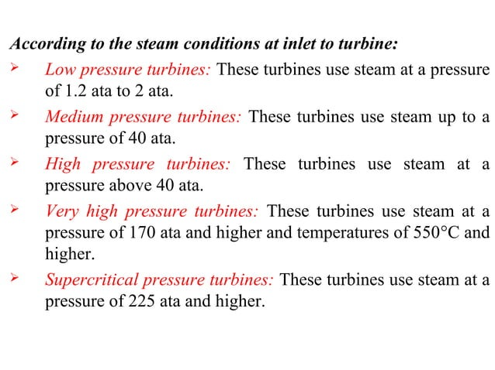
education for life www.rimt.ac.in
Department of Mechanical Engineering

Slide 9
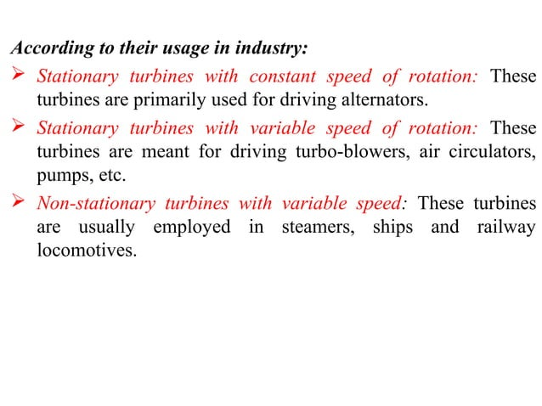
education for life www.rimt.ac.in
Department of Mechanical Engineering

Slide 10
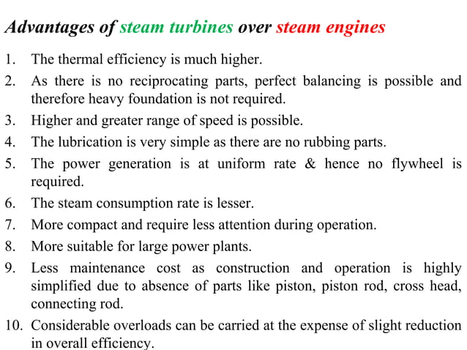
education for life www.rimt.ac.in
Department of Mechanical Engineering

Slide 11
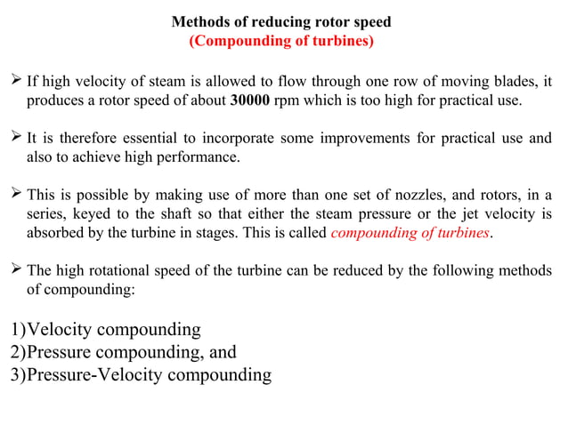
education for life www.rimt.ac.in
Department of Mechanical Engineering

Slide 12
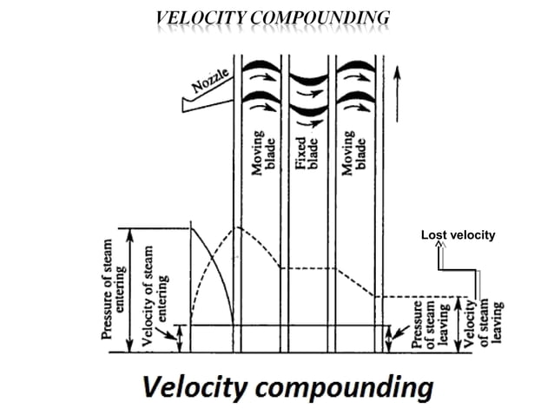
education for life www.rimt.ac.in
Department of Mechanical Engineering

Slide 13
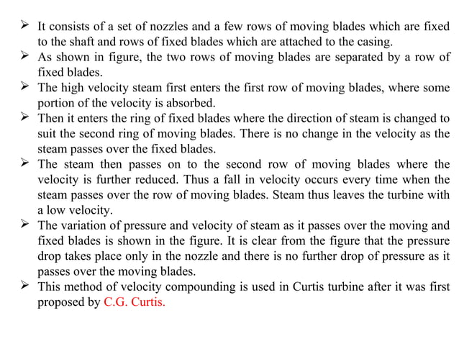
education for life www.rimt.ac.in
Department of Mechanical Engineering

Slide 14
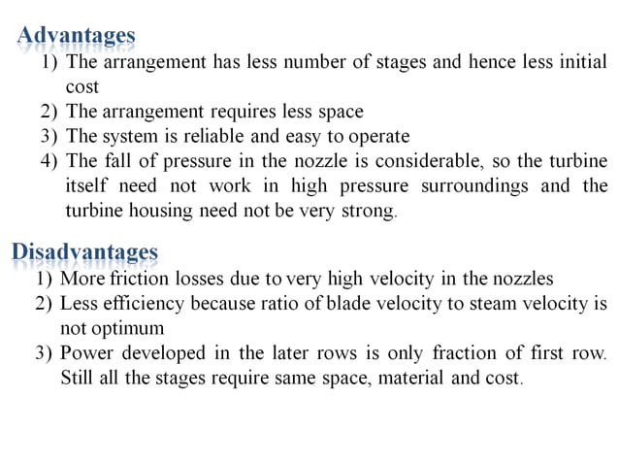
education for life www.rimt.ac.in
Department of Mechanical Engineering

Slide 15
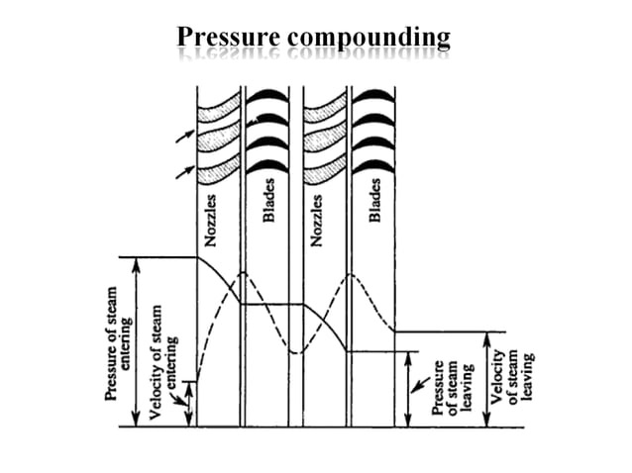
education for life www.rimt.ac.in
Department of Mechanical Engineering

Slide 16
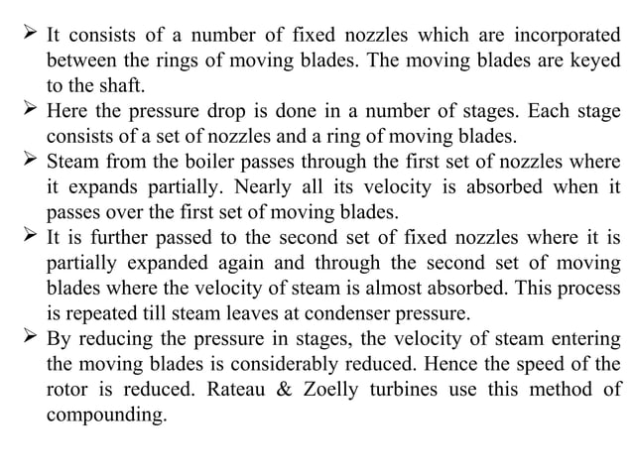
education for life www.rimt.ac.in
Department of Mechanical Engineering

Slide 17
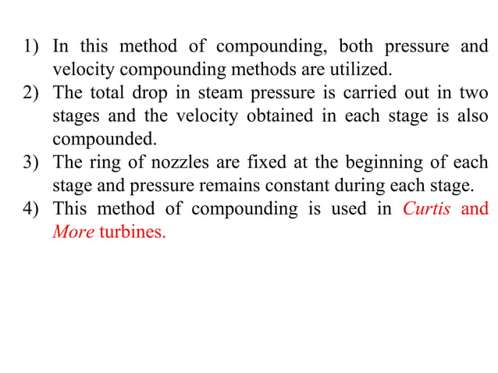
education for life www.rimt.ac.in
Department of Mechanical Engineering

Slide 18
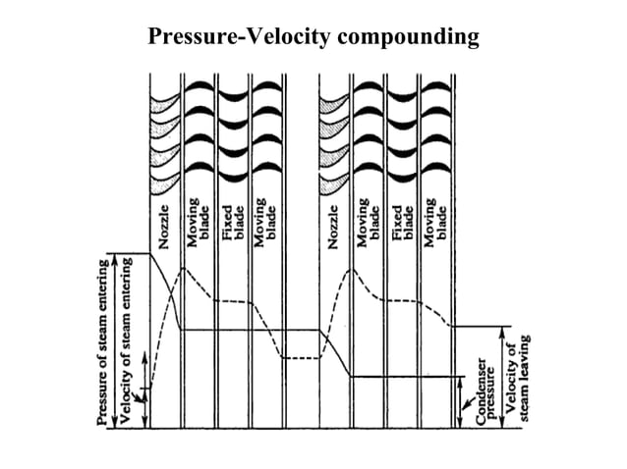
education for life www.rimt.ac.in
Department of Mechanical Engineering

Slide 19
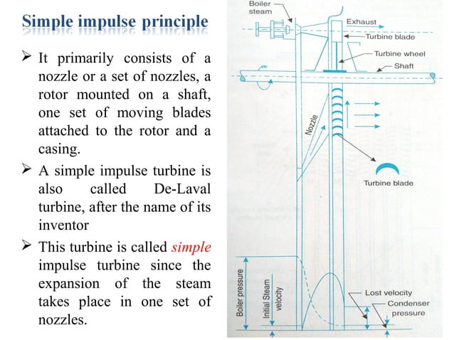
education for life www.rimt.ac.in

Slide 20
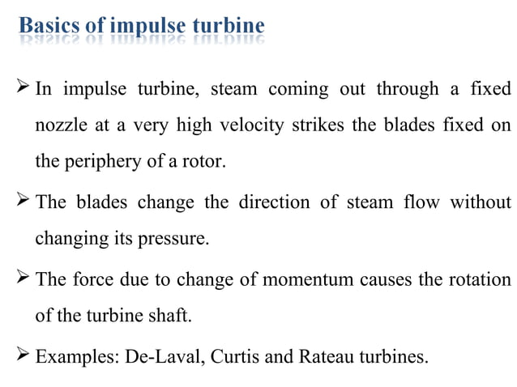
education for life www.rimt.ac.in
Department of Mechanical Engineering

Slide 21
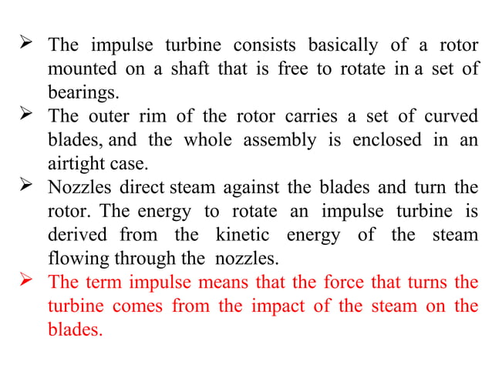

education for life www.rimt.ac.in
Department of Mechanical Engineering

Slide 22
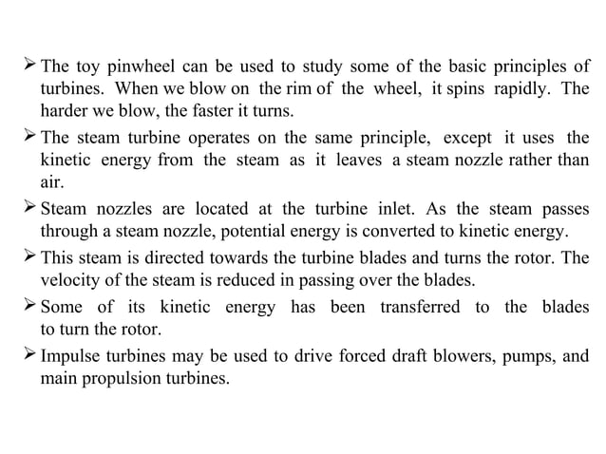
education for life www.rimt.ac.in
Department of Mechanical Engineering

Slide 23
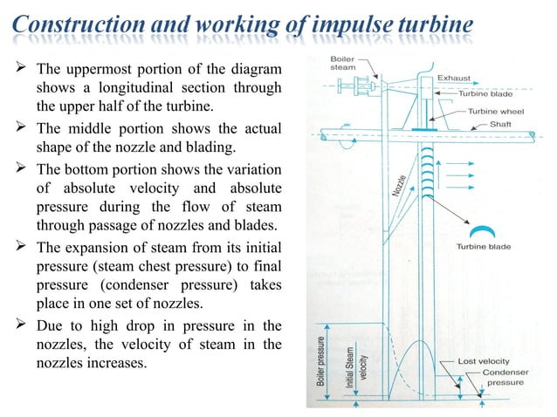
education for life www.rimt.ac.in

Slide 24
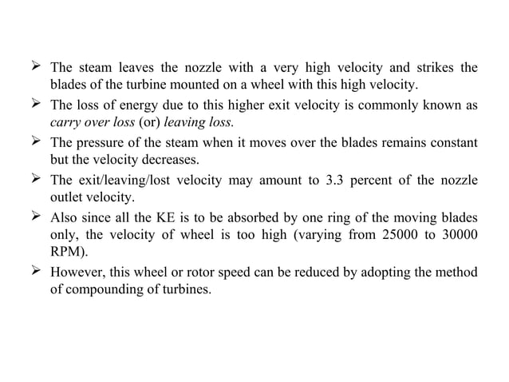
education for life www.rimt.ac.in
Department of Mechanical Engineering

Slide 25
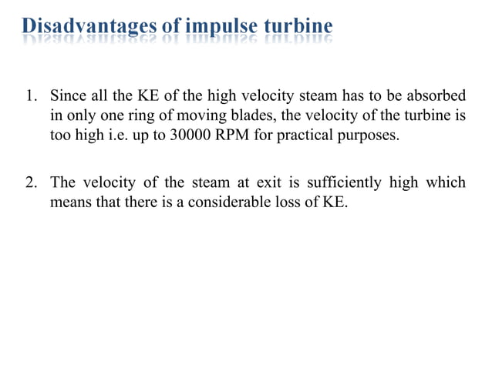
education for life www.rimt.ac.in
Department of Mechanical Engineering

Slide 26
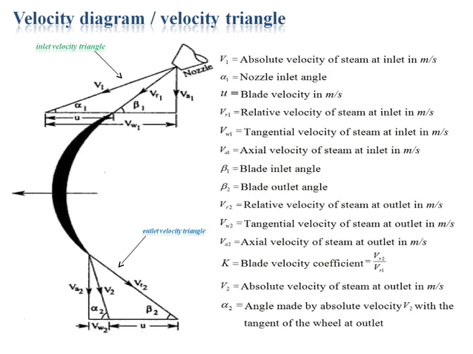
education for life www.rimt.ac.in
Department of Mechanical Engineering

Slide 27
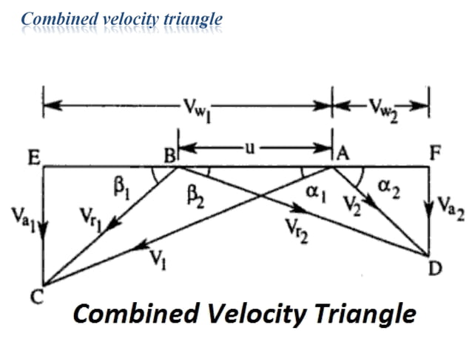
education for life www.rimt.ac.in
Department of Mechanical Engineering

Slide 28
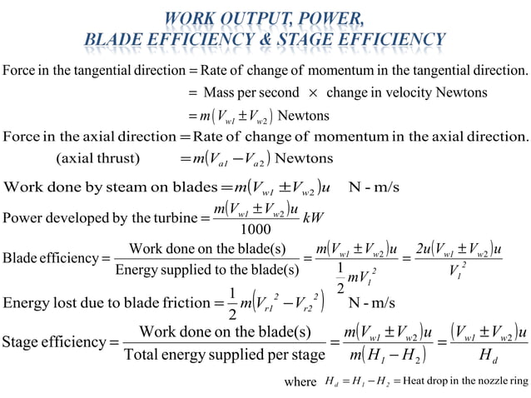
education for life www.rimt.ac.in

Slide 29
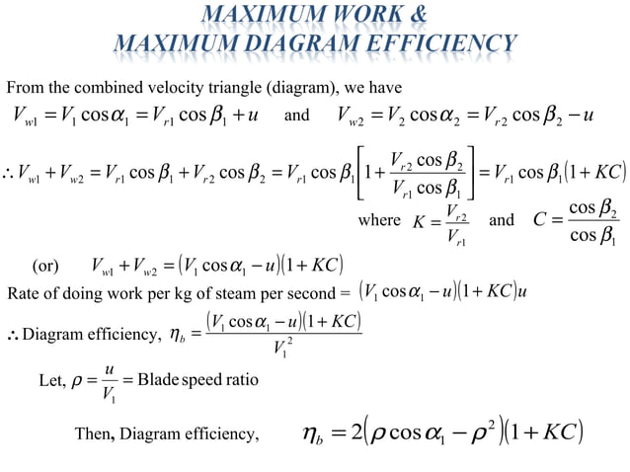
Department of Mechanical Engineering
education for life www.rimt.ac.in

Slide 30
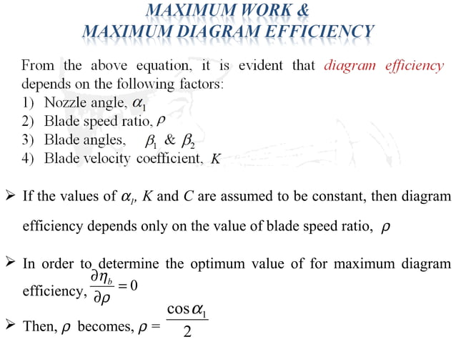
Department of Mechanical Engineering

Slide 31
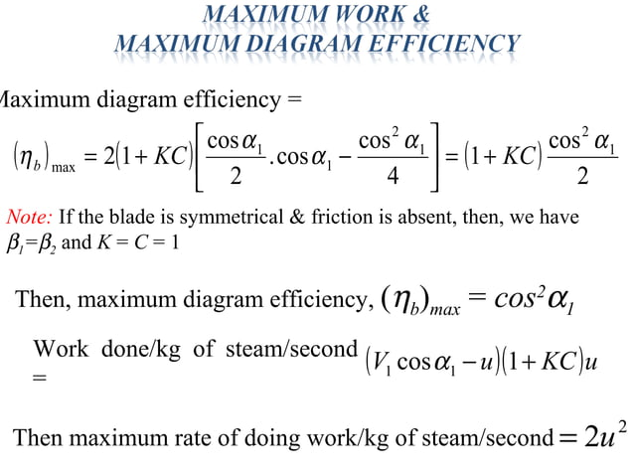
Department of Mechanical Engineering

