Slide 1

Applied Thermodynamics(BMEC-2304)
Course Name: B.Tech- Mechanical Engineering
Semester: 3rd
Prepared by: Ajay Singh Rana
education for life www.rimt.ac.in
Department of Mechanical Engineering

Slide 2
Topic Discussed
  Properties of Steam
  Steam Formation
  Phase Transformation
  Formation of Steam at Constant pressure
  Temperature Vs Enthalpy Graph
  Types of Steam
  Dryness Fraction
  Work done during evaporation
  Steam Tables
education for life www.rimt.ac.in
Department of Mechanical Engineering

Slide 3
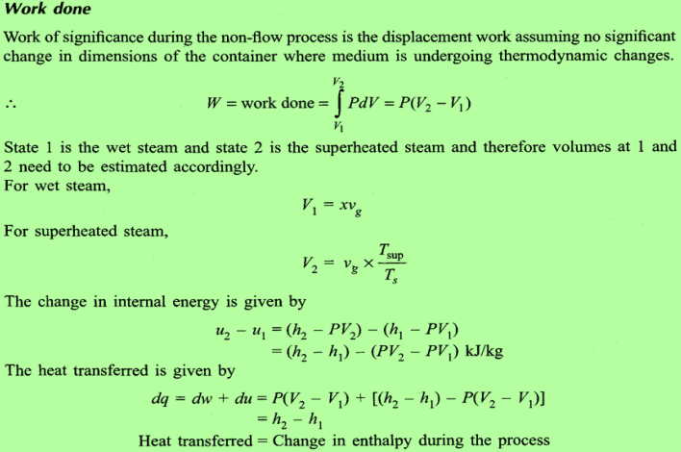
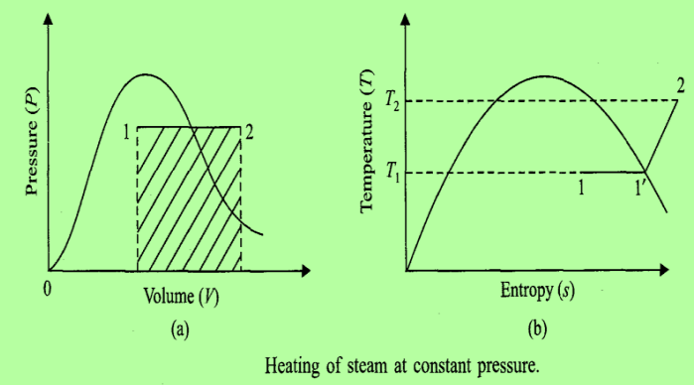
WORK DONE DURING EVAPORATION
CONSTANT PRESSURE PROCESS
education for life www.rimt.ac.in
Department of Mechanical Engineering

Slide 4
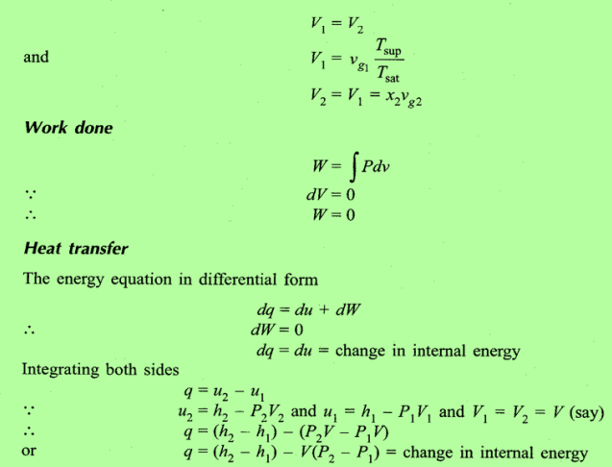
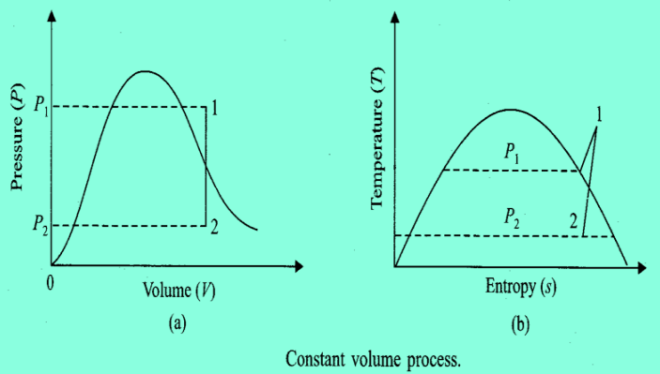
CONSTANT VOLUME PROCESS :
education for life www.rimt.ac.in
Department of Mechanical Engineering

Slide 5
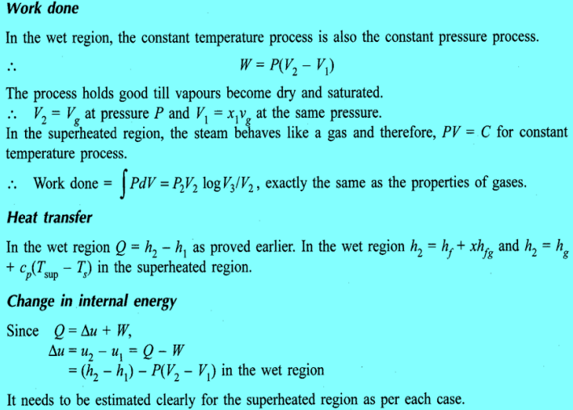
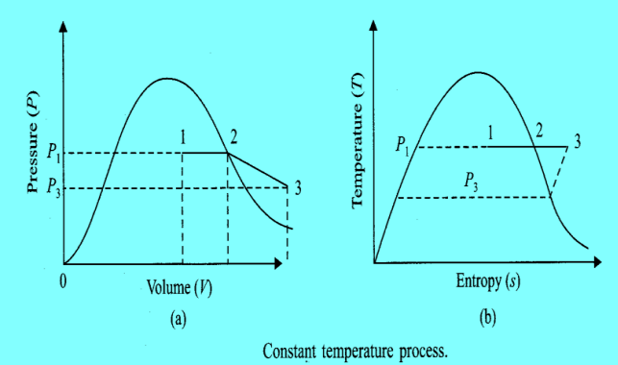
CONSTANT TEMPERATURE PROCESS
education for life www.rimt.ac.in
Department of Mechanical Engineering

Slide 6
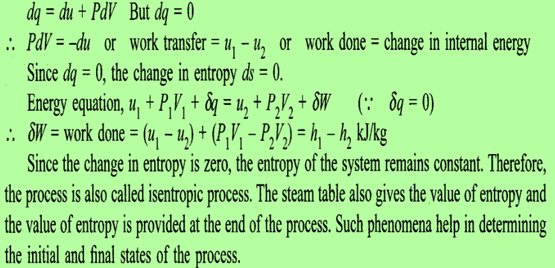
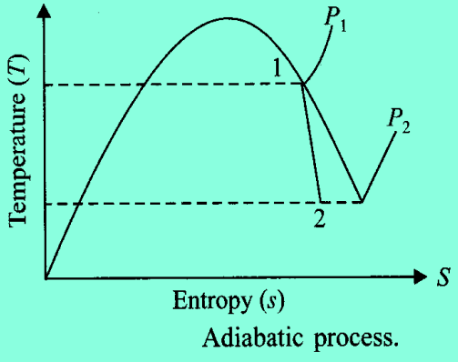
ADIABATIC PROCESS
education for life www.rimt.ac.in
Department of Mechanical Engineering

Slide 7
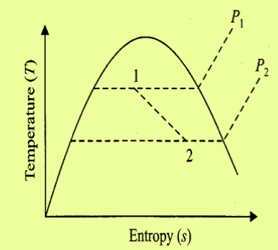
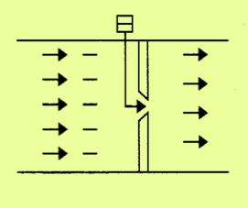
THROTTLING PROCESS
The throttling process takes place when steam is allowed to pass through a restricted opening or through a valve.
It is an open system where the flow takes place due to the pressure difference between two sides of the wall.
The process is in equilibrium at states 1 and 2 but intermediate states are not in equilibrium and therefore shown by the dotted lines.
The process of throttling involves pressure drops but enthalpy remains constant and the process is also known as isenthalpic process.
In such process, the steam after throttling may become superheated even if wet before throttling.
education for life www.rimt.ac.in
Department of Mechanical Engineering

Slide 8
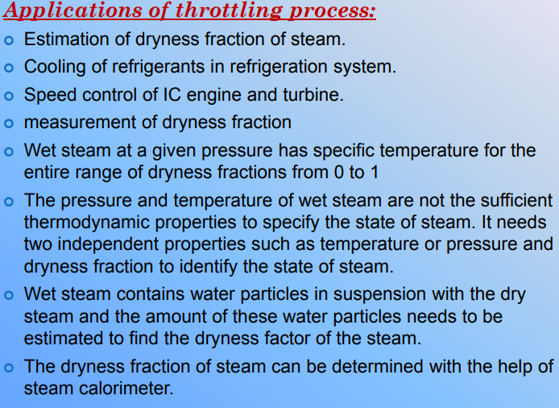
education for life www.rimt.ac.in
Department of Mechanical Engineering

Slide 9
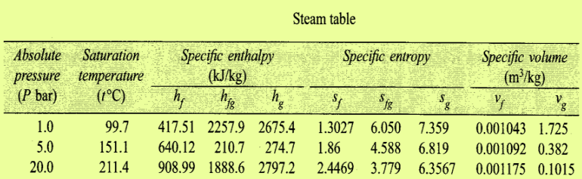
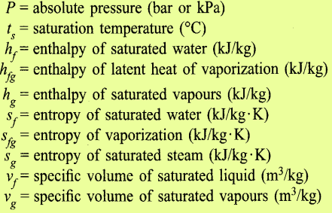
STEAM TABLE A T A GLANCE
education for life www.rimt.ac.in
Department of Mechanical Engineering

Slide 10
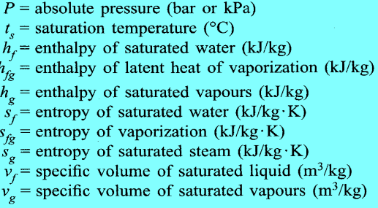
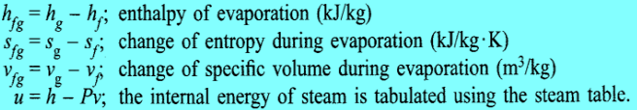
PROPERTIES WHICH CAN BE CALCULATED FROM STEAM TABLE
education for life www.rimt.ac.in
Department of Mechanical Engineering

