Slide 1

AUTOMOBILE ENGINEERING (BTME-3504)
Course Name: B.Tech-ME
Semester: 5th
Prepared by: Er. Amrinder Singh Pannu
education for life www.rimt.ac.in
Department of Mechanical Engineering

Slide 2
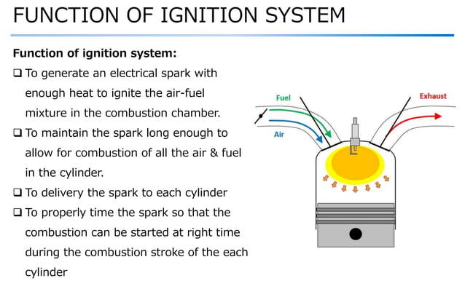
UNIT: IV
education for life www.rimt.ac.in
Department of Mechanical Engineering

Slide 3
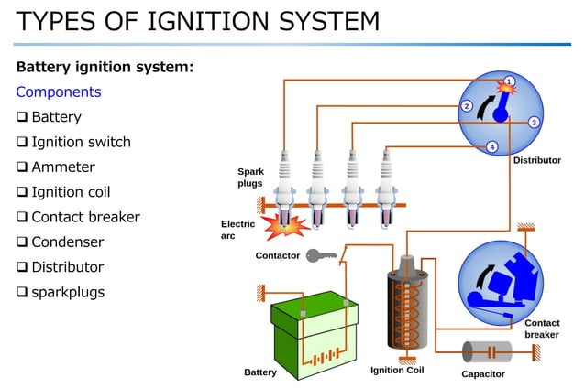
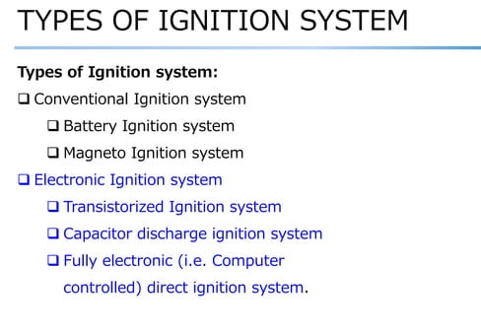
UNIT: IV
education for life www.rimt.ac.in
Department of Mechanical Engineering

Slide 4
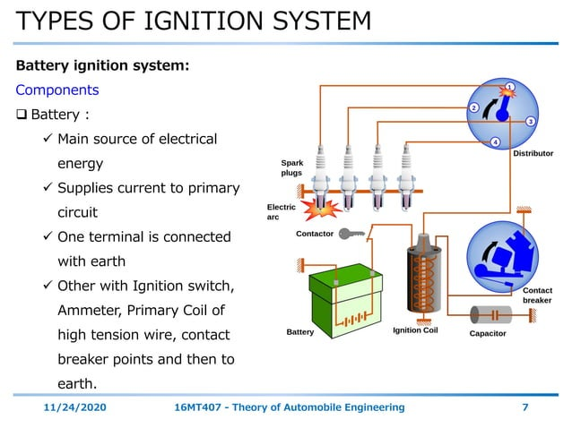
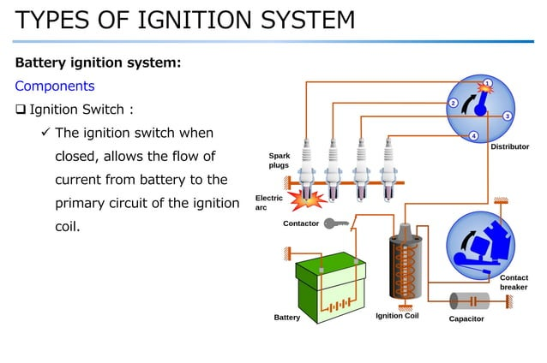
UNIT: IV
education for life www.rimt.ac.in
Department of Mechanical Engineering

Slide 5
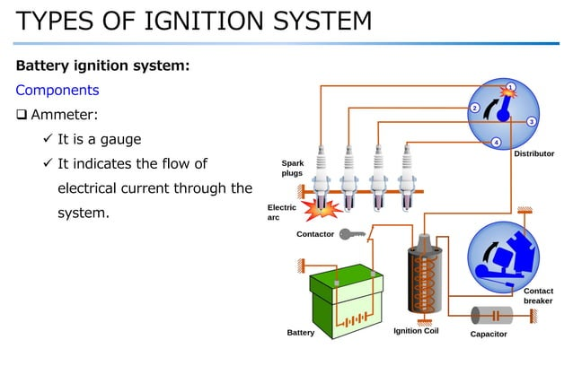
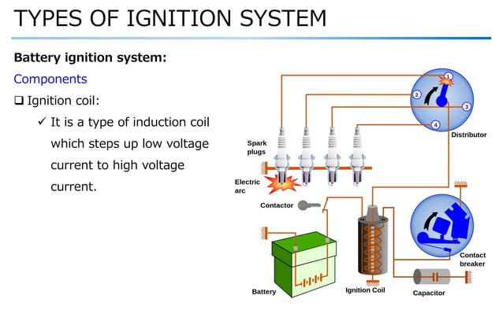
UNIT: IV
education for life www.rimt.ac.in
Department of Mechanical Engineering

Slide 6
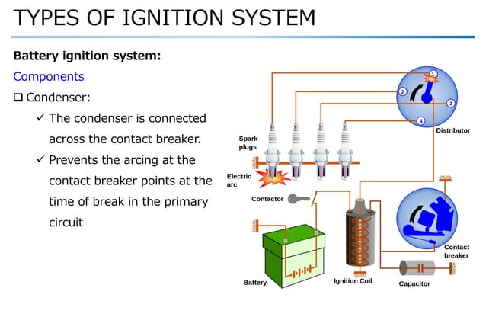
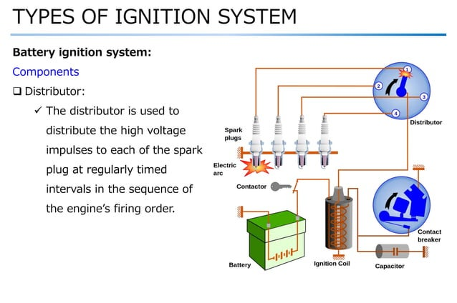
UNIT: IV
education for life www.rimt.ac.in
Department of Mechanical Engineering

Slide 7
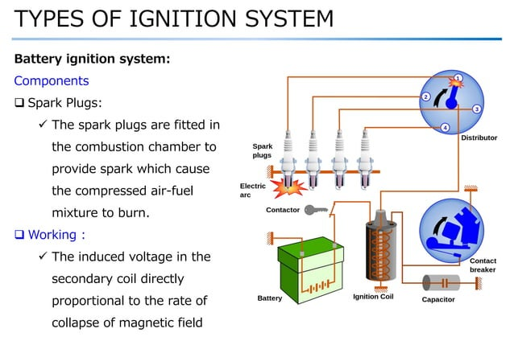
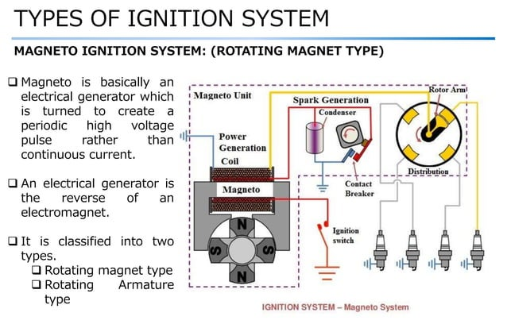
UNIT: IV
education for life www.rimt.ac.in
Department of Mechanical Engineering

Slide 8
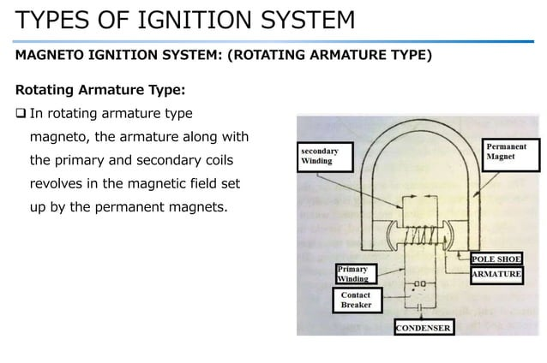
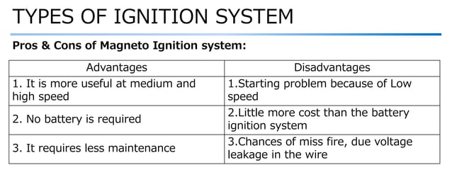
UNIT: IV
education for life www.rimt.ac.in
Department of Mechanical Engineering

Slide 9
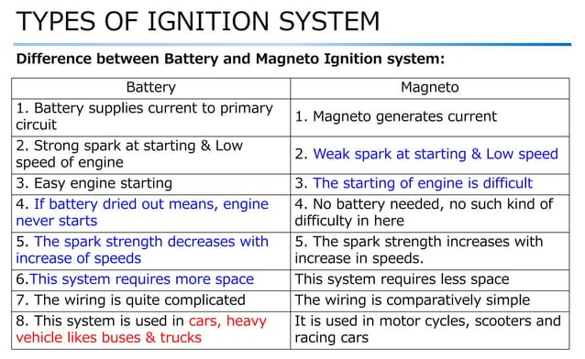
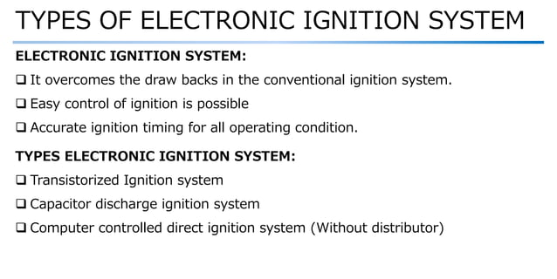
UNIT: IV
education for life www.rimt.ac.in
Department of Mechanical Engineering

Slide 10
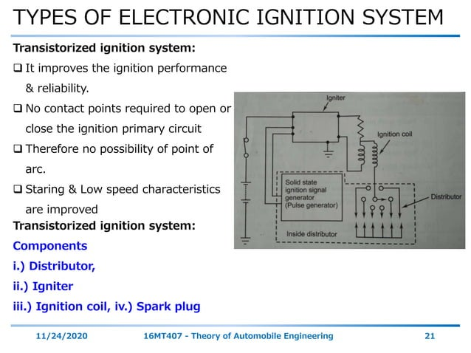
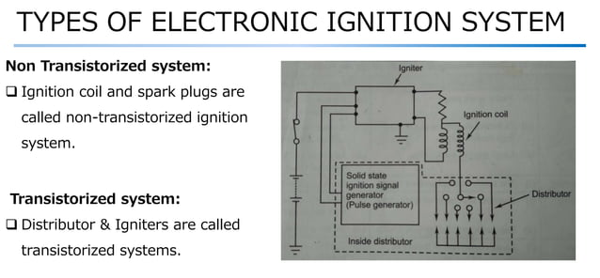
UNIT: IV
education for life www.rimt.ac.in
Department of Mechanical Engineering

Slide 11
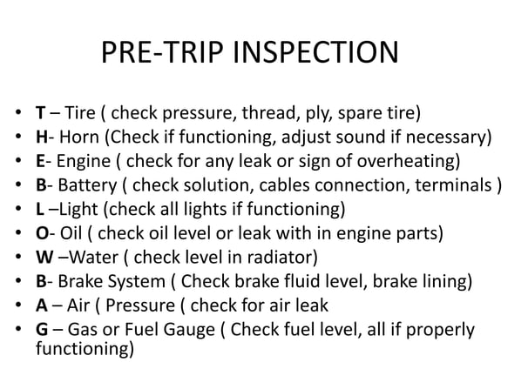
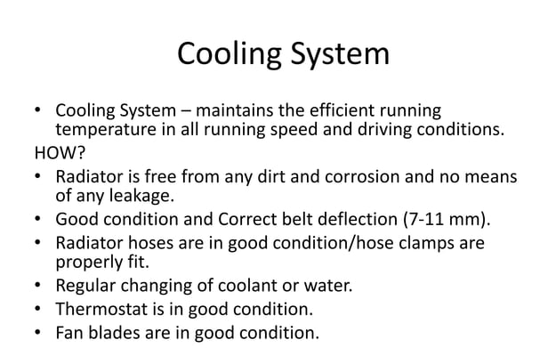
UNIT: IV
education for life www.rimt.ac.in
Department of Mechanical Engineering

Slide 12
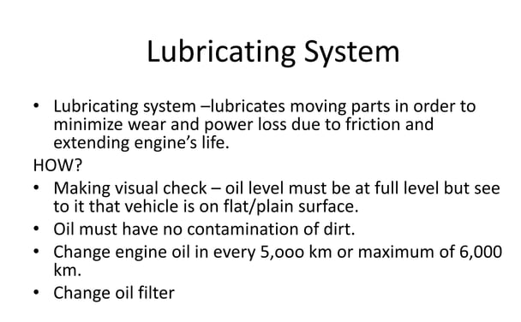
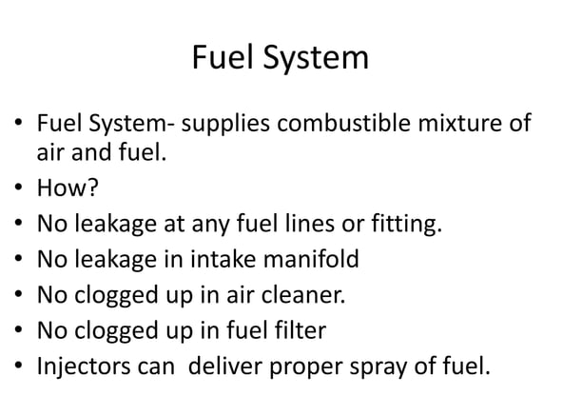
UNIT: IV
education for life www.rimt.ac.in
Department of Mechanical Engineering

Slide 13

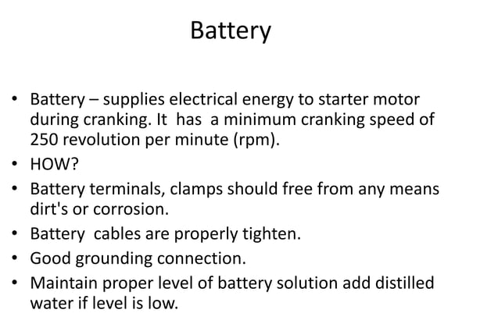
UNIT: IV
education for life www.rimt.ac.in
Department of Mechanical Engineering

Slide 14
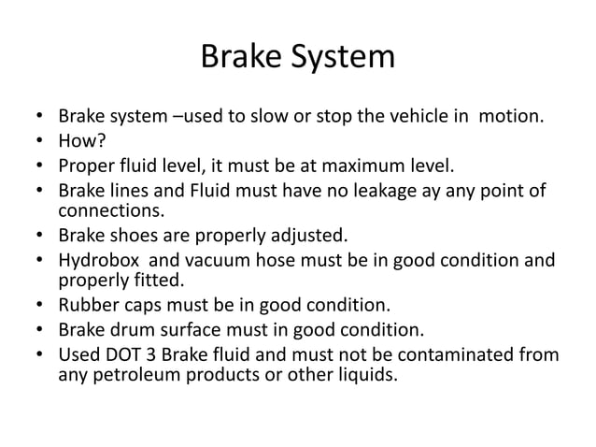
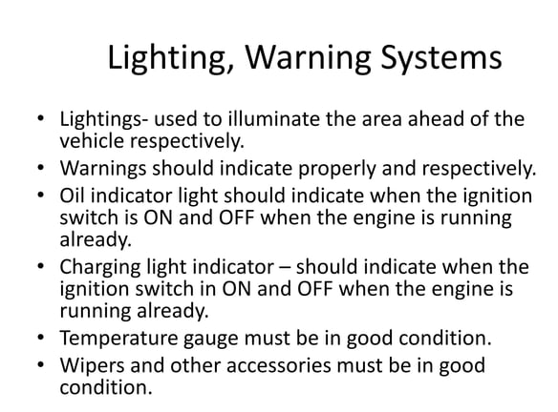
UNIT: IV
education for life www.rimt.ac.in
Department of Mechanical Engineering

Slide 15
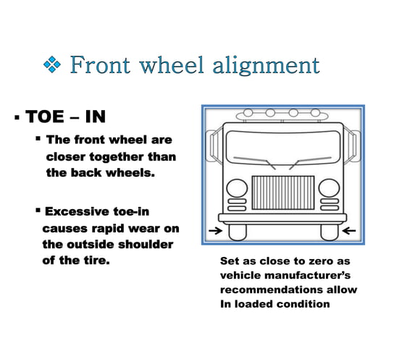
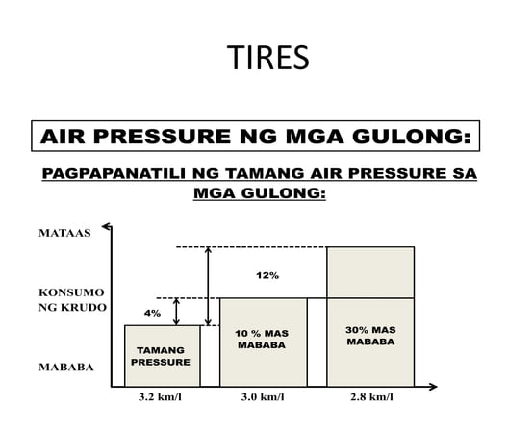
UNIT: IV
education for life www.rimt.ac.in
Department of Mechanical Engineering

Slide 16
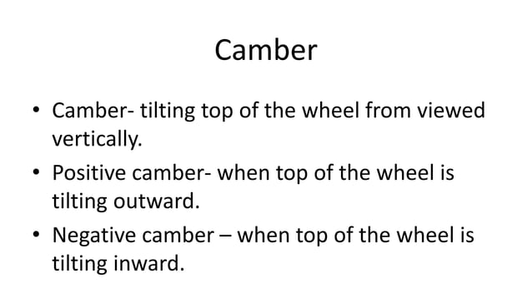
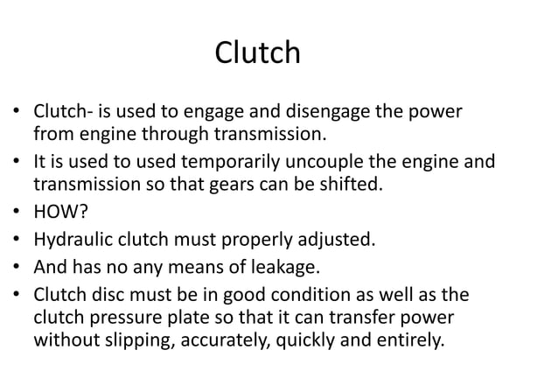
UNIT: IV
education for life www.rimt.ac.in
Department of Mechanical Engineering

Slide 17
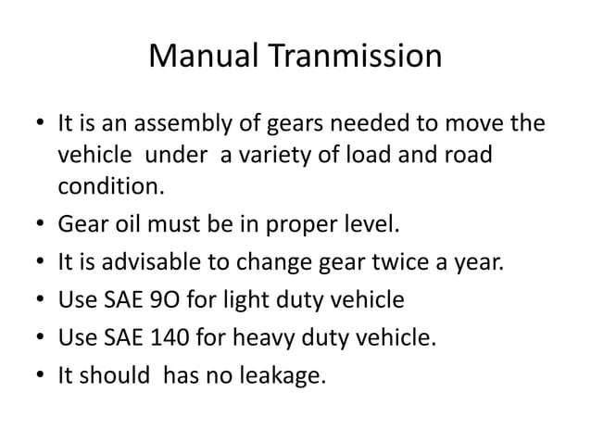
UNIT: IV
education for life www.rimt.ac.in
Department of Mechanical Engineering

