Slide 1

AUTOMOBILE ENGINEERING (BTME-3504)
Course Name: B.Tech-ME
Semester: 5th
Prepared by: Er. Amrinder Singh Pannu
education for life www.rimt.ac.in
Department of Mechanical Engineering

Slide 2
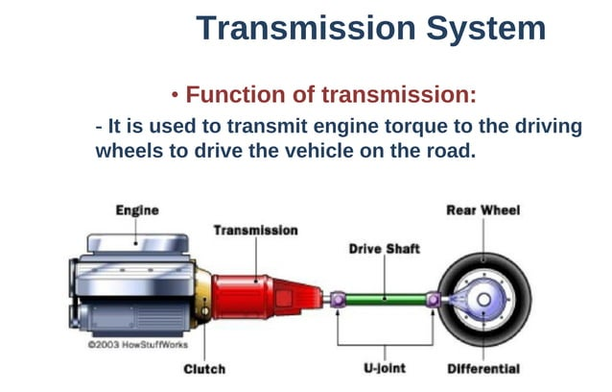
UNIT: III
education for life www.rimt.ac.in
Department of Mechanical Engineering

Slide 3
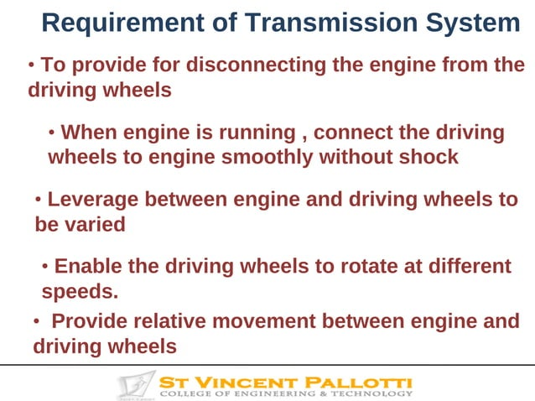
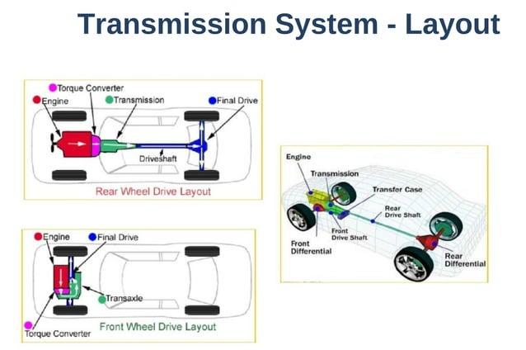
UNIT: III
education for life www.rimt.ac.in
Department of Mechanical Engineering

Slide 4
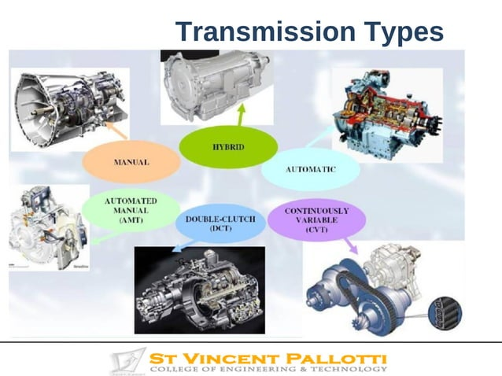
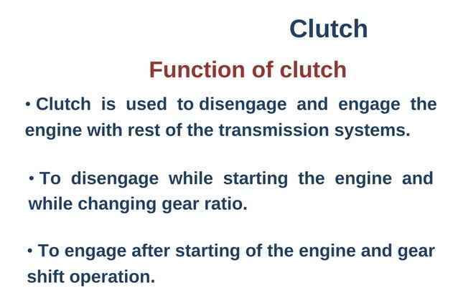
UNIT: III
education for life www.rimt.ac.in
Department of Mechanical Engineering

Slide 5
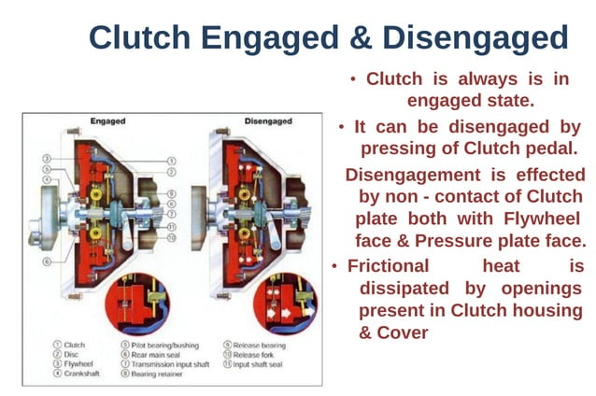
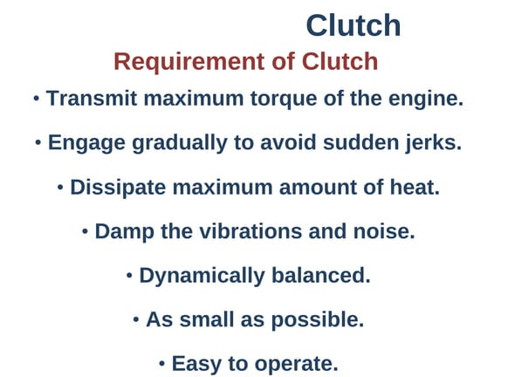
UNIT: III
education for life www.rimt.ac.in
Department of Mechanical Engineering

Slide 6
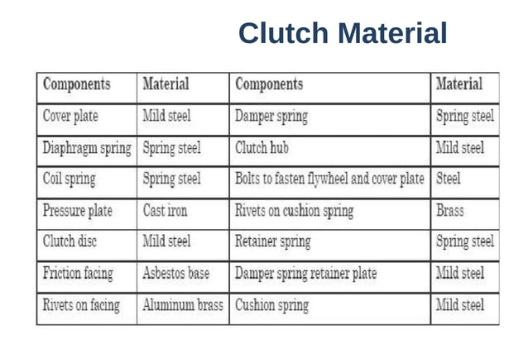
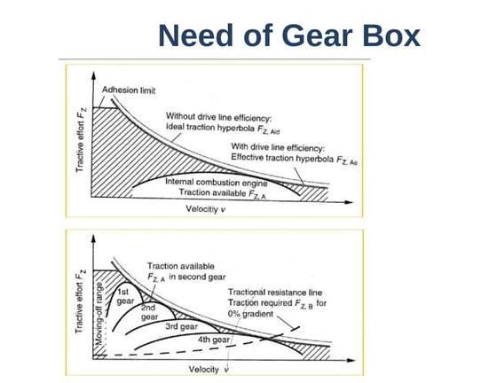
UNIT: III
education for life www.rimt.ac.in
Department of Mechanical Engineering

Slide 7
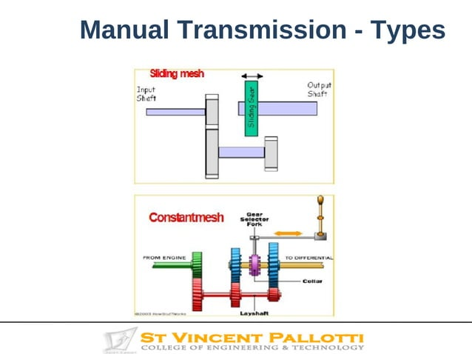
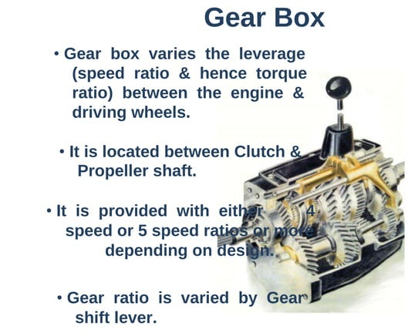
UNIT: III
education for life www.rimt.ac.in
Department of Mechanical Engineering

Slide 8
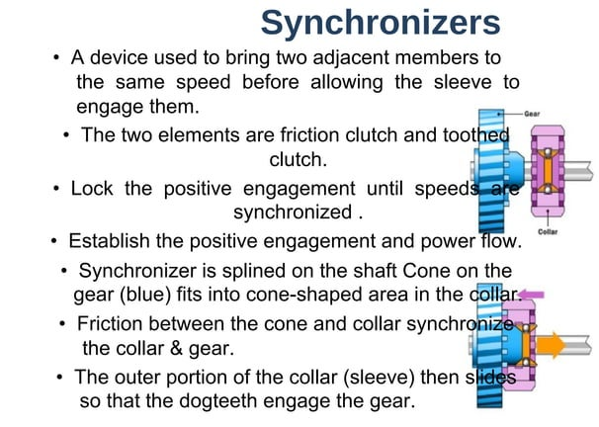
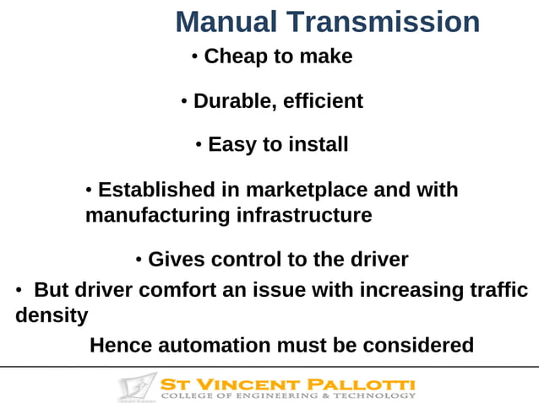
UNIT: III
education for life www.rimt.ac.in
Department of Mechanical Engineering

Slide 9
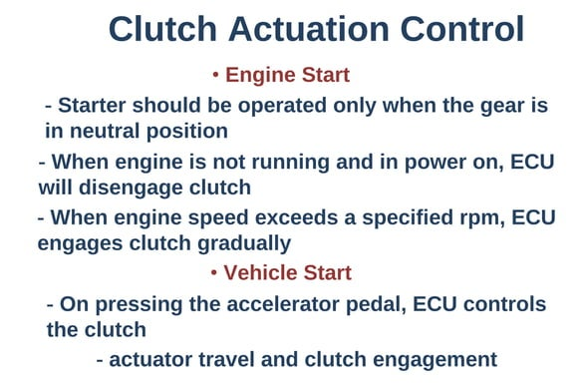
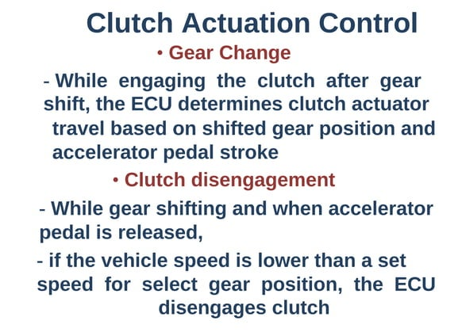
UNIT: III
education for life www.rimt.ac.in
Department of Mechanical Engineering

Slide 10
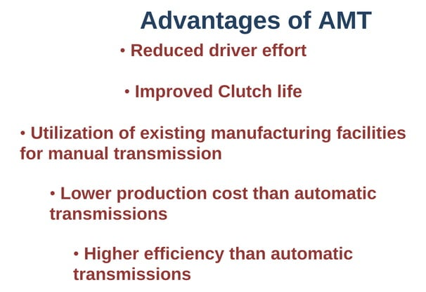
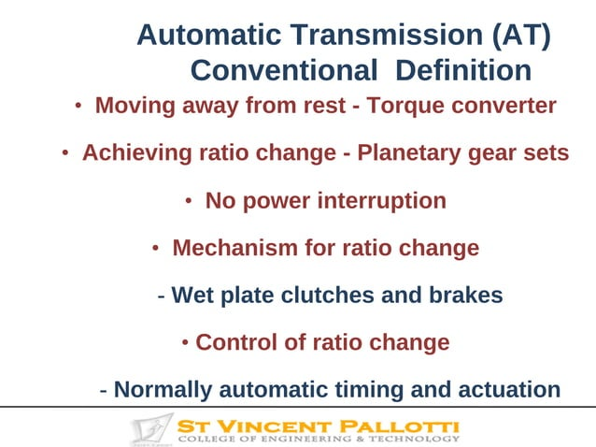
UNIT: III
education for life www.rimt.ac.in
Department of Mechanical Engineering

Slide 11
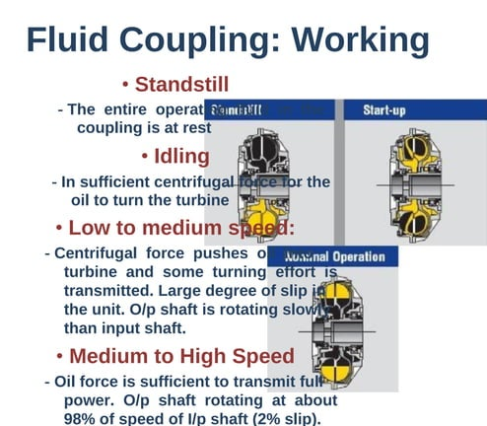
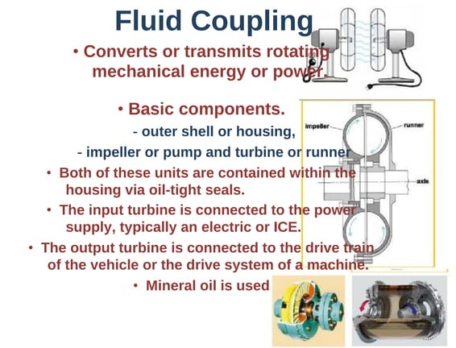
UNIT: III
education for life www.rimt.ac.in
Department of Mechanical Engineering

Slide 12
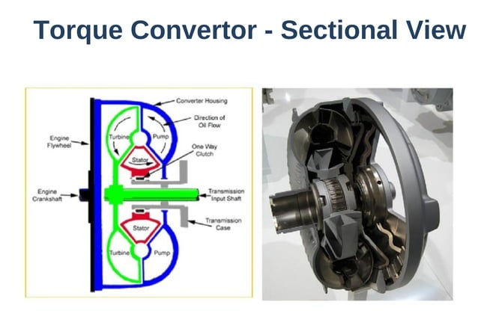
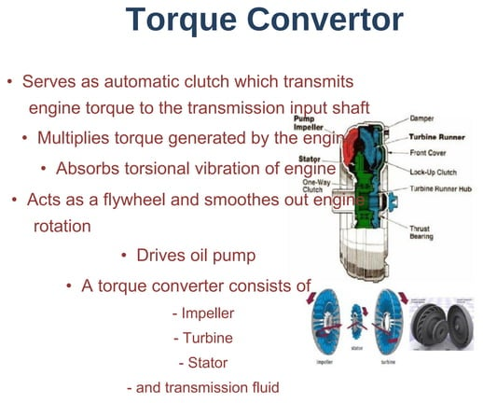
UNIT: III
education for life www.rimt.ac.in
Department of Mechanical Engineering

Slide 13
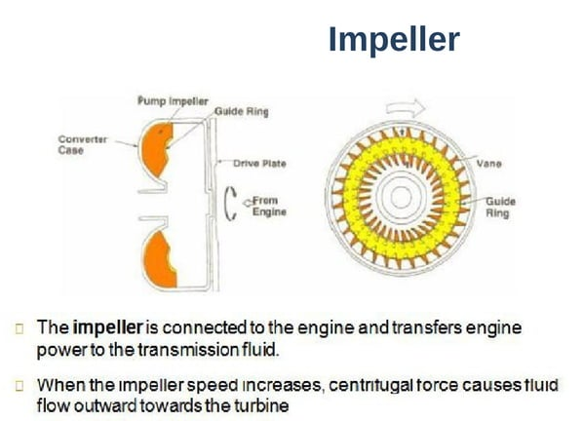
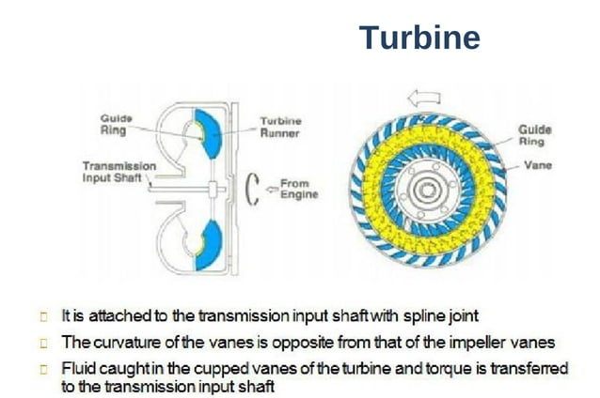
UNIT: III
education for life www.rimt.ac.in
Department of Mechanical Engineering

Slide 14
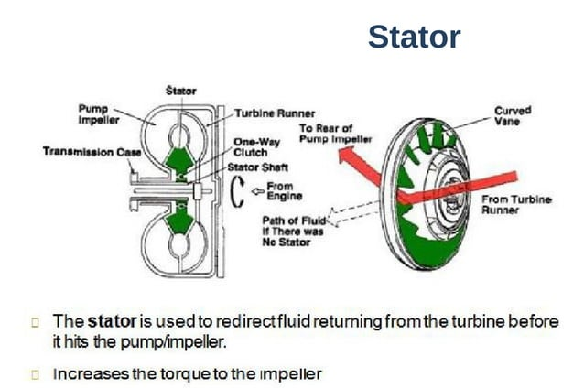
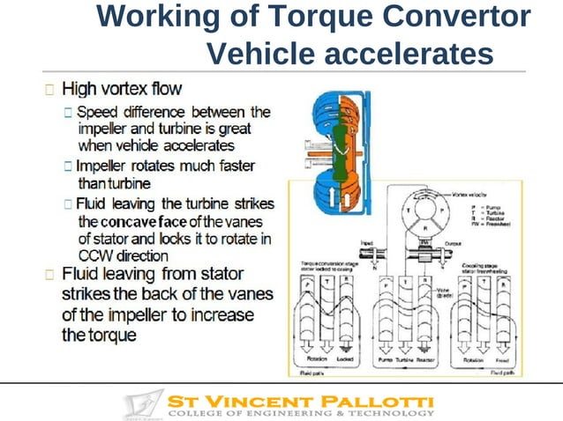
UNIT: III
education for life www.rimt.ac.in
Department of Mechanical Engineering

Slide 15
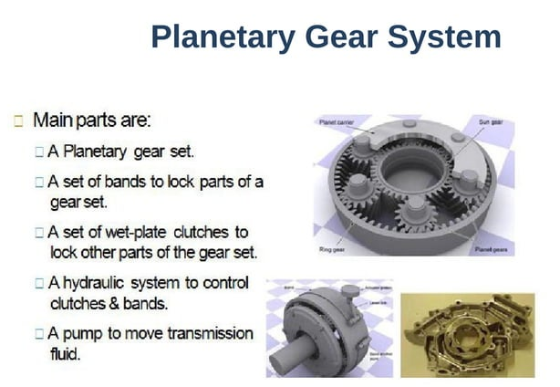
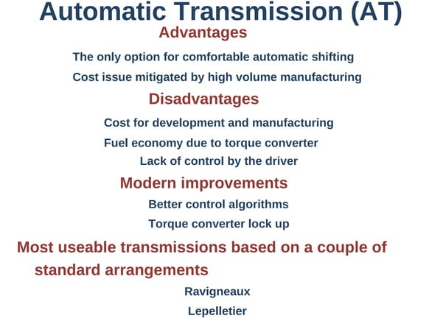
UNIT: III
education for life www.rimt.ac.in
Department of Mechanical Engineering

Slide 16
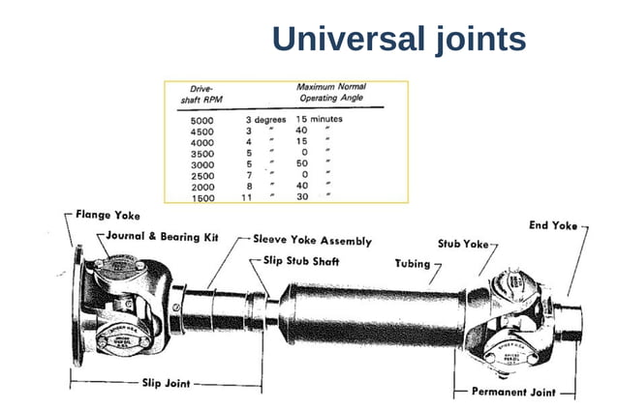
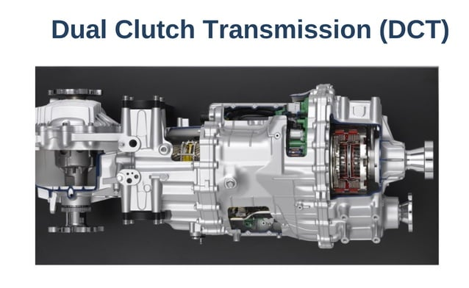
UNIT: III
education for life www.rimt.ac.in
Department of Mechanical Engineering

Slide 17
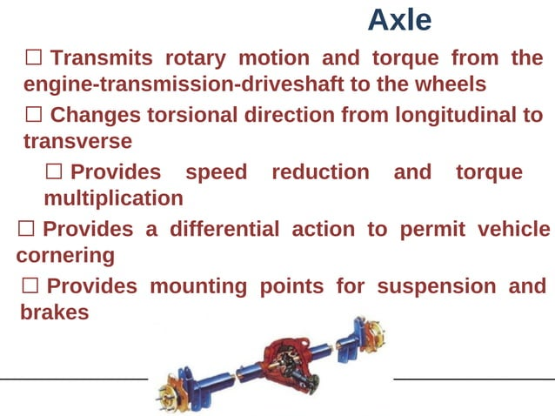
UNIT: III
education for life www.rimt.ac.in
Department of Mechanical Engineering

Slide 18
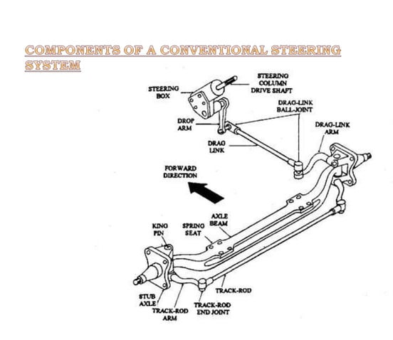
UNIT: III
education for life www.rimt.ac.in
Department of Mechanical Engineering

Slide 19
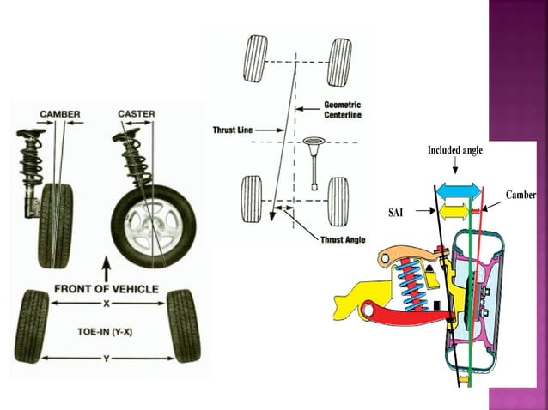
UNIT: III
education for life www.rimt.ac.in
Department of Mechanical Engineering

Slide 20
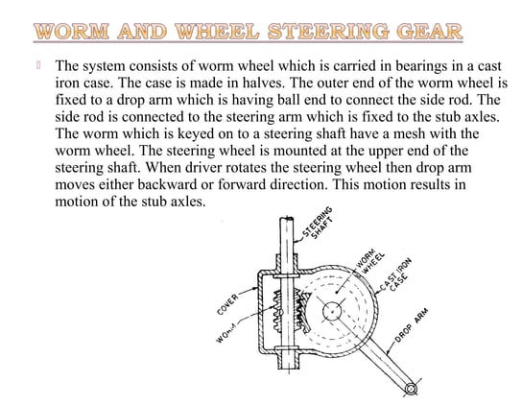
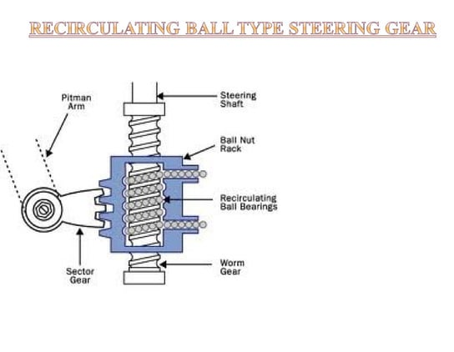
UNIT: III
education for life www.rimt.ac.in
Department of Mechanical Engineering

Slide 21
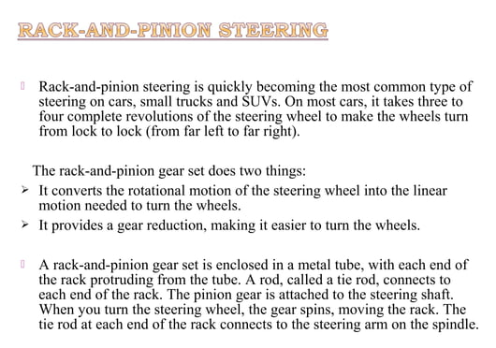
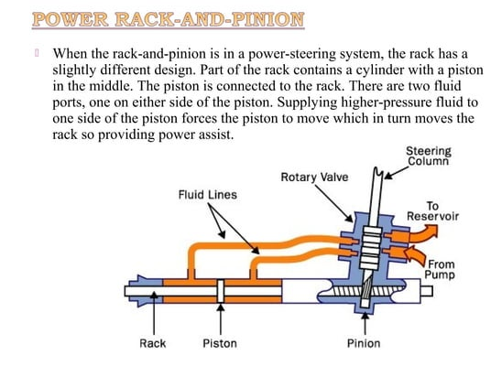
UNIT: III
education for life www.rimt.ac.in
Department of Mechanical Engineering

Slide 22
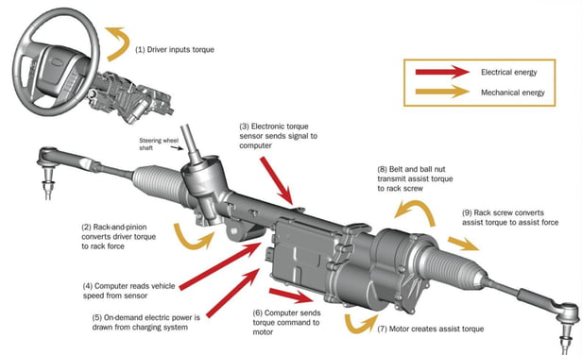
UNIT: III
education for life www.rimt.ac.in
Department of Mechanical Engineering

Slide 23
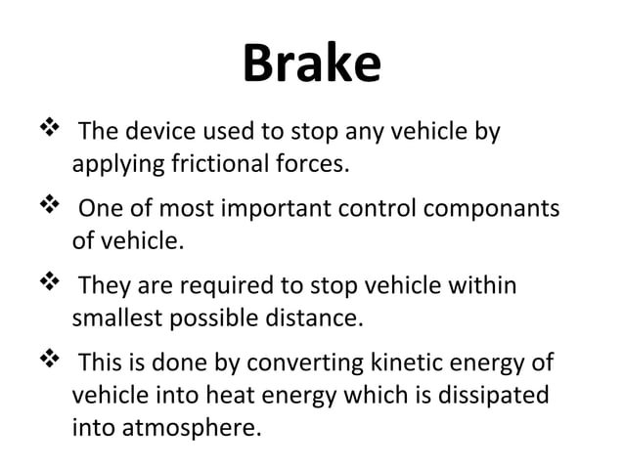
UNIT: III
education for life www.rimt.ac.in
Department of Mechanical Engineering

Slide 24
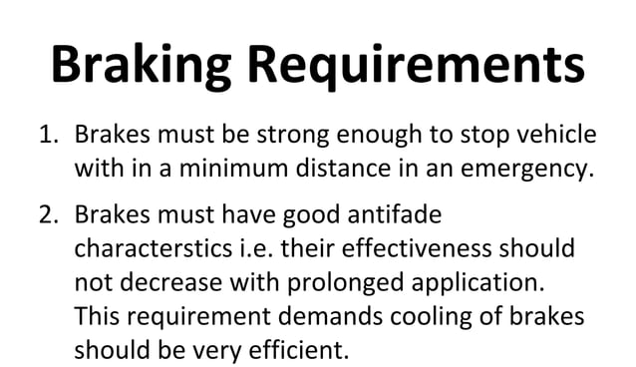
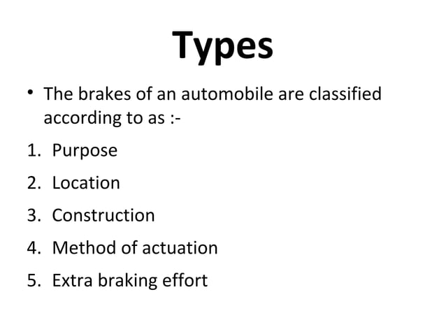
UNIT: III
education for life www.rimt.ac.in
Department of Mechanical Engineering

Slide 25
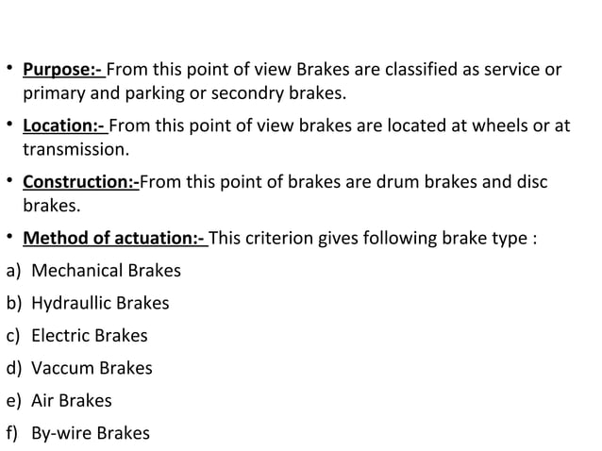
UNIT: III
education for life www.rimt.ac.in
Department of Mechanical Engineering

Slide 26
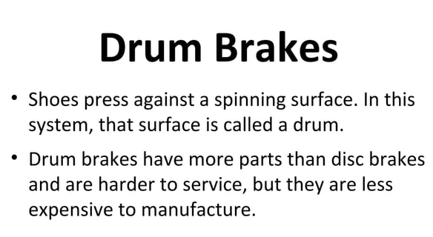
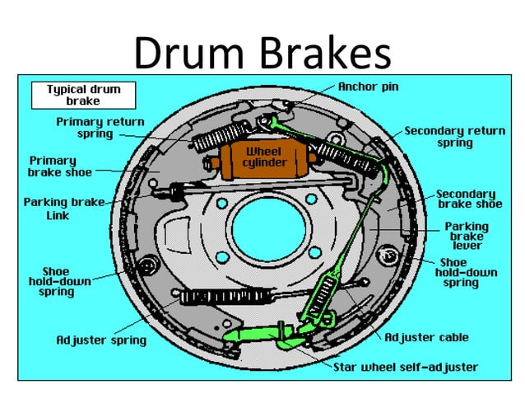
UNIT: III
education for life www.rimt.ac.in
Department of Mechanical Engineering

Slide 27
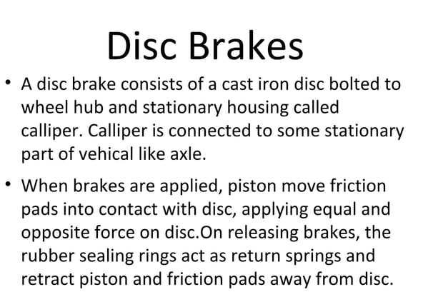
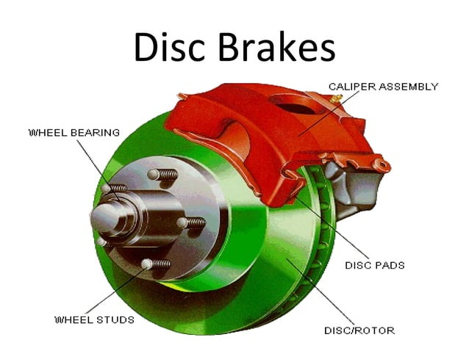
UNIT: III
education for life www.rimt.ac.in
Department of Mechanical Engineering

