Slide 1

Mathematics-III
(BTCS-2302)
Course Name: B.Tech. (CSE)
Semester: 3rd
Prepared by: Sachin Syan
education for life www.rimt.ac.in
Department of Computer Science and Engineering

Slide 2
Topic Discussed
Formation of PDE
Different Integral of PDE
Lagranges Method
education for life www.rimt.ac.in
Department of Computer Science and Engineering

Slide 3
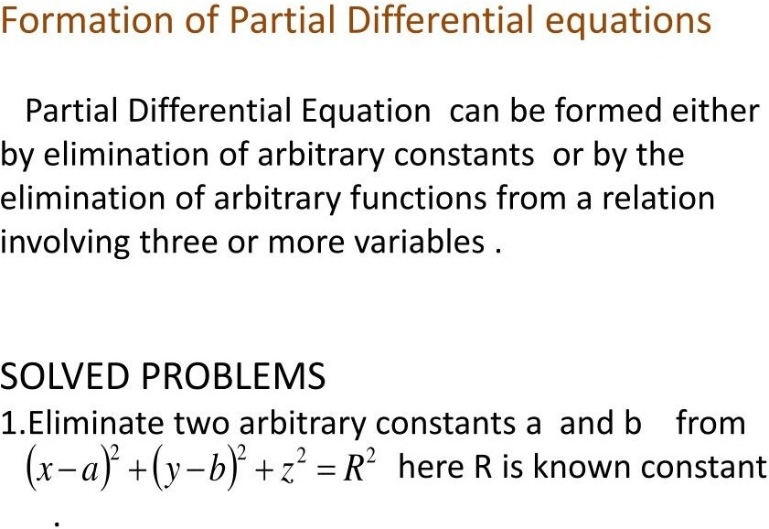
education for life www.rimt.ac.in
Department of Computer Science and Engineering

Slide 4
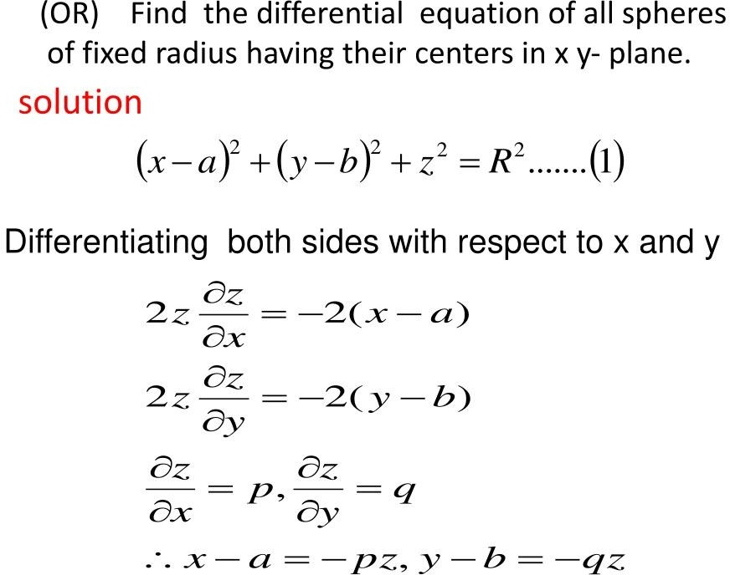
education for life www.rimt.ac.in
Department of Computer Science and Engineering

Slide 5
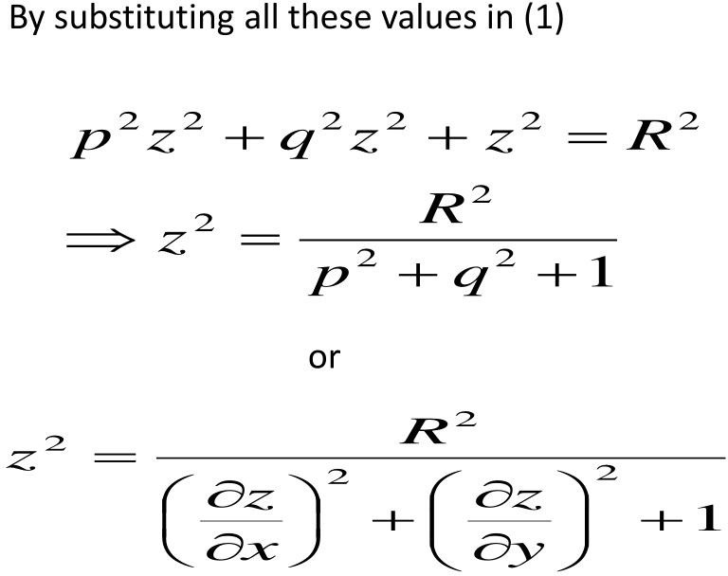
education for life www.rimt.ac.in
Department of Computer Science and Engineering

Slide 6
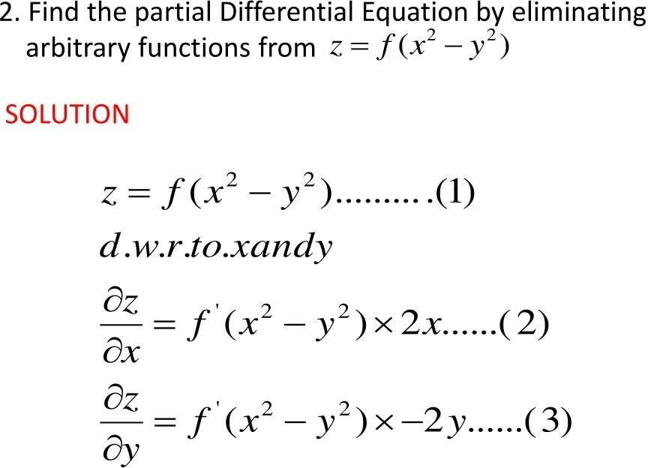
education for life www.rimt.ac.in
Department of Computer Science and Engineering

Slide 7
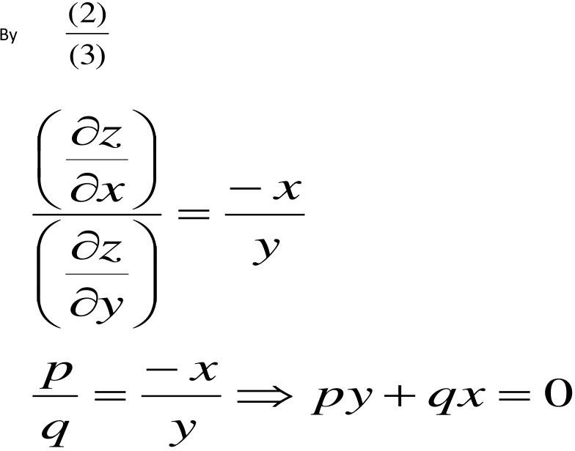
education for life www.rimt.ac.in
Department of Computer Science and Engineering

Slide 8
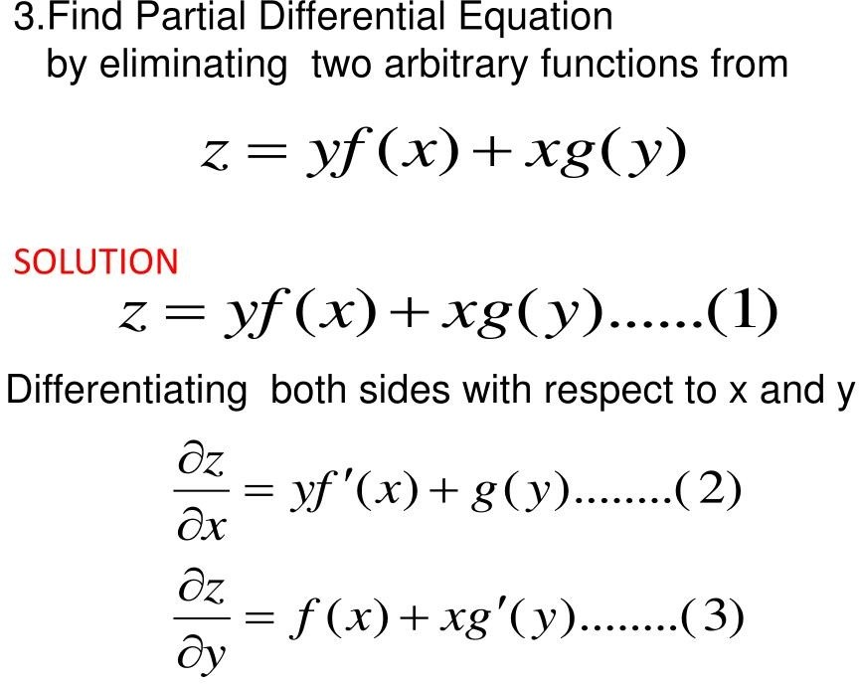
education for life www.rimt.ac.in
Department of Computer Science and Engineering

Slide 9
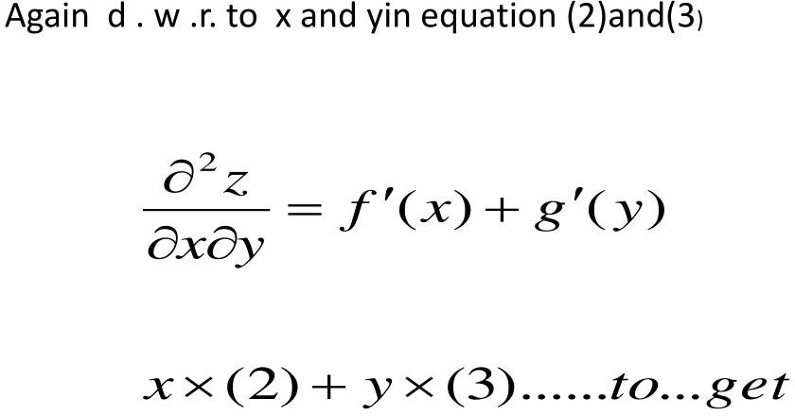
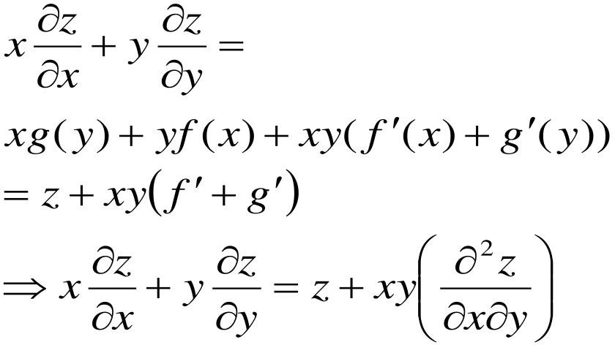
education for life www.rimt.ac.in
Department of Computer Science and Engineering

Slide 10
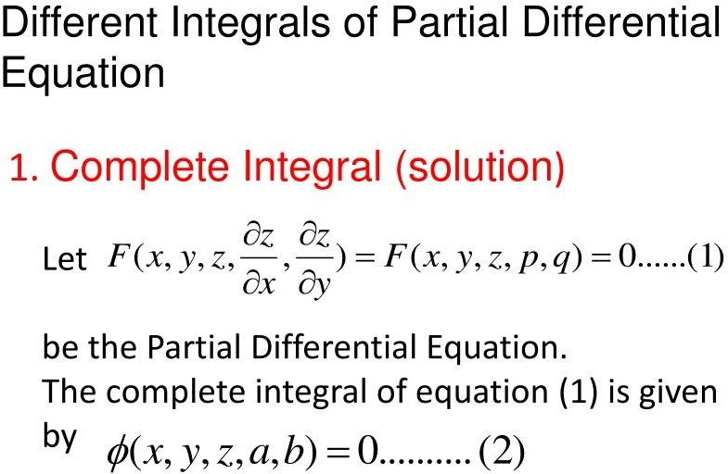
education for life www.rimt.ac.in
Department of Computer Science and Engineering

Slide 11
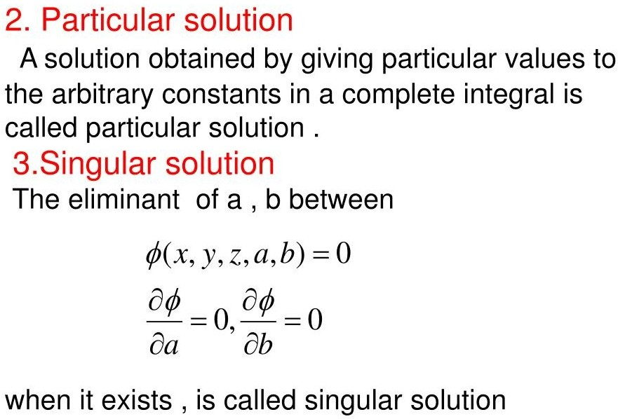
education for life www.rimt.ac.in
Department of Computer Science and Engineering

Slide 12
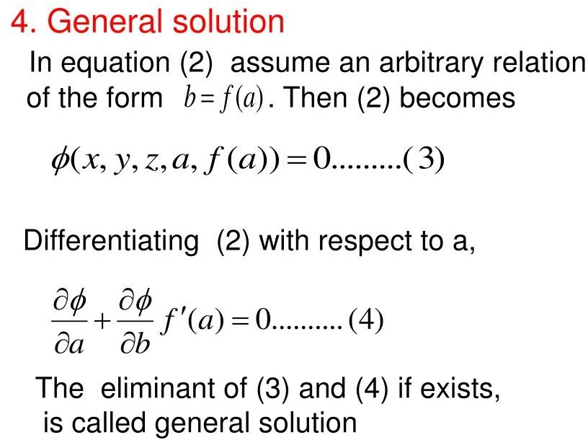
education for life www.rimt.ac.in
Department of Computer Science and Engineering

Slide 13
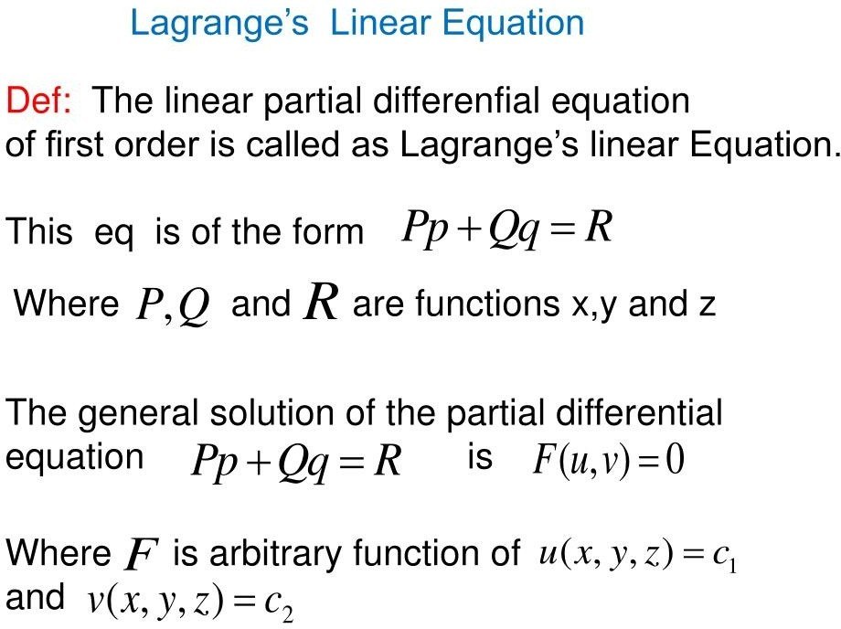
education for life www.rimt.ac.in
Department of Computer Science and Engineering

Slide 14
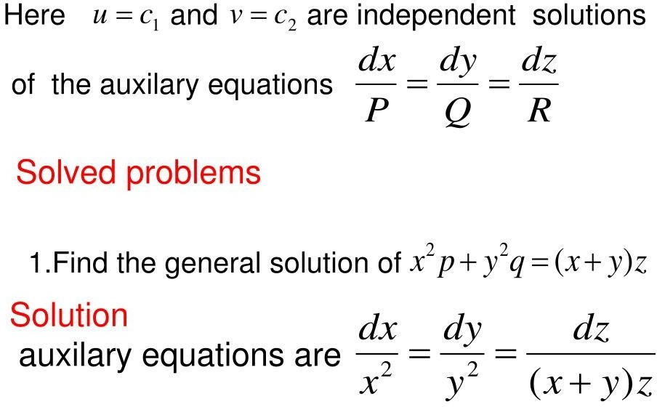
education for life www.rimt.ac.in
Department of Computer Science and Engineering

Slide 15
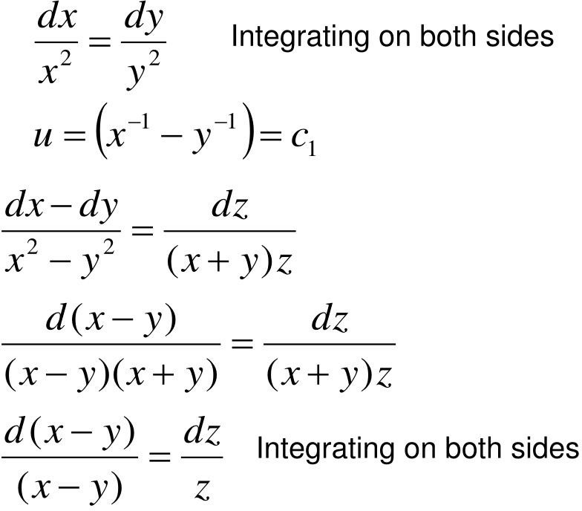
education for life www.rimt.ac.in
Department of Computer Science and Engineering

Slide 16
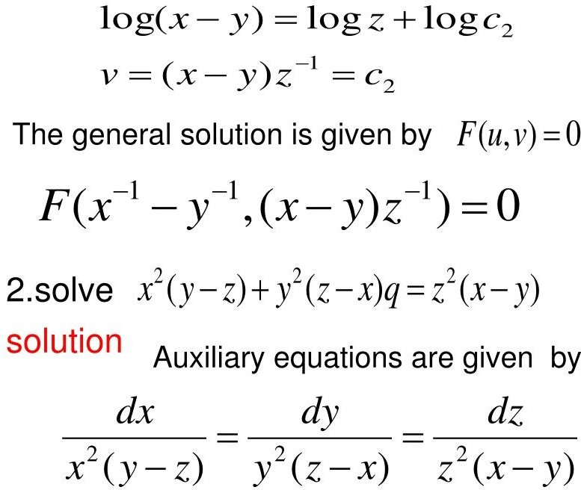
education for life www.rimt.ac.in
Department of Computer Science and Engineering

Slide 17
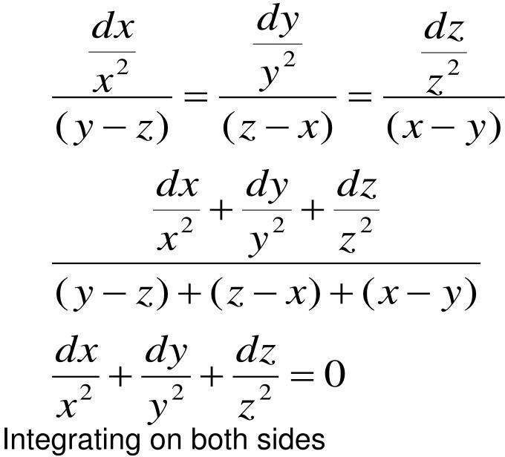
education for life www.rimt.ac.in
Department of Computer Science and Engineering

Slide 18
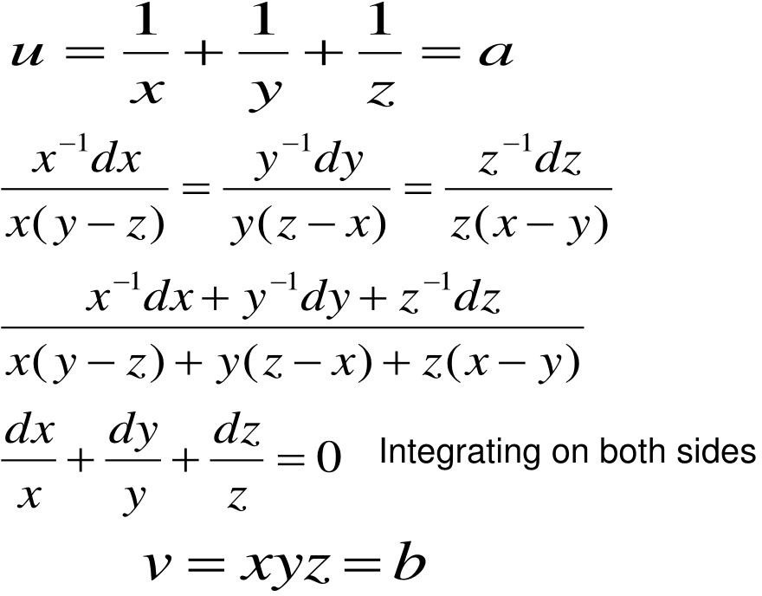
education for life www.rimt.ac.in
Department of Computer Science and Engineering

Slide 19
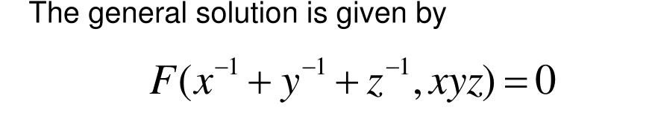
education for life www.rimt.ac.in
Department of Computer Science and Engineering

Slide 20
Topics Discussed in Next Lecture
Homogeneous linear equation with constant coefficients
education for life www.rimt.ac.in
Department of Computer Science and Engineering

