Slide 1

Mathematics-III
(BTCS-2302)
Course Name: B.Tech. (CSE)
Semester: 3rd
Prepared by: Sachin Syan
education for life www.rimt.ac.in
Department of Computer Science and Engineering

Slide 2
Topic Discussed
Laplace Transform of Some Important Functions
Laplace Transform of 1/t 𝑓(𝑡)
Laplace Transform of t .𝑓(𝑡)
Unit Step Function
Laplace Transform of Unit Step Function
Periodic Functions
Some Important Formulae of Laplace Transform
education for life www.rimt.ac.in
Department of Computer Science and Engineering

Slide 3
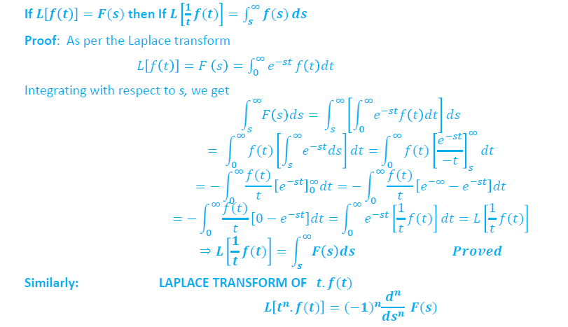
LAPLACE TRANSFORM OF (1 / t )f(t)
education for life www.rimt.ac.in
Department of Computer Science and Engineering

Slide 4
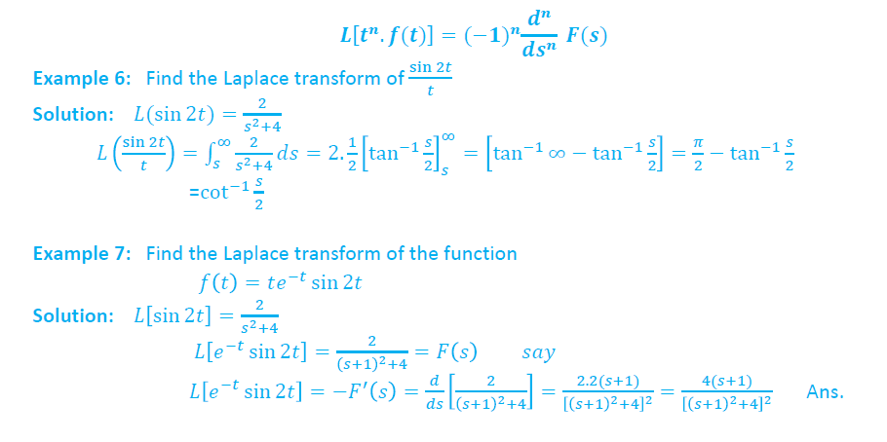
LAPLACE TRANSFORM OF t. f(t)
education for life www.rimt.ac.in
Department of Computer Science and Engineering

Slide 5
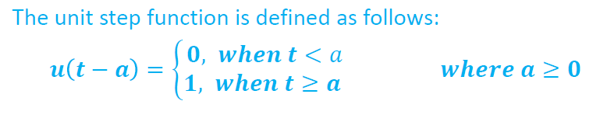
UNIT STEP FUNCTION
education for life www.rimt.ac.in
Department of Computer Science and Engineering

Slide 6
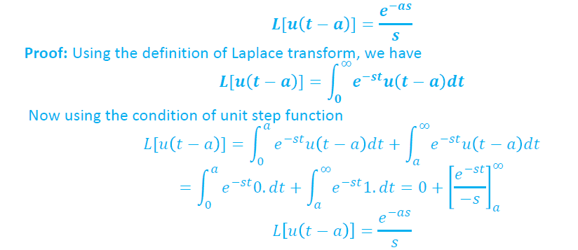
LAPLACE TRANSFORM OF UNIT STEP FUNCTION
education for life www.rimt.ac.in
Department of Computer Science and Engineering

Slide 7
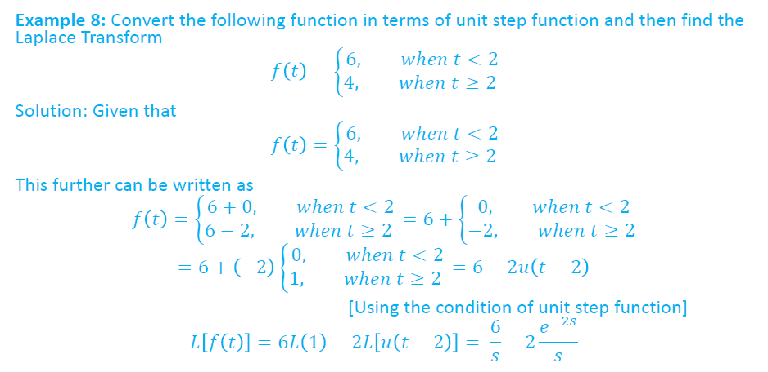
education for life www.rimt.ac.in
Department of Computer Science and Engineering

Slide 8
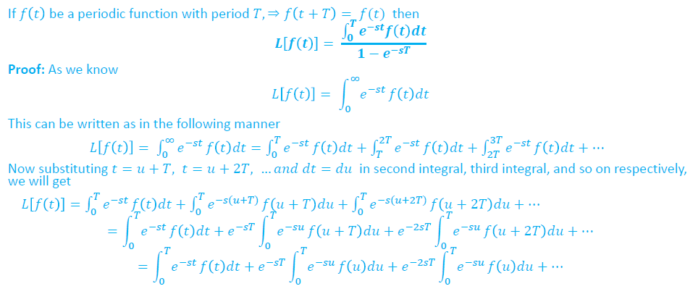
16. PERIODIC FUNCTIONS
education for life www.rimt.ac.in
Department of Computer Science and Engineering

Slide 9
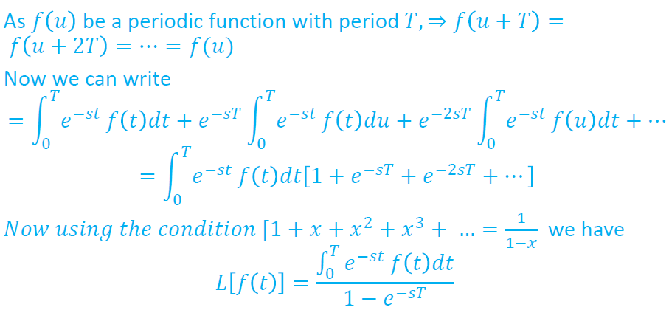
education for life www.rimt.ac.in
Department of Computer Science and Engineering

Slide 10
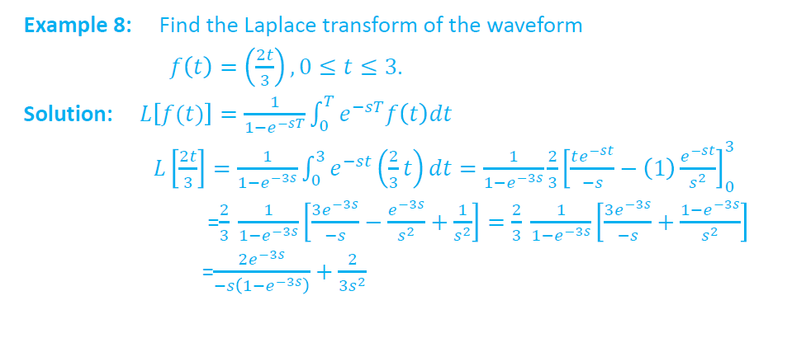
education for life www.rimt.ac.in
Department of Computer Science and Engineering

Slide 11
Topics Discussed in Next Lecture
Inverse Laplace Transform
Applications of Laplace Transform
education for life www.rimt.ac.in
Department of Computer Science and Engineering

