Slide 1

MACHINE DRAWING WITH AUTOCAD*
Course Name: B.Tech-ME
Semester: 3rd
Prepared by: Dr. Talwinder Singh Bedi
education for life www.rimt.ac.in
Department of Mechanical Engineering

Slide 2
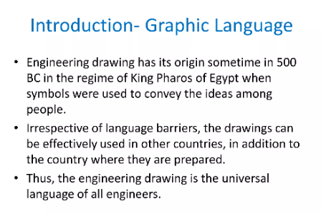
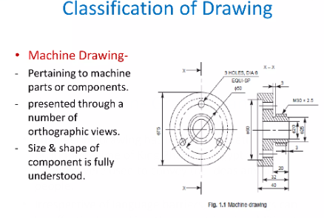
Topic: Introduction
UNIT: I
education for life www.rimt.ac.in
Department of Mechanical Engineering

Slide 3
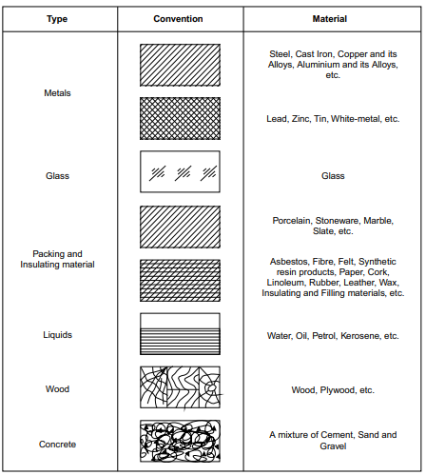
Conventional representation
UNIT: I
education for life www.rimt.ac.in
Department of Mechanical Engineering

Slide 4


Sectioning
UNIT: I
Half section: Symmetrical parts may be drawn, half in plain view and half in section
Local section: A local section may be drawn if half or full section is not convenient. The local break may be shown by a continuous thin free hand line
Arrangement of successive section: Successive sections may be placed separately, with designations for both cutting planes and sections (Fig. 2.25) or may be arranged below the cutting planes.
education for life www.rimt.ac.in
Department of Mechanical Engineering

Slide 5
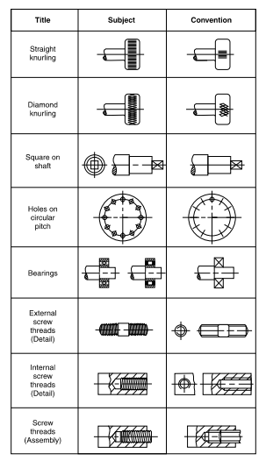
Conventional representation of machined components
UNIT: I
education for life www.rimt.ac.in
Department of Mechanical Engineering

Slide 6
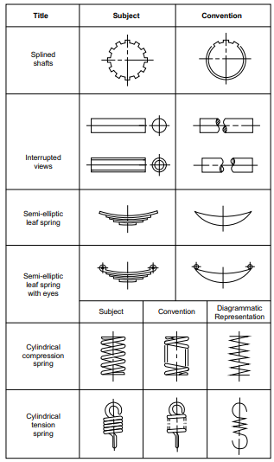
Conventional representation of machined components
UNIT: I
education for life www.rimt.ac.in
Department of Mechanical Engineering

Slide 7
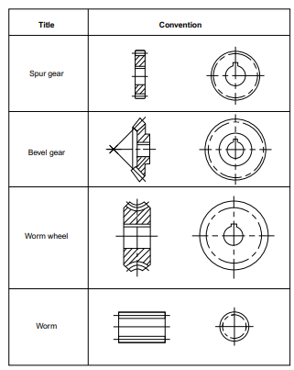
Conventional representation of machined components
UNIT: I
education for life www.rimt.ac.in
Department of Mechanical Engineering

Slide 8
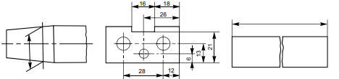
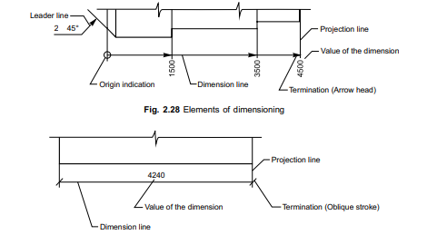
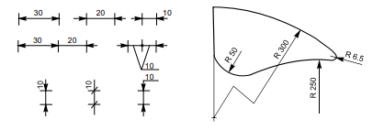
Dimensioning
UNIT: I
A drawing of a component, in addition to providing complete shape description, must also furnish information regarding the size description. These are provided through the distances between the surfaces, location of holes, nature of surface finish, type of material, etc. The expression of these features on a drawing, using lines, symbols, figures and notes is called dimensioning
education for life www.rimt.ac.in
Department of Mechanical Engineering

Slide 9
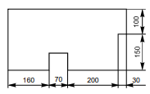
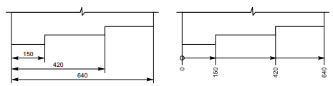
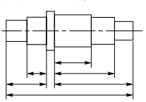
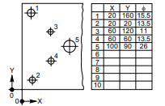
Dimensioning Types
UNIT: I
Chain Dimensioning
Parallel Dimensioning
Combined Dimensioning
Co-ordinate Dimensioning
education for life www.rimt.ac.in
Department of Mechanical Engineering

Slide 10
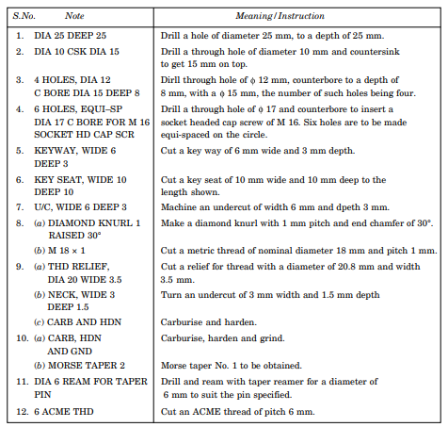
Important Note
UNIT: I
education for life www.rimt.ac.in
Department of Mechanical Engineering

Slide 11
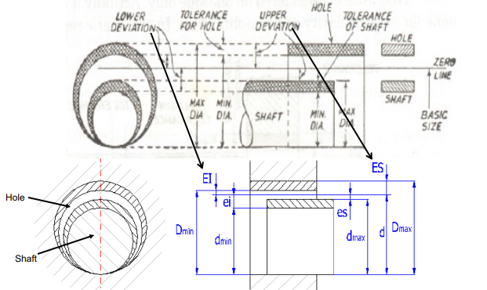
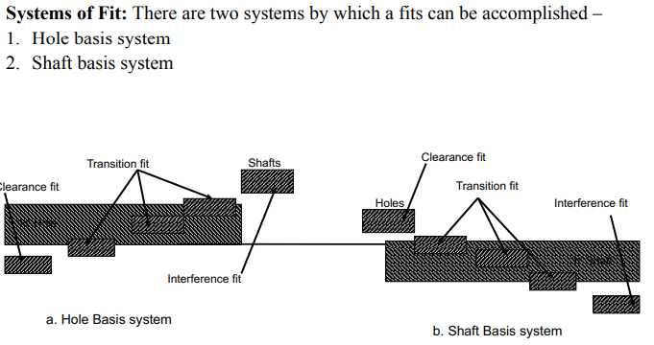
Limits, Fits and Tolerance
UNIT: I
education for life www.rimt.ac.in
Department of Mechanical Engineering

