Slide 1

Manufacturing Processes-I (BMEC-2305)
Course Name: B.Tech ME
Semester: 3rd
Prepared by: Er. Amrinder Singh Pannu
education for life www.rimt.ac.in
Department of Mechanical Engineering

Slide 2
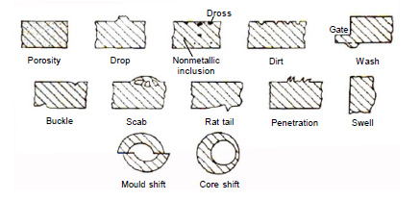
Unit-IV
Casting Defects
education for life www.rimt.ac.in
Department of Mechanical Engineering

Slide 3
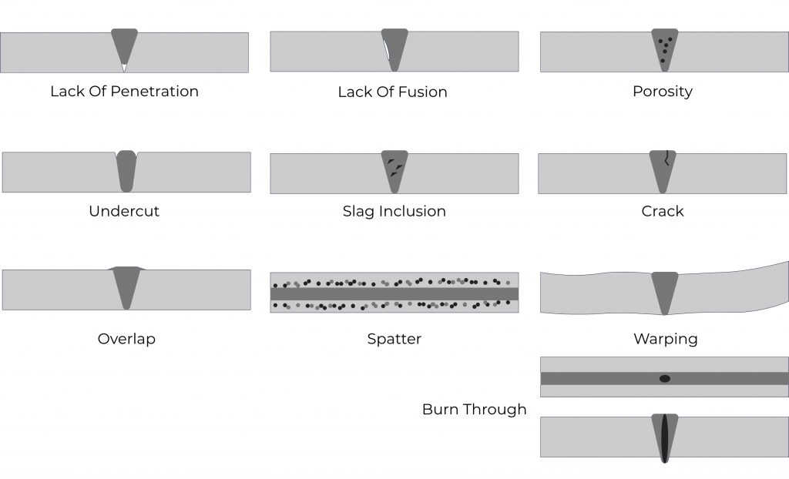
Unit-IV
Welding Defects
education for life www.rimt.ac.in
Department of Mechanical Engineering

Slide 4
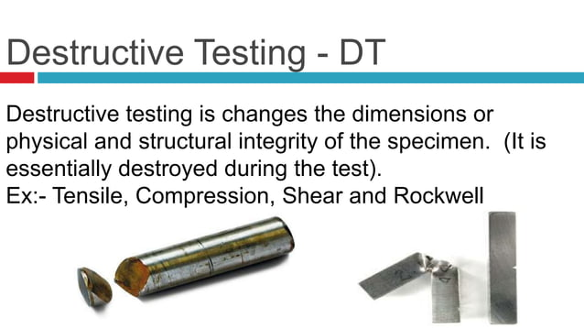
Unit-IV
education for life www.rimt.ac.in
Department of Mechanical Engineering

Slide 5
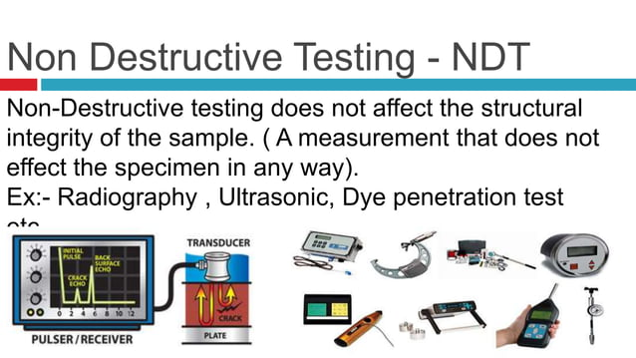
Unit-IV
education for life www.rimt.ac.in
Department of Mechanical Engineering

Slide 6
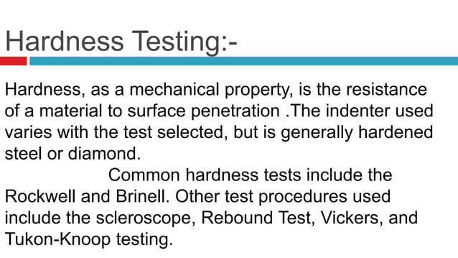
Unit-IV
education for life www.rimt.ac.in
Department of Mechanical Engineering

Slide 7
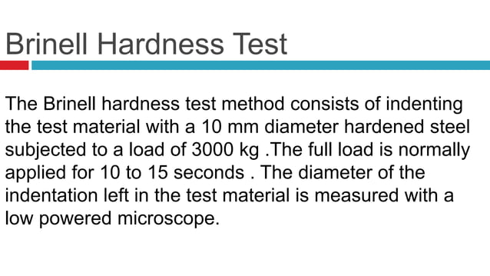
Unit-IV
education for life www.rimt.ac.in
Department of Mechanical Engineering

Slide 8
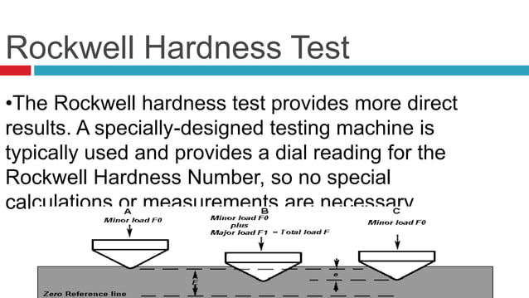
Unit-IV
education for life www.rimt.ac.in
Department of Mechanical Engineering

Slide 9
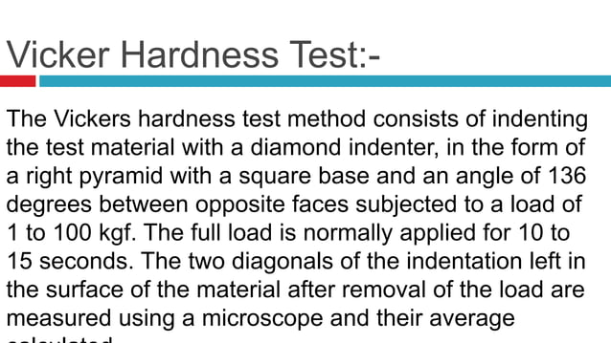
Unit-IV
education for life www.rimt.ac.in
Department of Mechanical Engineering

Slide 10
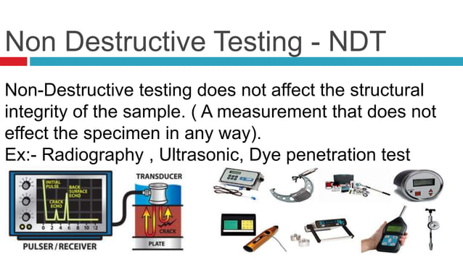
Unit-IV
education for life www.rimt.ac.in
Department of Mechanical Engineering

Slide 11
Unit-IV
education for life www.rimt.ac.in
Department of Mechanical Engineering

Slide 12
Unit-IV
education for life www.rimt.ac.in
Department of Mechanical Engineering

Slide 13
Unit-IV
education for life www.rimt.ac.in
Department of Mechanical Engineering

Slide 14
Unit-IV
education for life www.rimt.ac.in
Department of Mechanical Engineering

Slide 15
Unit-IV
education for life www.rimt.ac.in
Department of Mechanical Engineering

Slide 16
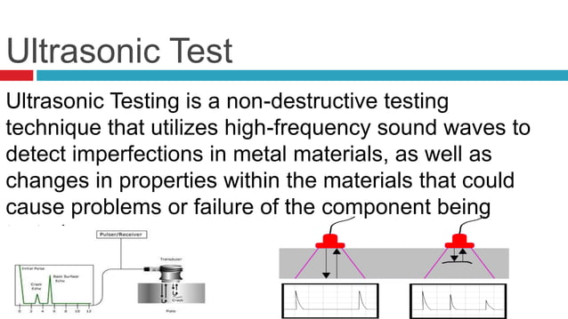
Unit-IV
education for life www.rimt.ac.in
Department of Mechanical Engineering

Slide 17
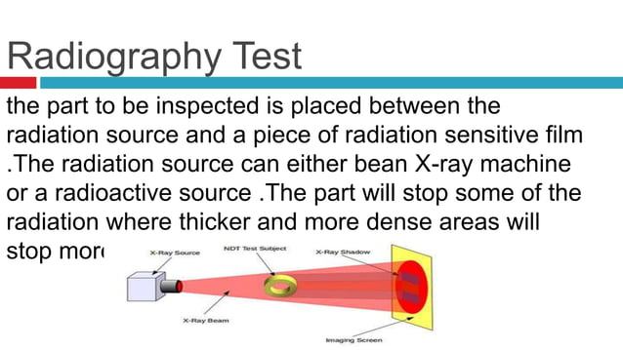
Unit-IV
education for life www.rimt.ac.in
Department of Mechanical Engineering

Slide 18
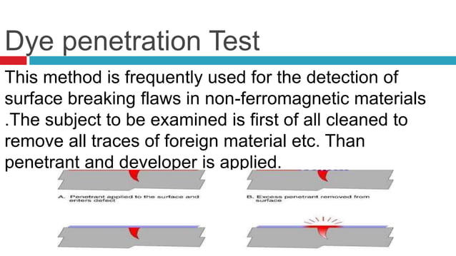
Unit-IV
education for life www.rimt.ac.in
Department of Mechanical Engineering

Slide 19
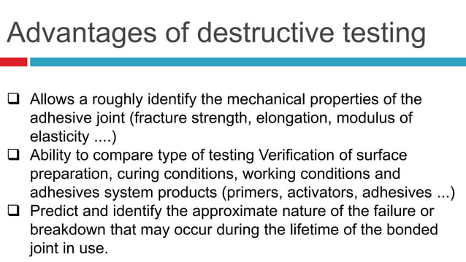
Unit-IV
education for life www.rimt.ac.in
Department of Mechanical Engineering

