Slide 1

Data Structure/BTCS-2304
Course Name: B.Tech CSE
Semester:3rd
Prepared by: Ms. Yogesh
education for life www.rimt.ac.in
Department of Computer Science & Engineering

Slide 2
Arrays
Array: a set of pairs (index and value)
data structure
For each index, there is a value associated with
that index.
representation (possible)
implemented by using consecutive memory.
education for life www.rimt.ac.in

Slide 3
Objects: A set of pairs <index, value> where for each value of index there is a value from the set item. Index is a finite ordered set of one or more dimensions, for example, {0, … , n-1} for one dimension,
{(0,0),(0,1),(0,2),(1,0),(1,1),(1,2),(2,0),(2,1),(2,2)} for two dimensions, etc.
Methods: for all A ∈ Array, i ∈ index, x ∈ item, j, size ∈ integer
Array Create(j, list) ::= return an array of j dimensions where list is a j-tuple whose kth element is the size of the kth dimension. Items are undefined.
Item Retrieve(A, i) ::= if (i ∈ index) return the item associated with index value i in array A else return error
Array Store(A, i, x) ::= if (i in index) return an array that is identical to array
A except the new pair <i, x> has been inserted else return error
The Array ADT
education for life www.rimt.ac.in

Slide 4
Arrays in C
int list[5], *plist[5];
list[5]: five integers
list[0], list[1], list[2], list[3], list[4]
*plist[5]: five pointers to integers
plist[0], plist[1], plist[2], plist[3], plist[4]
implementation of 1-D array
list[0] base address = α
list[1] α + sizeof(int)
list[2] α + 2*sizeof(int)
list[3] α + 3*sizeof(int)
list[4] α + 4*size(int)
education for life www.rimt.ac.in

Slide 5
Arrays in C (cont’d)
Compare int *list1 and int list2[5] in C.
Same: list1 and list2 are pointers.
Difference: list2 reserves five locations.
Notations:
list2 - a pointer to list2[0]
(list2 + i) - a pointer to list2[i] (&list2[i])
*(list2 + i) - list2[i]
education for life www.rimt.ac.in

Slide 6
Example
Example:
int one[] = {0, 1, 2, 3, 4}; //Goal: print out address and value
void print1(int *ptr, int rows)
{
printf(“Address Contents\n”);
for (i=0; i < rows; i++)
printf(“%8u%5d\n”, ptr+i, *(ptr+i));
printf(“\n”);
}
education for life www.rimt.ac.in

Slide 7
Other Data Structures
Based on Arrays
Arrays:
  Basic data structure
  May store any type of elements
Polynomials: defined by a list of coefficients and exponents
- degree of polynomial = the largest exponent in a polynomial
Polynomials A(X)=3X²⁰+2X⁵+4, B(X)=X⁴+10X³+3X²+1
education for life www.rimt.ac.in

Slide 8
Polynomial ADT
Objects: a set of ordered pairs of <e_{i},a_{i}>
where a_{i} in Coefficients and
e_{i} in Exponents, e_{i} are integers >= 0
Methods:
for all poly, poly1, poly2  Polynomial, coef Coefficients, expon  Exponents
Polynomial Zero( ) ::= return the polynomial p(x) = 0
Boolean IsZero(poly) ::= if (poly) return FALSE
else return TRUE
Coefficient Coef(poly, expon) ::= if (expon  poly) return its
coefficient else return Zero
Exponent Lead_Exp(poly) ::= return the largest exponent in poly
Polynomial Attach(poly,coef, expon) ::= if (expon  poly) return error
else return the polynomial poly
with the term <coef, expon>
inserted
education for life www.rimt.ac.in

Slide 9
Polyomial ADT (cont’d)
Polynomial Remove(poly, expon) ::= if (expon  poly) return the polynomial poly with the term whose exponent is expon deleted
else return error
Polynomial SingleMult(poly, coef, expon)::= return the polynomial
poly • coef • x^{expon}
Polynomial Add(poly1, poly2) ::= return the polynomial
poly1 +poly2
Polynomial Mult(poly1, poly2) ::= return the polynomial
poly1 • poly2
education for life www.rimt.ac.in

Slide 10
Polynomial Addition (1)
#define MAX_DEGREE 101
typedef struct {
int degree;
float coef[MAX_DEGREE];
} polynomial;
Running time?
Addition(polynomial * a, polynomial * b, polynomial* c)
{
…
}
advantage: easy implementation
disadvantage: waste space when sparse
education for life www.rimt.ac.in

Slide 11
Polynomial Addition (2)
Use one global array to store all polynomials
A(X)=2X¹⁰⁰⁰+1
B(X)=X⁴+10X³+3X²+1
starta finisha startb finishb avail
coef
exp
0 1 2 3 4 5 6
education for life www.rimt.ac.in

Slide 12
Polynomial Addition (2) (cont’d)
#define MAX_DEGREE 101
typedef struct {
int exp;
float coef;
} polynomial_term;
polynomial_term terms[3*MAX_DEGREE];
Running time?
Addition(int starta, int enda, int startb, int endb, int startc, int endc)
{
…
}
advantage: less space
disadvantage: longer code
education for life www.rimt.ac.in

Slide 13
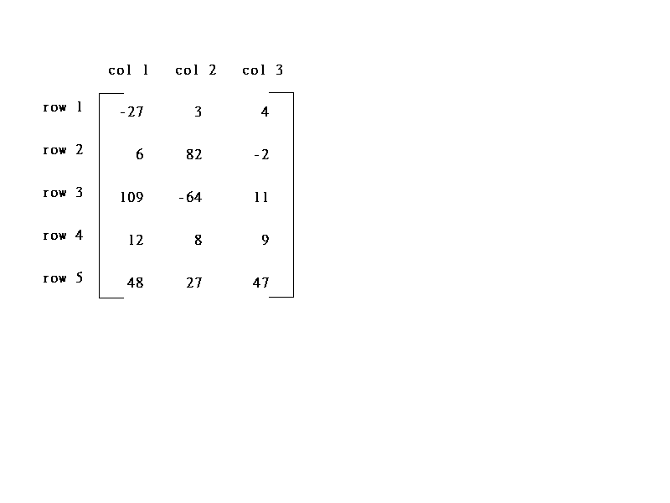
Sparse Matrices
col1 col2 col3 col4 col5 col6
row0
row1
row2
row3
row4
row5
5*3
6*6
15/15
8/36
sparse matrix
data structure?
education for life www.rimt.ac.in

Slide 14
Sparse Matrix ADT
Objects: a set of triples, <row, column, value>, where row
and column are integers and form a unique combination, and
value comes from the set item.
Methods:
for all a, b ∈ Sparse_Matrix, x  item, i, j, max_col,
max_row  index
Sparse_Marix Create(max_row, max_col) ::=
return a Sparse_matrix that can hold up to
max_items = max _row  max_col and
whose maximum row size is max_row and
whose maximum column size is max_col.
education for life www.rimt.ac.in

Slide 15
Sparse Matrix ADT (cont’d)
Sparse_Matrix Transpose(a) ::=
return the matrix produced by interchanging
the row and column value of every triple.
Sparse_Matrix Add(a, b) ::=
if the dimensions of a and b are the same
return the matrix produced by adding
corresponding items, namely those with
identical row and column values.
else return error
Sparse_Matrix Multiply(a, b) ::=
if number of columns in a equals number of rows in b
return the matrix d produced by multiplying
a by b according to the formula: d [i] [j] =
(a[i][k]•b[k][j]) where d (i, j) is the (i,j)th
element
else return error.
education for life www.rimt.ac.in

Slide 16
Sparse Matrix Representation
(1) Represented by a two-dimensional array.
Sparse matrix wastes space.
(2) Each element is characterized by <row, col, value>.
Sparse_matrix Create(max_row, max_col) ::=
#define MAX_TERMS 101 /* maximum number of terms +1*/
typedef struct {
int col;
int row;
int value;
} term;
term A[MAX_TERMS]
The terms in A should be ordered
based on <row, col>
education for life www.rimt.ac.in

Slide 17
Sparse Matrix Operations
Transpose of a sparse matrix.
What is the transpose of a matrix?
row col value row col value
a[0] 6 6 8 b[0] 6 6 8
[1] 0 0 15 [1] 0 0 15
[2] 0 3 22 [2] 0 4 91
[3] 0 5 -15 [3] 1 1 11
[4] 1 1 11 [4] 2 1 3
[5] 1 2 3 [5] 2 5 28
[6] 2 3 -6 [6] 3 0 22
[7] 4 0 91 [7] 3 2 -6
[8] 5 2 28 [8] 5 0 -15
transpose
education for life www.rimt.ac.in

Slide 18
Transpose a Sparse Matrix
(1) for each row i
take element <i, j, value> and store it
in element <j, i, value> of the transpose.
difficulty: where to put <j, i, value>?
(0, 0, 15) ====> (0, 0, 15)
(0, 3, 22) ====> (3, 0, 22)
(0, 5, -15) ====> (5, 0, -15)
(1, 1, 11) ====> (1, 1, 11)
Move elements down very often.
(2) For all elements in column j,
place element <i, j, value> in element <j, i, value>
education for life www.rimt.ac.in

Slide 19
Transpose of a Sparse Matrix (cont’d)
void transpose (term a[], term b[])
/* b is set to the transpose of a */
{
int n, i, j, currentb;
n = a[0].value; /* total number of elements */
b[0].row = a[0].col; /* rows in b = columns in a */
b[0].col = a[0].row; /*columns in b = rows in a */
b[0].value = n;
if (n > 0) { /*non zero matrix */
currentb = 1;
for (i = 0; i < a[0].col; i++)
/* transpose by columns in a */
for( j = 1; j <= n; j++)
/* find elements from the current column */
if (a[j].col == i) {
/* element is in current column, add it to b */
education for life www.rimt.ac.in

