Slide 1

Operating System/ BTCS-2401
Course Name: B.Tech CSE
Semester: 4th
Prepared by: Er. Jasdeep Singh
education for life www.rimt.ac.in
Department of Computer Science & Engineering

Slide 2
Topic 14th : Main Memory
education for life www.rimt.ac.in

Slide 3
Topics To Be Covered
Paging
Structure of the Page Table
Segmentation
Example: The Intel Pentium
education for life www.rimt.ac.in

Slide 4
Paging
Physical address space of a process can be noncontiguous; process is allocated physical memory whenever the latter is available
Divide physical memory into fixed-sized blocks called frames
  Size is power of 2, between 512 bytes and 16 Mbytes
Divide logical memory into blocks of same size called pages
Keep track of all free frames
To run a program of size N pages, need to find N free frames and load program
Set up a page table to translate logical to physical addresses
Backing store likewise split into pages
Still have Internal fragmentation
education for life www.rimt.ac.in

Slide 5
Address Translation Scheme
Address generated by CPU is divided into:
  Page number (p)- used as an index into a page table which contains base address of each page in physical memory
  Page offset (d)-combined with base address to define the physical memory address that is sent to the memory unit
  For given logical address space 2^{m} and page size 2^{n}
page number
page offset
p
d
m - n
n
education for life www.rimt.ac.in

Slide 6
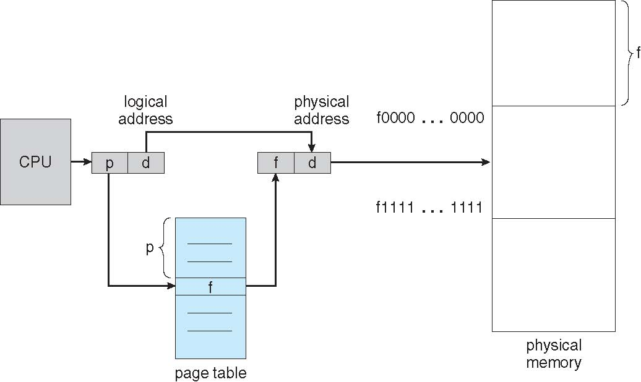
Paging Hardware
education for life www.rimt.ac.in

Slide 7
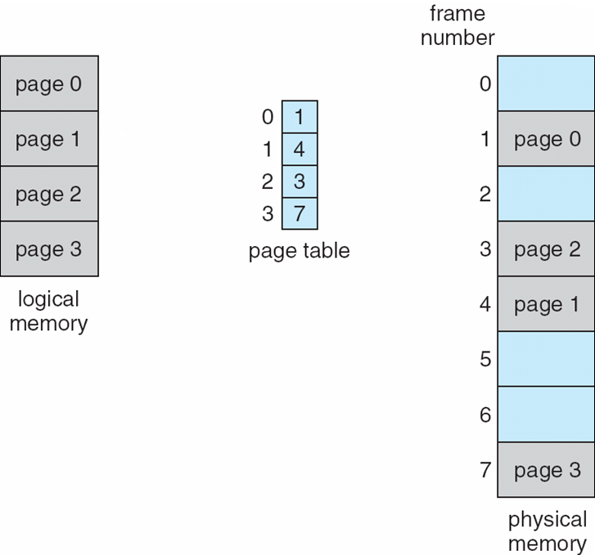
Paging Model of Logical and Physical Memory
education for life www.rimt.ac.in

Slide 8
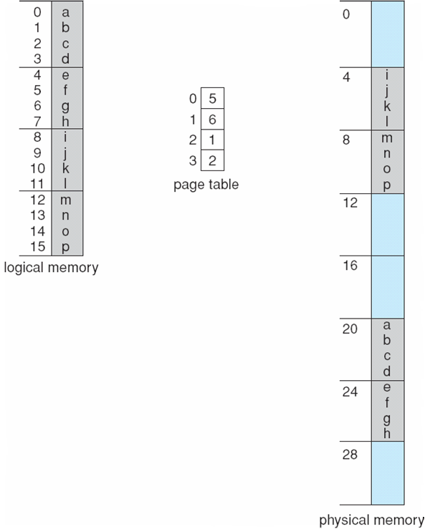
Paging Example
n=2 and m=4 32-byte memory and 4-byte pages
education for life www.rimt.ac.in

Slide 9
Paging (Cont.)
Calculating internal fragmentation
  Page size = 2,048 bytes
  Process size = 72,766 bytes
  35 pages + 1,086 bytes
  Internal fragmentation of 2,048 - 1,086 = 962 bytes
  Worst case fragmentation = 1 frame – 1 byte
  On average fragmentation = 1 / 2 frame size
  So small frame sizes desirable?
  But each page table entry takes memory to track
  Page sizes growing over time
    Solaris supports two page sizes – 8 KB and 4 MB
Process view and physical memory now very different
By implementation process can only access its own memory
education for life www.rimt.ac.in

Slide 10
Implementation of Page Table
Page table is kept in main memory
Page-table base register(PTBR) points to the page table
Page-table length register(PTLR) indicates size of the page table
In this scheme every data/instruction access requires two memory accesses
  One for the page table and one for the data / instruction
The two memory access problem can be solved by the use of a special fast-lookup hardware cache called associative memory or translation look-aside buffers(TLBs)
Some TLBs store address-space identifiers(ASIDs) in each TLB entry – uniquely identifies each process to provide address-space protection for that process
  Otherwise need to flush at every context switch
TLBs typically small (64 to 1,024 entries)
On a TLB miss, value is loaded into the TLB for faster access next time
  Replacement policies must be considered
  Some entries can be wired down for permanent fast access
education for life www.rimt.ac.in

Slide 11
Associative Memory
Associative memory – parallel search
Address translation (p, d)
  If p is in associative register, get frame # out
  Otherwise get frame # from page table in memory
Page #
Frame #
education for life www.rimt.ac.in

Slide 12
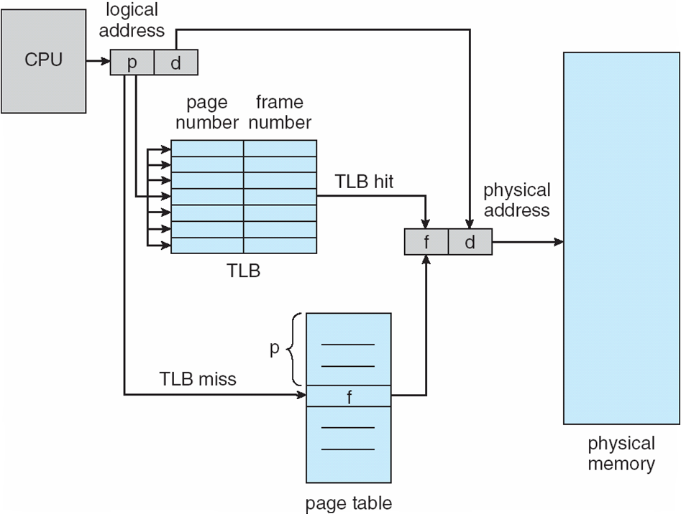
Paging Hardware With TLB
education for life www.rimt.ac.in

Slide 13
Memory Protection
Memory protection implemented by associating protection bit with each frame to indicate if read-only or read-write access is allowed
  Can also add more bits to indicate page execute-only, and so on
Valid- invalid bit attached to each entry in the page table:
  “valid” indicates that the associated page is in the process’ logical address space, and is thus a legal page
  “invalid” indicates that the page is not in the process’ logical address space
  Or use PTLR
Any violations result in a trap to the kernel
education for life www.rimt.ac.in

Slide 14
Shared Pages
  Shared code
  One copy of read-only code shared among processes (i.e., text editors, compilers, window systems)
  Similar to multiple threads sharing the same process space
  Also useful for interprocess communication if sharing of read-write pages is allowed
  Private code and data
  Each process keeps a separate copy of the code and data
  The pages for the private code and data can appear anywhere in the logical address space
education for life www.rimt.ac.in

Slide 15
Structure of the Page Table
Memory structures for paging can get huge using straight-forward methods
  Consider a 32-bit logical address space as on modern computers
  Page size of 4 KB (2¹²)
  Page table would have 1 million entries (2³² / 2¹²⁾
  If each entry is 4 bytes -> 4 MB of physical address space / memory for page table alone
    That amount of memory used to cost a lot
    Don’t want to allocate that contiguously in main memory
Hierarchical Paging
Hashed Page Tables
Inverted Page Tables
education for life www.rimt.ac.in

Slide 16
Hierarchical Page Tables
Break up the logical address space into multiple page tables
A simple technique is a two-level page table
We then page the page table
education for life www.rimt.ac.in

Slide 17
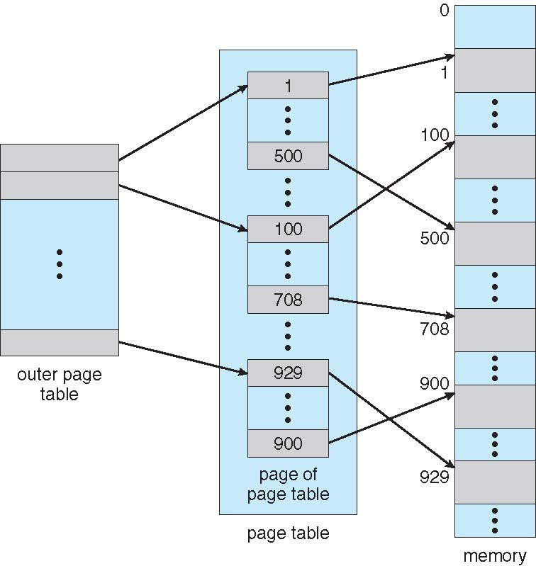
Two-Level Page-Table Scheme
education for life www.rimt.ac.in

Slide 18
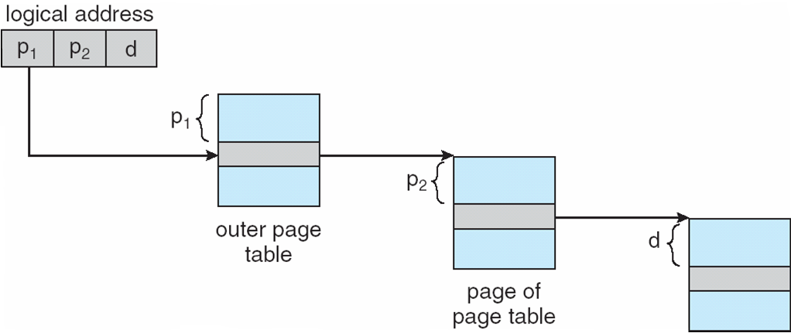
Address-Translation Scheme
education for life www.rimt.ac.in

Slide 19
Hashed Page Tables
Common in address spaces > 32 bits
The virtual page number is hashed into a page table
  This page table contains a chain of elements hashing to the same location
Each element contains (1) the virtual page number (2) the value of the mapped page frame (3) a pointer to the next element
Virtual page numbers are compared in this chain searching for a match
  If a match is found, the corresponding physical frame is extracted
education for life www.rimt.ac.in

Slide 20
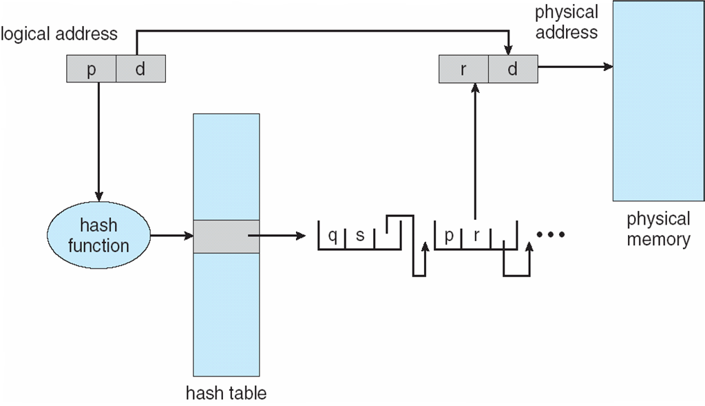
Hashed Page Table
education for life www.rimt.ac.in

Slide 21
Inverted Page Table
Rather than each process having a page table and keeping track of all possible logical pages, track all physical pages
One entry for each real page of memory
Entry consists of the virtual address of the page stored in that real memory location, with information about the process that owns that page
Decreases memory needed to store each page table, but increases time needed to search the table when a page reference occurs
Use hash table to limit the search to one — or at most a few — page-table entries
  TLB can accelerate access
But how to implement shared memory?
  One mapping of a virtual address to the shared physical address
education for life www.rimt.ac.in

Slide 22
Segmentation
Memory-management scheme that supports user view of memory
A program is a collection of segments
  A segment is a logical unit such as:
main program
procedure
function
method
object
local variables, global variables
common block
stack
symbol table
arrays
education for life www.rimt.ac.in

Slide 23
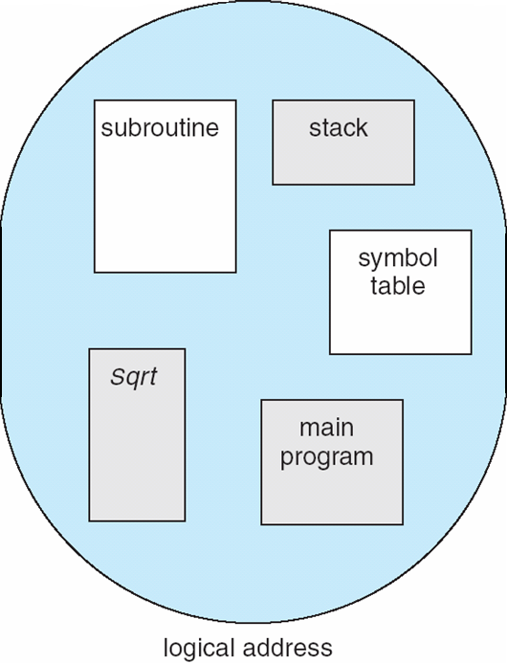
User’s View of a Program
education for life www.rimt.ac.in

Slide 24
Logical View of Segmentation
1
1
4
2
3
4
2
3
user space
physical memory space
education for life www.rimt.ac.in

Slide 25
Summary
Paging
Structure of the Page Table
Segmentation
Example: The Intel Pentium
education for life www.rimt.ac.in

Slide 26
Topics To Be Covered
File Concept
Access Methods
Directory Structure
File-System Mounting
File Sharing
Protection
education for life www.rimt.ac.in

Slide 27
References
Silberschatz and Peter B. Calvin, “Operating System Concepts" Addison Wesley Publishing Company
Dhamdhere, “Systems Programming & Operating Systems Tata McGraw Hill
education for life www.rimt.ac.in

