Slide 1

Operating System/ BTCS-2401
Course Name: B.Tech CSE
Semester: 4th
Prepared by: Er. Jasdeep Singh
education for life www.rimt.ac.in
Department of Computer Science & Engineering

Slide 2
Topic 6th: Threads
education for life www.rimt.ac.in

Slide 3
Topics To Be Covered
Overview
Multithreading Models
Thread Libraries
Threading Issues
Operating System Examples
Windows XP Threads
Linux Threads
education for life www.rimt.ac.in

Slide 4
Objectives
To introduce the notion of a thread — a fundamental unit of CPU utilization that forms the basis of multithreaded computer systems
To discuss the APIs for the threads, Win32, and Java thread libraries
To examine issues related to multithreaded programming
education for life www.rimt.ac.in

Slide 5
Motivation
Threads run within application
Multiple tasks with the application can be implemented by separate threads
  Update display
  Fetch data
  Spell checking
  Answer a network request
Process creation is heavy-weight while thread creation is light-weight
Can simplify code, increase efficiency
Kernels are generally multithreaded
education for life www.rimt.ac.in

Slide 6
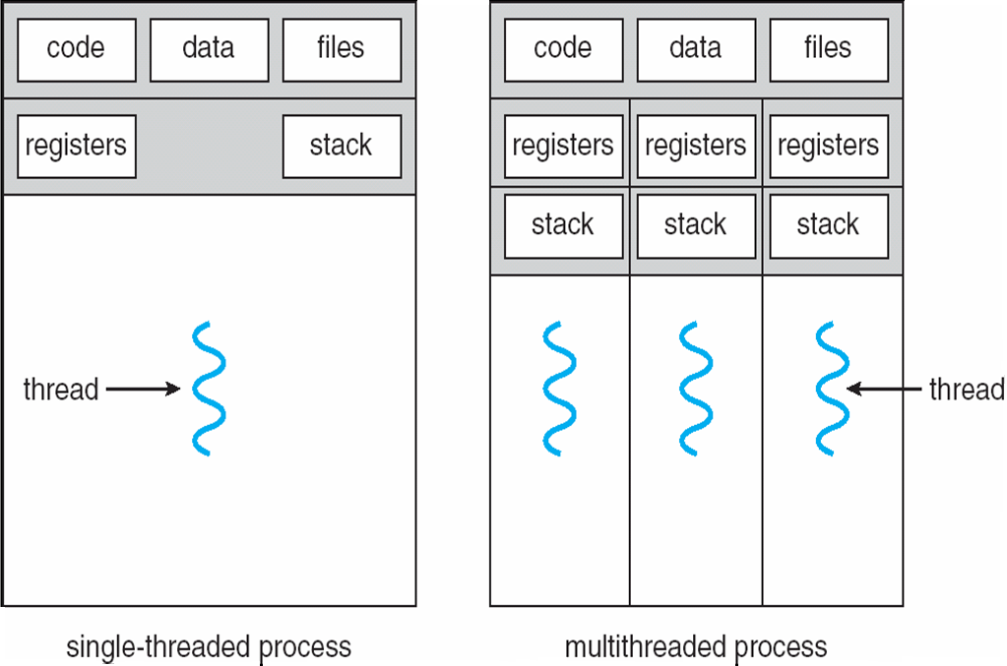
Single and Multithreaded Processes
education for life www.rimt.ac.in

Slide 7
Benefits
Responsiveness
Resource Sharing
Economy
Scalability
education for life www.rimt.ac.in

Slide 8
Multicore Programming
Multicore systems putting pressure on programmers, challenges include:
  Dividing activities
  Balance
  Data splitting
  Data dependency
  Testing and debugging
education for life www.rimt.ac.in

Slide 9
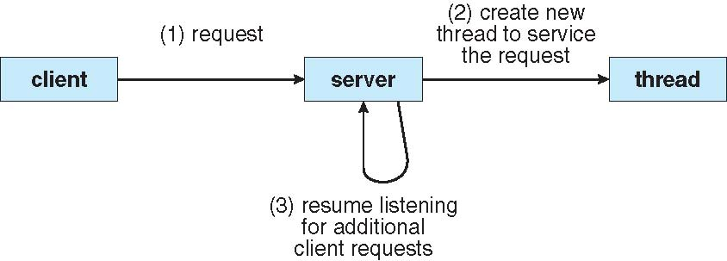
Multithreaded Server Architecture
education for life www.rimt.ac.in

Slide 10
User Threads
Thread management done by user-level threads library
Three primary thread libraries:
  POSIX Pthreads
  Win32 threads
  Java threads
education for life www.rimt.ac.in

Slide 11
Kernel Threads
Supported by the Kernel
Examples
  Windows XP/2000
  Solaris
  Linux
  Tru64 UNIX
  Mac OS X
education for life www.rimt.ac.in

Slide 12
Multithreading Models
Many-to-One
One-to-One
Many-to-Many
education for life www.rimt.ac.in

Slide 13
Many-to-One
Many user-level threads mapped to single kernel thread
Examples:
Solaris green threads
GNU Portable Threads
education for life www.rimt.ac.in

Slide 14
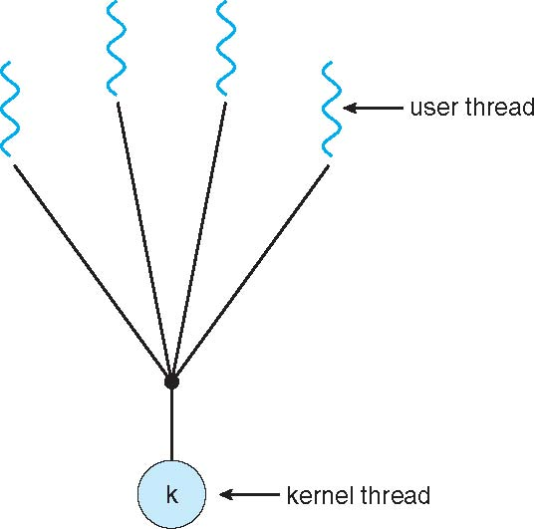
Many-to-One Model
education for life www.rimt.ac.in

Slide 15
One-to-One
Each user-level thread maps to kernel thread
Examples
  Windows NT/XP/2000
  Linux
  Solaris 9 and later
education for life www.rimt.ac.in

Slide 16
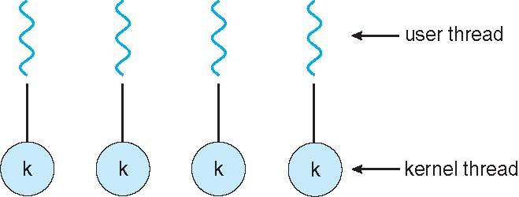
One-to-one Model
education for life www.rimt.ac.in

Slide 17
Many-to-Many Model
Allows many user level threads to be mapped to many kernel threads
Allows the operating system to create a sufficient number of kernel threads
Solaris prior to version 9
Windows NT/2000 with the Thread Fiber package
education for life www.rimt.ac.in

Slide 18
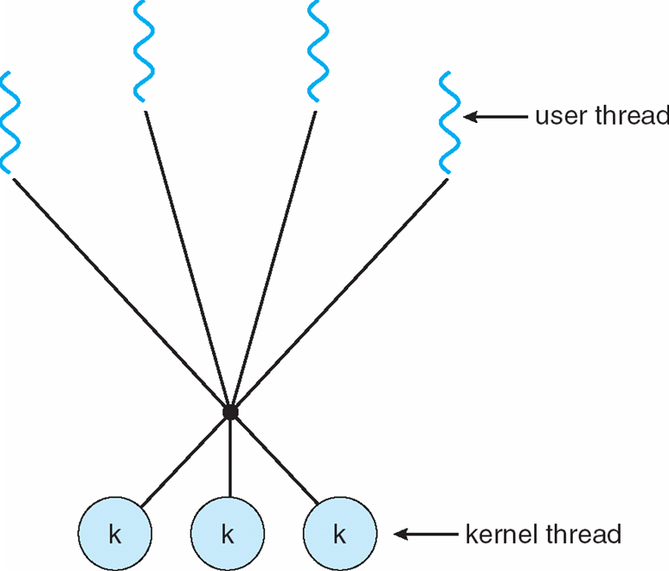
Many-to-Many Model
education for life www.rimt.ac.in

Slide 19
Two-level Model
Similar to M:M, except that it allows a user thread to be bound to kernel thread
Examples
  IRIX
  HP-UX
  Tru64 UNIX
  Solaris 8 and earlier
education for life www.rimt.ac.in

Slide 20
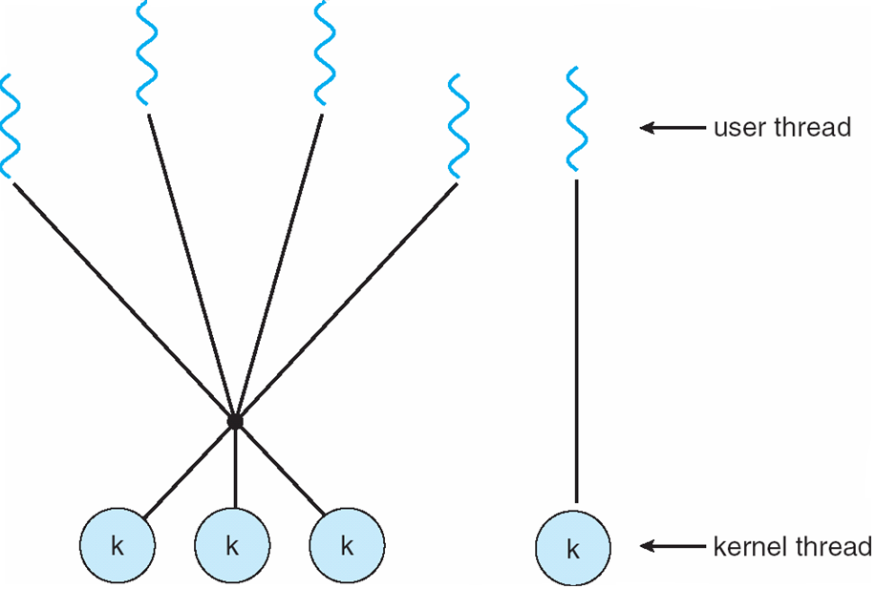
Two-level Model
education for life www.rimt.ac.in

Slide 21
Thread Libraries
Thread library provides programmer with API for creating and managing threads
Two primary ways of implementing
  Library entirely in user space
  Kernel-level library supported by the OS
education for life www.rimt.ac.in

Slide 22
Pthreads
May be provided either as user-level or kernel-level
A POSIX standard (IEEE 1003.1c) API for thread creation and synchronization
API specifies behavior of the thread library, implementation is up to development of the library
Common in UNIX operating systems (Solaris, Linux, Mac OS X)
education for life www.rimt.ac.in

Slide 23
Threading Issues
Semantics of fork() and exec() system calls
Thread cancellation of target thread
  Asynchronous or deferred
Signal handling
  Synchronous and asynchronous
education for life www.rimt.ac.in

Slide 24
Thread Cancellation
Terminating a thread before it has finished
Two general approaches:
  Asynchronous cancellation terminates the target thread immediately.
  Deferred cancellation allows the target thread to periodically check if it should be cancelled.
education for life www.rimt.ac.in

Slide 25
Signal Handling
Signals are used in UNIX systems to notify a process that a particular event has occurred.
A signal handler is used to process signals
  Signal is generated by particular event
  Signal is delivered to a process
  Signal is handled
Options:
  Deliver the signal to the thread to which the signal applies
  Deliver the signal to every thread in the process
  Deliver the signal to certain threads in the process
  Assign a specific thread to receive all signals for the process
education for life www.rimt.ac.in

Slide 26
Thread Pools
Create a number of threads in a pool where they await work
Advantages:
  Usually slightly faster to service a request with an existing thread than create a new thread
  Allows the number of threads in the application(s) to be bound to the size of the pool
education for life www.rimt.ac.in

Slide 27
Thread Specific Data
Allows each thread to have its own copy of data
Useful when you do not have control over the thread creation process (i.e., when using a thread pool)
education for life www.rimt.ac.in

Slide 28
Windows XP Threads
Implements the one-to-one mapping, kernel-level
Each thread contains
  A thread id
  Register set
  Separate user and kernel stacks
  Private data storage area
The register set, stacks, and private storage area are known as the context of the threads
The primary data structures of a thread include:
  ETHREAD (executive thread block)
  KTHREAD (kernel thread block)
  TEB (thread environment block)
education for life www.rimt.ac.in

Slide 29
Summary
Overview
Multithreading Models
Thread Libraries
Threading Issues
Operating System Examples
Windows XP Threads
Linux Threads
education for life www.rimt.ac.in

Slide 30
Topics To Be Next Covered
Basic Concepts
Scheduling Criteria
Scheduling Algorithms
education for life www.rimt.ac.in

Slide 31
References
Silberschatz and Peter B. Calvin, “Operating System Concepts" Addison Wesley Publishing Company
Dhamdhere, “Systems Programming & Operating Systems Tata McGraw Hill
education for life www.rimt.ac.in

