Slide 1
ENVIRONMENTAL POLLUTION

Slide 2
Introduction
Developmental activities produce large amount of wastes that leads to pollution of air, water, soil, and oceans; global warming and acid rains.
Untreated or improperly treated waste is a major cause of pollution of rivers and environmental degradation causing ill health and loss of crop productivity.
2
ENVIRONMENTAL POLLUTION

Slide 3
Objectives of the study
Define the terms pollution and pollutants;
List various kinds of pollution;
Describe types of pollution, sources, harmful effects on human health and control of air pollution, indoor air pollution, noise pollution;
Describe water pollution, its causes and control;
Describe thermal pollution;
Describe soil pollution, its causes and control;
Describe radiation pollution, sources and hazards.
ENVIRONMENTAL POLLUTION
3

Slide 4
POLLUTION AND POLLUTANTS
Pollution may be defined as addition of undesirable material into the environment as a result of human activities.
The agents which cause environmental pollution are called pollutants.
Pollutants may be defined as a physical, chemical or biological substance unintentionally released into the environment which is directly or indirectly harmful to humans and other living organisms.
4
ENVIRONMENTAL POLLUTION

Slide 5
TYPES OF POLLUTION
Air pollution
Noise pollution
Water pollution
Soil pollution
Thermal pollution
Radiation pollution
5
ENVIRONMENTAL POLLUTION

Slide 6
AIR POLLUTION
Air pollution may be defined as the presence of any solid, liquid or gaseous substance including noise and radioactive radiation in the atmosphere in such concentration that may be directly and indirectly injurious to humans or other living organisms, plants, property or interferes with the normal environmental processes.
Air pollutants are of two types
Suspended particulate matter
Gaseous pollutants like carbon dioxide (co2), nox etc.
ENVIRONMENTAL POLLUTION
6

Slide 7
Particulate pollutants
Particulate matter suspended in air are dust and soot released from the industrial chimneys.
Their size ranges from 0.001 to 500 µm in diameter.
Particles less than 10µm float and move freely with the air current.
Particles which are more than 10µm in diameter settle down.
Particles less than 0.02 µm form persistent aerosols.
Major source of SPM (suspended particulate matter) are
₇ ENVIRONMENTAL POLLUTION
vehicles, power plants, construction activities, oil refinery,

Slide 8
Fly ash (TYPE OF PM)
It is ejected mostly by thermal power plants as by products of coal burning operations.
It pollutes air and water and may cause heavy metal pollution in water bodies.
It affects vegetation as a result of its direct deposition on leaf surfaces or indirectly through its deposition on soil.
Now it is used for making bricks and as a land fill material.
8
ENVIRONMENTAL POLLUTION

Slide 9
Lead and other metals particles (TYPE OF PM)
The lead particles mixed with air produces injurious effects on kidney and liver and interferes with development of red blood cells.
Lead mixed with water and food can create cumulative poisoning.
It has long term effects on children as it lowers intelligence.
Oxides of iron, aluminum, manganese, magnesium, zinc and other metals have adverse effect due to deposition of dust on plants during mining operations and metallurgical
ENVIRONMENTAL POLLUTION
processes.
9

Slide 10
Gaseous pollutants
Power plants, industries, different types of vehicles release gaseous pollutants such as CO2, oxides of nitrogen and sulphur dioxide along with particulate matter in the form of smoke.
All of these have harmful effects on plants and humans.
10
ENVIRONMENTAL POLLUTION

Slide 11
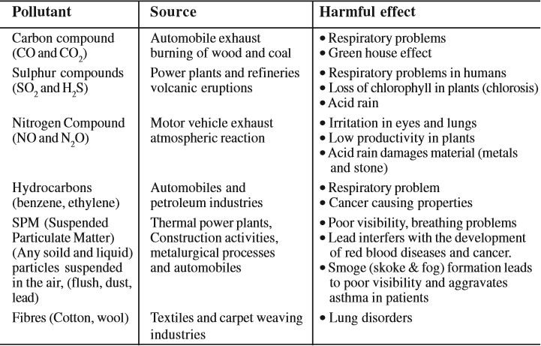
Gaseous air pollutants: their sources and effects
11
ENVIRONMENTAL POLLUTION

Slide 12
Prevention and control of indoor air pollution
Use of wood and dung cakes should be replaced by cleaner fuels such as biogas, kerosene or electricity.
Electricity and kerosene is limited.
Improved stoves for looking like smokeless chullahs have high thermal efficiency and reduced emission of pollutants including smoke.
The house designs should incorporate a well ventilated kitchen.
Use of biogas and CNG (Compressed Natural Gas) need to be encouraged.
Those species of trees such as baval (Acacia nilotica) which are least smoky should be planted and used.
Se_{EN}g_{V}r_{IR}e_{O}g_{N}a_{ME}t_{N}io_{TA}n_{L P}o_{O}f_{LL}w_{UT}a_{IO}s_{N}te, pretreatment at source,
12
sterilization of rooms will help in checking indoor air

Slide 13
Prevention and control of industrial pollution
Use of cleaner fuels such as liquefied natural gas (LNG) in power plants, fertilizer plants etc. Which is cheaper in addition to being environmentally friendly.
Employing environment friendly industrial processes so that emission of pollutants and hazardous waste is minimized.
Installing devices which reduce release of pollutants.
Devices like filters, electrostatic precipitators, etc.
13
ENVIRONMENTAL POLLUTION

Slide 14
Filters
They remove particulate matter from the gas stream.
The medium of a filter may be made of fibrous materials like cloth, granular material like sand, a rigid material like screen, or any mat like felt pad.
Bughouse filtration system is the most common one and is made of cotton or synthetic fibers ( for low temperatures) or glass cloth fabrics (for higher temperature up to 290oC).
Electrostatic precipitators (ESP)
ENVIRONMENTAL POLLUTION
The emanating dust is charged with ions and the
14

Slide 15
The particles are removed from the collection surface by occasional shaking or by rapping the surface.
ESPs are used in boilers, furnaces, and many other units of
thermal power plants, cement factories, steel plants, etc.
Inertial collectors
It works on the principle that inertia of SPM in a gas is higher than its solvent and as inertia is a function of the mass of the particulate matter this device collects heavier particles more efficiently.
‘Cyclone’ is a common inertial collector used in gas cleaning
_{pla}E_{n}N_{t}V_{s}IR.ONMENTAL POLLUTION
15

Slide 16
Scrubbers
Scrubbers are wet collectors.
They remove aerosols from a stream of gas either by collecting wet particles on a surface followed by their removal, or else the particles are wetted by a scrubbing liquid.
The particles get trapped as they travel from supporting gaseous medium across the interface to the liquid scrubbing medium.
16
ENVIRONMENTAL POLLUTION

Slide 17
Control of vehicular pollution
Standards have been set for the durability of catalytic converters which reduce vehicular emission.
In cities like Delhi, motor vehicles need to obtain Pollution Under Control (PUC) certificate at regular intervals.
The price of diesel is much cheaper than petrol which promotes use of diesel.
To reduce emission of sulphur dioxide, sulphur content in diesel has been reduced to 0.05%.
17
ENVIRONMENTAL POLLUTION

Slide 18
NOISE POLLUTION
Noise is one of the most pervasive pollutant.
Noise by definition is “sound without value” or “any noise that is unwanted by the recipient”.
Noise level is measured in terms of decibels (dB).
W.H.O. (World Health Organization) has prescribed optimum noise level as 45 dB by day and 35 dB by night.
Anything above 80 dB is hazardous.
ENVIRONMENTAL POLLUTION
18

Slide 19
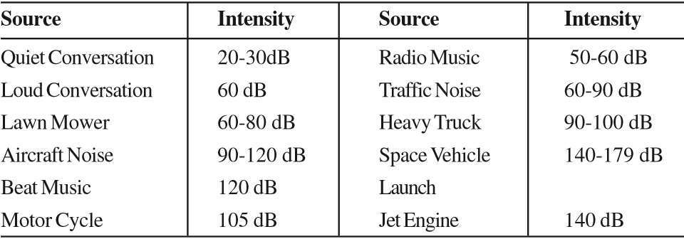
Sources of some noises and their intensity
19
ENVIRONMENTAL POLLUTION

Slide 20
Sources of noise pollution
Sources of noise pollution are many and may be located indoors or
outdoors.
Indoor sources
It include noise produced by radio, television, generators, electric fans, air coolers, air conditioners, different home appliances, and family conflict.
Noise pollution is more in cities due to a higher concentration of population and industries and activities such as transportation.
Noise like other pollutants is a by product of industrialization,
20
ENVIRONMENTAL POLLUTION
urbanization and modern civilization.

Slide 21
Outdoor sources
It Include indiscriminate use of loudspeakers, industrial activities, automobiles, rail traffic, aero planes and activities such as those at market place, religious, social, and cultural functions, sports and political rallies.
In rural areas farm machines, pump sets are main sources of noise pollution.
During festivals, marriage and many other
o_{E}c_{N}c_{V}a_{IR}s_{O}i_{N}o_{M}n_{EN}s_{T},_{AL}u_{P}s_{O}e_{LLU}o_{TI}f_{ON}fire crackers contribute to noise pollution.
21

Slide 22
Effects of noise pollution
Noise pollution is highly annoying and irritating.
Noise disturbs sleep, causes hypertension (high blood pressure), emotional problems such as aggression, mental depression and annoyance.
Noise pollution adversely affects efficiency and performance of individuals.
22
ENVIRONMENTAL POLLUTION

Slide 23
Prevention and control of noise pollution
Road traffic noise can be reduced by better designing and proper maintenance of vehicles.
Noise abatement measures include creating noise mounds, noise attenuation walls and well maintained roads and smooth surfacing of roads.
Retrofitting of locomotives, continuously welded rail track, use of electric locomotives or deployment of quieter rolling stock will reduce noises emanating
ENVfrIRoOmNMEtrNaTAinL sPO. LLUTION
23

Slide 24
Air traffic noise can be reduced by appropriate insulation and introduction of noise regulations for take off and landing of aircrafts at the airport.
Industrial noises can be reduced by sound proofing equipment like generators and areas producing lot of noise.
Power tools, very loud music and land movers, public functions using loudspeakers, etc should not be permitted at night. Use of horns, alarms, refrigeration units, etc. is to be restricted.
Use of fire crackers which are noisy and cause air pollution
shEoNuVIlRdONbMeENrTeALsPtrOiLcLtUeTdIO.N
24

Slide 25
WATER POLLUTION
Addition or presence of undesirable substances in water is called water pollution.
It is one of the most serious environmental problems.
Water pollution is caused by a variety of human activities such as industrial, agricultural and domestic.
Agricultural run off laden with excess fertilizers and pesticides, industrial effluents with toxic substances and sewage water with human and animal wastes pollute our water thoroughly.
25⚫ NaENtuVIrRaOlNMsENoTuALrcPeOLsLUToIOfN pollution of water are soil erosion,

Slide 26
Sources of water pollution
Water pollution is the major source of water born diseases and other health problems.
Sediments brought by runoff water from agricultural fields and discharge of untreated or partially treated sewage and industrial effluents, disposal of fly ash or solid waste into or close to a water body cause severe problems of water pollution.
Increased turbidity of water because of sediments reduces penetration of light in water that reduces
ENVIRONMENTAL POLLUTION
26
photosynthesis by aquatic plants.

Slide 27
Pollution due to pesticides and inorganic chemicals
Pesticides like DDT and others used in agriculture may contaminate water bodies.
Aquatic organisms take up pesticides from water get into the food chain (aquatic in this case) and move up the food chain.
At higher tropic level they get concentrated and may reach the upper end of the food chain.
Pollution of water bodies by mercury causes Minamata disease in humans and dropsy in fishes.
Lead causes displexia, cadmium poisoning causes Itai – Itai disease etc.
Oil pollution of sea occurs from leakage from ships, oil tankers, rigs and pipelines.
2⚫7
Acc^{E}i^{N}d^{V}e^{IR}n^{O}t^{N}sMEo^{N}f^{TA}o^{L}i^{P}l ^{O}ta^{LL}n^{UT}k^{I}e^{ON}rs spill large quantity of oil in seas

Slide 28
Thermal pollution
Discharge of hot water may increase the temperature of the receiving water by 10 to 15 °C above the ambient water temperature. This is thermal pollution.
Increase in water temperature decreases dissolved oxygen in water which adversely affects aquatic life.
Due to thermal pollution biological diversity is reduced.
One of the best methods of reducing thermal pollution is to store the hot water in cooling ponds, allow the water to cool before releasing into any receiving water body
28
ENVIRONMENTAL POLLUTION

Slide 29
Ground water pollution
Lot of people around the world depend on ground water for drinking, domestic, industrial and agricultural uses.
Generally groundwater is a clean source of water.
However, human activities such as improper sewage disposal, dumping of farm yard manures and agricultural chemicals, industrial effluents are causing pollution of ground water.
29
ENVIRONMENTAL POLLUTION

Slide 30
Eutrophication
‘Eu’ means well or healthy and ‘trophy’ means nutrition.
The enrichment of water bodies with nutrients causes
entrophication of the water body.
The sudden and explosive growth of phytoplankton and algae impart green color to the water is known as water bloom, or “algal blooms”.
These phytoplankton release toxic substances in water that causes sudden death of large population of fishes.
This phenomenon of nutrient enrichment of a water body is called eutrophication.
Human activities are mainly responsible for the eutrophication of a growing number of lakes and water bodies in the country
ENVIRONMENTAL POLLUTION
30

Slide 31
Control of water pollution
The following measures can be adopted to control water pollution:
The water requirement should be minimized by altering the techniques involved.
Water should be reused with or without treatment.
Recycling of water after treatment should be practiced to the maximum extent possible.
The quantity of waste water discharge should be
31
ENVIRONMENTAL POLLUTION
minimized.

Slide 32
SOIL POLLUTION
Addition of substances which adversely affect the quality of soil or its fertility is known as soil pollution.
Solid waste is a mixture of plastics, cloth, glass, metal and organic matter, sewage, sewage sludge, building debris, generated from households, commercial and industries establishments add to soil pollution.
Fly ash, iron and steel slag, medical and industrial wastes disposed on land are important sources of soil pollution.
In addition, fertilizers and pesticides from agricultural use which reach soil as run-off and land filling by municipal waste are growing cause of soil pollution.
Acid rain and dry deposition of pollutants on land
32
su^{E}r^{N}f^{V}a^{IR}c^{O}e^{NM}a^{EN}ls^{TA}o^{L P}c^{O}o^{LL}n^{UT}tr^{IO}ib^{N} ute to soil pollution.

Slide 33
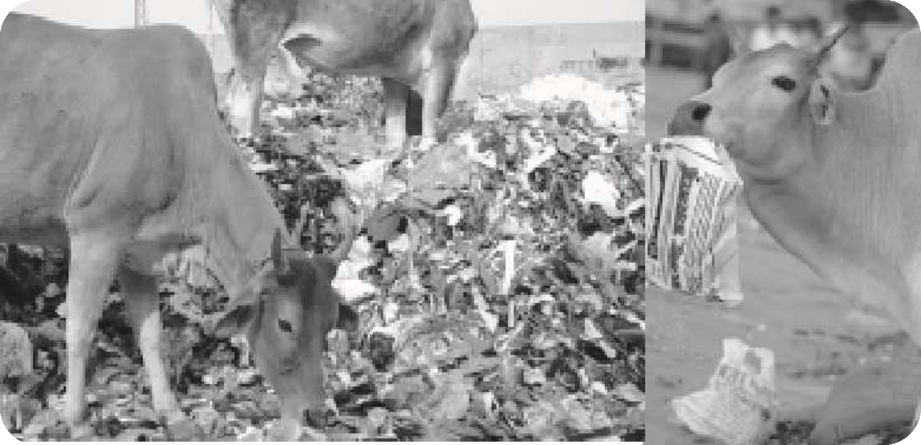

A pile of plastic bags along with leftovers- a cow
eating them
33
ENVIRONMENTAL POLLUTION

Slide 34
Sources of soil pollution
Plastic bags
They are made from low density polyethylene (LDPE), is virtually indestructible, create colossal environmental hazard.
Industrial sources
It includes fly ash, chemical residues, metallic and nuclear wastes. Large number of industrial chemicals, dyes, acids, etc. find their way into the soil and are known to create many health hazards including cancer.
Agricultural sources
Agricultural chemicals especially fertilizers and
peEsNVtIiRcOidNMeEsNTApLoPlOluLLtUeTIOtNhe soil.
Fertilizers in the run off water from these fields can
34

Slide 35
Control of soil pollution
Indiscriminate disposal of solid waste should be avoided.
To control soil pollution, it is essential to stop the use of plastic bags and instead use bags of degradable materials like paper and cloth.
Sewage should be treated properly before using as fertilizer and as landfills.
The organic matter from domestic, agricultural and other waste should be segregated and subjected to vermicomposting which generates useful manure as a by product.
35⚫
ThENeVIiRnOdNMuEsNtTrAiLaPlOLwLUaTsIOtNes prior to disposal should be properly treated for removing hazardous materials.

Slide 36
RADIATION POLLUTION
Radiation pollution is the increase in over the natural background radiation.
There are many sources of radiation pollution such as nuclear wastes from nuclear power plants, mining and processing of nuclear material etc.
The worse case of nuclear pollution was the Chernobyl disaster in Russia occurred in 1986 but
th_{EN}e_{VIR}e_{O}f_{N}fe_{ME}c_{N}t_{T}s_{AL}s_{P}t_{O}i_{L}ll_{LU}l_{T}o_{IO}n_{N}ger today.
36

Slide 37
doses
A traditional unit of human-equivalent dose is the rem, which stands for radiation equivalent in man.
At low doses, such as what we receive every day from background radiation (< 1 m rem), the cells repair the damage rapidly.
At higher doses (up to 100 rem), the cells might not be able to repair the damage, and the cells may either be changed permanently or die.
Cells changed permanently may go on to produce abnormal cells when they divide and may become cancerous.
At even higher doses, the cells cannot be replaced fa_{E}s_{NV}t_{IR}e_{O}n_{N}o_{ME}u_{N}g_{TA}h_{L P}a_{OL}n_{L}d_{UTI}t_{O}i_{N}ssues fail to function.
An example of this would be “radiation sickness.”
37

Slide 38
This is a condition that results after high doses is given to the whole body (>100 rem).
Nuclear explosions and accidents in nuclear reactors are a serious source of radiation hazard.
The effects of atomic explosions in Nagasaki and Hiroshima are still not forgotten.
The nuclear reactor accident at Chernobyl in 1986 led to deaths of many reactor personnel and a very large release of radionuclide to the environment causing a long term radiation damage to the people living in the
38
ENVIRONMENTAL POLLUTION
neighboring regions.

Slide 39


39
ENVIRONMENTAL POLLUTION

