Slide 1
Design of machine Elements– I; BTME 3501
Course Name: B.Tech (Mechanical Engineering) Semester: 5th
Prepared by: Er. Gaurav Bansal
education for life www.rimt.ac.in
Department of Mechanical Engineering

Slide 2
Topic Discussed
Machine Design
Types of Design
Design Procedure
Types of Load
Selection of material
Mechanical Properties of materials
education for life www.rimt.ac.in
Department of Mechanical Engineering

Slide 3
Machine Design
Machine design or engineering design, is the process of designing effective parts or components for machinery. It is the study how mechanical components operate in various situations in order to create a reliable system
The Machine Design helps to understand the designing fundamentals of the most essential and commonly utilized components, elements, parts, and units of several machines.
education for life www.rimt.ac.in
Department of Mechanical Engineering

Slide 4
Types of Design
1. Adaptive design. In most cases, the designer’s work is concerned with adaptation of existing designs. This type of design needs no special knowledge or skill and can be attempted by designers of ordinary technical training. The designer only makes minor alternation or modification in the existing designs of the product.
2. Development design. This type of design needs considerable scientific training and design ability in order to modify the existing designs into a new idea by adopting a new material or different method of manufacture. In this case, though the designer starts from the existing design, but the final product may differ quite markedly from the original product.
3. New design. This type of design needs lot of research, technical ability and creative thinking. Only those designers who have personal qualities of a sufficiently high order can take up the work of a new design.
education for life www.rimt.ac.in
Department of Mechanical Engineering

Slide 5
The designs, depending upon the methods used, may be classified as follows :
(a) Rational design. This type of design depends upon mathematical formulae of principle of mechanics.
(b) Empirical design. This type of design depends upon empirical formulae based on the practice and past experience.
(c) Industrial design. This type of design depends upon the production aspects to manufacture any machine component in the industry.
(d) Optimum design. It is the best design for the given objective function under the specified constraints. It may be achieved by minimizing the undesirable effects.
(e) System design. It is the design of any complex mechanical system like a motor car.
(f) Element design. It is the design of any element of the mechanical system like piston, crankshaft, connecting rod, etc.
(g) Computer aided design. This type of design depends upon the use of computer systems to assist in the creation, modification, analysis and optimization of a design

Slide 6
Design procedure
Recognition of need. First of all, make a complete statement of the problem, indicating the need, aim or purpose for which the machine is to be designed.
Synthesis (Mechanisms). Select the possible mechanism or group of mechanisms which will give the desired motion.
Analysis of forces. Find the forces acting on each member of the machine and the energy transmitted by each member.
Material selection. Select the material best suited for each member of the machine.
education for life www.rimt.ac.in
Department of Mechanical Engineering

Slide 7
5) Design of elements (Size and Stresses). Find the size of each member of the machine by considering the force acting on the member and the permissible stresses for the material used. It should be kept in mind that each member should not deflect or deform than the permissible limit.
6) Modification. Modify the size of the member to agree with the past experience and judgment to facilitate manufacture. The modification may also be necessary by consideration of manufacturing to reduce overall cost.
7) Detailed drawing. Draw the detailed drawing of each component and the assembly of the machine with complete specification for the manufacturing processes suggested.
8) Production. The component, as per the drawing, is manufactured in the workshop
education for life www.rimt.ac.in
Department of Mechanical Engineering

Slide 8
Types of Load
education for life www.rimt.ac.in
Department of Mechanical Engineering

Slide 9
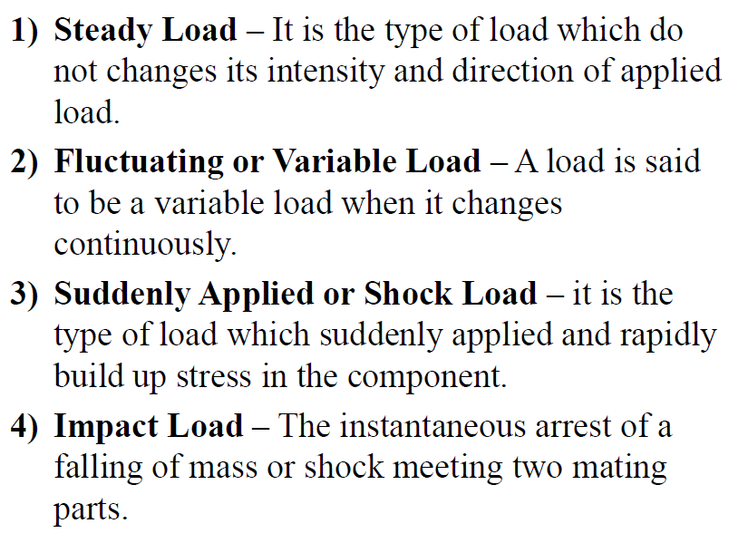
education for life www.rimt.ac.in
Department of Mechanical Engineering

Slide 10
Standardization
Engineering materials have various compositions, types, Applications, properties. Every material has its different mechanical properties, The Bureau of Indian Standards ( BIS ). have standardized the designation method for steel and other material. These standards are mainly followed by Indian industries, other countries may be using ASME standard.
education for life www.rimt.ac.in
Department of Mechanical Engineering

Slide 11
Steel
It is an alloy of iron and carbon, with carbon content up to a maximum of 1.5%. Other elements e.g. silicon, sulfur, phosphorus, and manganese are also present to a greater or lesser amount to impart certain desired properties to it. Most of the steel produced nowadays is plain carbon steel or simply carbon steel.
Carbon steel is defined as a steel which has its properties mainly due to its carbon content and does not contain more than 0.5% of silicon and 1.5% of manganese.
The plain carbon steels varying from 0.06% carbon to 1.5% carbon are divided into the following types depending upon the carbon content.
1. Dead mild steel — up to 0.15% carbon 2. Low carbon or mild steel — 0.15% to 0.45% carbon 3. Medium carbon steel — 0.45% to 0.8% carbon 4. High carbon steel — 0.8% to 1.5% carbon
education for life www.rimt.ac.in
Department of Mechanical Engineering

Slide 12
Steels are designated by a group of letters or numbers indicating any one of the following three properties. 1. tensile strength; 2. carbon content; and 3. composition of alloying elements.
Steel, which are standardized based on their tensile strength without detailed chemical composition, are specified in two ways- a symbol Fe followed by the minimum tensile strength. Another method is FeE steel followed by the yield strength.
For examples: Fe350 – This indicates a steel with a tensile strength of 250 newtons per mm square. FeE 250- yield strength of 250 N/mm2.
education for life www.rimt.ac.in
Department of Mechanical Engineering

Slide 13
Designation of Plain Carbon Steels
This consist following three quantities: 1. figure and indicating 100 times the average percentage of carbon. 2. a letter C 3. a figure indicating 10 times the average percentage of manganese.
Example: 55C4 indicates a plain carbon steel with 0.55% carbon and 0.4 % manganese.
education for life www.rimt.ac.in
Department of Mechanical Engineering

Slide 14
Selection of Material
Material selection is a step in the process of designing any physical object. In the context of product design, the main goal of material selection is to minimize cost while meeting product perform. Systematic selection of the best material for a given application begins with properties and costs of candidate materials. Material selection is often benefited by the use of material index or performance index relevant to the desired material properties.
For example, a thermal blanket must have poor thermal conductivity in order to minimize heat transfer for a given temperature difference. It is essential that a designer should have a thorough knowledge of the properties of the materials and their behavior under working conditions and goals.
education for life www.rimt.ac.in
Department of Mechanical Engineering

Slide 15
Mechanical properties of Material
The Mechanical Properties include
Elasticity,
Plasticity,
Ductility,
Malleability,
Hardness,
Toughness,
Brittleness
Fatigue,
Machineability,
Strength,
Resilience,
Proof Resilience,
Creep,
education for life www.rimt.ac.in
Department of Mechanical Engineering

Slide 16
1) Elasticity: Such property of material from which if we pull it and leave it, then it will come back in its shape again, it is called Elasticity. This property is useful for materials used in tools and machines. E.g. steel is more elastic than rubber.
Plasticity: Such a property of material from which if we pull but it cannot regain its original position when leaving it, then it is called plasticity. Eg: This property of the material is compulsory for forgings, in stamping images on coins and ornamental work.
Ductility: Such property of a material that we can pull and make it into long wire form, we call it Ductility. A ductile material needs to both strong and plastic. e.g. The ductile material used in mild steel, copper, aluminum, nickel, zinc, tin, and lead.
4) Malleability: If we beat any metal that causes it to spread and form into a sheet form, So we call this property Malleability. A malleable material needs to be plastic but it is not essential to be strong. E.g. Malleable material is used in engineering practice is lead, soft steel., wrought iron, copper, and aluminum.
education for life www.rimt.ac.in
Department of Mechanical Engineering

Slide 17
5) Hardness: Suppose there is a metal and we have to scratch it, The harder the scratch is, the harder our material will be considered. Suppose we have a material called iron and on the other side is silver aluminum So if we impact on both, the highest impact will be on aluminum because it is a weak metal and its hardness is less.
6) Toughness: Material that if we bend or twist, how much energy can absorb before it breaks is called Toughness. The toughness of the material has been decreased when it is heated. So Toughness is properties that provide information about the capacity to absorb maximum energy. In this, we suddenly impact and check how much energy is absorbed at that time.
7) Brittleness: If we pull such a material, it breaks instead of pulling it, we call it Brittleness. e.g. Cast iron is a brittle material.
education for life www.rimt.ac.in
Department of Mechanical Engineering

Slide 18
8) Fatigue: When a material loads more than a specific load, then there is a chance of failure But in fatigue, Any material fails even at low load if we apply a repetitive load. This failure is known as fatigue.Fatigue value is many times less than that stress, in which a material has to fail in actual. The factor of fatigue on materials: Less strength, life, and Durability. E.g. Fatigue property is used for observing In designing shafts, connecting rod, springs, gears, etc.
9) Machine ability: Such a material that is easy to work on, such as cutting, using a tool, and machining, we call it mach inability. E.g. Brass can be easily machined than steel.
10) Strength: If we put a load on metal, it is without changing its shape or if it is able to bear it without breaking it then it is called its strength. So the ability or capacity of a material to withstand or support a load without fracture is called its strength.
11) Resilience: Such material in which the strain energy is stored in the body till the elastic limit only, is called as the resilience. so it is the property of a material to absorb energy and to resist shock and impact loads. This property is essential for spring materials.
12) Proof Resilience: How much maximum strain energy stored in material up to the elastic limit is called proof resilience.
13) Creep: When we put the material under constant load, for a long time, at high temperature, then the deformation that happens inside it, is called Creep. Creep is used for examine in designing internal combustion engines, boilers, and turbines.
education for life www.rimt.ac.in
Department of Mechanical Engineering

Slide 19
Summary
This unit deals with the basic concept of design and understanding of various types of design, design process, general design considerations, concept of tearing, bearing and shearing. It also focuses on Designation of materials according to Indian standards code, basic criteria of selection of material and various mechanical properties of materials that are considered while selecting any material.
education for life www.rimt.ac.in
Department of Mechanical Engineering

Slide 20
Topics Discussed in Next Lecture
Concurrent engineering in design
Introduction to ‘Design for X’
Stress concentration
Factor of safety
Design for static and variable loading
Concept of fatigue and endurance strength
education for life www.rimt.ac.in
Department of Mechanical Engineering

