Slide 1
Refrigeration and Air conditioning(BTME-4702)
Course Name: RAC Semester: 7th
Prepared by: Dr. Sachin Saini
education for life www.rimt.ac.in
Department of Mechanical Engineering

Slide 2
Refrigeration Systems
Vapour compression refrigeration system
Vapour absorption refrigeration system
education for life www.rimt.ac.in
Department of MECHANICAL Engineering

Slide 3
Vapour Compression System
This is the most important system from the point of commercial & domestic utility & most practical form of refrigeration.
The working fluid refrigerant used in this refrigeration system readily evaporates & condenses or changes alternatively between the vapour & liquid phases without leaving the refrigerating plant.
During evaporation it absorbs heat from the cold body or in condensing or cooling it rejects heat to the external hot body .
The heat absorbed from cold body during evaporation is used as its latent heat for converting it from liquid to vapour.
Thus a cooling effect is created in working fluid.
education for life www.rimt.ac.in
Department of Mechanical Engineering

Slide 4
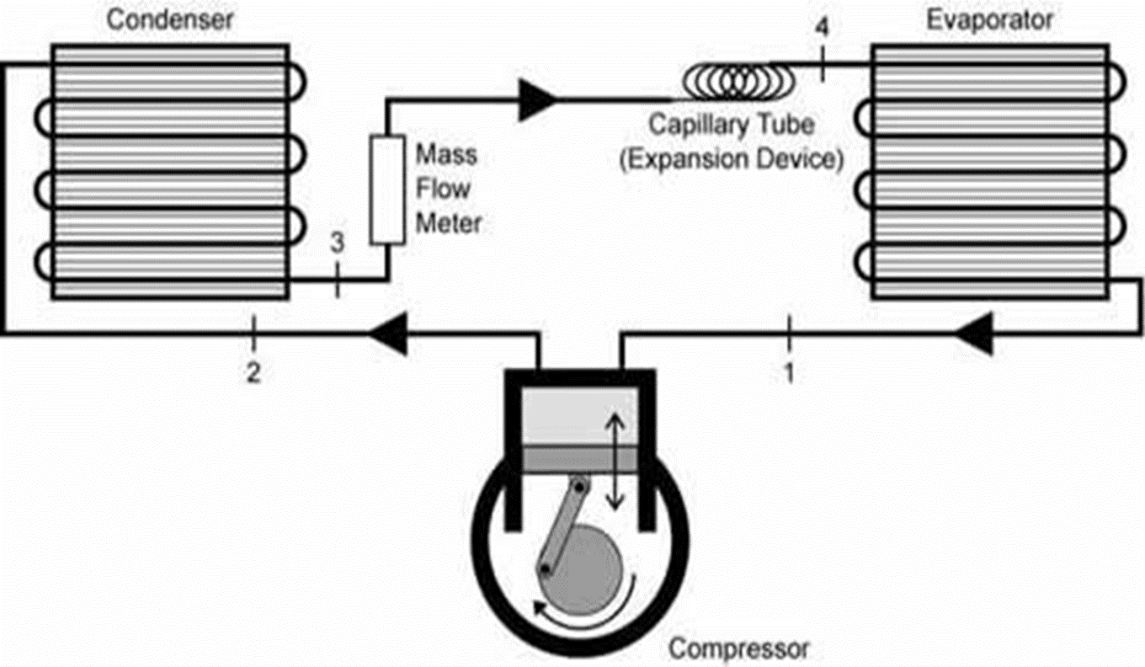
Vapour Compression System
education for life www.rimt.ac.in
Department of Mechanical Engineering

Slide 5
Vapour Compression System
education for life www.rimt.ac.in
Department of Mechanical Engineering

Slide 6
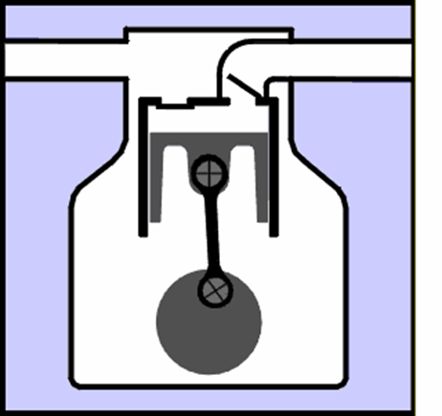
Vapour Compression System: Construction
This system consists of a compressor, condenser, a receiver tank, an expansion valve and an evaporator.
Compressor: Reciprocating compressors generally used. For very big plants centrifugal compressors directly coupled with high speed rotating engines (gas turbine) are used.
education for life www.rimt.ac.in
Department of Mechanical Engineering

Slide 7
Vapour Compression System
Condenser : It is a coil of tubes made of copper.
Receiver tank: It is the reservoir of liquid refrigerant.
Expansion Valve: This is a throttle valve. High pressure refrigerant is made to flow at a controlled rate through this valve.
Evaporator : It is the actual cooler and kept in the space to be cooled. The evaporator is a coil of tubes made of copper.
education for life www.rimt.ac.in
Department of MECHANICAL Engineering

Slide 8
Vapour Compression System: Working
Working :
The low pressure refrigerant vapour coming out of the
evaporator flows into the compressor.
The compressor is driven by a prime mover.
In the compressor the refrigerant vapour is compressed.
The high pressure refrigerant vapour from the compressor is then passed through the condenser.
The refrigerant gives out the heat it had taken in the evaporator (N).
The Heat equivalent of work done on the compressor.
This heat is carried by condenser medium which may be air or water.
The high pressure liquid refrigerant then enters the expansion valve.
This valve allows the high pressure liquid refrigerant to flow at a controlled rate into the evaporator.
While passing through this valve the liquid partially evaporates.
Most of the refrigerant is vapourised only in the evaporator, at a low pressure.
In the evaporator the liquid refrigerant absorbs its latent heat of vaporization from the material which is to be cooled.
Thus the refrigerating effect (N) is obtained.
Then the low pressure refrigerant enters the compressor and the cycle is repeated.
education for life www.rimt.ac.in
Department of MECHANICAL Engineering

Slide 9
Advantages
Smaller size for a given refrigerating capacity
Higher coeff. of performance
Lower power requirements for a given capacity
Less complexity in both design & operation
It can be used over large of temp.
It represents a significant portion of the refrigeration industry due to the use of these units in large number.
For domestic preservation, the storage is generally short term. The domestic refrigerators used for the purposes are usually small in sizes with rating in ranges from 1/20 to ½ tonne.
The unit is usually self contained and hermetically sealed.
Due to short term storage the domestic refrigerator load is intermittent
education for life www.rimt.ac.in
Department of MECHANICAL Engineering

Slide 10
COP
education for life www.rimt.ac.in
Department of MECHANICAL Engineering

Slide 11
Features of Actual Vapor-Compression Cycle
education for life www.rimt.ac.in
Department of Mechanical Engineering

Slide 12
Features of Vapour Compression Cycle
education for life www.rimt.ac.in
Department of Mechanical Engineering

Slide 13
Features of Vapour Compression Cycle
education for life www.rimt.ac.in
Department of Mechanical Engineering

Slide 14
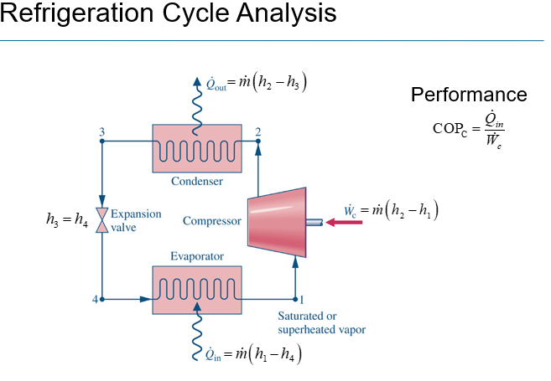
Vapour Compression Cycle analysis
education for life www.rimt.ac.in
Department of Mechanical Engineering

Slide 15
Ideal Vapour Compression Cycle
education for life www.rimt.ac.in
Department of Mechanical Engineering

Slide 16
Vapour Compression Cycle
education for life www.rimt.ac.in
Department of Mechanical Engineering

Slide 17
Features of Vapour Compression Cycle
education for life www.rimt.ac.in
Department of Mechanical Engineering

Slide 18
Practical Vapour Compression Cycle
education for life www.rimt.ac.in
Department of Mechanical Engineering

Slide 19
Summary
In this chapter, the focus is on Vapour compression cycle which thrusts upon its application in daily lives.
education for life www.rimt.ac.in
Department of Mechanical Engineering

Slide 20
Topics to be Discussed in Next Lecture
Vapour Absorption cycle
Refrigerant and its various types
Applications of refrigerant in various fields
education for life www.rimt.ac.in
Department of Mechanical Engineering

