Slide 1
COMMUNICATIVE ENGLISH / BENG-1101
Course Name: B.Tech (Common to all branches) Semester: First
Prepared by: AMIT MOHAN
Head & Assistant Professor
education for life www.rimt.ac.in
Department of English

Slide 2
Topic Discussed
Communication Skills
Introduction, Meaning & Definition
Process of Communication
education for life www.rimt.ac.in
Department of English

Slide 3
INTRODUCTION
Communication is the name we give to countless ways the human beings, birds, animals, and other creatures come across : the singing and chirping of birds; every music and sound that resonates our ears; every word, picture, posture and body movement that catches our eyes; etc. ​
Communication is not limited to human beings only, but extends beyond it as well. Birds and animals communicate, plants co-communicate; In short, every living being communicates in its own language style. No one can live without communication.
Everyone conveys information, thoughts, ideas, feelings, emotions etc. - whether they are conscious about it or not.
education for life www.rimt.ac.in
Department of English

Slide 4
MEANING
English word ‘Communication’ has been derived from the Latin word - ‘communis’ or ‘communicare’ ; which means ‘to share’, ‘to impart’ ‘to convey’ or ‘to transmit’.​
Communication is an exchange of facts, ideas, opinions, or emotions by two or more persons.​
It is a two-way process. ​
It can be Verbal and Non-verbal. It is a language of signs & gestures.
education for life www.rimt.ac.in
Department of English

Slide 5
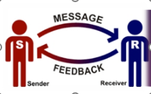
DEFINITIONS
“Communication is the process of meaningful interaction among human beings…” - McFarland​
Communication is the process by which information is transmitted between individuals & organizations…”
- Peter Little ​
Communication is a process of transmitting ideas or thoughts from one person to another for the purpose of creating understanding.” - Brown
education for life www.rimt.ac.in
Department of English

Slide 6
PROCESS OF COMMUNICATION
education for life www.rimt.ac.in
Department of English

Slide 7
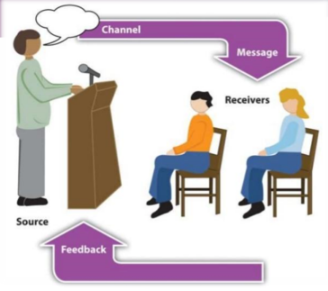
Elements / Components of Communication Process
Message​
Sender ​
Encoding ​
Medium / Channel ​
Receiver ​
Decoding ​
Feedback
education for life www.rimt.ac.in
Department of English

Slide 8
PROCESS
education for life www.rimt.ac.in
Department of English

Slide 9
CONCLUSION
In short, Being an effective communicator means that you correctly interpret the received message and respond appropriately.
Communication is the exchange of information and ideas, whether written or verbal.
It is a two-way process.
Effective communication skills are about conveying your message to others clearly.
Communication is an important skill for successful businesses and for building relationships by influencing interactions either positively or negatively.
Effective communication engages the choice and use of an effective communication channel and presentation of information to the target audience.
education for life www.rimt.ac.in
Department of English

Slide 10
Topics Discussed in Next Lecture
Communication
Objectives of Communication
Types of Communication
education for life www.rimt.ac.in
Department of English

