Slide 1
Mathematics-III (BTCS-2302)
Course Name: Sachin Syan Semester: 3rd
Prepared by: Sachin Syan
education for life www.rimt.ac.in
Department of Computer Science & Engineering

Slide 2
Topic Discussed
Gauss Elimination Method
Partial Pivoting
Complete Pivoting
Gauss Jordan Method
education for life www.rimt.ac.in
Department of Computer Science & Engineering

Slide 3
Gauss Elimination Method:
In this method, the unknowns are eliminated successively and the system is reduced to an upper triangular system from which the unknowns are found by back substitution. The method is quite general and is well-adapted for computer operations. Here we shall explain it by considering a system of three equations for the sake of clarity.
Consider the equations
education for life www.rimt.ac.in
Department of Computer Science & Engineering

Slide 4
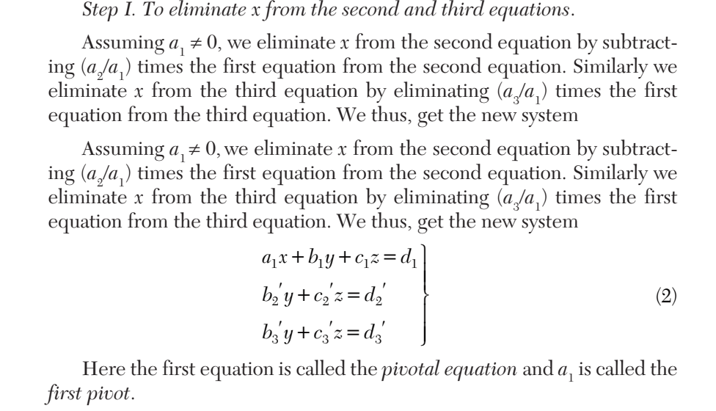
Gauss Elimination Method
education for life www.rimt.ac.in
Department of Computer Science & Engineering

Slide 5
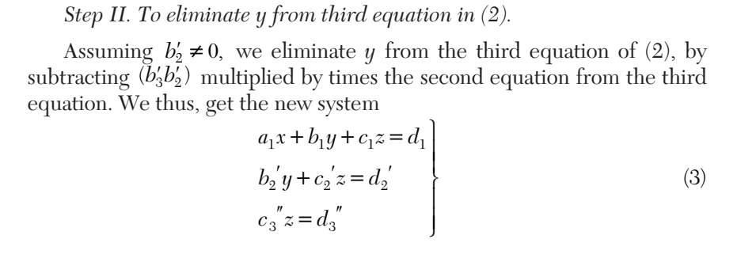
Gauss Elimination Method
education for life www.rimt.ac.in
Department of Computer Science & Engineering

Slide 6
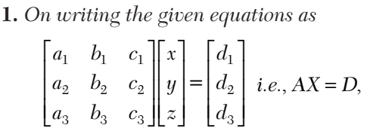
Gauss Elimination Method
education for life www.rimt.ac.in
Department of Computer Science & Engineering

Slide 7
Gauss Elimination Method
Partial pivoting: In the first step, the numerically largest coefficient of x is chosen from all the equations and brought as the first pivot by interchanging the first equation with the equation having the largest coefficient of x. In the second step, the numerically largest coefficient of y is chosen from the remaining equations (leaving the first equation) and brought as the second pivot by interchanging the second equation with the equation having the largest coefficient of y. This process is continued until we arrive at the equation with the single variable. This modified procedure is called partial pivoting.
education for life www.rimt.ac.in
Department of Computer Science & Engineering

Slide 8
Gauss Elimination Method
Complete pivoting: If we are not keen about the elimination of x, y, z in a specified order, then we can choose at each stage the numerically largest coefficient of the entire matrix of coefficients. This requires not only an interchange of equations but also an interchange of the position of the variables
education for life www.rimt.ac.in
Department of Computer Science & Engineering

Slide 9
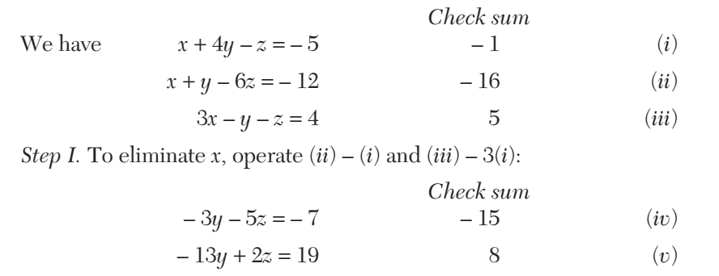
Gauss Elimination Method
education for life www.rimt.ac.in
Department of Computer Science & Engineering

Slide 10
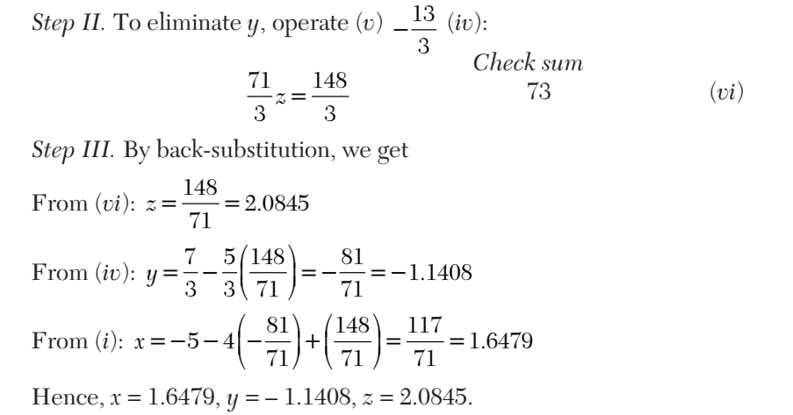
Gauss Elimination Method
education for life www.rimt.ac.in
Department of Computer Science & Engineering

Slide 11
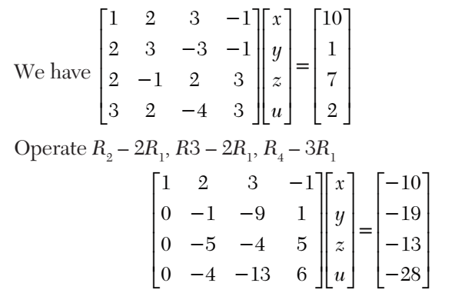
Gauss Elimination Method
education for life www.rimt.ac.in
Department of Computer Science & Engineering

Slide 12
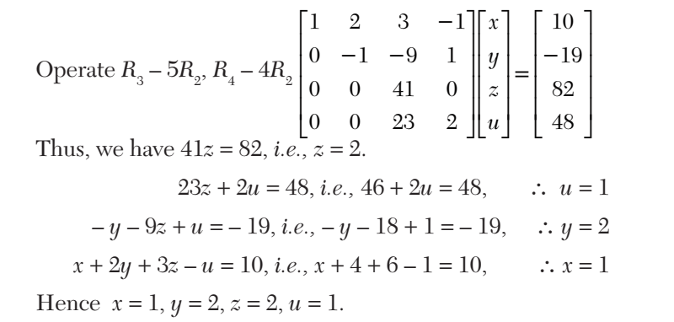
Gauss Elimination Method
education for life www.rimt.ac.in
Department of Computer Science & Engineering

Slide 13
Gauss-Jordan method: This is a modification of the Gauss elimination method. In this method, elimination of unknowns is performed not in the equations below but in the equations above also, ultimately reducing the system to a diagonal matrix form, i.e., each equation involving only one unknown. From these equations, the unknowns x, y, z can be obtained readily. Thus in this method, the labor of back-substitution for finding the un-knowns is saved at the cost of additional calculations.
education for life www.rimt.ac.in
Department of Computer Science & Engineering

Slide 14
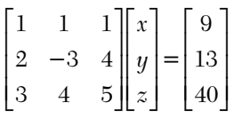
Gauss Jordan Method
education for life www.rimt.ac.in
Department of Computer Science & Engineering

Slide 15
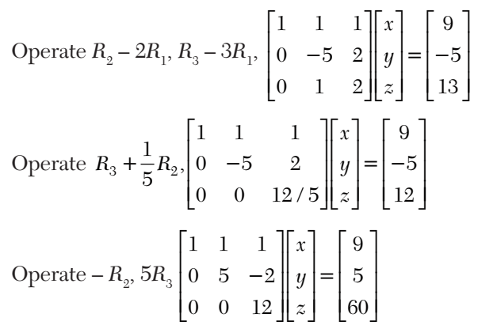
Gauss Jordan Method
education for life www.rimt.ac.in
Department of Computer Science & Engineering

Slide 16
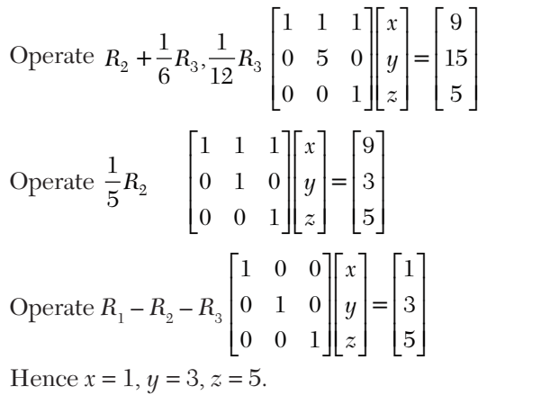
Gauss Jordan Method
education for life www.rimt.ac.in
Department of Computer Science & Engineering

Slide 17
Topics Discussed in Next Lecture
Gauss- Seidel iteration method
Rayleigh’s Power method for Eigen values and Eigenvectors.
education for life www.rimt.ac.in
Department of Computer Science & Engineering

