Slide 1
Non Traditional Machining (BTME-4712)
Course Name: B.Tech ME Semester: 7th
Prepared by: Er. Amrinder Singh Pannu
education for life www.rimt.ac.in
Department of Mechanical Engineering

Slide 3
Unit-IV
education for life www.rimt.ac.in
Department of Mechanical Engineering

Slide 4
Unit-IV
education for life www.rimt.ac.in
Department of Mechanical Engineering

Slide 5
Unit-IV
education for life www.rimt.ac.in
Department of Mechanical Engineering

Slide 6
Unit-IV
education for life www.rimt.ac.in
Department of Mechanical Engineering

Slide 7
Unit-IV
education for life www.rimt.ac.in
Department of Mechanical Engineering

Slide 8
Unit-IV
education for life www.rimt.ac.in
Department of Mechanical Engineering

Slide 9
Unit-IV
education for life www.rimt.ac.in
Department of Mechanical Engineering

Slide 10
Unit-IV
education for life www.rimt.ac.in
Department of Mechanical Engineering

Slide 11
Unit-IV
education for life www.rimt.ac.in
Department of Mechanical Engineering

Slide 12
Unit-IV
education for life www.rimt.ac.in
Department of Mechanical Engineering

Slide 13
Unit-IV
education for life www.rimt.ac.in
Department of Mechanical Engineering

Slide 14
Unit-IV
education for life www.rimt.ac.in
Department of Mechanical Engineering

Slide 15
Unit-IV
education for life www.rimt.ac.in
Department of Mechanical Engineering

Slide 16
Unit-IV
education for life www.rimt.ac.in
Department of Mechanical Engineering

Slide 17
Unit-IV
education for life www.rimt.ac.in
Department of Mechanical Engineering

Slide 18
Unit-IV
education for life www.rimt.ac.in
Department of Mechanical Engineering

Slide 19
Unit-IV
education for life www.rimt.ac.in
Department of Mechanical Engineering

Slide 20
Unit-IV
education for life www.rimt.ac.in
Department of Mechanical Engineering

Slide 21
Unit-IV
education for life www.rimt.ac.in
Department of Mechanical Engineering

Slide 22
Unit-IV
education for life www.rimt.ac.in
Department of Mechanical Engineering

Slide 23
Unit-IV
education for life www.rimt.ac.in
Department of Mechanical Engineering

Slide 24
Unit-IV
education for life www.rimt.ac.in
Department of Mechanical Engineering

Slide 25
Unit-IV
education for life www.rimt.ac.in
Department of Mechanical Engineering

Slide 26
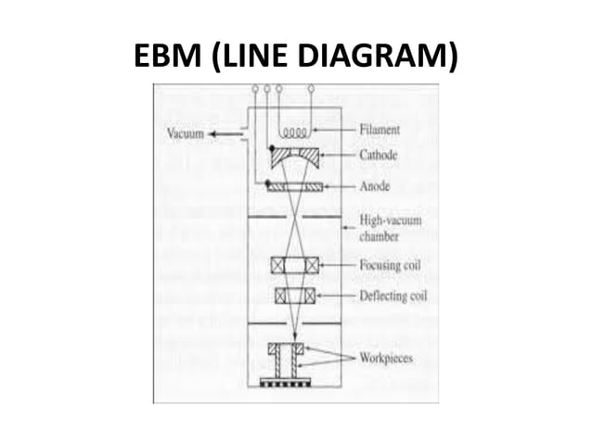
Unit-IV
education for life www.rimt.ac.in
Department of Mechanical Engineering

Slide 27
Unit-IV
education for life www.rimt.ac.in
Department of Mechanical Engineering

Slide 28
Unit-IV
education for life www.rimt.ac.in
Department of Mechanical Engineering

Slide 29
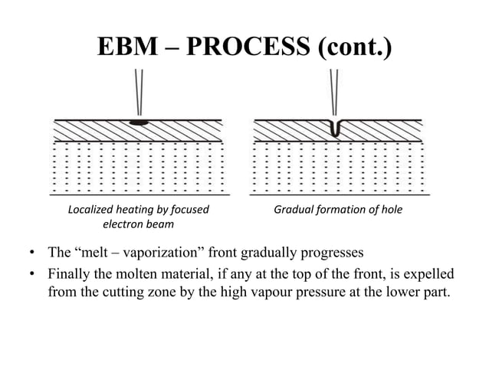
Unit-IV
education for life www.rimt.ac.in
Department of Mechanical Engineering

Slide 30
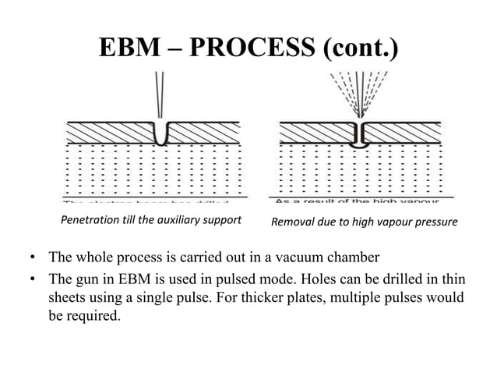
Unit-IV
education for life www.rimt.ac.in
Department of Mechanical Engineering

Slide 31
Unit-IV
education for life www.rimt.ac.in
Department of Mechanical Engineering

Slide 32
Unit-IV
education for life www.rimt.ac.in
Department of Mechanical Engineering

Slide 33
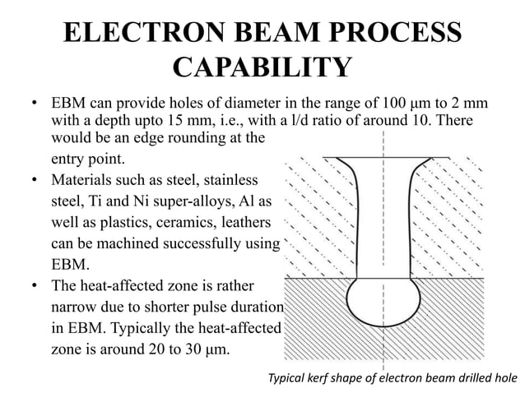
Unit-IV
education for life www.rimt.ac.in
Department of Mechanical Engineering

Slide 34
Unit-IV
education for life www.rimt.ac.in
Department of Mechanical Engineering

Slide 35
Unit-IV
education for life www.rimt.ac.in
Department of Mechanical Engineering

Slide 36
Unit-IV
education for life www.rimt.ac.in
Department of Mechanical Engineering

