Slide 1
Non Traditional Machining (BTME-4712)
Course Name: B.Tech ME Semester: 7th
Prepared by: Er. Amrinder Singh Pannu
education for life www.rimt.ac.in
Department of Mechanical Engineering

Slide 2
Unit-I
education for life www.rimt.ac.in
Department of Mechanical Engineering

Slide 3
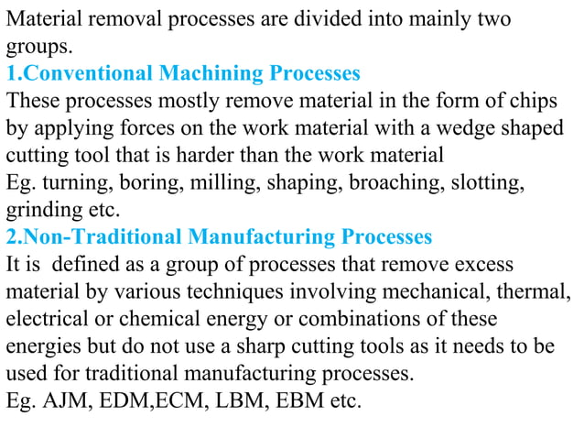
Unit-I
education for life www.rimt.ac.in
Department of Mechanical Engineering

Slide 4
Unit-I
education for life www.rimt.ac.in
Department of Mechanical Engineering

Slide 5
Unit-I
education for life www.rimt.ac.in
Department of Mechanical Engineering

Slide 6
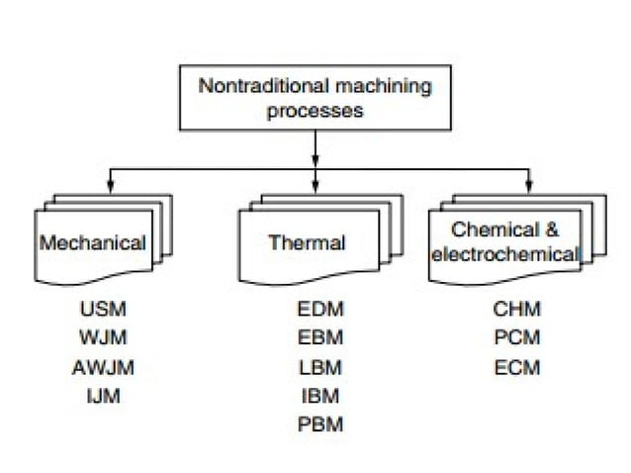
Unit-I
education for life www.rimt.ac.in
Department of Mechanical Engineering

Slide 7
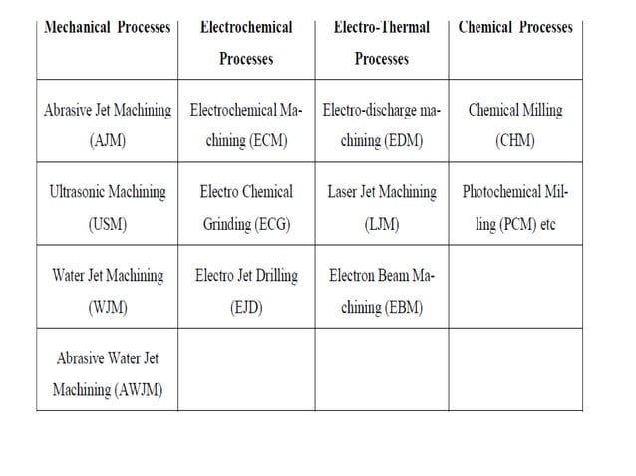
Unit-I
education for life www.rimt.ac.in
Department of Mechanical Engineering

Slide 8
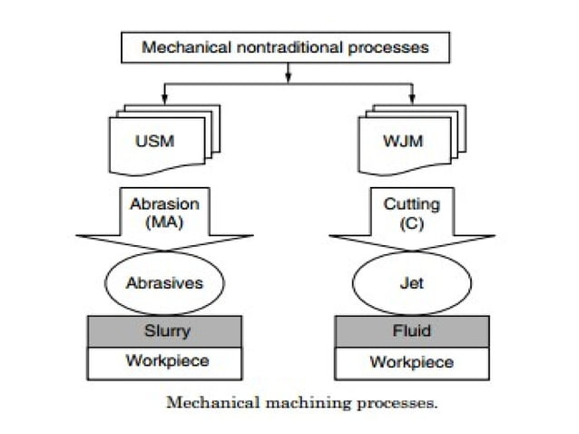
Unit-I
education for life www.rimt.ac.in
Department of Mechanical Engineering

Slide 9
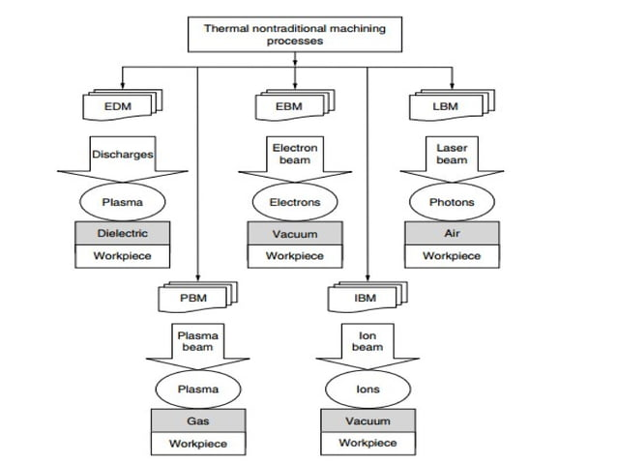
Unit-I
education for life www.rimt.ac.in
Department of Mechanical Engineering

Slide 10
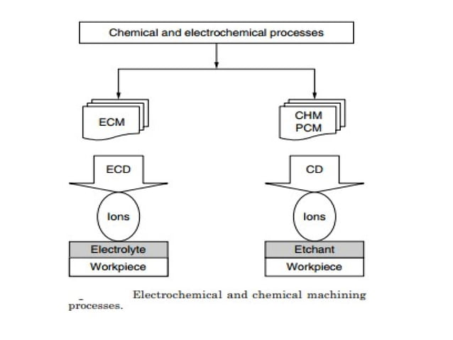
Unit-I
education for life www.rimt.ac.in
Department of Mechanical Engineering

Slide 11
Unit-I
education for life www.rimt.ac.in
Department of Mechanical Engineering

Slide 12
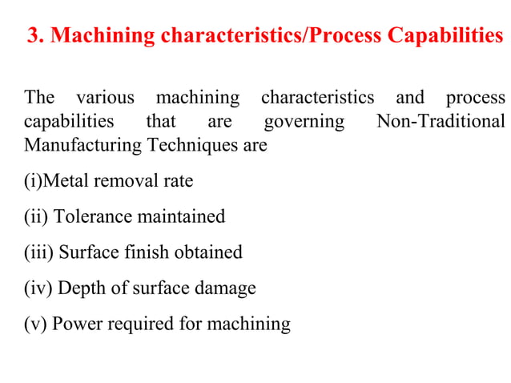
Unit-I
education for life www.rimt.ac.in
Department of Mechanical Engineering

Slide 13
Unit-I
education for life www.rimt.ac.in
Department of Mechanical Engineering

Slide 14
Unit-I
education for life www.rimt.ac.in
Department of Mechanical Engineering

