Slide 1
Manufacturing Processes-I (BMEC-2305)
Course Name: B.Tech ME Semester: 3rd
Prepared by: Er. Amrinder Singh Pannu
education for life www.rimt.ac.in
Department of Mechanical Engineering

Slide 2
Unit-III
education for life www.rimt.ac.in
Department of MechanicalEngineering

Slide 3
Unit-III
education for life www.rimt.ac.in
Department of Mechanical Engineering

Slide 4
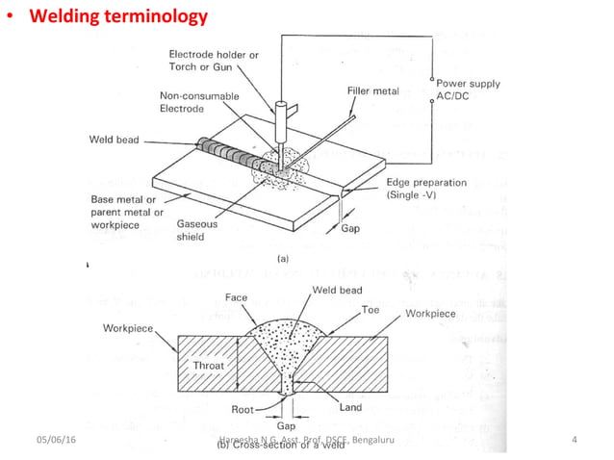
Unit-III
education for life www.rimt.ac.in
Department of MechanicalEngineering

Slide 5
Unit-III
education for life www.rimt.ac.in
Department of MechanicalEngineering

Slide 6
Unit-III
education for life www.rimt.ac.in
Department of MechanicalEngineering

Slide 7
Unit-III
education for life www.rimt.ac.in
Department of MechanicalEngineering

Slide 8
Unit-III
education for life www.rimt.ac.in
Department of Mechanical Engineering

Slide 9
Unit-III
education for life www.rimt.ac.in
Department of Mechanical Engineering

Slide 10
Unit-III
education for life www.rimt.ac.in
Department of Mechanical Engineering

Slide 11
Unit-III
education for life www.rimt.ac.in
Department of Mechanical Engineering

Slide 12
Unit-III
education for life www.rimt.ac.in
Department of Mechanical Engineering

Slide 13
Unit-III
education for life www.rimt.ac.in
Department of Mechanical Engineering

Slide 14
Unit-III
education for life www.rimt.ac.in
Department of Mechanical Engineering

Slide 15
Unit-III
education for life www.rimt.ac.in
Department of Mechanical Engineering

Slide 16
Unit-III
education for life www.rimt.ac.in
Department of Mechanical Engineering

Slide 17
Unit-III
education for life www.rimt.ac.in
Department of Mechanical Engineering

Slide 18
Unit-III
education for life www.rimt.ac.in
Department of Mechanical Engineering

