Slide 1
Manufacturing Processes-I (BMEC-2305)
Course Name: B.Tech ME Semester: 3rd
Prepared by: Er. Amrinder Singh Pannu
education for life www.rimt.ac.in
Department of Mechanical Engineering

Slide 2
Unit-II
education for life www.rimt.ac.in
education for life www.rimt.ac.in
Department of Mechanical Engineering

Slide 3
Unit-II
education for life www.rimt.ac.in
Department of Mechanical Engineering

Slide 4
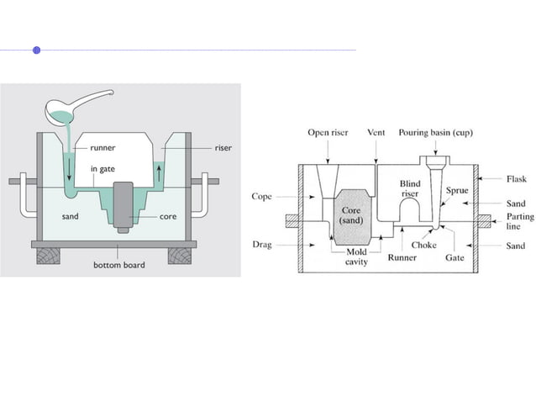
Unit-II
education for life www.rimt.ac.in
Department of Mechanical Engineering

Slide 5
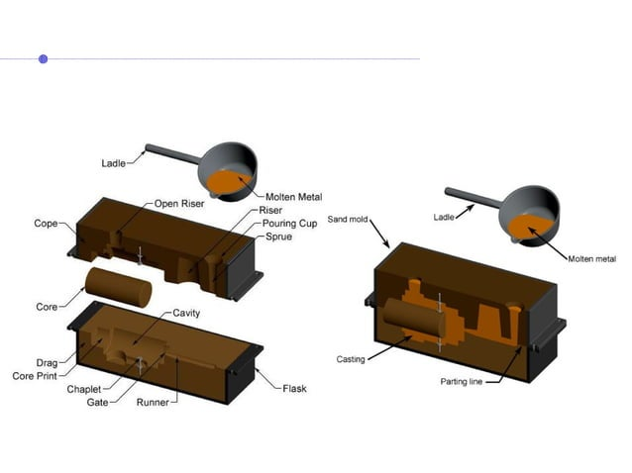
Unit-II
education for life www.rimt.ac.in
Department of Mechanical Engineering

Slide 6
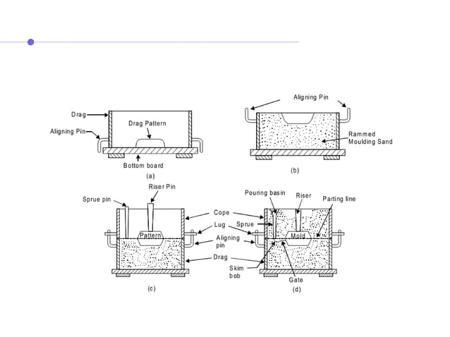
Unit-II
education for life www.rimt.ac.in
Department of Mechanical Engineering

Slide 7
Unit-II
education for life www.rimt.ac.in
Department of Mechanical Engineering

Slide 8
Unit-II
education for life www.rimt.ac.in
Department of Mechanical Engineering

Slide 9
Unit-II
education for life www.rimt.ac.in
Department of Mechanical Engineering

Slide 10
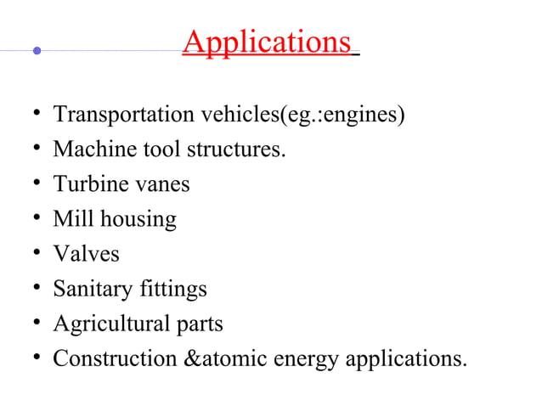
Unit-II
education for life www.rimt.ac.in
Department of Mechanical Engineering

Slide 11
Unit-II
education for life www.rimt.ac.in
Department of Mechanical Engineering

Slide 12
Unit-II
education for life www.rimt.ac.in
Department of Mechanical Engineering

Slide 13
Unit-II
education for life www.rimt.ac.in
Department of Mechanical Engineering

Slide 14
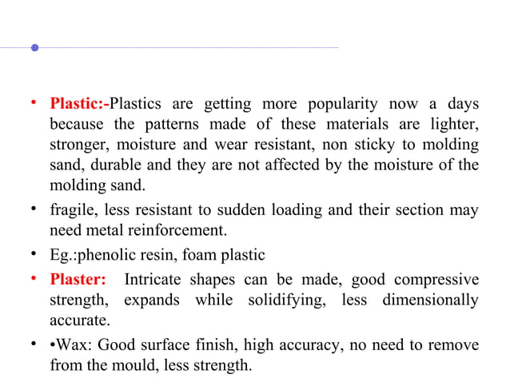
Unit-II
education for life www.rimt.ac.in
Department of Mechanical Engineering

Slide 15
Unit-II
education for life www.rimt.ac.in
Department of Mechanical Engineering

Slide 16
Unit-II
education for life www.rimt.ac.in
Department of Mechanical Engineering

Slide 17
Unit-II
education for life www.rimt.ac.in
Department of Mechanical Engineering

Slide 18
Unit-II
education for life www.rimt.ac.in
Department of Mechanical Engineering

Slide 19
Unit-II
education for life www.rimt.ac.in
Department of Mechanical Engineering

Slide 20
Unit-II
education for life www.rimt.ac.in
Department of Mechanical Engineering

Slide 21
Unit-II
education for life www.rimt.ac.in
Department of Mechanical Engineering

Slide 22
Unit-II
education for life www.rimt.ac.in
Department of Mechanical Engineering

Slide 23
Unit-II
education for life www.rimt.ac.in
Department of Mechanical Engineering

Slide 24
Unit-II
education for life www.rimt.ac.in
Department of Mechanical Engineering

Slide 25
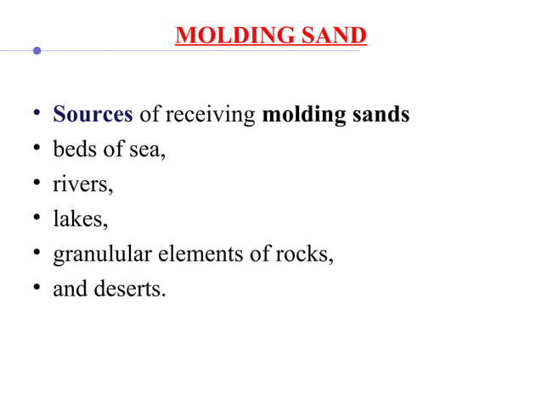
Unit-II
education for life www.rimt.ac.in
Department of Mechanical Engineering

Slide 26
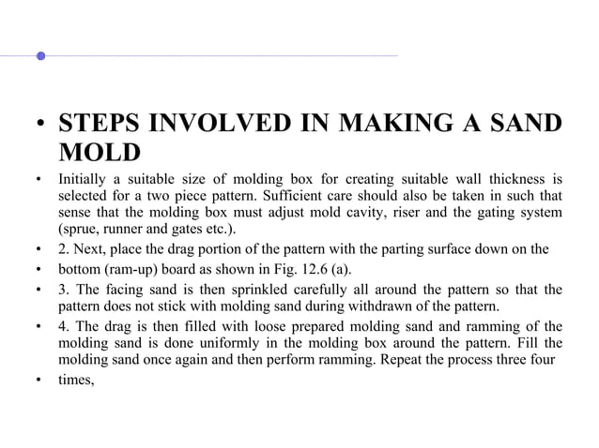
Unit-II
education for life www.rimt.ac.in
Department of Mechanical Engineering

Slide 27
Unit-II
education for life www.rimt.ac.in
Department of Mechanical Engineering

Slide 28
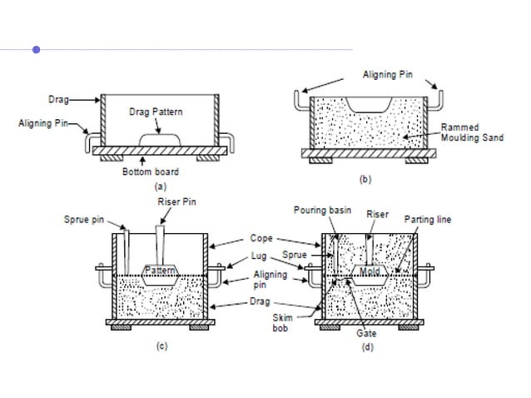
Unit-II
education for life www.rimt.ac.in
Department of Mechanical Engineering

Slide 29
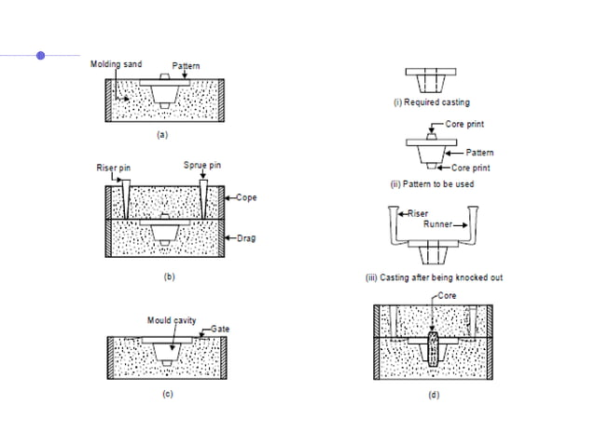
Unit-II
education for life www.rimt.ac.in
Department of Mechanical Engineering

Slide 30
Unit-II
education for life www.rimt.ac.in
Department of Mechanical Engineering

Slide 31
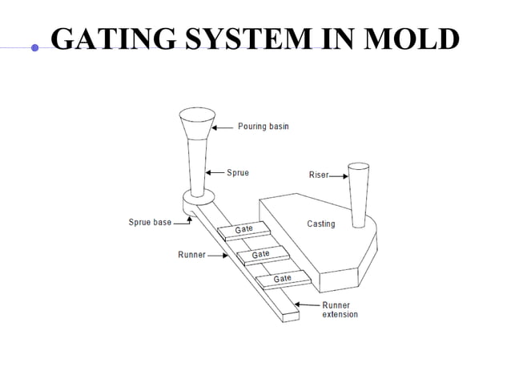
Unit-II
education for life www.rimt.ac.in
Department of Mechanical Engineering

Slide 32
Unit-II
education for life www.rimt.ac.in
Department of Mechanical Engineering

Slide 33
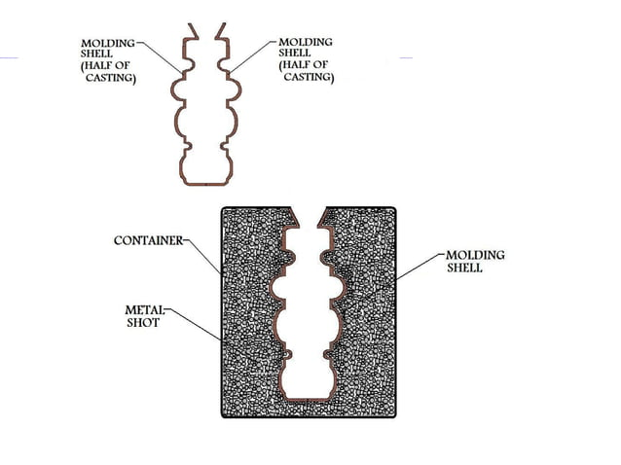
Unit-II
education for life www.rimt.ac.in
Department of Mechanical Engineering

Slide 34
Unit-II
education for life www.rimt.ac.in
Department of Mechanical Engineering

Slide 35
Unit-II
education for life www.rimt.ac.in
Department of Mechanical Engineering

Slide 36
Unit-II
education for life www.rimt.ac.in
Department of Mechanical Engineering

Slide 37
Unit-II
education for life www.rimt.ac.in
Department of Mechanical Engineering

Slide 38
Unit-II
education for life www.rimt.ac.in
Department of Mechanical Engineering

Slide 39
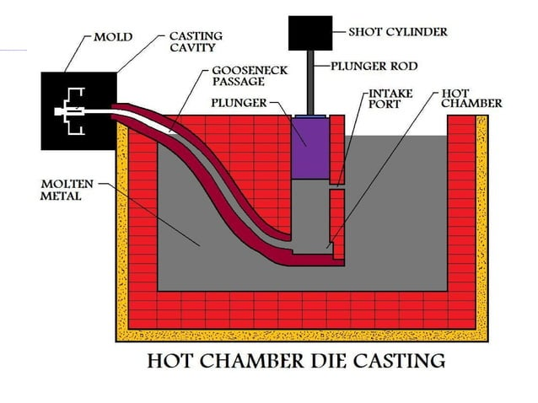
Unit-II
education for life www.rimt.ac.in
Department of Mechanical Engineering

Slide 40
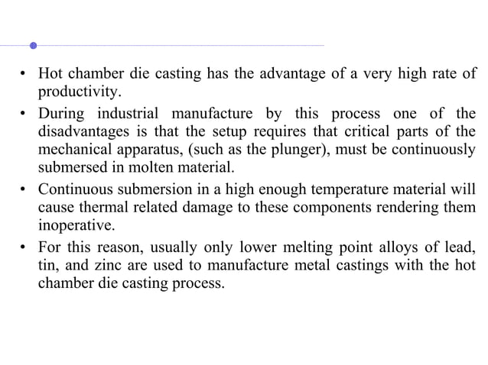
Unit-II
education for life www.rimt.ac.in
Department of Mechanical Engineering

Slide 41
Unit-II
education for life www.rimt.ac.in
Department of Mechanical Engineering

Slide 42
Unit-II
education for life www.rimt.ac.in
Department of Mechanical Engineering

Slide 43
Unit-II
education for life www.rimt.ac.in
Department of Mechanical Engineering

Slide 44
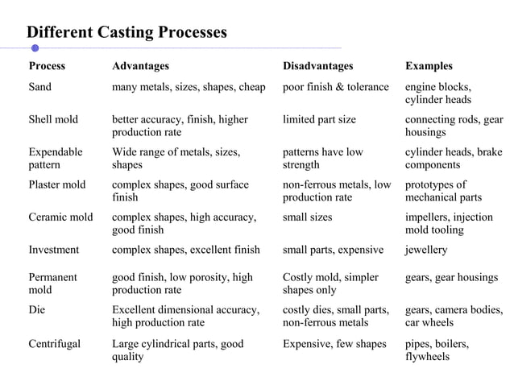
Unit-II
education for life www.rimt.ac.in
Department of Mechanical Engineering

