Slide 1
Types of magnetism
Magnetism
All matter
Diamagnetism
Arising out of atomic magnetic moments (spin +orbital)
Interacting
atomic moments
Non interacting
atomic moments
Ferromagnetism
Ferrimagnetism
Antiferromagnetism
Paramagnetism

Slide 2
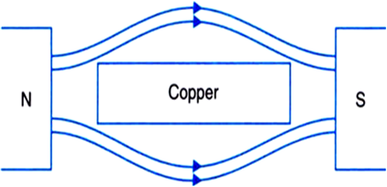
Diamagnetism
Repels the applied magnetic field.
Volume susceptibility χ_{m} is of order of -10⁻⁵.
e.g. Cu, Au, Ag, Hg, Si, Zn, Al₂O₃

Slide 3
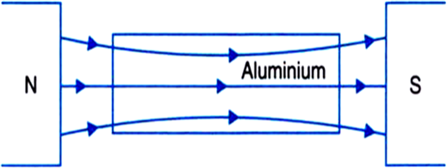
Paramagnetism
Weakly attracts the applied magnetic field.
χ_{m} is in the range from 10⁻⁵ to 10⁻².
e.g. Al, Cr, Na, Ti,Zr, Mo

Slide 4
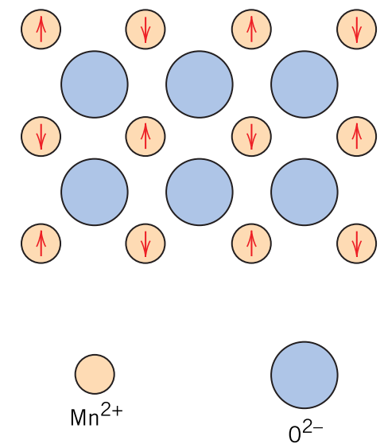
Antiferromagnetism
Magnetic moment coupling between adjacent atoms or ions results in an antiparallel alignment;
the alignment of the spin moments of neighboring atoms or ions in exactly opposite directions is termed ANTIFERROMAGNETISM.
e.g. Cr, MnO, FeO

Slide 5
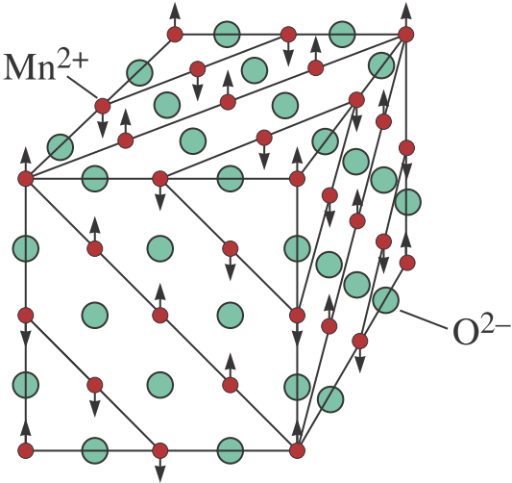
Antiferromagnetism
CASE STUDY: MnO
Mn²⁺ ions possess a net magnetic moment (spin origin).
O²⁻ ions has no magnetic moment due to cancellation of spin and orbital moments.
These Mn²⁺ ions are arrayed in the crystal structure such that the moments of adjacent ions are antiparallel.
The opposing magnetic moments cancel one another, consequently, the solid do not possesses net magnetic moment.

Slide 6
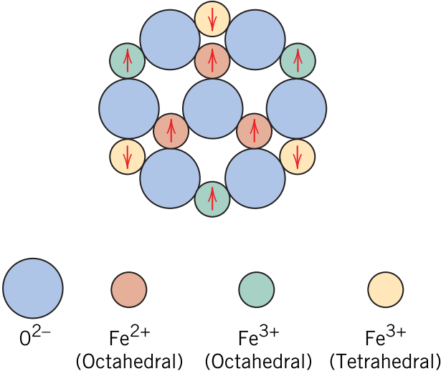
Ferrimagnetism
Constituent atoms may be antiferromagnetically coupled, but can have different magnetic moments.
Hence, there is some net magnetic moment in each coupling.
e.g. MnFe₂O₄, Fe₃O₄, NiFe₂O₄

