Slide 1
What is superconductivity?
Superconductors shows
Zero resistivity or
Infinite conductivity below a certain temperature called as critical temperature.
10
Ag
20
Sn
Resistivity (ρ) [x 10⁻¹¹ Ohm m] →
Resistivity (ρ) [x 10⁻¹¹ Ohm m] →
5
10
0
10
20
0
T_{c}
5
10
T (K) →
T (K) →
Superconducting transition temperature

Slide 2
Current carrying capacity
The maximum current a superconductor can carry is limited by the magnetic field that it produces at the surface of the superconductor
H_{c} / J_{c}
Normal
Superconducting state if
T < T_{c}
J < J_{c}
H < H_{c}
J_{c} [Amp / m²] →
μ₀ Hc [Wb / m²] →
Superconducting
T (K) →
T_{c}

Slide 3
Meissner effect
How to identify a superconductor?
A superconductor is a perfect diamagnet.
Magnetic susceptibility χ = −1.
Flux lines of the magnetic field are excluded out of the superconductor  Meissner effect
Normal
Superconducting

Slide 4
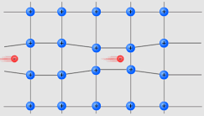
Electron- Lattice Interaction
Phonon is a quanta of lattice vibrations.
Analogous to photon – a quanta of light.
Produced by a distortion due to lattice vibrations.
Can interact with another phonon or electrons.

Slide 5
Bardeen-Cooper-Schreiffer (BCS) theory
How superconductors shows zero resistivity?
Phonon scattering due to lattice vibrations felt by one electron in the Cooper pair is nullified by the other electron in the pair.
The electron pair moves through the lattice without getting scattered by the lattice vibrations.
The force of attraction between the electrons in the Cooper pair is stronger than the repulsive force between the electrons when T < Tc.
Three-way interaction between two electron and a phonon.

Slide 6
Cooper pair
Normal state At Tc Superconducting state

Slide 7
Type-I (Ideal) superconductors
Type I SC placed in a magnetic field totally repels the flux lines till the magnetic field attains the critical value H_{c}
Type I
−M →
Normal
Superconducting
H →
H_{c}

Slide 8
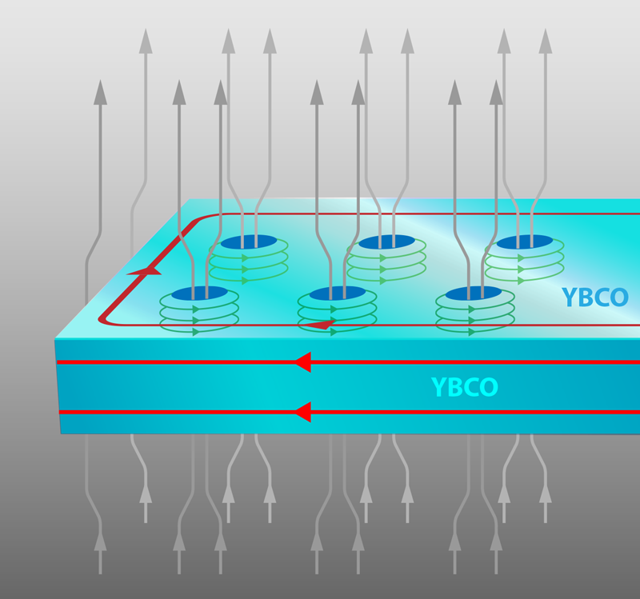
Type-II (Hard) superconductors
Type II superconductor has three regions
Type I
Vortex Region
Gradual penetration of the magnetic flux lines
−M →
Super conducting
Vortex
Normal
H →
H_{c1}
H_{c}
H_{c2}

Slide 9
Type-II (Hard) superconductors
As type II SC can carry high current densities (J_{c}) they are of great practical importance
The penetration characteristics of the magnetic flux lines (between H_{c1} and H_{c2}) is a function of the microstructure of the material  presence of pinning centers in the material.
Pinning centers:  Cell walls of high dislocation density (cold worked/recovery annealed)  Grain boundaries (Fine grained material)  Precipitates (Dispersion of very fine precipitates with interparticle spacing ~ 300 Å)

Slide 10
Applications of superconductors
Strong magnetic fields → 50 Tesla (without heating, without large power input)
Logic and storage functions in computers Josephson junction → fast switching times (~ 10 ps)
Magnetic levitation (arising from Meissner effect)
Power transmission

Slide 11
Comparison
 | Type I superconductors | Type II superconductors
1 | Soft superconductors- can tolerate impurities without affecting properties. | Hard superconductors- cannot tolerate impurities and affects the properties.
2 | Low critical field (0.1 T) | High critical field (30 T)
3 | Show complete Meissner effect. | Traps magnetic flux, hence, incomplete Meissner effect.
5 | Sudden loss of magnetization. | Gradual loss of magnetization.
6 | Current flows through the surface only. | Current flows throughout the material.
6 | e.g. Tin, Aluminum, Zinc | e.g. Tantalum, Neobium, NbN

Slide 12
High temperature superconductors
Compound | T_{c} | Comments
Nb₃Ge | 23 K | Till 1986
La-Ba-Cu-O | 34 K | Bednorz and Mueller (1986)
YBa₂Cu₃O_{7-x} | 90 K | > Boiling point of Liquid N₂
Tl (Bi)-Ba(Sr)-Ca-Cu-O | 125 K
H₂S | 203 K | Gas solidifies on application of high pressure (in Gpa)

Slide 13
Summary
Superconductors shows zero resistance below a certain temperature.
The superconducting state is limited by a temperature, current and magnetic field called as critical temperature, critical current and critical field.
In superconductors, the electrical conduction takes place by a pair of electrons, called as Cooper pair.
Type- I superconductors are perfectly diamagnetic and shows Meissner effect.
Type-II superconductors are not perfectly diamagnetic and do not show complete Meissner effect.

