Slide 1
Web Development/BTCS-2410
Course Name: B.Tech CSE Semester:4th
Prepared by: Ms. Yogesh
education for life www.rimt.ac.in
Department of Computer Science & Engineering

Slide 2
How the Web Works?
WWW use classical client / server architecture
HTTP is text-based request-response protocol
HTTP
Page request
HTTP
Server response
Server running Web Server Software (IIS, Apache, etc.)
Client running a Web Browser
education for life www.rimt.ac.in

Slide 3
What is a Web Page?
Web pages are text files containing HTML
HTML – Hyper Text Markup Language
A notation for describing
document structure (semantic markup)
formatting (presentation markup)
Looks (looked?) like:
A Microsoft Word document
The markup tags provide information about the page content structure
education for life www.rimt.ac.in

Slide 4
Creating HTML Pages
An HTML file must have an .htm or .html file extension
HTML files can be created with text editors:
NotePad, NotePad ++, PSPad
Or HTML editors (WYSIWYG Editors):
Microsoft FrontPage
Macromedia Dreamweaver
Netscape Composer
Microsoft Word
education for life www.rimt.ac.in

Slide 5
HTML Structure
HTML is comprised of “elements” and “tags”
Begins with <html> and ends with </html>
When writing XHTML, must define a namespace
Elements (tags) are nested one inside another:
Tags have attributes:
HTML describes structure using two main sections: <head> and <body>
<html xmlns="http://www.w3.org/1999/xhtml">
<html> <head></head> <body></body> </html>
<img src="logo.jpg" alt="logo" />
education for life www.rimt.ac.in

Slide 6
HTML Code Formatting
The HTML source code should be formatted to increase readability and facilitate debugging.
Every block element should start on a new line.
Every nested (block) element should be indented.
Browsers ignore multiple whitespaces in the page source, so formatting is harmless.
For performance reasons, formatting can be sacrificed.
education for life www.rimt.ac.in

Slide 7
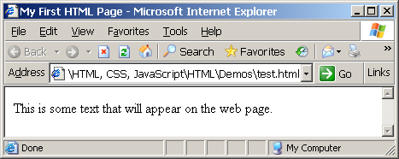
First HTML Page
test.html
<!DOCTYPE HTML>
<html>
<head>
<title>My First HTML Page</title>
</head>
<body>
<p>This is some text...</p>
</body>
</html>
education for life www.rimt.ac.in

Slide 8
First HTML Page: Tags
<!DOCTYPE HTML>
<html>
<head>
<title>My First HTML Page</title>
</head>
<body>
<p>This is some text...</p>
</body>
</html>
Opening tag
Closing tag
An HTML element consists of an opening tag, a closing tag and the content inside.
education for life www.rimt.ac.in

Slide 9
First HTML Page: Header
HTML header
<!DOCTYPE HTML>
<html>
<head>
<title>My First HTML Page</title>
</head>
<body>
<p>This is some text...</p>
</body>
</html>
education for life www.rimt.ac.in

Slide 10
First HTML Page: Body
<!DOCTYPE HTML>
<html>
<head>
<title>My First HTML Page</title>
</head>
<body>
<p>This is some text...</p>
</body>
</html>
HTML body
education for life www.rimt.ac.in

Slide 11
Some Simple Tags
Hyperlink Tags
Image Tags
Text formatting tags
<a href="http://www.telerik.com/"
title="Telerik">Link to Telerik Web site</a>
<img src="logo.gif" alt="logo" />
This text is <em>emphasized.</em>
<br />new line<br />
This one is <strong>more emphasized.</strong>
education for life www.rimt.ac.in

Slide 12
Some Simple Tags – Example
some-tags.html
<!DOCTYPE HTML>
<html>
<head>
<title>Simple Tags Demo</title>
</head>
<body>
<a href="http://www.telerik.com/" title=
"Telerik site">This is a link.</a>
<br />
<img src="logo.gif" alt="logo" />
<br />
<strong>Bold</strong> and <em>italic</em> text.
</body>
</html>
education for life www.rimt.ac.in

Slide 13
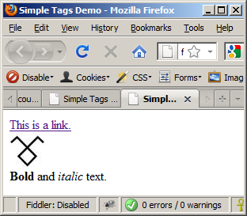
Some Simple Tags – Example (2)
some-tags.html
<!DOCTYPE HTML>
<html>
<head>
<title>Simple Tags Demo</title>
</head>
<body>
<a href="http://www.telerik.com/" title=
"Telerik site">This is a link.</a>
<br />
<img src="logo.gif" alt="logo" />
<br />
<strong>Bold</strong> and <em>italic</em> text.
</body>
</html>
education for life www.rimt.ac.in

