Slide 1
Applied Thermodynamics(BMEC-2304)
Course Name: B.Tech- Mechanical Engineering Semester: 3rd
Prepared by: Ajay Singh Rana
education for life www.rimt.ac.in
Department of Mechanical Engineering

Slide 2
Topic Discussed
Fuel and its Classifications
Basic Definitions
Advantages and Disadvantages of different types of fuel
Theoretical (or) Minimum mass of air required for complete combustion
Enthalpy of Formation
Adiabatic Flame Temperature
education for life www.rimt.ac.in
Department of Computer Science & Engineering

Slide 3
Fuels and its Classifications
Fuel is a combustible substance, containing carbon as main constituent which on proper burning gives large amount of heat which can be used economically for domestic and industrial purpose.
Classifications:
According to their occurrence fuels are classified as
• Primary fuel which are found in nature as such it is used. e.g. wood, coal, petroleum, natural gas.
• Secondary fuels are those which are derived from primary fuel. e.g. charcoal, coke, kerosene, diesel, petrol, producer gas.
education for life www.rimt.ac.in
Department of Computer Science & Engineering

Slide 4
Basic Definitions
Calorific value of fuels : The calorific value (or) heating value of solid (or) liquid fuel may be defined as amount of heat given out by complete combustion of 1 Kg. of fuel. It is expressed in Kcal/Kg. of fuel at N.T.P. in S.I. system J/Kg. KJ/Kg (or) MJ/Kg.
Types of calorific values of fuels :
1. Higher calorific values of fuel (H.C.V.) (or) Gross C.V. It is a total heat liberated by complete burning of 1 kg or 1m3 of fuel including heat of steam formed by combustion of Hydrogen in the fuel.
education for life www.rimt.ac.in
Department of Mechanical Engineering

Slide 5
Lower calorific value of fuel (L.C.V.) (or) Net C.V. It is a total heat liberated by complete burning of 1 kg or 1m3 of fuel deducting heat of steam formed by combustion of Hydrogen in the fuel.
Advantages of liquid fuels over solid fuels used in boiler.
Advantages : 1) Liquid fuel having higher calorific value. 2) Less space is required for storage. 3) Easy control of combustion by stopping supply of fuel. 4) It is very clean fuel, dust free. 5) Reduction in cost of handling. 6) Easily transported through pipes. 7) During burning it does not form ash.
Disadvantages : 1) Cost of liquid fuel is high. 2) The storage tank specially designed. 3) It has higher cost. 4) Danger of explosion. 5) Liquid fuels mostly we import from other countries. So we depends on other countries.
education for life www.rimt.ac.in
Department of Mechanical Engineering

Slide 6
Advantages of gaseous fuels :
1. They are free from solid and liquid impurity. 2. Maximum complete combustion of gaseous fuel is possible. 3. The rate of combustion and temperature in the combustion chamber can be easily controlled. 4. For complete combustion less amount of excess air is required. 5. Do not produce ash and smoke. 6. Large amount of heat and temperature is obtained at a moderate cost.
Disadvantages :
1. They are readily inflammable. 2. They require large storage capacity. 3.The cost of gaseous fuel are more.
education for life www.rimt.ac.in
Department of Mechanical Engineering

Slide 7
COMBUSTION DEFINED
The fuels when burnt release their stored chemical energy in the form of heat.
The oxidation process, when accompanied by the rapid liberation of heat, is known as combustion. To start combustion, the hydrocarbons and the oxygen must be brought to certain minimum ignition temperature.
In a complete combustion process of a fuel, all the carbon (C) present in the fuel is burned into carbon dioxide (CO2), all the hydrogen (H) is burned into water (H2O) and all the sulphur (S) is burned into sulphur dioxide (SO2). Whenever unburned C, H2, CO appears in the flue gases, the combustion process is not complete and hence not stoichiometric.
education for life www.rimt.ac.in
Department of Mechanical Engineering

Slide 8
Carbon, hydrogen and sulphur in the fuel combine with oxygen in the air to form carbon dioxide, water vapour and sulphur dioxide releasing tremendous amount of heat energy. The common combustion reactions are :
In case oxygen is not available in the right amount for the combustion of fuel, carbon may also combine with oxygen to form carbon monoxide. This results in the release of only about 30% of heat (2430 KCal/Kg of carbon) compared to CO2. The reaction is shown below :
education for life www.rimt.ac.in
Department of Mechanical Engineering

Slide 9
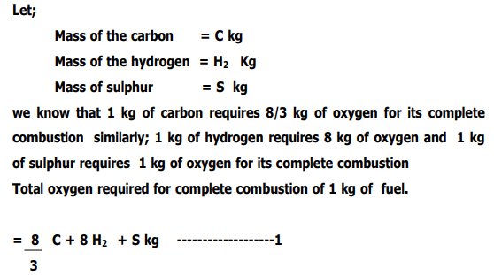
Theoretical (or) Minimum mass of air required for complete combustion.
Proper supply of oxygen is very essential for the complete combustion of a fuel, for obtaining maximum amount of heat from a fuel. The theoretical or minimum mass (or) volume of oxygen required for complete combustion of 1 kg of fuel may be calculated from chemical analysis of the fuel. The mass of oxygen, required by each of the constituents of the fuel, may be calculated from the chemical equation. Now consider 1 kg of a fuel.
education for life www.rimt.ac.in
Department of Mechanical Engineering

Slide 10
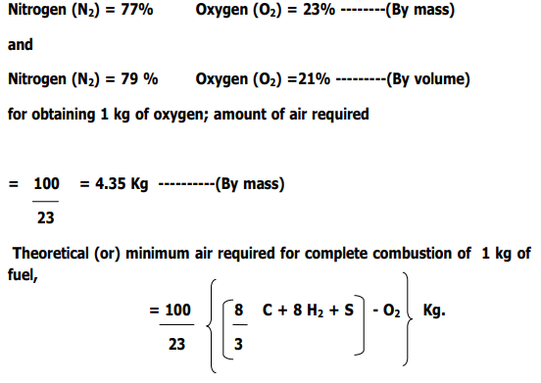
education for life www.rimt.ac.in
Department of Mechanical Engineering

Slide 11
education for life www.rimt.ac.in
Department of Mechanical Engineering

Slide 12
education for life www.rimt.ac.in
Department of Mechanical Engineering

Slide 13
Enthalpy of Formation
Enthalpy of formation is the heat associated with forming it from its most basic components.
For example, take the reaction forming hexane (C₆H₁₄) from six moles of elemental carbon and seven moles of H₂. The heat given off by this reaction, under constant pressure, is equal to the enthalpy of formation of hexane.
education for life www.rimt.ac.in
Department of Mechanical Engineering

Slide 14
Adiabatic Flame Temperature When a combustion reaction takes place energy is released to the combustion products. If no heat is lost in this process, the temperature of the combustion products is known as the "Adiabatic Flame Temperature." For methane combustion in air at 1 atmosphere the Adiabatic Flame Temperature is 2,328 K or 2055 C. For hydrogen burning in air at 1 atmosphere the Adiabatic Flame temperature is 2,400 K or 2127 C. When a flame loses heat to the environment, or is diluted with an inert material that has to be heated with the heat released in the combustion reaction, the actual temperature reached is less than the ideal adiabatic flame temperature. This is the actual "Flame Temperature."
education for life www.rimt.ac.in
Department of Mechanical Engineering

