Slide 1
Operating System/ BTCS-2401
Course Name: B.Tech CSE Semester: 4th
Prepared by: Er. Jasdeep Singh
education for life www.rimt.ac.in
Department of Computer Science & Engineering

Slide 2
Topic 13th : Main Memory
education for life www.rimt.ac.in

Slide 3
Topics To Be Covered
Background
Swapping
Contiguous Memory Allocation
education for life www.rimt.ac.in

Slide 4
Objectives
To provide a detailed description of various ways of organizing memory hardware
To discuss various memory-management techniques, including paging and segmentation
To provide a detailed description of the Intel Pentium, which supports both pure segmentation and segmentation with paging
education for life www.rimt.ac.in

Slide 5
Background
Program must be brought (from disk) into memory and placed within a process for it to be run
Main memory and registers are only storage CPU can access directly
Memory unit only sees a stream of addresses + read requests, or address + data and write requests
Register access in one CPU clock (or less)
Main memory can take many cycles
Cache sits between main memory and CPU registers
Protection of memory required to ensure correct operation
education for life www.rimt.ac.in

Slide 6
Address Binding
Inconvenient to have first user process physical address always at 0000
How can it not be?
Further, addresses represented in different ways at different stages of a program’s life
Source code addresses usually symbolic
Compiled code addresses bind to relocatable addresses
i.e. “14 bytes from beginning of this module”
Linker or loader will bind relocatable addresses to absolute addresses
i.e. 74014
Each binding maps one address space to another
education for life www.rimt.ac.in

Slide 7
Binding of Instructions and Data to Memory
Address binding of instructions and data to memory addresses can happen at three different stages
Compile time: If memory location known a priori, absolute code can be generated; must recompile code if starting location changes
Load time: Must generate relocatable code if memory location is not known at compile time
Execution time: Binding delayed until run time if the process can be moved during its execution from one memory segment to another
Need hardware support for address maps (e.g., base and limit registers)
education for life www.rimt.ac.in

Slide 8
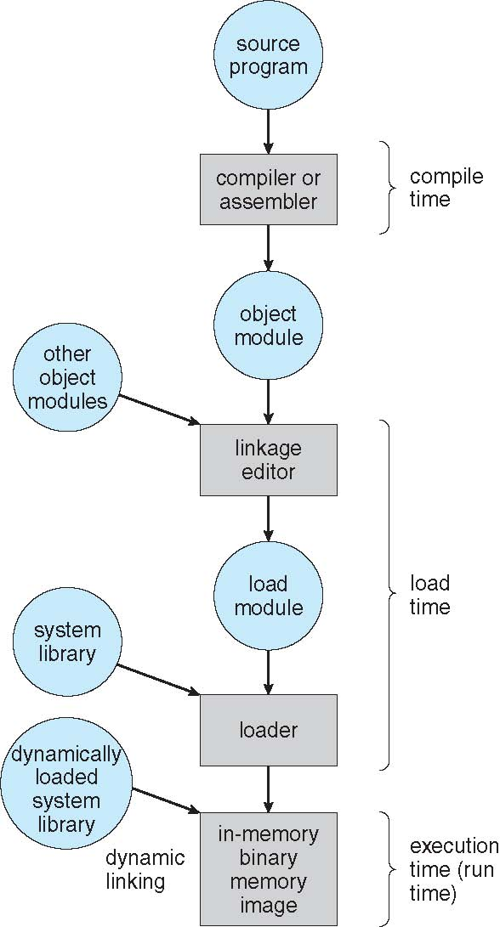
Multistep Processing of a User Program
education for life www.rimt.ac.in

Slide 9
Logical vs. Physical Address Space
The concept of a logical address space that is bound to a separate physical address space is central to proper memory management
Logical address space generated by the CPU; also referred to as virtual addresses
Physical addresses -address seen by the memory unit
Logical and physical addresses are the same in compile-time and load-time address-binding schemes; logical (virtual) and physical addresses differ in execution-time address-binding scheme
Logical address space is the set of all logical addresses generated by a program
Physical address space is the set of all physical addresses generated by a program
education for life www.rimt.ac.in

Slide 10
Memory-Management Unit (MMU)
Hardware device that at run time maps virtual to physical address
Many methods possible, covered in the rest of this chapter
To start, consider simple scheme where the value in the relocation register is added to every address generated by a user process at the time it is sent to memory
Base register now called relocation register
MS-DOS on Intel 80x86 used 4 relocation registers
The user program deals with logical addresses; it never sees the real physical addresses
Execution-time binding occurs when reference is made to location in memory
Logical address bound to physical addresses
education for life www.rimt.ac.in

Slide 11
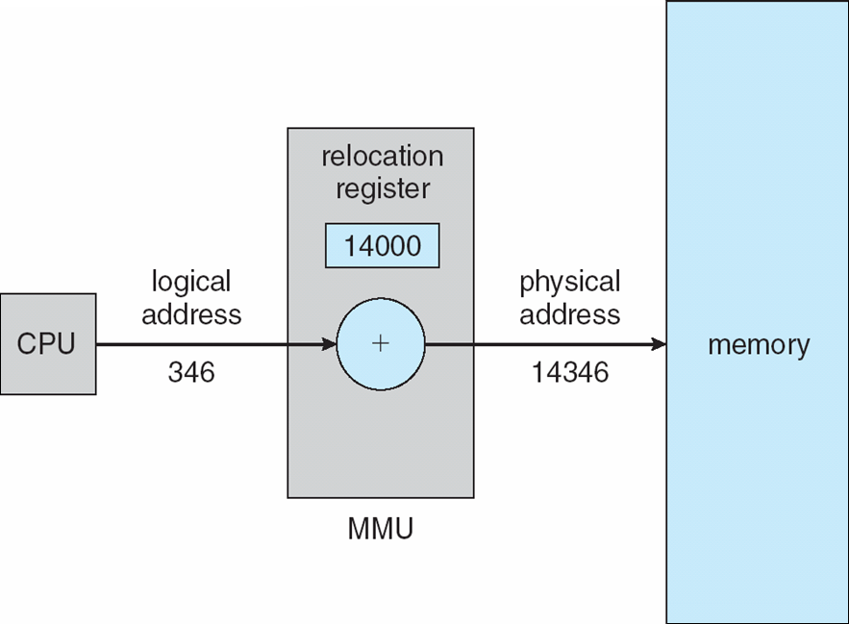
Dynamic relocation using a relocation register
education for life www.rimt.ac.in

Slide 12
Dynamic Loading
Routine is not loaded until it is called
Better memory-space utilization; unused routine is never loaded
All routines kept on disk in relocatable load format
Useful when large amounts of code are needed to handle infrequently occurring cases
No special support from the operating system is required
Implemented through program design
OS can help by providing libraries to implement dynamic loading
education for life www.rimt.ac.in

Slide 13
Dynamic Linking
Static linking – system libraries and program code combined by the loader into the binary program image
Dynamic linking –linking postponed until execution time
Small piece of code, stub, used to locate the appropriate memory-resident library routine
Stub replaces itself with the address of the routine, and executes the routine
Operating system checks if routine is in processes’ memory address
If not in address space, add to address space
Dynamic linking is particularly useful for libraries
System also known as shared libraries
Consider applicability to patching system libraries
Versioning may be needed
education for life www.rimt.ac.in

Slide 14
Swapping
A process can be swapped temporarily out of memory to a backing store, and then brought back into memory for continued execution
Total physical memory space of processes can exceed physical memory
Backing store disk large enough to accommodate copies of all memory images for all users; must provide direct access to these memory images
Roll out , roll in swapping variant used for priority-based scheduling algorithms; lower-priority process is swapped out so higher-priority process can be loaded and executed
Major part of swap time is transfer time; total transfer time is directly proportional to the amount of memory swapped
System maintains a ready queue of ready-to-run processes which have memory images on disk
Does the swapped out process need to swap back in to same physical addresses?
Depends on address binding method
Plus consider pending I/O to / from process memory space
Modified versions of swapping are found on many systems (i.e., UNIX, Linux, and Windows)
Swapping normally disabled
Started if more than threshold amount of memory allocated
Disabled again once memory demand reduced below threshold
education for life www.rimt.ac.in

Slide 15
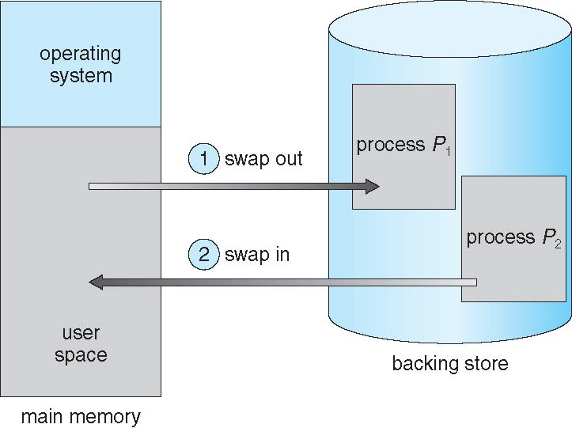
Schematic View of Swapping
education for life www.rimt.ac.in

Slide 16
Context Switch Time including Swapping
If next processes to be put on CPU is not in memory, need to swap out a process and swap in target process
Context switch time can then be very high
100MB process swapping to hard disk with transfer rate of 50MB/sec
Plus disk latency of 8 ms
Swap out time of 2008 ms
Plus swap in of same sized process
Total context switch swapping component time of 4016ms (> 4 seconds)
Can reduce if reduce size of memory swapped – by knowing how much memory really being used
System calls to inform OS of memory use via request memory and release memory
education for life www.rimt.ac.in

Slide 17
Contiguous Allocation
Main memory usually into two partitions:
Resident operating system, usually held in low memory with interrupt vector
User processes then held in high memory
Each process contained in single contiguous section of memory
Relocation registers used to protect user processes from each other, and from changing operating-system code and data
Base register contains value of smallest physical address
Limit register contains range of logical addresses – each logical address must be less than the limit register
MMU maps logical address dynamically
Can then allow actions such as kernel code being transient and kernel changing size
education for life www.rimt.ac.in

Slide 18
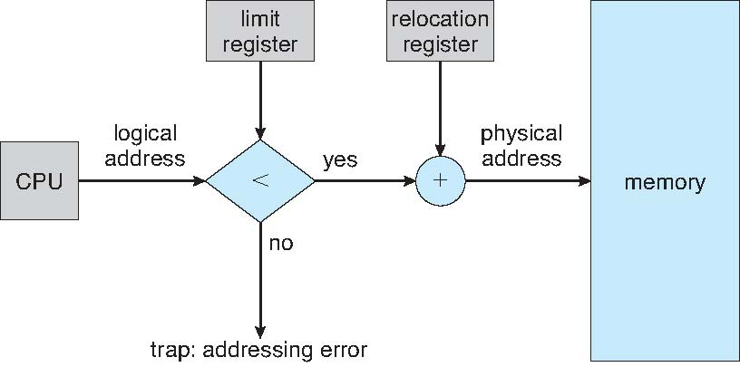
Hardware Support for Relocation and Limit Registers
education for life www.rimt.ac.in

Slide 19
Dynamic Storage-Allocation Problem
How to satisfy a request of size n from a list of free holes?
First-fit Allocate the first hole that is big enough
Best-fit Allocate the smallest hole that is big enough; must search entire list, unless ordered by size
Produces the smallest leftover hole
Worst-fit Allocate the largest hole; must also search entire list
Produces the largest leftover hole
First-fit and best-fit better than worst-fit in terms of speed and storage utilization
education for life www.rimt.ac.in

Slide 20
Fragmentation
External Fragmentation total memory space exists to satisfy a request, but it is not contiguous
Internal Fragmentation allocated memory may be slightly larger than requested memory; this size difference is memory internal to a partition, but not being used
First fit analysis reveals that given N blocks allocated, 0.5 N blocks lost to fragmentation
1/3 may be unusable -> 50-percent rule
education for life www.rimt.ac.in

Slide 21
Fragmentation (Cont.)
Reduce external fragmentation by compaction
Shuffle memory contents to place all free memory together in one large block
Compaction is possible only if relocation is dynamic, and is done at execution time
I/O problem
Latch job in memory while it is involved in I/O
Do I/O only into OS buffers
Now consider that backing store has same fragmentation problems
education for life www.rimt.ac.in

Slide 22
Summary
Background
Swapping
Contiguous Memory Allocation
education for life www.rimt.ac.in

Slide 23
Topics To Be Next Covered
Paging
Structure of the Page Table
Segmentation
Example: The Intel Pentium
education for life www.rimt.ac.in

Slide 24
References
Silberschatz and Peter B. Calvin, “Operating System Concepts" Addison Wesley Publishing Company
Dhamdhere, “Systems Programming & Operating Systems Tata McGraw Hill
education for life www.rimt.ac.in

