Slide 1
Numerical & Statistical Methods (BTEE-3604)
Course Name: B.Tech (EE) Semester: 6th
Prepared by: Sachin Syan
education for life www.rimt.ac.in
Department of Electrical Engineering

Slide 2
Topic Discussed
Introduction to Numerical Solution of Ordinary Differential Equations
Solution of a Differential Equation
Solutions of Initial values problems using Euler’s
Modified Euler’s method
Runge Kutta Method
education for life www.rimt.ac.in
Department of Electrical Engineering

Slide 3
NUMERICAL SOLUTION OFORDINARY
DIFFERENTIAL EQUATIONS
Introduction A number of problems in science and technology can be formulated into differential equations. The analytical methods of solving differential equations are applicable only to a limited class of equations. Quite often differential equations appearing in physical problems do not belong to any of these familiar types and one is obliged to resort to numerical methods. These methods are of even greater importance when we realize that computing machines are now readily available which reduce numerical work considerably.
education for life www.rimt.ac.in
Department of Electrical Engineering

Slide 4
NUMERICAL SOLUTION OFORDINARY
DIFFERENTIAL EQUATIONS
Solution of a Differential Equation
The solution of an ordinary differential equation means finding an explicit expression for y in terms of a finite number of elementary functions of x. Such a solution of a differential equation is known as the closed or finite form of solution. In the absence of such a solution, we have recourse to numerical methods of solution. Let us consider the first order differential equation dy/dx = f(x, y), given y(x₀) = y₀
education for life www.rimt.ac.in
Department of Electrical Engineering

Slide 5
NUMERICAL SOLUTION OFORDINARY
DIFFERENTIAL EQUATIONS
to study the various numerical methods of solving such equations. In most of these methods, we replace the differential equation by a difference equation and then solve it. These methods yield solutions either as a power series in x from which the values of y can be found by direct substitution, or a set of values of x and y. The methods of Picard and Taylor series belong to the former class of solutions. In these methods, y in (1) is approximated by a truncated series, each term of which is a function of x. The information about the curve at one point is utilized and the solution is not iterated. As such, these are referred to as single-step methods.
The methods of Euler, Runge-Kutta belong to the latter class of solutions. In these methods, the next point on the curve is evaluated in short steps ahead, by performing iterations until sufficient accuracy is achieved. As such, these methods are called step-by-step methods.
education for life www.rimt.ac.in
Department of Electrical Engineering

Slide 6
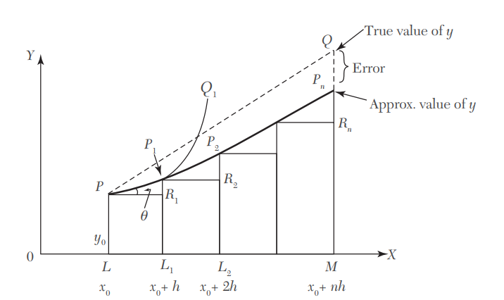
Euler’s Method
Consider the equation
Its curve of solution through P(x₀, y₀) is shown dotted in Figure Now we have to find the ordinate of any other point Q on this curve.
education for life www.rimt.ac.in
Department of Electrical Engineering

Slide 7
Euler’s Method
Let us divide LM into n sub-intervals each of width h at L₁, L₂ …so that h is quite small
In the interval LL₁, we approximate the curve by the tangent at P. If the ordinate through L₁ meets this tangent in P₁(x₀ + h, y₁), then
Let P₁Q₁ be the curve of solution of (1) through P₁ and let its tangent at P₁ meet the ordinate through L₂ in P₂(x₀ + 2h, y₂). Then
education for life www.rimt.ac.in
Department of Electrical Engineering

Slide 8
Euler’s Method
Repeating this process n times, we finally reach on an approximation MP_{n} of MQ given by
This is Euler’s method of finding an approximate solution of (1).
NOTE
In Euler’s method, we approximate the curve of solution by the tangent in each interval, i.e., by a sequence of short lines. Unless h is small, the error is bound to be quite significant. This sequence of lines may also deviate considerably from the curve of solution. As such, the method is very slow and hence there is a modification of this method which is given in the next section.
education for life www.rimt.ac.in
Department of Electrical Engineering

Slide 9
Euler’s Method
EXAMPLE: Using Euler’s method, find an approximate value of y corresponding to x = 1, given that dy/dx = x + y and y = 1 when x = 0.
Solution:
We take n =10 and h = 0.1 which is sufficiently small. The various calculations are arranged as follows:
education for life www.rimt.ac.in
Department of Electrical Engineering

Slide 10
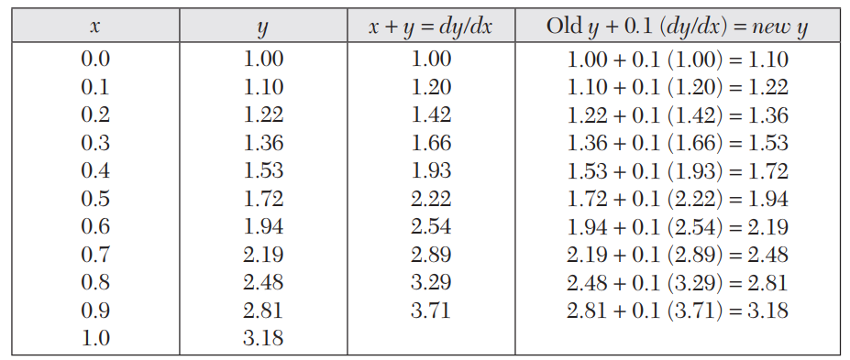
Euler’s Method
Thus the required approximate value of y = 3.18.
education for life www.rimt.ac.in
Department of Electrical Engineering

Slide 11
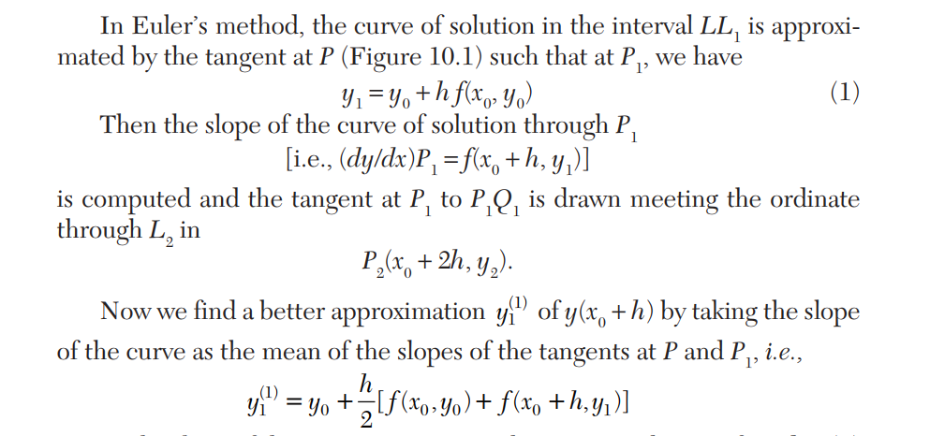
Modified Euler’s Method
education for life www.rimt.ac.in
Department of Electrical Engineering

Slide 12
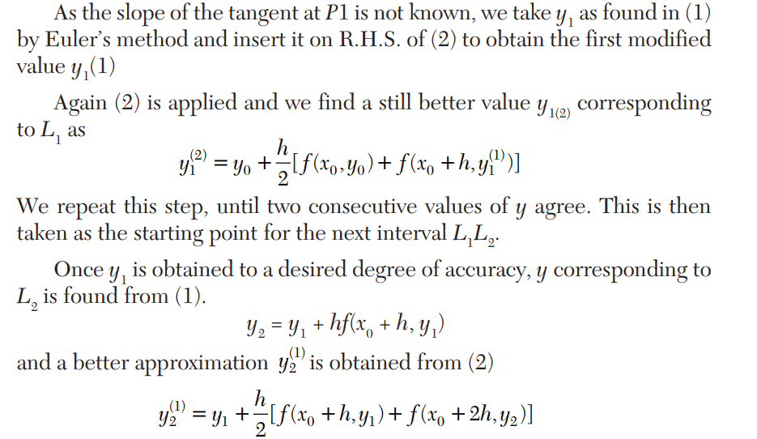
Modified Euler’s Method
education for life www.rimt.ac.in
Department of Electrical Engineering

Slide 13
Modified Euler’s Method
education for life www.rimt.ac.in
Department of Electrical Engineering

Slide 14
Modified Euler’s Method
education for life www.rimt.ac.in
Department of Electrical Engineering

Slide 15
Modified Euler’s Method
EXAMPLE: Using Euler’s method, find an approximate value of y corresponding to x = 1, given that dy/dx = x + y and y = 1 when x = 0.
Solution:
We take h = 0.1 which is sufficiently small. The various calculations are arranged as follows:
education for life www.rimt.ac.in
Department of Electrical Engineering

Slide 16
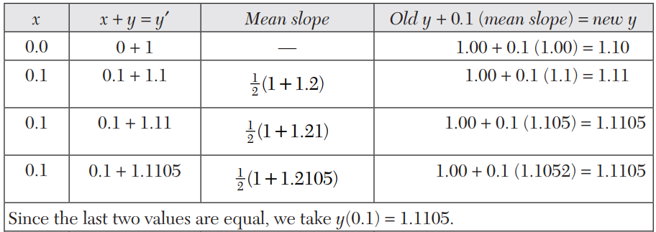
Modified Euler’s Method
education for life www.rimt.ac.in
Department of Electrical Engineering

Slide 17
Modified Euler’s Method
education for life www.rimt.ac.in
Department of Electrical Engineering

Slide 18
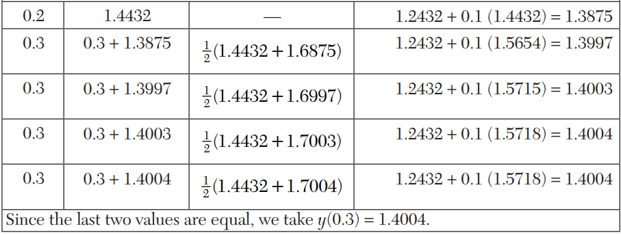
Modified Euler’s Method
education for life www.rimt.ac.in
Department of Electrical Engineering

Slide 19
Runge’s Method
Consider the equation ….(1)
Clearly the slope of the curve through P(x₀, y₀) is f(x₀, y₀) Figure) Integrating both sides of (1) from (x₀, y₀) to (x₀ + h, y₀ + k), we have
education for life www.rimt.ac.in
Department of Electrical Engineering

Slide 20
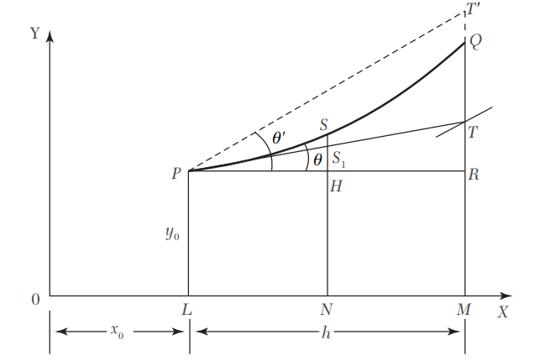
Runge’s Method
education for life www.rimt.ac.in
Department of Electrical Engineering

Slide 21
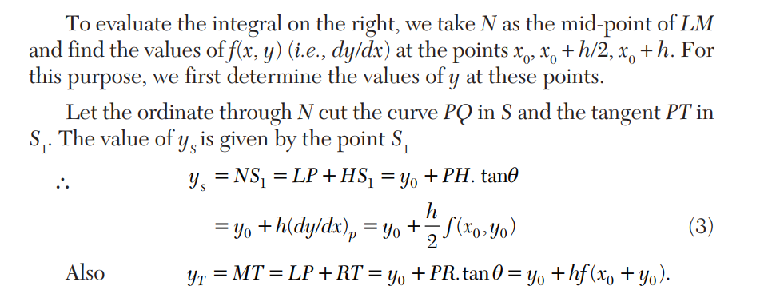
Runge’s Method
education for life www.rimt.ac.in
Department of Electrical Engineering

Slide 22
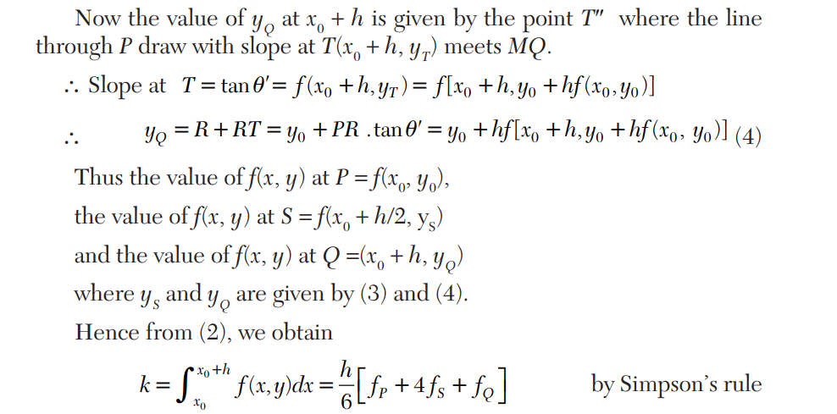
Runge’s Method
education for life www.rimt.ac.in
Department of Electrical Engineering

Slide 23
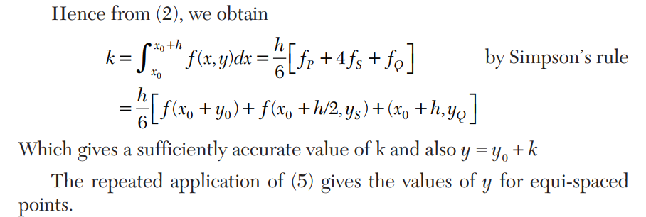
Runge’s Method
education for life www.rimt.ac.in
Department of Electrical Engineering

Slide 24
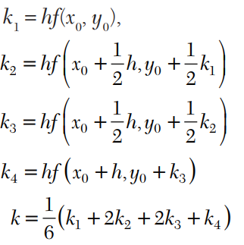
Runge’s Method
Using the Runge-Kutta method of fourth order, solve
Which gives the required approximate value as y₁ = y₀ + k
education for life www.rimt.ac.in
Department of Electrical Engineering

Slide 25
Runge’s Method
Example: Using the Runge-Kutta method of fourth order, solve
with y(0) = 1 at x = 0.2, 0.4.
Solution:
education for life www.rimt.ac.in
Department of Electrical Engineering

Slide 26
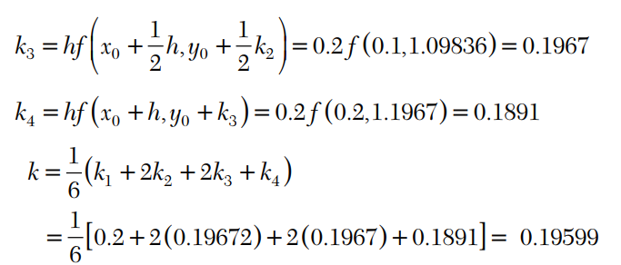
Runge’s Method
education for life www.rimt.ac.in
Department of Electrical Engineering

Slide 27
Runge’s Method
education for life www.rimt.ac.in
Department of Electrical Engineering

Slide 28
Topics Discussed in Next Lecture
Probability distribution
education for life www.rimt.ac.in
Department of Electrical Engineering

