Slide 1
INDUSTRIAL ENGINEERING AND MANAGEMENT (BTME-4701)
Course Name: B.Tech-ME Semester: 7th
Prepared by: Dr. Talwinder Singh Bedi
education for life www.rimt.ac.in
Department of Mechanical Engineering

Slide 2
UNIT: I
education for life www.rimt.ac.in
Department of Mechanical Engineering

Slide 3
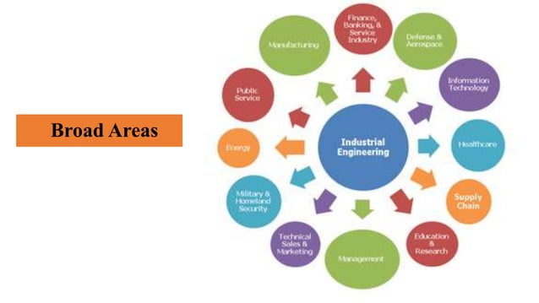
UNIT: I
education for life www.rimt.ac.in
Department of Mechanical Engineering

Slide 4
UNIT: I
education for life www.rimt.ac.in
Department of Mechanical Engineering

Slide 5
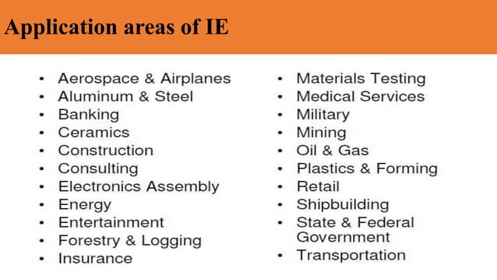
UNIT: I
education for life www.rimt.ac.in
Department of Mechanical Engineering

Slide 6
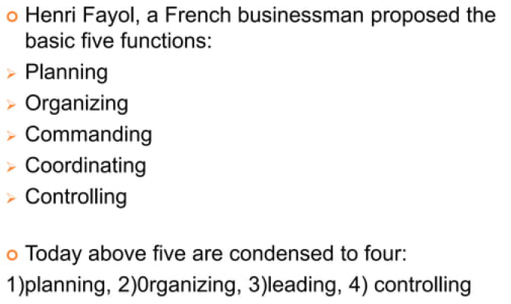
UNIT: I
education for life www.rimt.ac.in
Department of Mechanical Engineering

Slide 7
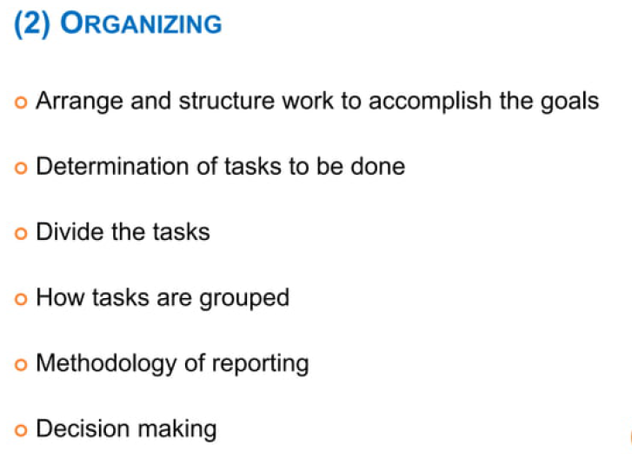
UNIT: I
education for life www.rimt.ac.in
Department of Mechanical Engineering

Slide 8
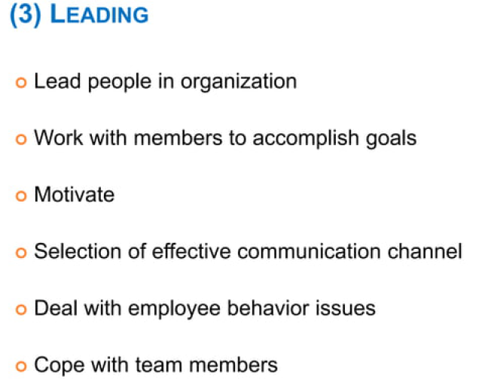
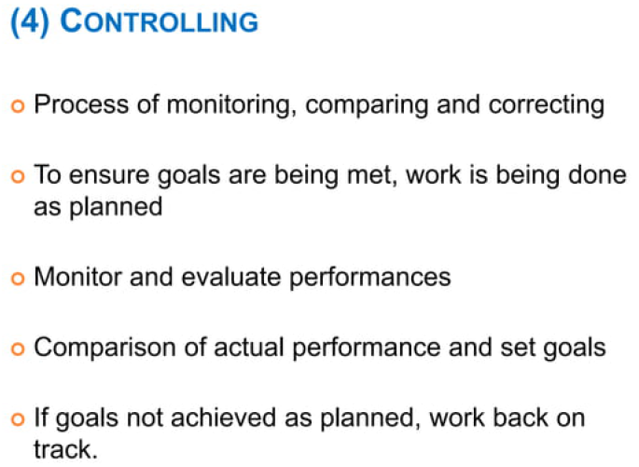
UNIT: I
education for life www.rimt.ac.in
Department of Mechanical Engineering

Slide 9
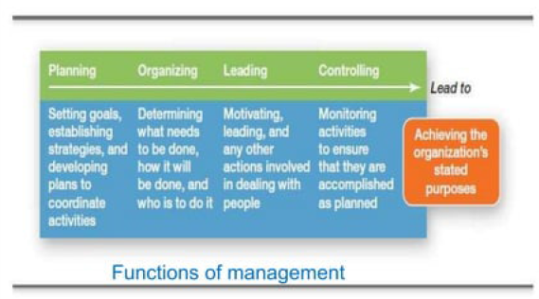
UNIT: I
education for life www.rimt.ac.in
Department of Mechanical Engineering

Slide 10
UNIT: I
education for life www.rimt.ac.in
Department of Mechanical Engineering

Slide 11
UNIT: I
education for life www.rimt.ac.in
Department of Mechanical Engineering

Slide 12
UNIT: I
education for life www.rimt.ac.in
Department of Mechanical Engineering

Slide 13
UNIT: I
education for life www.rimt.ac.in
Department of Mechanical Engineering

Slide 15
UNIT: I
education for life www.rimt.ac.in
Department of Mechanical Engineering

Slide 16
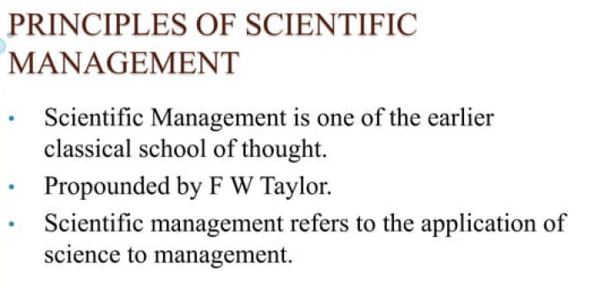
UNIT: I
education for life www.rimt.ac.in
Department of Mechanical Engineering

Slide 17
UNIT: I
education for life www.rimt.ac.in
Department of Mechanical Engineering

Slide 18
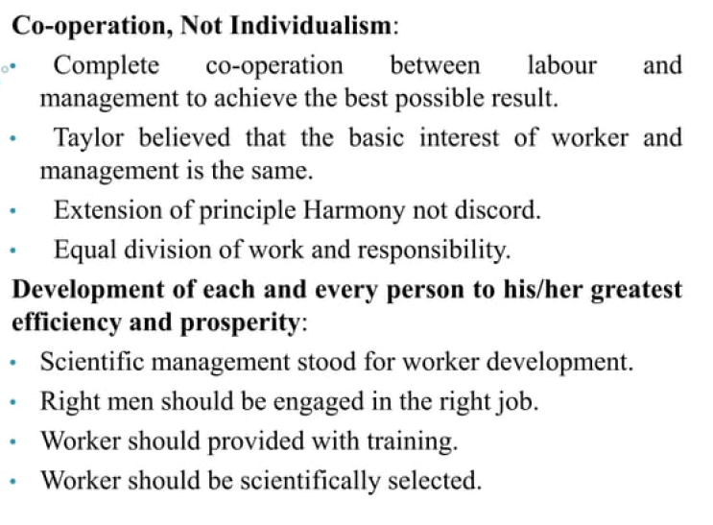
UNIT: I
education for life www.rimt.ac.in
Department of Mechanical Engineering

