Slide 1
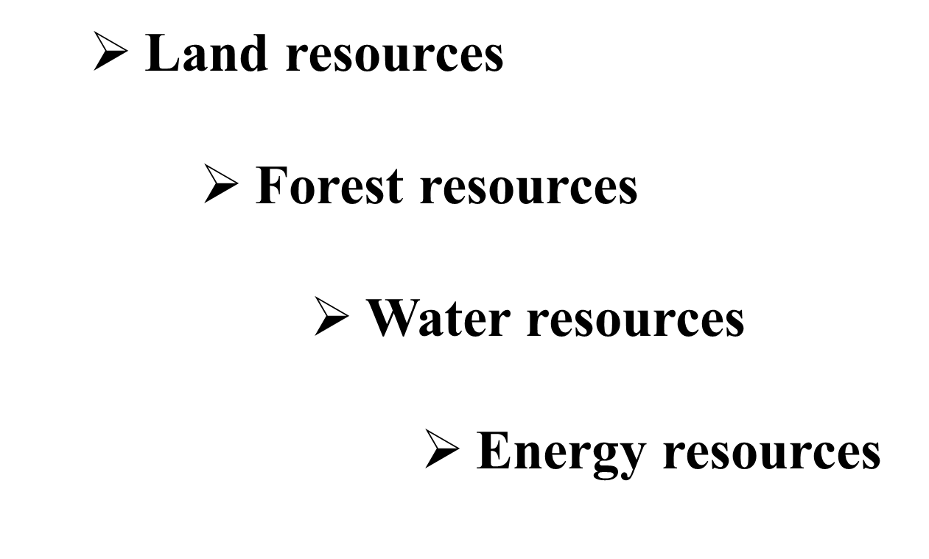

Slide 2
Land Resources
The Importance of Land
The human civilization has thrived on land.
Land is used for agriculture.
Land contains huge amount of mineral deposits.
It also contains water in the form of underground water.
Most of the animals find their habitat on land.
Land directly or indirectly provides all the resources required to fulfil the basic needs of humans: food, cloth, and shelter.

Slide 3
Soil profile
Soil profile is a vertical cross section from surface down to the parent materials. A well- developed soil profile shows distinct horizons.
The three major horizons are A, B, and C horizons. Horizons are sometimes also called zones.

Slide 4
The soil profile is important tool for nutrient management and soil fertility.
Decomposition of weathers and organic matter, profile of the soil changes.
The soil profile is made of distinct layers , known as horizons.
Five most common horizons are collectively known as master horizons.
Study of soil profile is essential for proposed the soil structure and for technical descriptions.

Slide 5
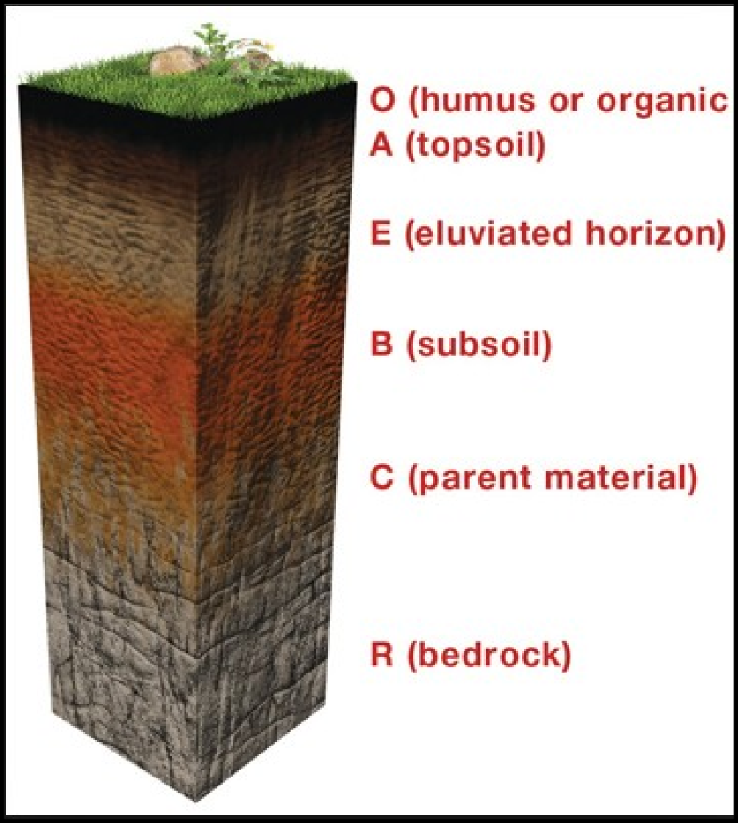
Horizons in Soil profile

Slide 6
Functions of Soil
Role in nutrient cycles
In agriculture
Regulate the water
Regulate the emissions of gases
Degrade pollutants and filter ground water
Producing clay
Provide the structural material as brick, cement etc.
Sequester carbon as organic matter.

Slide 7
Land Degradation
The fertility of land supports the growth and productivity of natural vegetation and agricultural crops. A number of natural and man-made factors lower the quality of land. This is commonly referred to as land degradation.

Slide 8
Causes of land degradation
Natural factors
Heavy rains
High speed wind and storms
Natural disasters like earthquakes ,floods, prolonged drought, etc.
Anthropogenic factors
Mining.
Urbanization
The indiscriminate and uncontrolled removal of trees
Excess use of fertilizers
Industrial discharges
Overgrazing, soil erosion, etc..

Slide 9
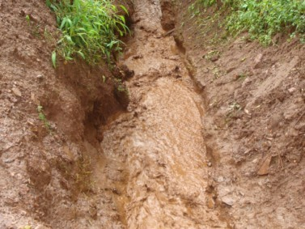
Soil Erosion
Soil erosion is removal of top soil from its resting place by various physical agencies like wind and water. It can be defined as “the detachment and transport of the fertile layer of soil by water or air.” It is also known as the creeping death of land.
The detachment and transportation of the fertile layer of soil by water or air.

Slide 10
Causes of Soil Erosion
Large-scale deforestation for meeting commercial as well as day-to-day needs
Heavy floods in rivers
Overgrazing by cattle
Dry violent winds
Improper agricultural techniques

Slide 11
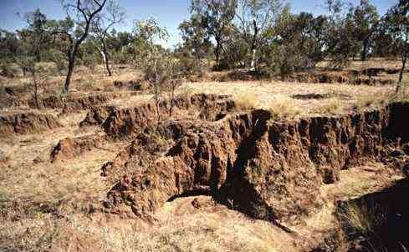
Effects of Soil Erosion
Desertification of land
Decrease in productivity of land
Reduction in the agricultural land at the banks of rivers
Deposition of soil in river beds and canals causing diversion of their natural flow and hence leading to disasters

Slide 12
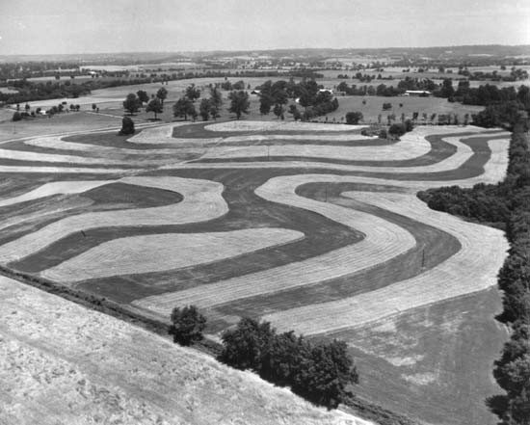
Methods of Controlling Soil Erosion
Reduced tillage
Contour cultivation
Strip cropping
Terracing
A forestation on barren land
Control of overgrazing
Construction of small check dams
Promotion of equitable use of water resources
Prevention of excavation of rocks

Slide 13
Desertification
Conversion of fertile land into an infertile desert land is called desertification.
Causes of Desertification
Natural Factors
Anthropogenic Factors
Very low rainfall High salinity of soils Excessive evaporation
Vast difference in diurnal temperature extremes
Overgrazing Over irrigation
Excessive ploughing Excessive use of fertilizers Continuous cutting of trees

Slide 14
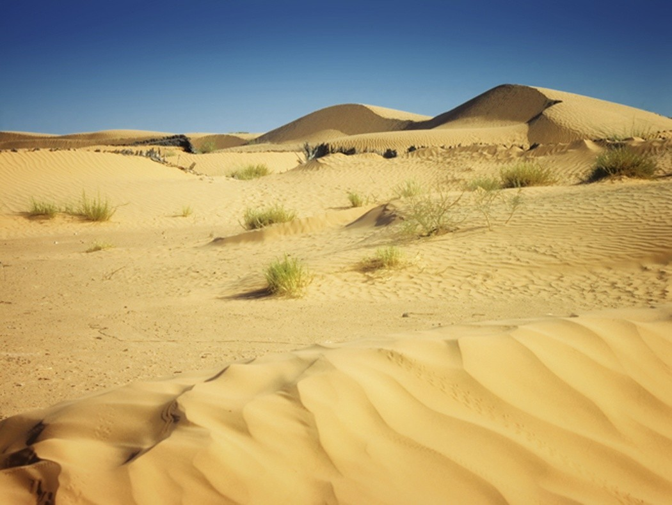
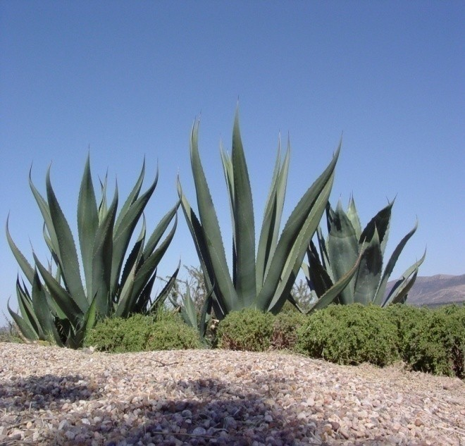
Effects of Desertification
Poor soil quality
Rapid soil erosion
Unfavorable climate
Huge economic losses
Low water table, salty and hard water

Slide 15
Control of Desertification
Promoting large-scale plantation of trees
Changing agricultural practices and promoting dry land farming
Development of pasture lands (suitable for Grazing) and control of overgrazing
Promoting equitable use of water resources
Development of water catchment areas
The desertification is increasing significantly in Bhuj in northern Gujarat due to over usages of ground water for last 20 years.
Water tables going down by 3m/year.

