Slide 1
Engineering Mathematics-I (BMAT-1111)
Course Name: B.Tech (CSE) Semester: Ist
Prepared by: Sachin Syan
education for life www.rimt.ac.in
Department of Computer Science & Engineering

Slide 2
Topic Discussed
Linear Ordinary Differential Equations of Second and Higher Order
Introduction
Types of Differential Equations
Complete Solution of Homogeneous DE
Rules for Finding the Complementary Function
Complete Solution of Non-Homogeneous DE
Rules for Finding the Particular Integral
education for life www.rimt.ac.in
Department of Computer Science & Engineering

Slide 3
Introduction
Linear Differential Equation of nth Order:
A linear differential equation of nth order is that in which the dependent variable and its derivatives occur only in the first degree and are not multiplied together. Thus, the general linear differential equation of the nth order is of the form
where P₁, P₂, ……, P_{n – 1} , P_{n} and X are functions of x only
education for life www.rimt.ac.in
Department of Computer Science & Engineering

Slide 4
Introduction
A linear differential equation with constant coefficients of nth Order
A linear differential equation with constant coefficients is of the form
where a₁, a₂, …… , a_{n – 1}, a_{n} are constants and X is either a
constant or a function of x only
education for life www.rimt.ac.in
Department of Computer Science & Engineering

Slide 5
Types of Differential Equations
Homogeneous Differential Equation
A linear differential equation with constant coefficients is of the form
Non-Homogeneous Differential Equation
A linear differential equation with constant coefficients is of the form
education for life www.rimt.ac.in
Department of Computer Science & Engineering

Slide 6
Complete Solution of Homogeneous Differential Equation
Consider
We write
Thus, the symbol D is a differential operator or simply an operator.
Written in symbolic form, equation (1) becomes (D^{n} + a₁ D^{n – 1} + a₂ D^{n – 2} + …… + a_{n – 1} D + a_{n}) y = 0
or f (D) y = 0
Where f(D) = D^{n} + a₁ D^{n – 1} + a₂ D^{n – 2} + …… + a_{n – 1} D + a_{n}
i.e., f (D) is a polynomial in D
Then y = Complete Solution = Complementary function
education for life www.rimt.ac.in
Department of Computer Science & Engineering

Slide 7
Rule for Finding Complementary Function
Consider
Symbolic Form: (D^{n} + a₁ D^{n – 1} + a₂ D^{n – 2} + …… + a_{n – 1} D + a_{n}) y = 0
or f (D) y = 0
Where f(D) = D^{n} + a₁ D^{n – 1} + a₂ D^{n – 2} + …… + a_{n – 1} D + a_{n}
Auxiliary Equation: Putting D = m
m^{n} + a₁ m^{n – 1} + a₂ m^{n – 2} + …… + a_{n – 1} m + a_{n} = 0
Let m = m₁ , m₂ , m₃, …… , mn be the roots of the A.E. The solution of equation (1)
depends
upon the nature of roots of the A.E. The following cases arise:
education for life www.rimt.ac.in
Department of Computer Science & Engineering

Slide 8
Rule for Finding Complementary Function
Case I. If all the roots of the A.E. are real and distinct
Hence the complete solution of equation (1) is
Case II. If two roots of the A.E. are equal, let m₁ = m₂
Hence the complete solution of equation (1) is
Case III. If two roots of the A.E. are imaginary
Let m₁ = a + i b and m₂ = a – i b
Hence the complete solution of equation (1) is
Case IV. If two pairs of imaginary roots be equal
Let m₁ =m₂ = a + i b and m₃ =m₄ = a – i b
Hence the complete solution of equation (1) is
education for life www.rimt.ac.in
Department of Computer Science & Engineering

Slide 9
1 3
Rule for Finding Complementary Function
Example : Solve 9y’’’ + 3y’’ – 5y’ + y = 0
Solution: Symbolic form of given equation is (9D³ + 3D² – 5D + 1) y = 0 A.E. is 9D3 + 3D2 – 5D + 1 = 0 or (D + 1) (3D – 1)2 = 0
Complete Solution is
education for life www.rimt.ac.in
Department of Computer Science & Engineering

Slide 10
1 3
Rule for Finding Complementary Function
Example : Solve
Solution Given equation in symbolic form is (D⁴ + 4) x = 0, where Its A.E. is D⁴ + 4 = 0 or (D⁴ + 4D² + 4) – 4D² = 0 or (D² + 2)² – (2D)² = 0 or (D² + 2D + 2) (D² – 2D + 2) = 0
D = and
i.e., D = – 1 i and 1 i
Complete Solution is
education for life www.rimt.ac.in
Department of Computer Science & Engineering

Slide 11
1 3
Rule for Finding Complementary Function
Example : Solve
Solution Given equation in symbolic form is (D⁴ + 4) x = 0, where Its A.E. is D⁴ + 4 = 0 or (D⁴ + 4D² + 4) – 4D² = 0 or (D² + 2)² – (2D)² = 0 or (D² + 2D + 2) (D² – 2D + 2) = 0
D = and
i.e., D = – 1 i and 1 i
Complete Solution is
education for life www.rimt.ac.in
Department of Computer Science & Engineering

Slide 12
Complete Solution of Non-Homogeneous Differential Equation
Consider
We write
Thus, the symbol D is a differential operator or simply an operator.
Written in symbolic form, equation (1) becomes (D^{n} + a₁ D^{n – 1} + a₂ D^{n – 2} + …… + a_{n – 1} D + a_{n}) y = X
or f (D) y = X
Where f(D) = D^{n} + a₁ D^{n – 1} + a₂ D^{n – 2} + …… + a_{n – 1} D + a_{n}
i.e., f (D) is a polynomial in D
Then y = Complete Solution = Complementary function + Particular Integral
For Complementary function same rule as we have done
We will find the Particular Integral
education for life www.rimt.ac.in
Department of Computer Science & Engineering

Slide 13
Rules for finding Particular integral(P.I.)
Particular Integral
CaseI. When X = e^{ax}
education for life www.rimt.ac.in
Department of Computer Science & Engineering

Slide 14
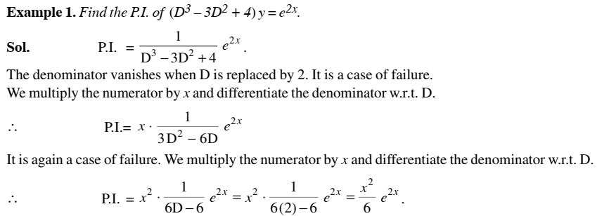
Rules for finding Particular integral(P.I.)
education for life www.rimt.ac.in
Department of Computer Science & Engineering

Slide 15
Rules for finding Particular integral(P.I.)
education for life www.rimt.ac.in
Department of Computer Science & Engineering

Slide 16
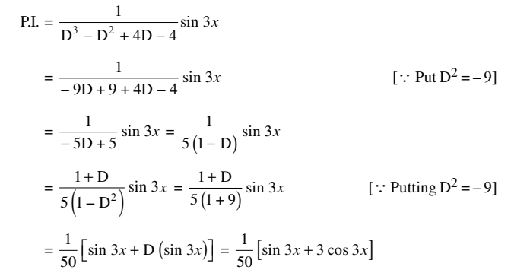
Rules for finding Particular integral(P.I.)
education for life www.rimt.ac.in
Department of Computer Science & Engineering

Slide 17
Rules for finding Particular integral(P.I.)
education for life www.rimt.ac.in
Department of Computer Science & Engineering

Slide 18
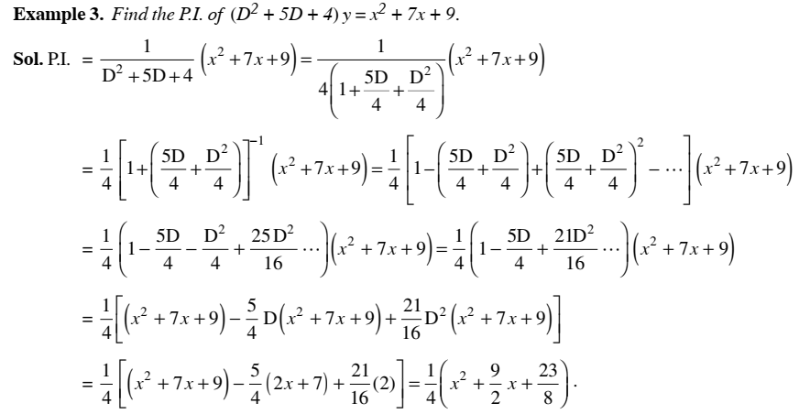
Rules for finding Particular integral(P.I.)
education for life www.rimt.ac.in
Department of Computer Science & Engineering

Slide 19
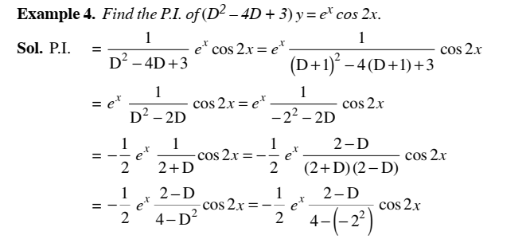
Rules for finding Particular integral(P.I.)
education for life www.rimt.ac.in
Department of Computer Science & Engineering

Slide 20
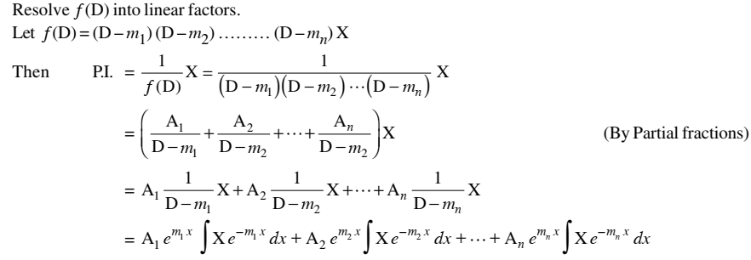
Rules for finding Particular integral(P.I.)
education for life www.rimt.ac.in
Department of Computer Science & Engineering

Slide 21
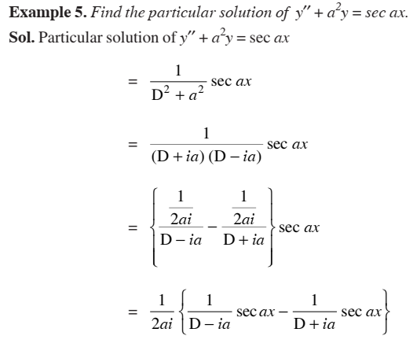
Rules for finding Particular integral(P.I.)
education for life www.rimt.ac.in
Department of Computer Science & Engineering

Slide 22
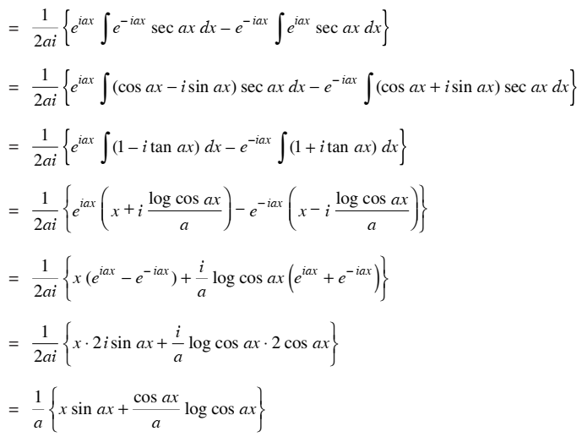
Rules for finding Particular integral(P.I.)
education for life www.rimt.ac.in
Department of Computer Science & Engineering

Slide 23
Topics Discussed in Next Lecture
Linear Ordinary Differential Equations of Second and Higher Order
Method of Variation of Parameters
Operator Method
Cauchy’ s Homogeneous Linear Equation
Legendre’s Linear Equation
Simultaneous Linear Equation with constant corfficients
education for life www.rimt.ac.in
Department of Computer Science & Engineering

