Slide 1
EXPERT SYSTEM BTCS-3613
Course Name: B.TECH (CSE) Semester: 6th
Prepared by: Sahilpreet Singh
education for life www.rimt.ac.in
Department of Computer Science & Engineering

Slide 2
Topic 2:-Expert system Development process
education for life www.rimt.ac.in

Slide 3
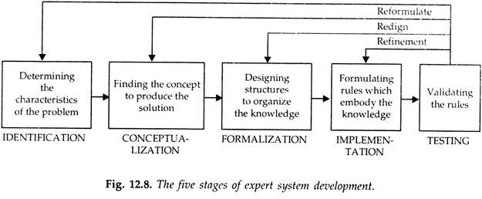
STEPS
education for life www.rimt.ac.in

Slide 4
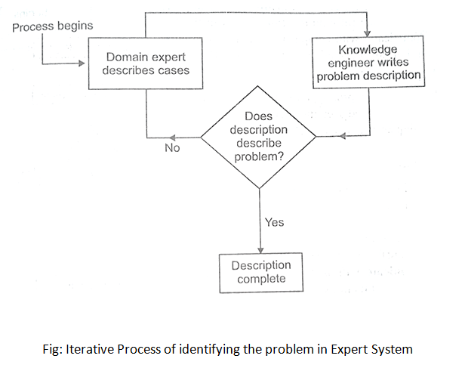
Step1: Identification: Determining the characteristics of the problem.
education for life www.rimt.ac.in

Slide 5
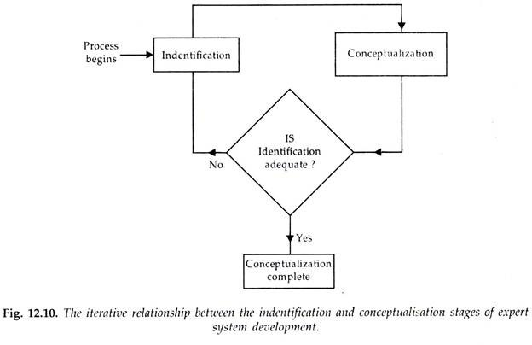
Step2: Conceptualization: Finding the concept to produce the solution.
education for life www.rimt.ac.in

Slide 6
Step3: Formalization: Designing structures to organize the knowledge.
During formalization, it is important that the knowledge engineer be familiar with the following:
1. The various techniques of knowledge representation and intelligent search techniques used in expert systems.
2. The expert system tools which can greatly expedite the development process.
3. Other expert systems which may solve similar problems and thus may be adaptable to problem at hand.
education for life www.rimt.ac.in

Slide 7
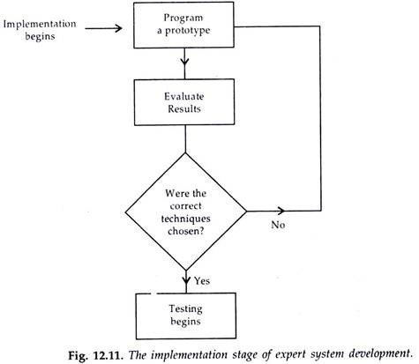
Step4: Implementation: Formulating rules which embody the knowledge.
education for life www.rimt.ac.in

Slide 8
Step5: Testing: Testing (Validation, Verification and Maintenance).
Testing includes are:
i. The system implements correctly or incorrectly.
ii. Rules implement correctly or not.
iii. The System uses for testing for both simple and complex problems by domain experts to uncover more defects.
iv. An Expert System is finally tested to be successful only when it is operated at the level of a human expert.
v. The testing process is NOT complete until it indicates that the solutions suggested by the expert system are consistently valid.
education for life www.rimt.ac.in

