Slide 1
COMMUNICATIVE ENGLISH / BENG-1101
Course Name: B.Tech (Common to all branches) Semester: First
Prepared by: AMIT MOHAN
Head & Assistant Professor
education for life www.rimt.ac.in
Department of English

Slide 2
Topic Discussed
Business Writing Skills
Resume Writing
education for life www.rimt.ac.in
Department of English

Slide 3
What is Resume ?
A resume is a SUMMARY or WRITTEN STATEMENT of one’s personal history, i.e. objectives, educational qualifications, biographical details, work history/experience, achievements, activities, honors/awards and other strong points that make you suitable for getting selected for a job.
Writing a resume is also an ego-building experience : the person who looks so good on paper is YOU.
First impression of you for employer - Wow Factor - Grab employer’s attention
education for life www.rimt.ac.in
Department of English

Slide 4
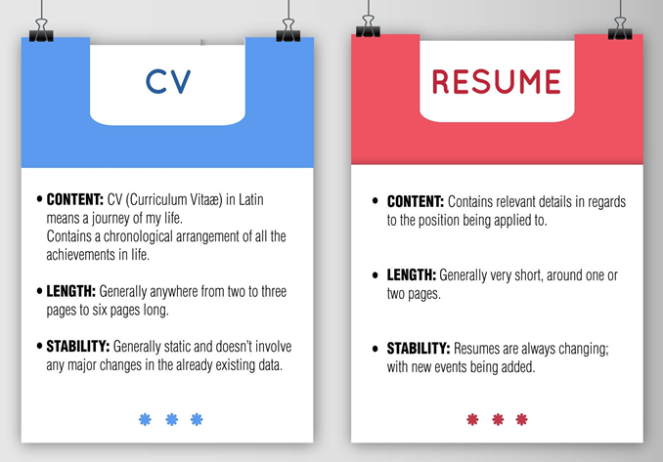
education for life www.rimt.ac.in
Department of English

Slide 5
education for life www.rimt.ac.in
Department of English

Slide 6
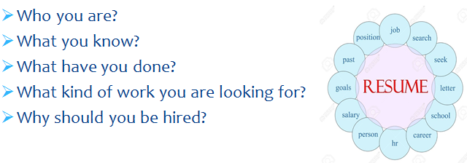
A Good Resume should answer the
following questions :
education for life www.rimt.ac.in
Department of English

Slide 7
education for life www.rimt.ac.in
Department of English

Slide 8
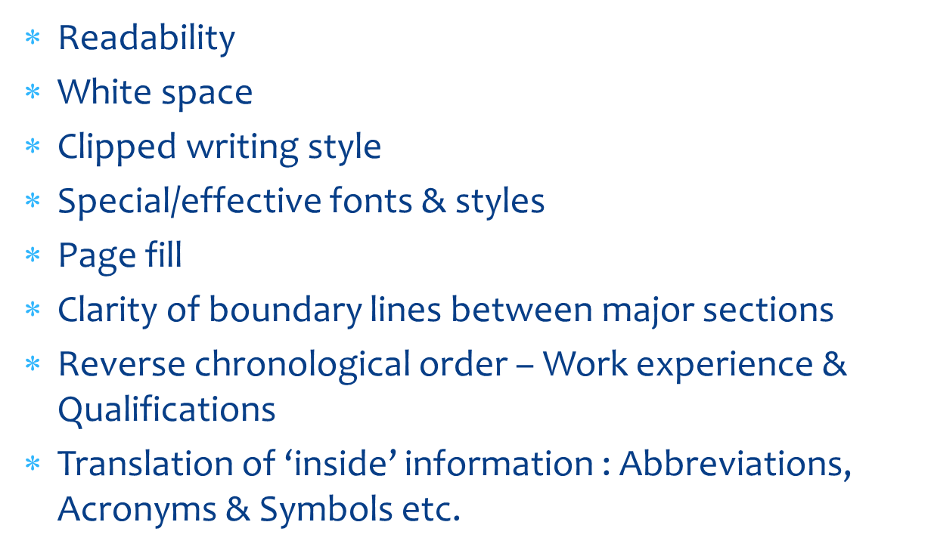
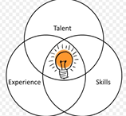
Use facts , not opinions
Use positive language & simple words
Grammar & spelling usage
Proofreading before final draft
Paper & Printer quality
education for life www.rimt.ac.in
Department of English

Slide 9
Contain an Objective Statement
Pleasing to the Eye, Easy to Read!
Lists skills, employers want to know what you can bring to their company.
Relevant to the Job. It should fit with the job you are applying for.
Keep your resume to 1-2 pages
List education and work experience in reverse chronological order
Put your resume, cover letter, and references on professional style resume paper
Make it relevant and focus on skills/accomplishments
education for life www.rimt.ac.in
Department of English

Slide 10
Grammatical and spelling errors
Unprofessional (check your email address)
Too much info (overly wordy)
Irrelevant information
No objective statement
Lengthy paragraphs
Personal information
Leave a large amount of white space
education for life www.rimt.ac.in
Department of English

Slide 11
education for life www.rimt.ac.in
Department of English

Slide 12
Topics Discussed in Next Lecture
Business Writing Skills
Grammar
education for life www.rimt.ac.in
Department of English

