Slide 1
COMPUTER NETWORKS-II / BTCS-3501
Course Name: B.Tech CSE Semester: 5th
Prepared by: Er. Jasdeep Singh
education for life www.rimt.ac.in
Department of Computer Science & Engineering

Slide 2
Topics to be covered
Frequency reuse
education for life www.rimt.ac.in

Slide 3
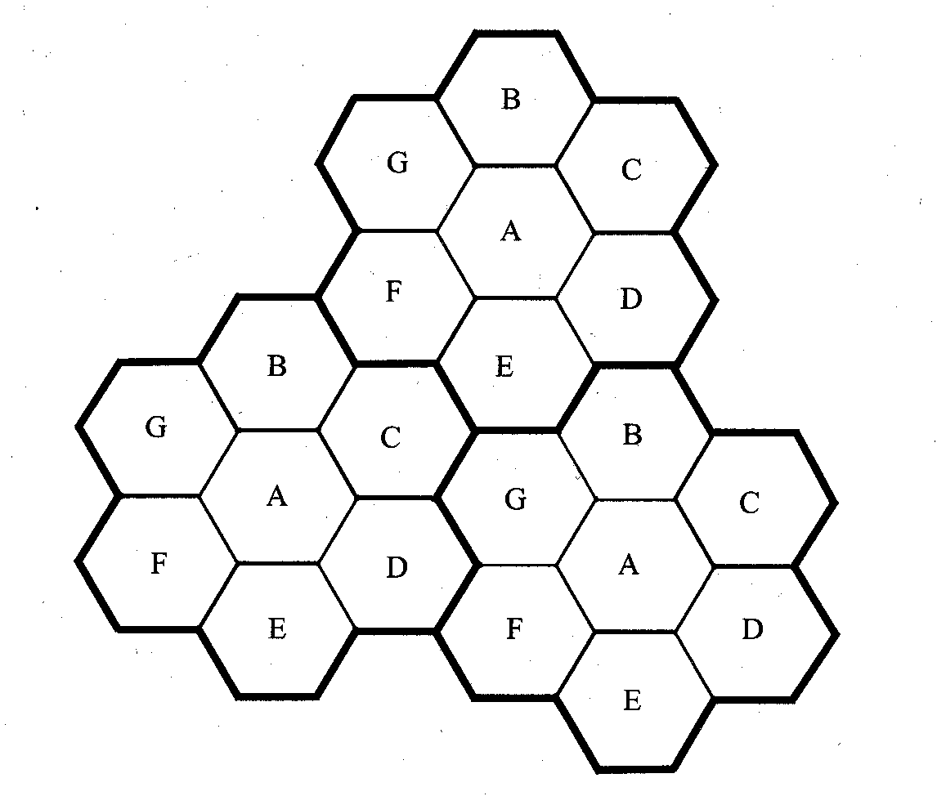
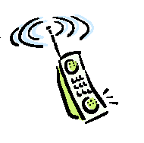
Introduction to Cellular Systems
Solves the problem of spectral congestion and user capacity.
Offer very high capacity in a limited spectrum without major technological changes.
Reuse of radio channel in different cells.
Enable a fix number of channels to serve an arbitrarily large number of users by reusing the channel throughout the coverage region.
education for life www.rimt.ac.in

Slide 4
Frequency Reuse
Each cellular base station is allocated a group of radio channels within a small geographic area called a cell.
Neighboring cells are assigned different channel groups.
By limiting the coverage area to within the boundary of the cell, the channel groups may be reused to cover different cells.
Keep interference levels within tolerable limits.
Frequency reuse or frequency planning
seven groups of channel from A to G
footprint of a cell - actual radio coverage
omni-directional antenna v.s. directional antenna
education for life www.rimt.ac.in

Slide 5
Consider a cellular system which has a total of S duplex channels.
Each cell is allocated a group of k channels, .
The S channels are divided among N cells.
The total number of available radio channels
The N cells which use the complete set of channels is called cluster.
The cluster can be repeated M times within the system. The total number of channels, C, is used as a measure of capacity
The capacity is directly proportional to the number of replication M.
The cluster size, N, is typically equal to 4, 7, or 12.
Small N is desirable to maximize capacity.
The frequency reuse factor is given by
education for life www.rimt.ac.in

Slide 6
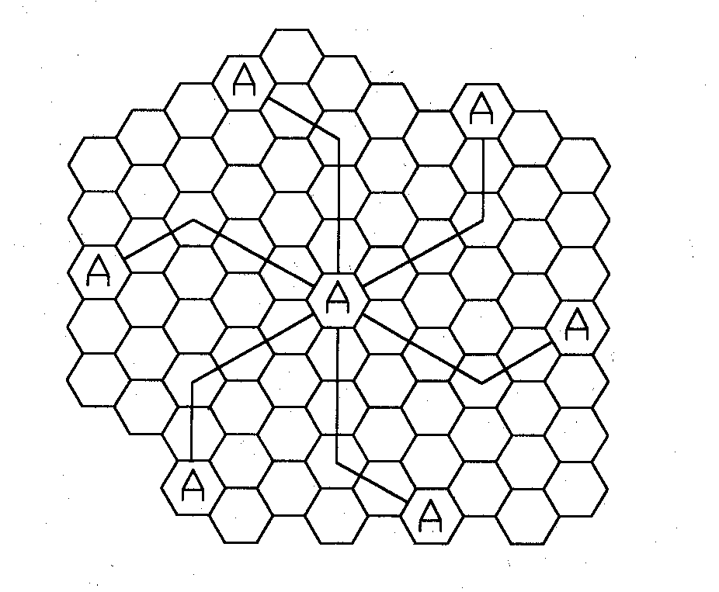
Hexagonal geometry has
exactly six equidistance neighbors
the lines joining the centers of any cell and each of its neighbors are separated by multiples of 60 degrees.
Only certain cluster sizes and cell layout are possible.
The number of cells per cluster, N, can only have values which satisfy
Co-channel neighbors of a particular cell, ex, i=3 and j=2.
education for life www.rimt.ac.in

Slide 7
Channel Assignment Strategies
Frequency reuse scheme
increases capacity
minimize interference
Channel assignment strategy
fixed channel assignment
dynamic channel assignment
Fixed channel assignment
each cell is allocated a predetermined set of voice channel
any new call attempt can only be served by the unused channels
the call will be blocked if all channels in that cell are occupied
Dynamic channel assignment
channels are not allocated to cells permanently.
allocate channels based on request.
reduce the likelihood of blocking, increase capacity.
education for life www.rimt.ac.in

Slide 8
2.5.2 Adjacent Channel Interference
Adjacent channel interference: interference from adjacent in frequency to the desired signal.
Imperfect receiver filters allow nearby frequencies to leak into the passband
Performance degrade seriously due to near-far effect.
education for life www.rimt.ac.in

Slide 9
Adjacent channel interference can be minimized through careful filtering and channel assignment.
Keep the frequency separation between each channel in a given cell as large as possible
A channel separation greater than six is needed to bring the adjacent channel interference to an acceptable level.
education for life www.rimt.ac.in

Slide 10
Topics to be covered in next lecture
channel assignment strategies
education for life www.rimt.ac.in

