Slide 1
COMPUTER NETWORKS-II / BTCS-3501
Course Name: B.Tech CSE Semester: 5th
Prepared by: Er. Jasdeep Singh
education for life www.rimt.ac.in
Department of Computer Science & Engineering

Slide 2
Topics to be covered
Interference and system capacity
education for life www.rimt.ac.in

Slide 3
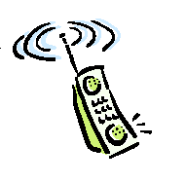
Interference and System Capacity
Sources of interference
another mobile in the same cell
a call in progress in the neighboring cell
other base stations operating in the same frequency band
noncellular system leaks energy into the cellular frequency band
Two major cellular interference
co-channel interference
adjacent channel interference
education for life www.rimt.ac.in

Slide 4
Co-channel Interference and System Capacity
Frequency reuse - there are several cells that use the same set of frequencies
co-channel cells
co-channel interference
To reduce co-channel interference, co-channel cell must be separated by a minimum distance.
When the size of the cell is approximately the same
co-channel interference is independent of the transmitted power
co-channel interference is a function of
R: Radius of the cell
D: distance to the center of the nearest co-channel cell
Increasing the ratio Q=D/R, the interference is reduced.
Q is called the co-channel reuse ratio
education for life www.rimt.ac.in

Slide 5
For a hexagonal geometry
A small value of Q provides large capacity
A large value of Q improves the transmission quality - smaller level of co-channel interference
A tradeoff must be made between these two objectives
education for life www.rimt.ac.in

Slide 6
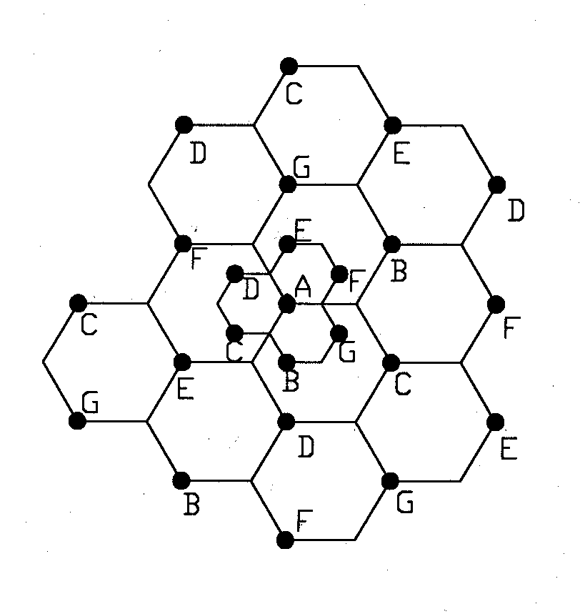
Cell Splitting
Split congested cell into smaller cells.
Preserve frequency reuse plan.
Reduce transmission power.
Reduce R to R/2
microcell

Slide 7
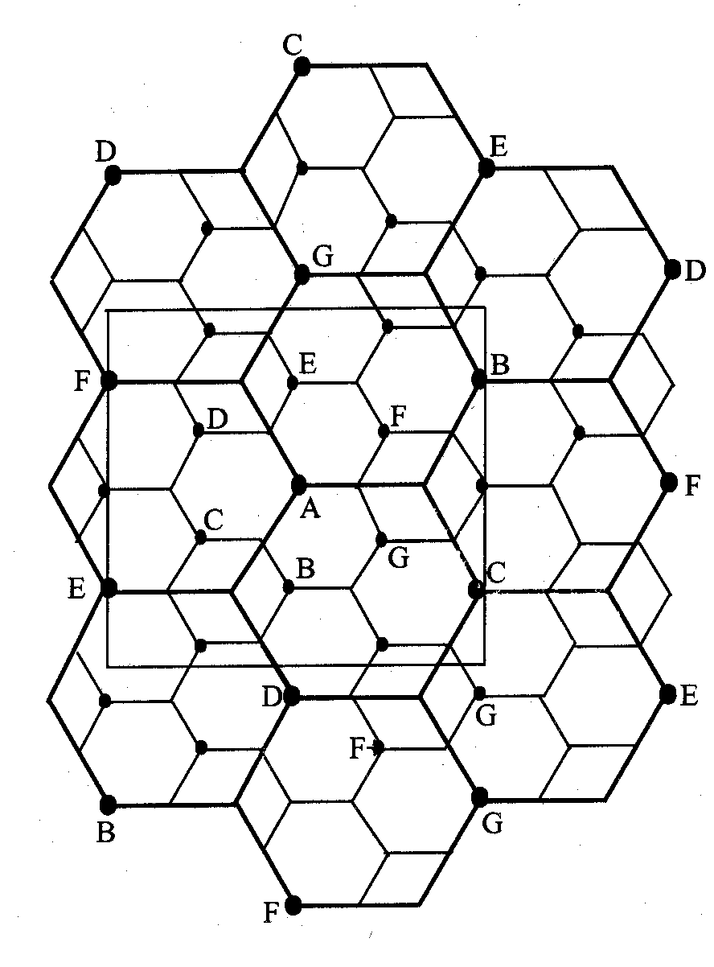
Illustration of cell splitting within a 3 km by 3 km square

Slide 8
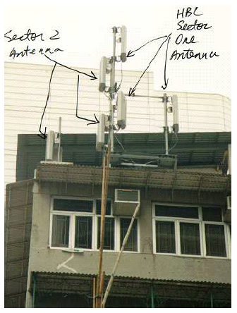
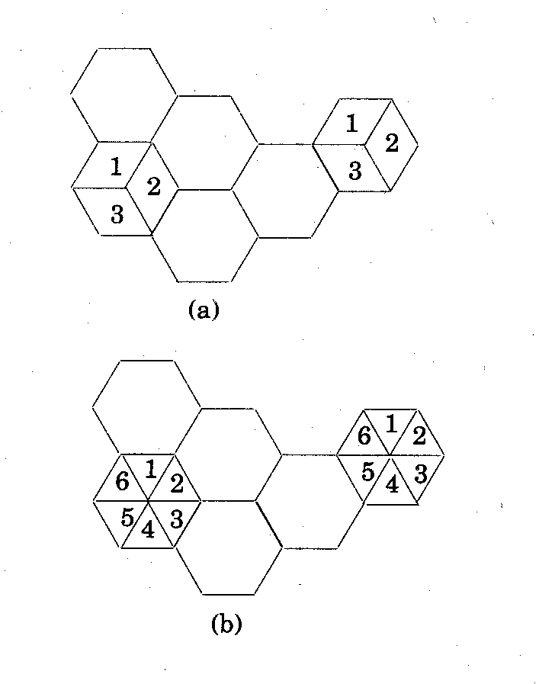
Sectoring
Decrease the co-channel interference and keep the cell radius R unchanged
Replacing single omni-directional antenna by several directional antennas
Radiating within a specified sector
education for life www.rimt.ac.in

Slide 9
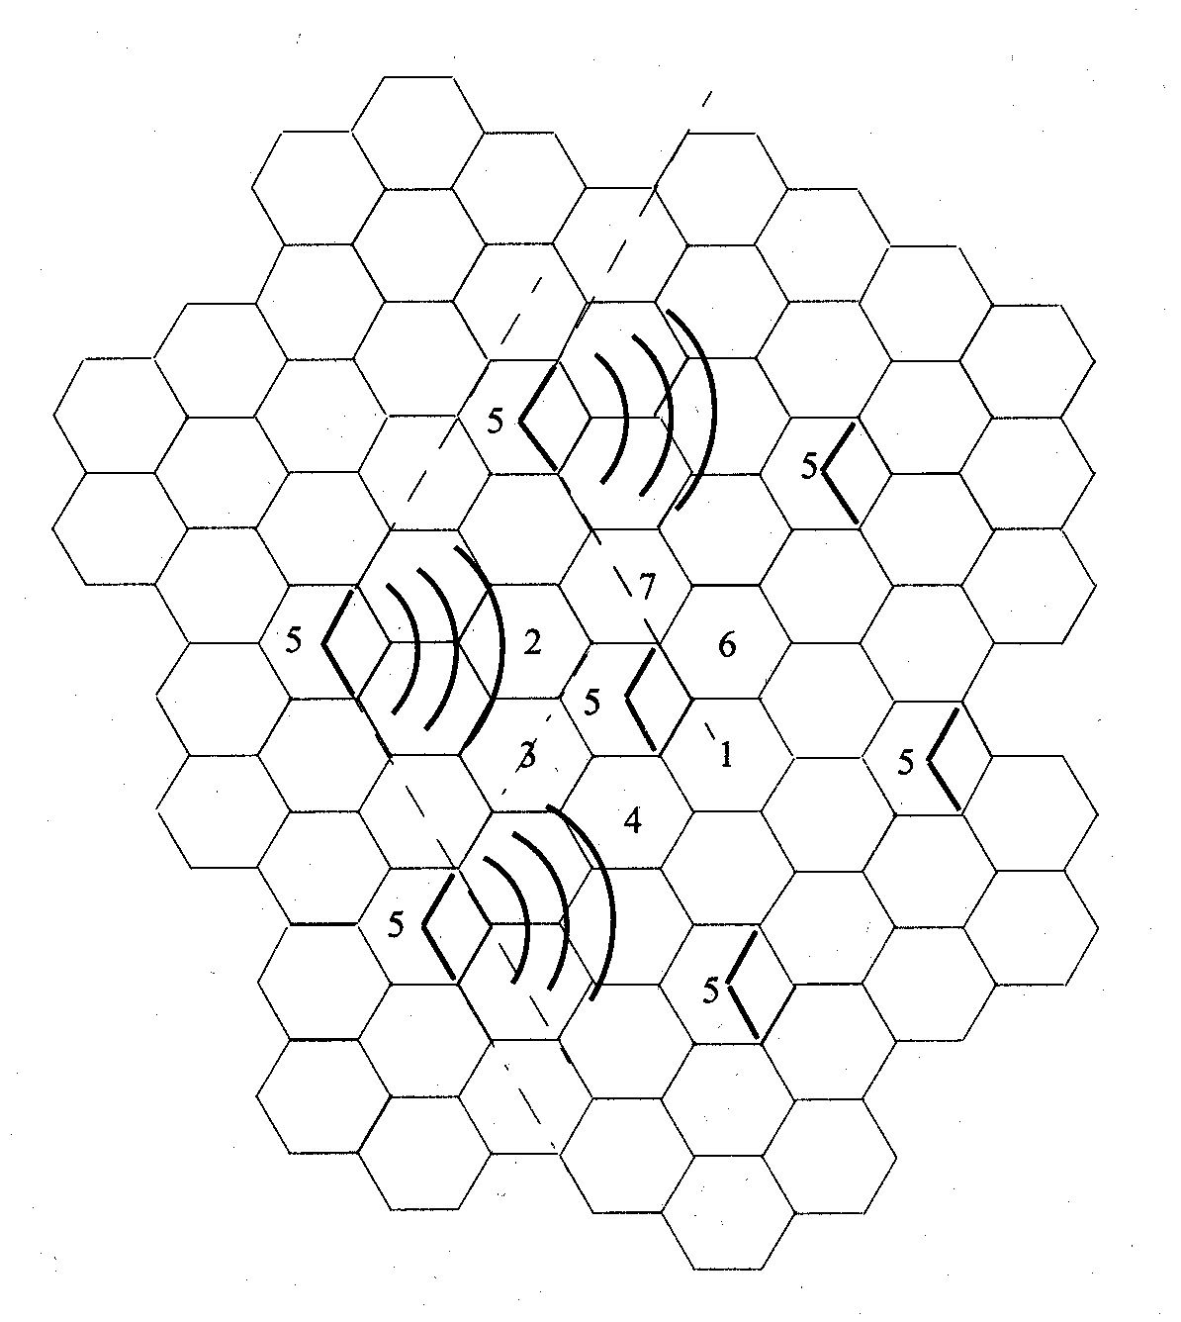
Interference Reduction
position of the mobile
interference cells
education for life www.rimt.ac.in

Slide 10
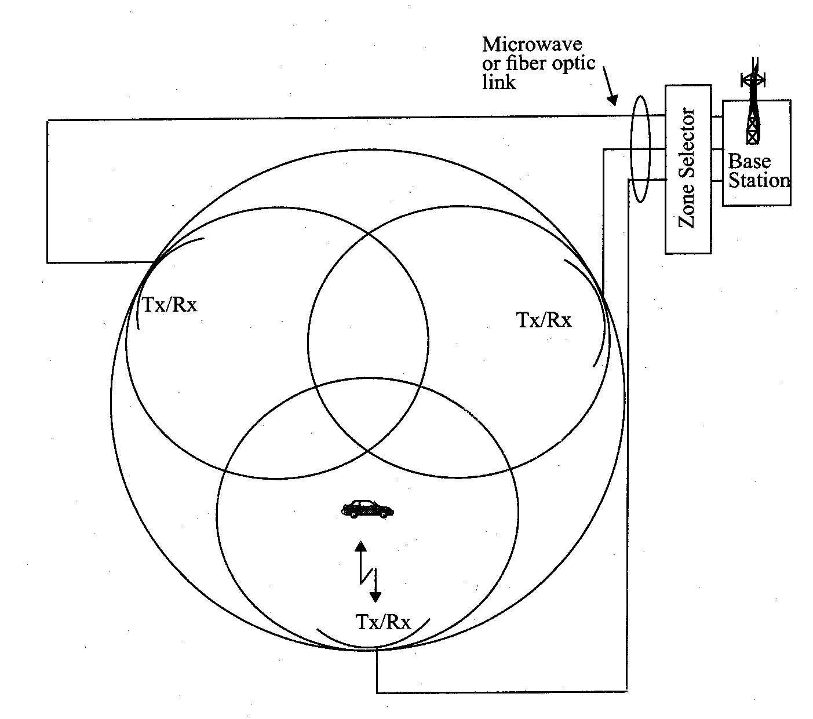
Microcell Zone Concept
Antennas are placed at the outer edges of the cell
Any channel may be assigned to any zone by the base station
Mobile is served by the zone with the strongest signal.
Handoff within a cell
No channel re-assignment
Switch the channel to a different zone site
Reduce interference
Low power transmitters are employed
education for life www.rimt.ac.in

Slide 11
Topics to be covered in next lecture
improving coverage and capacity in cellular systems
education for life www.rimt.ac.in

