Slide 1
EXPERT SYSTEM BTCS-3613
Course Name: B.Tech (CSE) Semester: 6th
Prepared by: Sahilpreet Singh
education for life www.rimt.ac.in
Department of Computer Science & Engineering

Slide 2
Topic:-AGENT in EXPERT SYSTEM
education for life www.rimt.ac.in

Slide 3
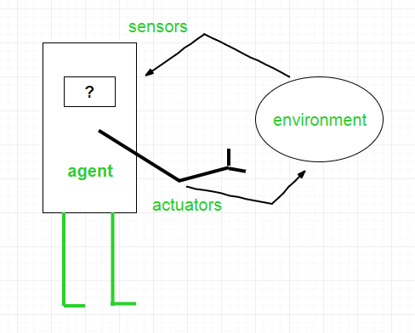
INTRODUCTION
A rational agent could be anything that makes decisions, as a person, firm, machine, or software.
It carries out an action with the best outcome after considering past and current percepts.
An agent is anything that can be viewed as :
perceiving its environment through sensors and
acting upon that environment through actuators
education for life www.rimt.ac.in

Slide 4
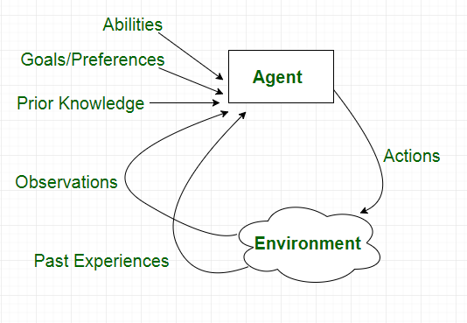
A software agent has Keystrokes, file contents, received network packages which act as sensors and displays on the screen, files, sent network packets acting as actuators.
A Human-agent has eyes, ears, and other organs which act as sensors, and hands, legs, mouth, and other body parts acting as actuators.
A Robotic agent has Cameras and infrared range finders which act as sensors and various motors acting as actuators.
education for life www.rimt.ac.in

Slide 5
Types of Agents
Simple Reflex Agents
Model-Based Reflex Agents
Goal-Based Agents
Utility-Based Agents
Learning Agent
education for life www.rimt.ac.in

Slide 6
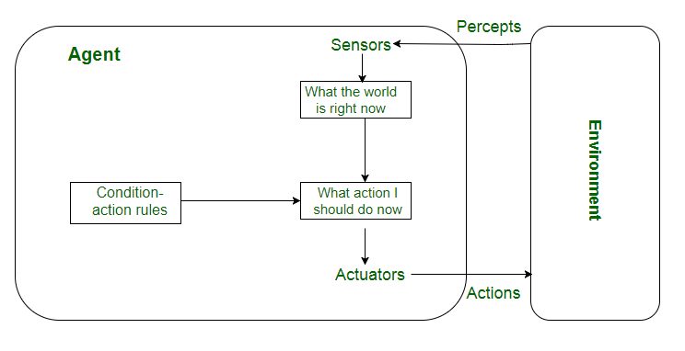
Simple reflex agents
Simple reflex agents ignore the rest of the percept history and act only on the basis of the current percept.
The agent function is based on the condition-action rule.
If the condition is true, then the action is taken, else not.
education for life www.rimt.ac.in

Slide 7
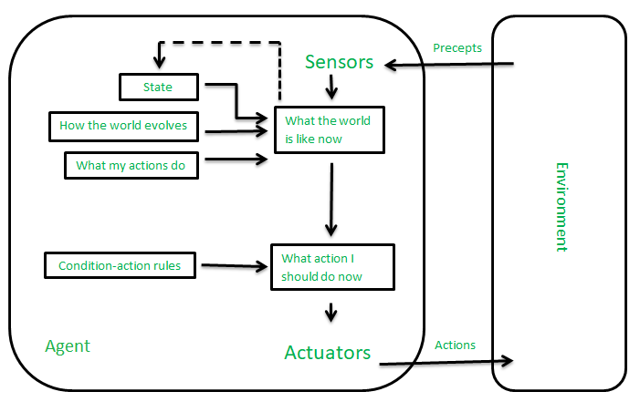
Model-based reflex agents
It works by finding a rule whose condition matches the current situation.
It can handle partially observable environments by the use of a model about the world.
education for life www.rimt.ac.in

Slide 8
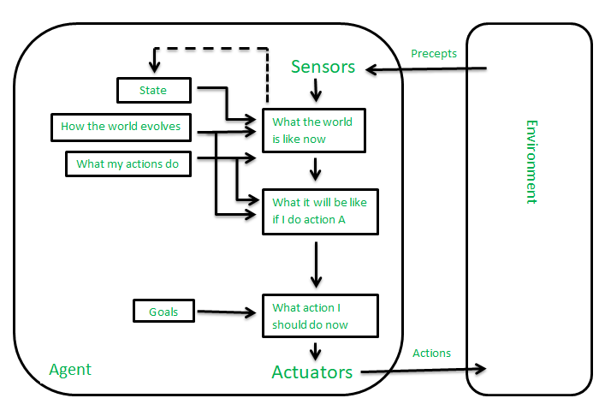
Goal-based agents
These kinds of agents take decisions based on how far they are currently from their goal(description of desirable situations).
This allows the agent a way to choose among multiple possibilities, selecting the one which reaches a goal state.
education for life www.rimt.ac.in

Slide 9
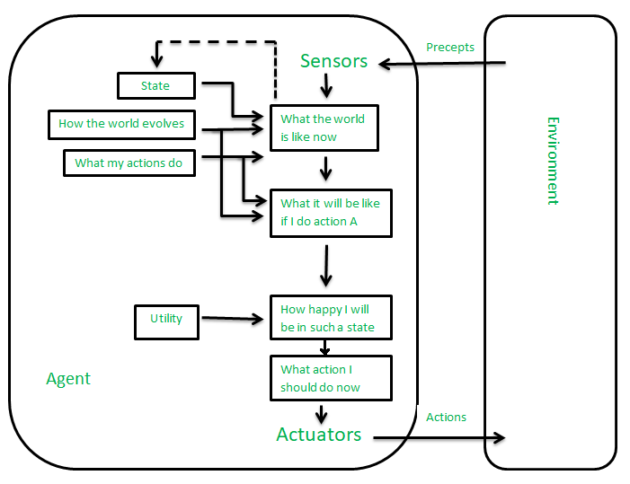
Utility-based agents
The agents which are developed having their end uses as building blocks are called utility-based agents.
When there are multiple possible alternatives, then to decide which one is best, utility-based agents are used.
education for life www.rimt.ac.in

Slide 10
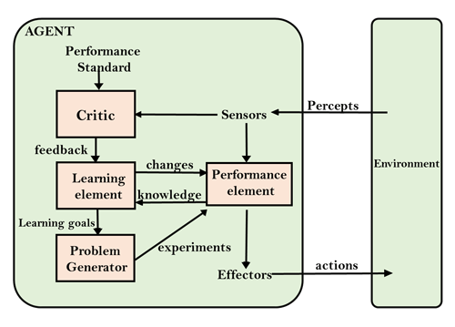
Learning Agent
A learning agent in AI is the type of agent that can learn from its past experiences or it has learning capabilities.
It starts to act with basic knowledge and then is able to act and adapt automatically through learning
education for life www.rimt.ac.in

Slide 11
A learning agent has mainly four conceptual components:
Learning element: It is responsible for making improvements by learning from the environment
Critic: The learning element takes feedback from critics which describes how well the agent is doing with respect to a fixed performance standard.
Performance element: It is responsible for selecting external action
Problem Generator: This component is responsible for suggesting actions that will lead to new and informative experiences.
education for life www.rimt.ac.in

