Slide 1
Strength of Materials-I(BMEC-2301)
Course Name: B.Tech-Mechanical Semester: 3rd
Prepared by: Ajay Singh Rana
education for life www.rimt.ac.in
Department of Mechanical Engineering

Slide 2
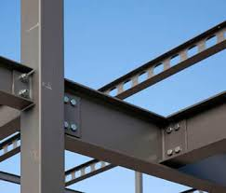
Bending Stresses in Beams
education for life www.rimt.ac.in
Department of Mechanical Engineering

Slide 3
Topic Discussed
Introduction
Pure Bending
Assumptions in Pure Bending
Bending Stresses in Beam subjected to Pure Bending
Modulus of Section
Numerical
Flitched beams
education for life www.rimt.ac.in
Department of Mechanical Engineering

Slide 4
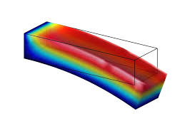
Introduction
When some external load acts on a beam, the shear force and bending moments are setup. Due to the shear force and bending moment, the beam undergoes certain deformation. The material of the beam will offer resistance or stresses against these deformations. These stresses with certain assumptions can be calculated.
The stresses introduced by bending moment are known as Bending stresses
education for life www.rimt.ac.in
Department of Mechanical Engineering

Slide 5
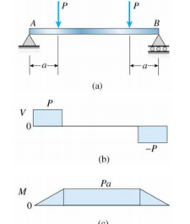
Pure Bending:- If the length of the beam is subjected to a constant bending moment and no shear force, then stresses setup due to bending moment only and that length of the beam is said to be in pure bending
Beam with central region is in pure bending and end regions in nonuniform bending is shown
education for life www.rimt.ac.in
Department of Mechanical Engineering

Slide 6
Pure Bending Assumptions:
1. Beam is straight before loads are applied and has a constant cross-sectional area.
2. Beam has a longitudinal plane of symmetry and the bending moment lies within this plane.
3. Beam is subjected to pure bending (bending moment does not change along the length).
4. Beam material is homogeneous and isotropic and obeys Hook's law.
5. The modulus of elasticity in tension and compression are equal.
education for life www.rimt.ac.in
Department of Mechanical Engineering

Slide 7
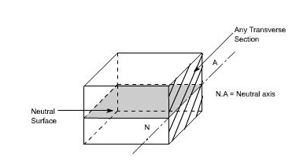
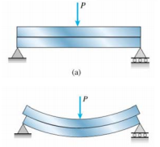
Bending Stresses in beam subjected to pure bending:
When a beam is under bending the fibers at the top will be shortened while at the bottom will be lengthened provided the bending moment M acts at the ends. In between these there are some fibers which remain unchanged in length that is they are not strained, that is they do not carry any stress. The plane containing such fibers is called neutral surface. The line of intersection between the neutral surface and the transverse exploratory section is called the neutral axis Neutral axis (N A).
education for life www.rimt.ac.in
Department of Mechanical Engineering

Slide 8
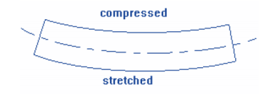
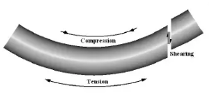
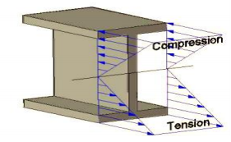
The bent beam goes into tension (stretched) on one side and compression on the other
Bending stress is distributed through a beam as seen in the diagram below:
education for life www.rimt.ac.in
Department of Mechanical Engineering

Slide 9
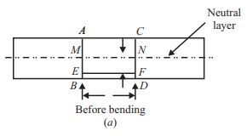
So, in reality, bending stresses are tensile or compressive stresses in the beam! A simply-supported beam always has tensile stresses at the bottom of the beam and compressive stresses at the top of the beam.
With reference to Fig. (a), let us consider any two normal sections AB and CD of a beam at a small distance δL apart (i.e., AC = BD = δL). Let AB and CD intersect the neutral layer at M and N respectively.
Let; M = bending moment acting on the beam
θ = Angle subtended at the centre by the arc.
R = Radius of curvature of the neutral layer M′N′.
education for life www.rimt.ac.in
Department of Mechanical Engineering

Slide 10
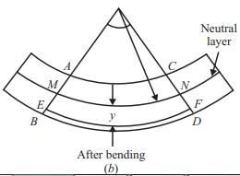
At any distance ‘y’ from the neutral layer MN, let us consider a layer EF. Fig. (b) shows the beam due to sagging bending moment. After bending, A′B′, C′D′, M′N′ and E′F′ represent the final positions of AB, CD, MN and EF respectively.
education for life www.rimt.ac.in
Department of Mechanical Engineering

Slide 11
When produced, A′B′ and C′D′ intersect each other at O subtending an angle θ radian at O, which is the centre of curvature. Since δL is very small, arcs A′C′, M′N′, E′F′ and B′D′ may be taken as circular. Now, strain in the layer EF due to bending is given by
e = (E′F′ – EF)/EF = (E′F′ – MN)/MN
Since MN is the neutral layer, MN = M′N′
education for life www.rimt.ac.in
Department of Mechanical Engineering

Slide 12
Let σ = stress set up in the layer EF due to bending
E = Young’s modulus of the material of the beam.
Then E = σ/e or, e = σ/E ....(ii)
Equate equation (i) and (ii);
we get y/ R = σ/E
education for life www.rimt.ac.in
Department of Mechanical Engineering

Slide 13
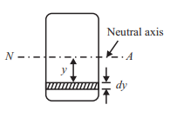
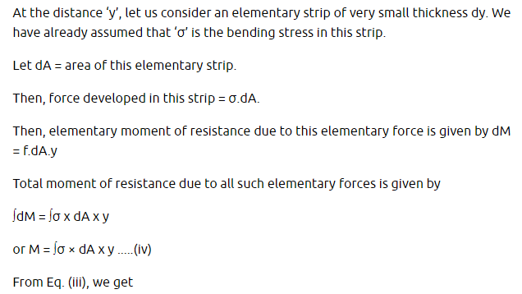
education for life www.rimt.ac.in
Department of Mechanical Engineering

Slide 14
education for life www.rimt.ac.in
Department of Mechanical Engineering

Slide 15
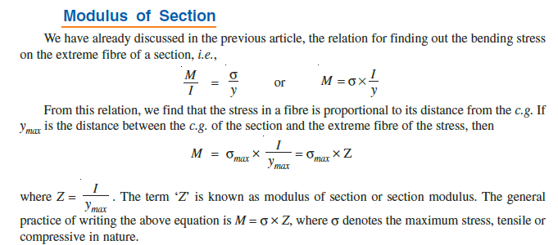
education for life www.rimt.ac.in
Department of Mechanical Engineering

Slide 16
Rectangular Section:
Circular Section:
education for life www.rimt.ac.in
Department of Mechanical Engineering

Slide 17
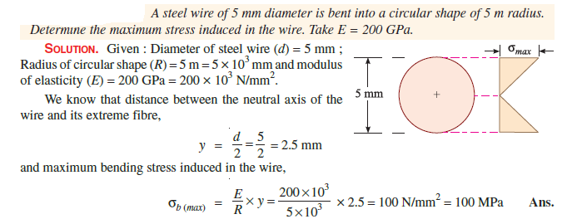
education for life www.rimt.ac.in
Department of Mechanical Engineering

Slide 18
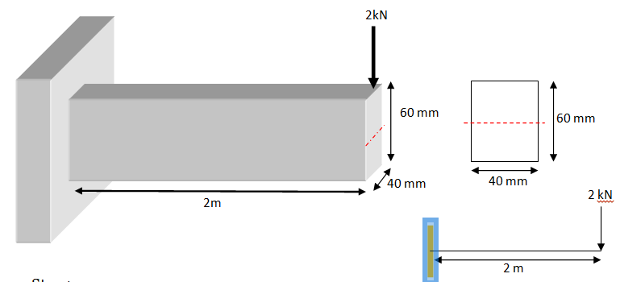
Q-1 A cantilever beam of length 2m fails when a load of 2KN is applied at the free end. If the section is 40mmx60mm, find the stress at the failure.
education for life www.rimt.ac.in
Department of Mechanical Engineering

Slide 19
Step 1:
Data:
Length of beam = 2m or 2000mm
Load at failure = 2KN
Section dimensions = 40mm X 60mm
Step 2:
Calculation of moment of inertia
$$I=\frac{b×d^{3}}{12}=\frac{40×{60}^{3}}{12}=7.2×{10}^{5} {mm}^{4}$$
education for life www.rimt.ac.in
Department of Mechanical Engineering

Slide 20
Step 3:
Calculation of bending moment about fixed end
M = WL
= (2)(2)
= 4KN-m
= 4000 × 1000 N-mm= 4 × 10⁶ N-mm
Step 4:
Calculation of bending stress
$\frac{M}{I}=\frac{σ}{y}$
Substitute for above (where y = depth /2= 60/2 = 30mm)
There fore
$$\frac{4×{10}^{6}}{7.2×{10}^{5}}=\frac{σ}{30}$$
σ = 166.67N/mm²
education for life www.rimt.ac.in
Department of Mechanical Engineering

Slide 21
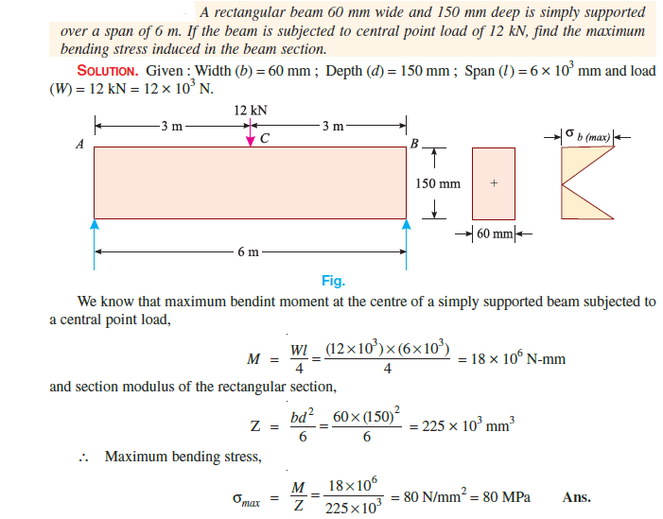
education for life www.rimt.ac.in
Department of Mechanical Engineering

Slide 22
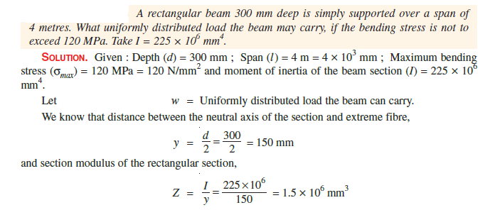
education for life www.rimt.ac.in
Department of Mechanical Engineering

Slide 23
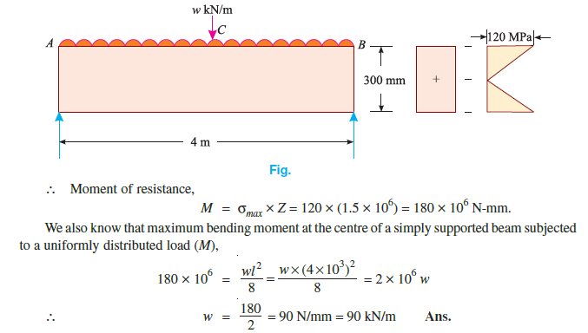
education for life www.rimt.ac.in
Department of Mechanical Engineering

Slide 24
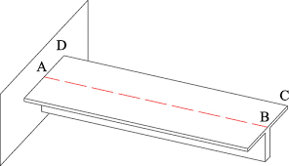
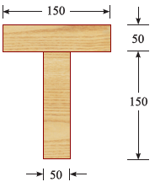
T-section cantilever beam
education for life www.rimt.ac.in
Department of Mechanical Engineering

Slide 25
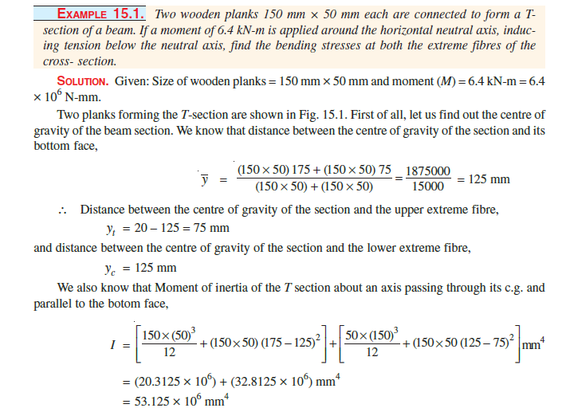
education for life www.rimt.ac.in
Department of Mechanical Engineering

Slide 26
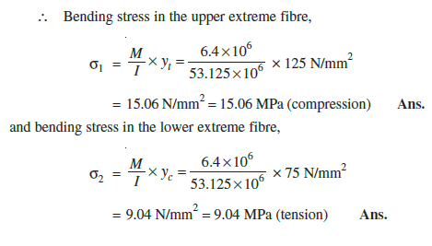
education for life www.rimt.ac.in
Department of Mechanical Engineering

Slide 27
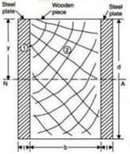
education for life www.rimt.ac.in
Department of Mechanical Engineering

Slide 28
education for life www.rimt.ac.in
Department of Mechanical Engineering

Slide 29
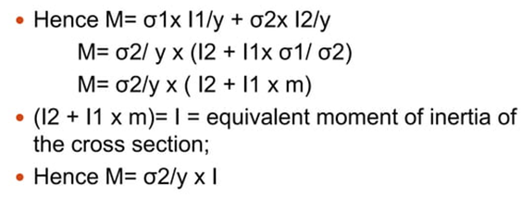
education for life www.rimt.ac.in
Department of Mechanical Engineering

