Slide 1
Operating System/ BTCS-2401
Course Name: B.Tech CSE Semester: 4th
Prepared by: Er. Jasdeep Singh
education for life www.rimt.ac.in
Department of Computer Science & Engineering

Slide 2
Topic 15th : File-System Interface
education for life www.rimt.ac.in

Slide 3
Topics To Be Covered
File Concept
Access Methods
Directory Structure
File-System Mounting
File Sharing
Protection
education for life www.rimt.ac.in

Slide 4
Objectives
To explain the function of file systems
To describe the interfaces to file systems
To discuss file-system design tradeoffs, including access methods, file sharing, file locking, and directory structures
To explore file-system protection
education for life www.rimt.ac.in

Slide 5
File Concept
Contiguous logical address space
Types:
Data
numeric
character
binary
Program
education for life www.rimt.ac.in

Slide 6
File Structure
None - sequence of words, bytes
Simple record structure
Lines
Fixed length
Variable length
Complex Structures
Formatted document
Relocatable load file
Can simulate last two with first method by inserting appropriate control characters
Who decides:
Operating system
Program
education for life www.rimt.ac.in

Slide 7
File Attributes
Name – only information kept in human-readable form
Identifier – unique tag (number) identifies file within file system
Type – needed for systems that support different types
Location – pointer to file location on device
Size – current file size
Protection – controls who can do reading, writing, executing
Time, date, and user identification – data for protection, security, and usage monitoring
Information about files are kept in the directory structure, which is maintained on the disk
education for life www.rimt.ac.in

Slide 8
File Operations
File is an abstract data type
Create
Write
Read
Reposition within file
Delete
Truncate
Open(F_{i}) – search the directory structure on disk for entry F_{i}, and move the content of entry to memory
Close (F_{i}) – move the content of entry F_{i} in memory to directory structure on disk
education for life www.rimt.ac.in

Slide 9
Open Files
Several pieces of data are needed to manage open files:
File pointer: pointer to last read/write location, per process that has the file open
File-open count: counter of number of times a file is open – to allow removal of data from open-file table when last processes closes it
Disk location of the file: cache of data access information
Access rights: per-process access mode information
education for life www.rimt.ac.in

Slide 10
Open File Locking
Provided by some operating systems and file systems
Mediates access to a file
Mandatory or advisory:
Mandatory – access is denied depending on locks held and requested
Advisory – processes can find status of locks and decide what to do
education for life www.rimt.ac.in

Slide 11
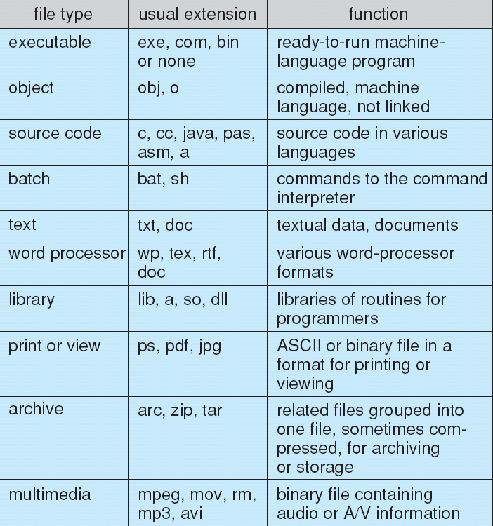
File Types – Name, Extension
education for life www.rimt.ac.in

Slide 12
Access Methods
Sequential Access
read next
write next
reset
no read after last write
(rewrite)
Direct Access
read n
write n
position to n
read next
write next
rewrite n
n = relative block number
education for life www.rimt.ac.in

Slide 13
Disk Structure
Disk can be subdivided into partitions
Disks or partitions can be RAID protected against failure
Disk or partition can be used raw – without a file system, or formatted with a file system
Partitions also known as minidisks, slices
Entity containing file system known as a volume
Each volume containing file system also tracks that file system’s info in device directory
As well as general-purpose file system there are many , special purpose file system frequently all within the same operating system or computer
education for life www.rimt.ac.in

Slide 14
Operations Performed on Directory
Search for a file
Create a file
Delete a file
List a directory
Rename a file
Traverse the file system
education for life www.rimt.ac.in

Slide 15
File System Mounting
A file system must be mounted before it can be accessed
A unmounted file system (i.e., Fig. 11-11(b)) is mounted at a mount point
education for life www.rimt.ac.in

Slide 16
File Sharing
Sharing of files on multi-user systems is desirable
Sharing may be done through a protection scheme
On distributed systems, files may be shared across a network
Network File System (NFS) is a common distributed file-sharing method
education for life www.rimt.ac.in

Slide 17
File Sharing – Multiple Users
User IDs identify users, allowing permissions and protections to be per-user
Group IDs allow users to be in groups, permitting group access rights
education for life www.rimt.ac.in

Slide 18
File Sharing – Failure Modes
Remote file systems add new failure modes, due to network failure, server failure
Recovery from failure can involve state information about status of each remote request
Stateless protocols such as NFS include all information in each request, allowing easy recovery but less security
education for life www.rimt.ac.in

Slide 19
Protection
File owner/creator should be able to control:
what can be done
by whom
Types of access
Read
Write
Execute
Append
Delete
List
education for life www.rimt.ac.in

Slide 20
Summary
File Concept
Access Methods
Directory Structure
File-System Mounting
File Sharing
Protection
education for life www.rimt.ac.in

Slide 21
Topics To Be Next Covered
Background
Demand Paging
Copy-on-Write
Page Replacement
Allocation of Frames
education for life www.rimt.ac.in

Slide 22
References
Silberschatz and Peter B. Calvin, “Operating System Concepts" Addison Wesley Publishing Company
Dhamdhere, “Systems Programming & Operating Systems Tata McGraw Hill
education for life www.rimt.ac.in

