Slide 1
Operating System/ BTCS-2401
Course Name: B.Tech CSE Semester: 4th
Prepared by: Er. Jasdeep Singh
education for life www.rimt.ac.in
Department of Computer Science & Engineering

Slide 2
Topic 8th : CPU Scheduling
education for life www.rimt.ac.in

Slide 3
Topics To Be Covered
Thread Scheduling
Multiple-Processor Scheduling
Operating Systems Examples
Algorithm Evaluation
education for life www.rimt.ac.in

Slide 4
Thread Scheduling
Distinction between user-level and kernel-level threads
When threads supported, threads scheduled, not processes
Many-to-one and many-to-many models, thread library schedules user-level threads to run on LWP
Known as process-contention scope (PCS) since scheduling competition is within the process
Typically done via priority set by programmer
Kernel thread scheduled onto available CPU is system-contention scope (SCS) – competition among all threads in system
education for life www.rimt.ac.in

Slide 5
Pthread Scheduling
API allows specifying either PCS or SCS during thread creation
PTHREAD_SCOPE_PROCESS schedules threads using PCS scheduling
PTHREAD_SCOPE_SYSTEM schedules threads using SCS scheduling
Can be limited by OS – Linux and Mac OS X only allow PTHREAD_SCOPE_SYSTEM
education for life www.rimt.ac.in

Slide 6
Multiple-Processor Scheduling
CPU scheduling more complex when multiple CPUs are available
Homogeneous processors within a multiprocessor
Asymmetric multiprocessing – only one processor accesses the system data structures, alleviating the need for data sharing
Symmetric multiprocessing (SMP) – each processor is self-scheduling, all processes in common ready queue, or each has its own private queue of ready processes
Currently, most common
Processor affinity – process has affinity for processor on which it is currently running
soft affinity
hard affinity
Variations including processor sets
education for life www.rimt.ac.in

Slide 7
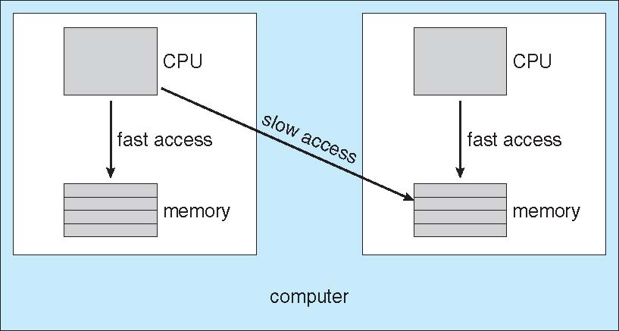
NUMA and CPU Scheduling
Note that memory-placement algorithms can also consider affinity
education for life www.rimt.ac.in

Slide 8
Multicore Processors
Recent trend to place multiple processor cores on same physical chip
Faster and consumes less power
Multiple threads per core also growing
Takes advantage of memory stall to make progress on another thread while memory retrieve happens
education for life www.rimt.ac.in

Slide 9
Virtualization and Scheduling
Virtualization software schedules multiple guests onto CPU(s)
Each guest doing its own scheduling
Not knowing it doesn’t own the CPUs
Can result in poor response time
Can effect time-of-day clocks in guests
Can undo good scheduling algorithm efforts of guests

Slide 10
Operating System Examples
Solaris scheduling
Windows XP scheduling
Linux scheduling
education for life www.rimt.ac.in

Slide 11
Solaris
Priority-based scheduling
Six classes available
Time sharing (default)
Interactive
Real time
System
Fair Share
Fixed priority
Given thread can be in one class at a time
Each class has its own scheduling algorithm
Time sharing is multi-level feedback queue
Loadable table configurable by sysadmin
education for life www.rimt.ac.in

Slide 12
Solaris Scheduling (Cont.)
Scheduler converts class-specific priorities into a per-thread global priority
Thread with highest priority runs next
Runs until (1) blocks, (2) uses time slice, (3) preempted by higher-priority thread
Multiple threads at same priority selected via RR
education for life www.rimt.ac.in

Slide 13
Windows Scheduling
Windows uses priority-based preemptive scheduling
Highest-priority thread runs next
Dispatcher is scheduler
Thread runs until (1) blocks, (2) uses time slice, (3) preempted by higher-priority thread
Real-time threads can preempt non-real-time
32-level priority scheme
Variable class is 1-15,real is 16-31
Priority 0 is memory-management thread
Queue for each priority
education for life www.rimt.ac.in

Slide 14
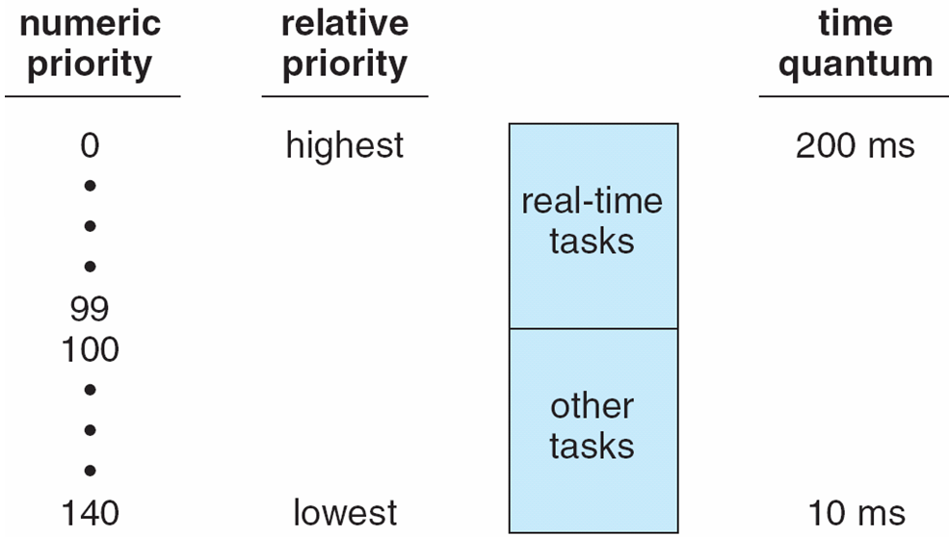
Priorities and Time-slice length
education for life www.rimt.ac.in

Slide 15
Algorithm Evaluation
How to select CPU-scheduling algorithm for an OS?
Determine criteria, then evaluate algorithms
Deterministic modeling
Type of analytic evaluation
Takes a particular predetermined workload and defines the performance of each algorithm for that workload
education for life www.rimt.ac.in

Slide 16
Queueing Models
Describes the arrival of processes, and CPU and I/O bursts probabilistically
Commonly exponential, and described by mean
Computes average throughput, utilization, waiting time, etc
Computer system described as network of servers, each with queue of waiting processes
Knowing arrival rates and service rates
Computes utilization, average queue length, average wait time, etc
education for life www.rimt.ac.in

Slide 17
Simulations
Queueing models limited
Simulations more accurate
Programmed model of computer system
Clock is a variable
Gather statistics indicating algorithm performance
Data to drive simulation gathered via
Random number generator according to probabilities
Distributions defined mathematically or empirically
Trace tapes record sequences of real events in real systems
education for life www.rimt.ac.in

Slide 18
Implementation
Even simulations have limited accuracy
Just implement new scheduler and test in real systems
High cost, high risk
Environments vary
Most flexible schedulers can be modified per-site or per-system
Or APIs to modify priorities
But again environments vary
education for life www.rimt.ac.in

Slide 19
Dispatch Latency
education for life www.rimt.ac.in

Slide 20
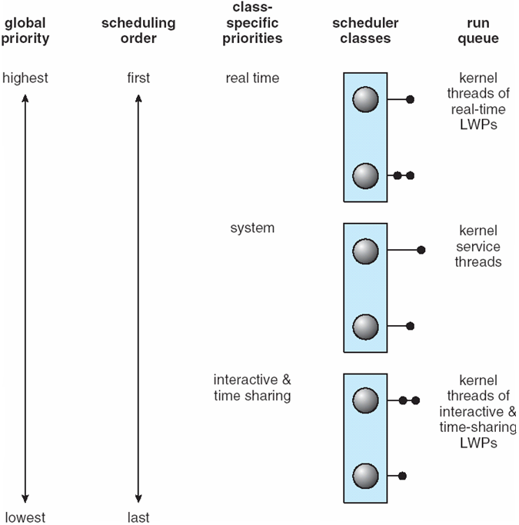
Solaris 2 Scheduling
education for life www.rimt.ac.in

Slide 21
Summary
Thread Scheduling
Multiple-Processor Scheduling
Operating Systems Examples
Algorithm Evaluation
education for life www.rimt.ac.in

Slide 22
Topics To Be Next Covered
Background
The Critical-Section Problem
Peterson’s Solution
Synchronization Hardware
education for life www.rimt.ac.in

Slide 23
References
Silberschatz and Peter B. Calvin, “Operating System Concepts" Addison Wesley Publishing Company
Dhamdhere, “Systems Programming & Operating Systems Tata McGraw Hill
education for life www.rimt.ac.in

