Slide 1
Operating System/ BTCS-2401
Course Name: B.Tech CSE Semester: 4th
Prepared by: Er. Jasdeep Singh
education for life www.rimt.ac.in
Department of Computer Science & Engineering

Slide 2
Topic 16th : Virtual Memory
education for life www.rimt.ac.in

Slide 3
Topics To Be Covered
Background
Demand Paging
Copy-on-Write
Page Replacement
Allocation of Frames
education for life www.rimt.ac.in

Slide 4
Objectives
To describe the benefits of a virtual memory system
To explain the concepts of demand paging, page-replacement algorithms, and allocation of page frames
To discuss the principle of the working-set model
education for life www.rimt.ac.in

Slide 5
Background
Code needs to be in memory to execute, but entire program rarely used
Error code, unusual routines, large data structures
Entire program code not needed at same time
Consider ability to execute partially-loaded program
Program no longer constrained by limits of physical memory
Program and programs could be larger than physical memory
education for life www.rimt.ac.in

Slide 6
Background
Virtual memory -separation of user logical memory from physical memory
Only part of the program needs to be in memory for execution
Logical address space can therefore be much larger than physical address space
Allows address spaces to be shared by several processes
Allows for more efficient process creation
More programs running concurrently
Less I/O needed to load or swap processes
Virtual memory can be implemented via:
Demand paging
Demand segmentation
education for life www.rimt.ac.in

Slide 7
Virtual Address Space
Enable sparse address spaces with holes left for growth, dynamically linked libraries, etc
System libraries shared via mapping into virtual address space
Shared memory by mapping pages read-write into virtual address space
Pages can be shared during fork(), speeding process creation
education for life www.rimt.ac.in

Slide 8
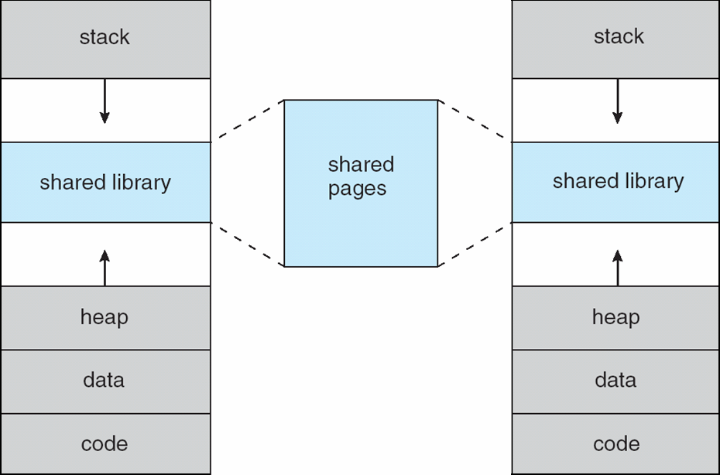
Shared Library Using Virtual Memory
education for life www.rimt.ac.in

Slide 9
Demand Paging
Could bring entire process into memory at load time
Or bring a page into memory only when it is needed
Less I/O needed, no unnecessary I/O
Less memory needed
Faster response
More users
Page is needed ⇒ reference to it
invalid reference ⇒ abort
not-in-memory ⇒ bring to memory
Lazy Swapper -never swaps a page into memory unless page will be needed
Swapper that deals with pages is a pager
education for life www.rimt.ac.in

Slide 10
Page Fault
If there is a reference to a page, first reference to that page will trap to operating system:
page fault
Operating system looks at another table to decide:
Invalid reference ⇒ abort
Just not in memory
Get empty frame
Swap page into frame via scheduled disk operation
Reset tables to indicate page now in memory Set validation bit = v
Restart the instruction that caused the page fault
education for life www.rimt.ac.in

Slide 11
Aspects of Demand Paging
Extreme case – start process with no pages in memory
OS sets instruction pointer to first instruction of process, non-memory-resident -> page fault
And for every other process pages on first access
Pure demand paging
Actually, a given instruction could access multiple pages -> multiple page faults
Hardware support needed for demand paging
Page table with valid / invalid bit
Secondary memory
Instruction restart
education for life www.rimt.ac.in

Slide 12
Demand Paging Optimizations
Copy entire process image to swap space at process load time
Then page in and out of swap space
Used in older BSD Unix
Demand page in from program binary on disk, but discard rather than paging out when freeing frame
Used in Solaris and current BSD
education for life www.rimt.ac.in

Slide 13
Page Replacement
Prevent over-allocation of memory by modifying page-fault service routine to include page replacement
Use modify (dirty) bit to reduce overhead of page transfers – only modified pages are written to disk
Page replacement completes separation between logical memory and physical memory – large virtual memory can be provided on a smaller physical memory
education for life www.rimt.ac.in

Slide 14
Basic Page Replacement
Find the location of the desired page on disk
Find a free frame: - If there is a free frame, use it - If there is no free frame, use a page replacement algorithm to select a victim frame - Write victim frame to disk if dirty
Bring the desired page into the (newly) free frame; update the page and frame tables
Continue the process by restarting the instruction that caused the trap
Note now potentially 2 page transfers for page fault – increasing EAT
education for life www.rimt.ac.in

Slide 15
Page and Frame Replacement Algorithms
Frame-allocation algorithm determines
How many frames to give each process
Which frames to replace
Page-replacement algorithm
Want lowest page-fault rate on both first access and re-access
Evaluate algorithm by running it on a particular string of memory references (reference string) and computing the number of page faults on that string
String is just page numbers, not full addresses
Repeated access to the same page does not cause a page fault
In all our examples, the reference string is 7,0,1,2,0,3,0,4,2,3,0,3,0,3,2,1,2,0,1,7,0,1
education for life www.rimt.ac.in

Slide 16
First-In-First-Out (FIFO) Algorithm
Reference string:7,0,1,2,0,3,0,4,2,3,0,3,0,3,2,1,2,0,1,7,0,1
3 frames (3 pages can be in memory at a time per process)
Can vary by reference string: consider 1,2,3,4,1,2,5,1,2,3,4,5
Adding more frames can cause more page faults!
Belady ’s Anomaly
How to track ages of pages?
Just use a FIFO queue
1
7
2
4 0 7
2
0
3
15 page faults
2 1 0
3
1
0
3 2 1
education for life www.rimt.ac.in

Slide 17
Counting Algorithms
Keep a counter of the number of references that have been made to each page
Not common
LFU Algorithm replaces page with smallest count
MFU Algorithm based on the argument that the page with the smallest count was probably just brought in and has yet to be used
education for life www.rimt.ac.in

Slide 18
Page-Buffering Algorithms
Keep a pool of free frames, always
Then frame available when needed, not found at fault time
Read page into free frame and select victim to evict and add to free pool
When convenient, evict victim
Possibly, keep list of modified pages
When backing store otherwise idle, write pages there and set to non-dirty
Possibly, keep free frame contents intact and note what is in them
If referenced again before reused, no need to load contents again from disk
Generally useful to reduce penalty if wrong victim frame selected
education for life www.rimt.ac.in

Slide 19
Allocation of Frames
Each process needs minimum number of frames
Example: IBM 370 – 6 pages to handle SS MOVE instruction:
instruction is 6 bytes, might span 2 pages
2 pages to handle from
2 pages to handle to
Maximum of course is total frames in the system
Two major allocation schemes
fixed allocation
priority allocation
Many variations
education for life www.rimt.ac.in

Slide 20
Fixed Allocation
Equal allocation – For example, if there are 100 frames (after allocating frames for the OS) and 5 processes, give each process 20 frames
Keep some as free frame buffer pool
Proportional allocation – Allocate according to the size of process
Dynamic as degree of multiprogramming, process sizes change
education for life www.rimt.ac.in

Slide 21
Priority Allocation
Use a proportional allocation scheme using priorities rather than size
If process P_{i} generates a page fault,
select for replacement one of its frames
select for replacement a frame from a process with lower priority number
education for life www.rimt.ac.in

Slide 22
Global vs. Local Allocation
– Global replacement process selects a replacement frame from the set of all frames; one process can take a frame from another
But then process execution time can vary greatly
But greater throughput so more common
Local replacement– each process selects from only its own set of allocated frames
More consistent per-process performance
But possibly underutilized memory
education for life www.rimt.ac.in

Slide 23
Summary
Background
Demand Paging
Copy-on-Write
Page Replacement
Allocation of Frames
education for life www.rimt.ac.in

Slide 24
Topics To Be Next Covered
Thrashing
Memory-Mapped Files
Allocating Kernel Memory
Other Considerations
Operating-System Examples
education for life www.rimt.ac.in

Slide 25
References
Silberschatz and Peter B. Calvin, “Operating System Concepts" Addison Wesley Publishing Company
Dhamdhere, “Systems Programming & Operating Systems Tata McGraw Hill
education for life www.rimt.ac.in

