Slide 1
Operating System/ BTCS-2401
Course Name: B.Tech CSE Semester: 4th
Prepared by: Er. Jasdeep Singh
education for life www.rimt.ac.in
Department of Computer Science & Engineering

Slide 2
Topic 30th : Case Studies-Windows 2000
education for life www.rimt.ac.in

Slide 3
Topics To Be Covered
History
Design Principles
System Components
Environmental Subsystems
File system
Networking
Programmer Interface
education for life www.rimt.ac.in

Slide 4
Windows 2000
32-bit preemptive multitasking operating system for Intel microprocessors
Key goals for the system:
portability
security
POSIX compliance
multiprocessor support
extensibility
international support
compatibility with MS-DOS and MS-Windows applications
Uses a micro-kernel architecture
Available in four versions, Professional, Server, Advanced Server, National Server
New version – Windows 2003, is now available
education for life www.rimt.ac.in

Slide 5
History
In 1988, Microsoft decided to develop a “new technology” (NT) portable operating system that supported both the OS/2 and POSIX APIs.
Originally, NT was supposed to use the OS/2 API as its native environment but during development NT was changed to use the Win32 API, reflecting the popularity of Windows 3.0.
education for life www.rimt.ac.in

Slide 6
Design Principles
Extensibility — layered architecture
Executive, which runs in protected mode, provides the basic system services.
On top of the executive, several server subsystems operate in user mode.
Modular structure allows additional environmental subsystems to be added without affecting the executive.
Portability — 2000 can be moved from on hardware architecture to another with relatively few changes.
Written in C and C++
Processor-dependent code is isolated in a dynamic link library (DLL) called the “hardware abstraction layer” (HAL).
education for life www.rimt.ac.in

Slide 7
Design Principles (Cont.)
Reliability — 2000 uses hardware protection for virtual memory, and software protection mechanisms for operating system resources.
Compatibility — applications that follow the IEEE 1003.1 (POSIX) standard can be complied to run on 2000 without changing the source code.
Performance — 2000 subsystems can communicate with one another via high-performance message passing
Preemption of low priority threads enables the system to respond quickly to external events
Designed for symmetrical multiprocessing
International support — supports different locales via the national language support (NLS) API.
education for life www.rimt.ac.in

Slide 8
2000 Architecture
Layered system of modules
Protected mode — HAL, kernel, executive
User mode — collection of subsystems
Environmental subsystems emulate different operating systems
Protection subsystems provide security functions
education for life www.rimt.ac.in

Slide 9
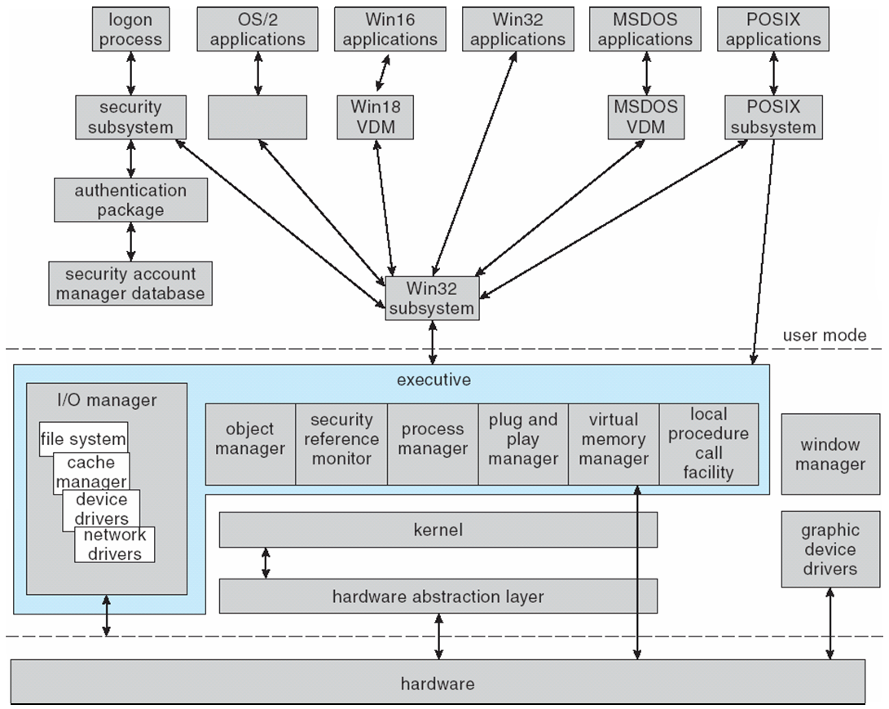
Depiction of 2000 Architecture
education for life www.rimt.ac.in

Slide 10
System Components — Kernel
Foundation for the executive and the subsystems
Never paged out of memory; execution is never preempted
Four main responsibilities:
thread scheduling
interrupt and exception handling
low-level processor synchronization
recovery after a power failure
Kernel is object-oriented, uses two sets of objects
dispatcher objects control dispatching and synchronization (events, mutants, mutexes, semaphores, threads and timers).
control objects (asynchronous procedure calls, interrupts, power notify, power status, process and profile objects)
education for life www.rimt.ac.in

Slide 11
Kernel — Process and Threads
The process has a virtual memory address space, information (such as a base priority), and an affinity for one or more processors.
Threads are the unit of execution scheduled by the kernel’s dispatcher.
Each thread has its own state, including a priority, processor affinity, and accounting information.
A thread can be one of six states: ready, standby, running, waiting, transition, and terminated.
education for life www.rimt.ac.in

Slide 12
Kernel — Scheduling
The dispatcher uses a 32-level priority scheme to determine the order of thread execution.
Priorities are divided into two classes:
The real-time class contains threads with priorities ranging from 16 to 31
The variable class contains threads having priorities from 0 to 15
Characteristics of 2000’s priority strategy
Trends to give very good response times to interactive threads that are using the mouse and windows
Enables I/O-bound threads to keep the I/O devices busy
Complete-bound threads soak up the spare CPU cycles in the background.
education for life www.rimt.ac.in

Slide 13
Kernel — Scheduling (Cont.)
Scheduling can occur when a thread enters the ready or wait state, when a thread terminates, or when an application changes a thread’s priority or processor affinity.
Real-time threads are given preferential access to the CPU; but 2000 does not guarantee that a real-time thread will start to execute within any particular time limit.
This is known as soft realtime.
education for life www.rimt.ac.in

Slide 14
Kernel — Trap Handling
The kernel provides trap handling when exceptions and interrupts are generated by hardware of software.
Exceptions that cannot be handled by the trap handler are handled by the kernel's exception dispatcher.
The interrupt dispatcher in the kernel handles interrupts by calling either an interrupt service routine (such as in a device driver) or an internal kernel routine.
The kernel uses spin locks that reside in global memory to achieve multiprocessor mutual exclusion.
education for life www.rimt.ac.in

Slide 15
Executive — Object Manager
2000 uses objects for all its services and entities; the object manger supervises the use of all the objects.
Generates an object handle
Checks security
Keeps track of which processes are using each object
Objects are manipulated by a standard set of methods, namely create, open, close, delete, query name, parse and security
education for life www.rimt.ac.in

Slide 16
Executive — Naming Objects
The 2000 executive allows any object to be given a name, which may be either permanent or temporary.
Object names are structured like file path names in MS-DOS and UNIX.
2000 implements a symbolic link object, which is similar to symbolic links in UNIX that allow multiple nicknames or aliases to refer to the same file.
A process gets an object handle by creating an object by opening an existing one, by receiving a duplicated handle from another process, or by inheriting a handle from a parent process.
Each object is protected by an access control list.
education for life www.rimt.ac.in

Slide 17
Executive — Process Manager
Provides services for creating, deleting, and using threads and processes
Issues such as parent/child relationships or process hierarchies are left to the particular environmental subsystem that owns the process
education for life www.rimt.ac.in

Slide 18
Executive — I/O Manager
The I/O manager is responsible for:
file systems
cache management
device drivers
network drivers
Keeps track of which installable file systems are loaded, and manages buffers for I/O requests
Works with VM Manager to provide memory-mapped file I/O
Controls the 2000 cache manager, which handles caching for the entire I/O system
Supports both synchronous and asynchronous operations, provides time outs for drivers, and has mechanisms for one driver to call another
education for life www.rimt.ac.in

Slide 19
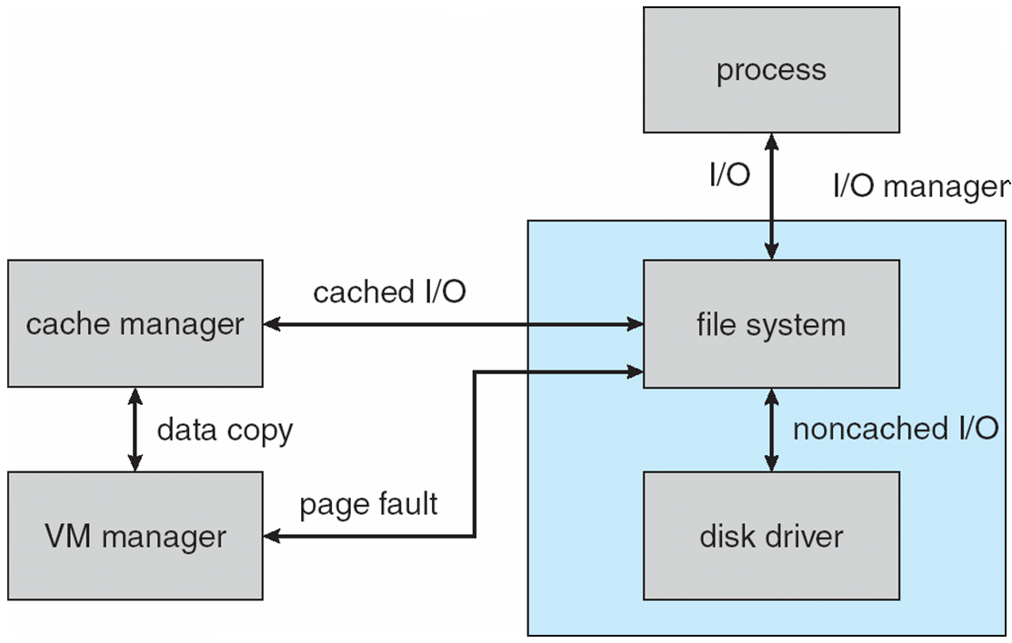
File I/O
education for life www.rimt.ac.in

Slide 20
Executive — Security Reference Monitor
The object-oriented nature of 2000 enables the use of a uniform mechanism to perform runtime access validation and audit checks for every entity in the system.
Whenever a process opens a handle to an object, the security reference monitor checks the process’s security token and the object’s access control list to see whether the process has the necessary rights.
education for life www.rimt.ac.in

Slide 21
Executive – Plug-and-Play Manager
Plug-and-Play (PnP) manager is used to recognize and adapt to changes in the hardware configuration.
When new devices are added (for example, PCI or USB), the PnP manager loads the appropriate driver.
The manager also keeps track of the resources used by each device.
education for life www.rimt.ac.in

Slide 22
Networking — Protocols
The server message block (SMB) protocol is used to send I/O requests over the network. It has four message types:
Session control
File
Printer
Message
The network basic Input/Output system (NetBIOS) is a hardware abstraction interface for networks. Used to:
Establish logical names on the network
Establish logical connections of sessions between two logical names on the network
Support reliable data transfer for a session via NetBIOS requests or SMBs
education for life www.rimt.ac.in

Slide 23
Access to a Remote File
The application calls the I/O manager to request that a file be opened (we assume that the file name is in the standard UNC format).
The I/O manager builds an I/O request packet.
The I/O manager recognizes that the access is for a remote file, and calls a driver called a Multiple Universal Naming Convention Provider (MUP).
The MUP sends the I/O request packet asynchronously to all registered redirectors.
A redirector that can satisfy the request responds to the MUP.
To avoid asking all the redirectors the same question in the future, the MUP uses a cache to remember with redirector can handle this file.
education for life www.rimt.ac.in

Slide 24
Summary
System Components
Environmental Subsystems
File system
Networking
Programmer Interface
education for life www.rimt.ac.in

Slide 25
References
Silberschatz and Peter B. Calvin, “Operating System Concepts" Addison Wesley Publishing Company
Dhamdhere, “Systems Programming & Operating Systems Tata McGraw Hill
education for life www.rimt.ac.in

