Slide 1
Operating System/ BTCS-2401
Course Name: B.Tech CSE Semester: 4th
Prepared by: Er. Jasdeep Singh
education for life www.rimt.ac.in
Department of Computer Science & Engineering

Slide 2
Topic 11th : Deadlocks
education for life www.rimt.ac.in

Slide 3
Topics To Be Covered
The Deadlock Problem
System Model
Deadlock Characterization
education for life www.rimt.ac.in

Slide 4
Chapter Objectives
To develop a description of deadlocks, which prevent sets of concurrent processes from completing their tasks
To present a number of different methods for preventing or avoiding deadlocks in a computer system
education for life www.rimt.ac.in

Slide 5
The Deadlock Problem
A set of blocked processes each holding a resource and waiting to acquire a resource held by another process in the set
Example
System has 2 disk drives
P₁ and P₂ each hold one disk drive and each needs another one
Example
semaphores A and B, initialized to 1 P₀ P₁
wait (A); wait(B) wait (B); wait(A)
education for life www.rimt.ac.in

Slide 6
Bridge Crossing Example
Traffic only in one direction
Each section of a bridge can be viewed as a resource
If a deadlock occurs, it can be resolved if one car backs up (preempt resources and rollback)
Several cars may have to be backed up if a deadlock occurs
Starvation is possible
education for life www.rimt.ac.in

Slide 7
System Model
Resource types R₁, R₂, . . ., R_{m}
CPU cycles, memory space, I/O devices
Each resource type R_{i} has W_{i} instances.
Each process utilizes a resource as follows:
request
use
release
education for life www.rimt.ac.in

Slide 8
Deadlock Characterization
Deadlock can arise if four conditions hold simultaneously.
Mutual exclusion: only one process at a time can use a resource
Hold and wait: a process holding at least one resource is waiting to acquire additional resources held by other processes
No preemption: a resource can be released only voluntarily by the process holding it, after that process has completed its task
Circular wait: there exists a set {P₀, P₁, …, P_{n}} of waiting processes such that P₀ is waiting for a resource that is held by P₁, P₁ is waiting for a resource that is held by
P₂, …, P_{n–1} is waiting for a resource that is held by P_{n}, and P_{n} is waiting for a resource that is held by P₀.
education for life www.rimt.ac.in

Slide 9
Resource-Allocation Graph
A set of vertices V and a set of edges E.
V is partitioned into two types:
P = {P₁, P₂, …, P_{n}}, the set consisting of all the processes in the system
R = {R₁, R₂, …, R_{m}}, the set consisting of all resource types in the system
request edge – directed edge P_{i} → R_{j}
assignment edge – directed edge R_{j} → P_{i}
education for life www.rimt.ac.in

Slide 10
Resource-Allocation Graph (Cont.)
Process Resource Type with 4 instances
P_{i} requests instance of R_{j}
P_{i} is holding an instance of R_{j}
P_{i}
R_{j}
P_{i}
R_{j}
education for life www.rimt.ac.in

Slide 11
Example of a Resource Allocation Graph
education for life www.rimt.ac.in

Slide 12
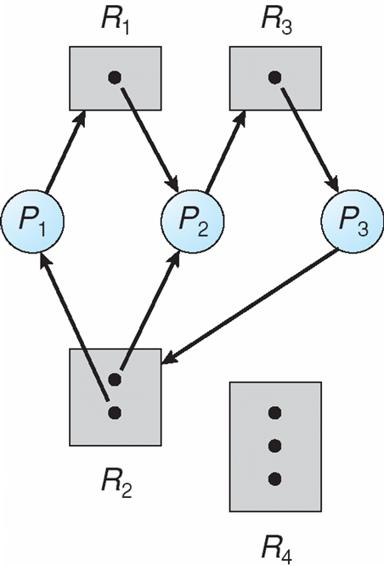
Resource Allocation Graph With A Deadlock
education for life www.rimt.ac.in

Slide 13
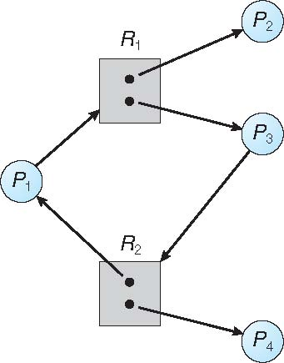
Graph With A Cycle But No Deadlock
education for life www.rimt.ac.in

Slide 14
Basic Facts
If graph contains no cycles ⇒ no deadlock
If graph contains a cycle ⇒
if only one instance per resource type, then deadlock
if several instances per resource type, possibility of deadlock
education for life www.rimt.ac.in

Slide 15
Summary
The Deadlock Problem
System Model
Deadlock Characterization
education for life www.rimt.ac.in

Slide 16
Topics To Be Next Covered
Methods for Handling Deadlocks
Deadlock Prevention
Deadlock Avoidance
Deadlock Detection
Recovery from Deadlock
education for life www.rimt.ac.in

Slide 17
References
Silberschatz and Peter B. Calvin, “Operating System Concepts" Addison Wesley Publishing Company
Dhamdhere, “Systems Programming & Operating Systems Tata McGraw Hill

