Slide 1
Operating System/ BTCS-2401
Course Name: B.Tech CSE Semester: 4th
Prepared by: Er. Jasdeep Singh
education for life www.rimt.ac.in
Department of Computer Science & Engineering

Slide 2
Topic 12th :CPU Scheduling
education for life www.rimt.ac.in

Slide 3
Topics To Be Covered
Methods for Handling Deadlocks
Deadlock Prevention
Deadlock Avoidance
Deadlock Detection
Recovery from Deadlock
education for life www.rimt.ac.in

Slide 4
Methods for Handling Deadlocks
Ensure that the system will never enter a deadlock state
Allow the system to enter a deadlock state and then recover
Ignore the problem and pretend that deadlocks never occur in the system; used by most operating systems, including UNIX
education for life www.rimt.ac.in

Slide 5
Deadlock Prevention
Restrain the ways request can be made
Mutual Exclusion – not required for sharable resources; must hold for nonsharable resources
Hold and Wait – must guarantee that whenever a process requests a resource, it does not hold any other resources
Require process to request and be allocated all its resources before it begins execution, or allow process to request resources only when the process has none
Low resource utilization; starvation possible
education for life www.rimt.ac.in

Slide 6
Deadlock Prevention (Cont.)
No Preemption –
If a process that is holding some resources requests another resource that cannot be immediately allocated to it, then all resources currently being held are released
Preempted resources are added to the list of resources for which the process is waiting
Process will be restarted only when it can regain its old resources, as well as the new ones that it is requesting
Circular Wait – impose a total ordering of all resource types, and require that each process requests resources in an increasing order of enumeration
education for life www.rimt.ac.in

Slide 7
Deadlock Avoidance
Requires that the system has some additional a priori information available
Simplest and most useful model requires that each process declare the maximum number of resources of each type that it may need
The deadlock-avoidance algorithm dynamically examines the resource-allocation state to ensure that there can never be a circular-wait condition
Resource-allocation state is defined by the number of available and allocated resources, and the maximum demands of the processes
education for life www.rimt.ac.in

Slide 8
Safe State
When a process requests an available resource, system must decide if immediate allocation leaves the system in a safe state
System is in safe state if there exists a sequence <P₁, P₂, …, P_{n}> of ALL the processes in the systems such that for each P_{i}, the resources that P_{i} can still request can be satisfied by currently available resources + resources held by all the P_{j}, with j < I
That is:
If P_{i} resource needs are not immediately available, then P_{i} can wait until all P_{j} have finished
When P_{j} is finished, P_{i} can obtain needed resources, execute, return allocated resources, and terminate
When P_{i} terminates, P_{i +1} can obtain its needed resources, and so on
education for life www.rimt.ac.in

Slide 9
Basic Facts
If a system is in safe state ⇒ no deadlocks
If a system is in unsafe state ⇒ possibility of deadlock
Avoidance ⇒ ensure that a system will never enter an unsafe state.
education for life www.rimt.ac.in

Slide 10
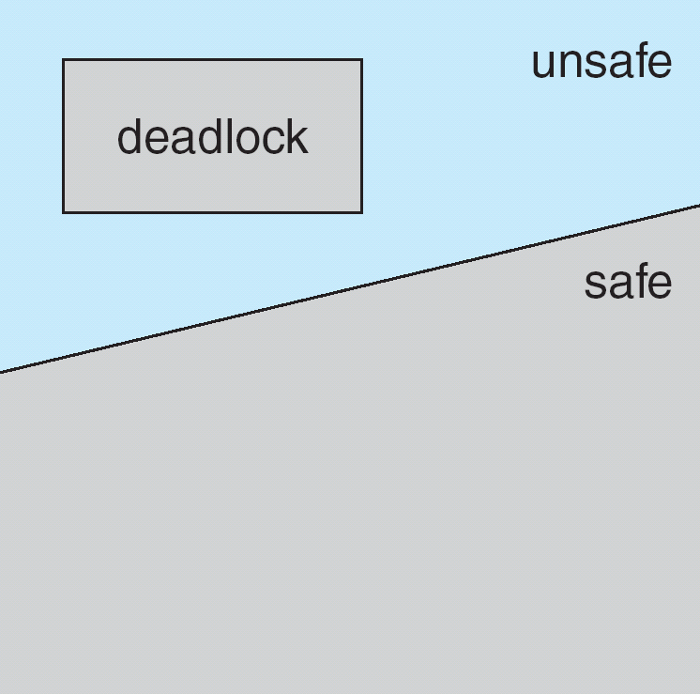
Safe, Unsafe, Deadlock State
education for life www.rimt.ac.in

Slide 11
Avoidance algorithms
Single instance of a resource type
Use a resource-allocation graph
Multiple instances of a resource type
Use the banker’s algorithm
education for life www.rimt.ac.in

Slide 12
Resource-Allocation Graph Scheme
Claim edge P_{i} → R_{j} indicated that process P_{j} may request resource R_{j}; represented by a dashed line
Claim edge converts to request edge when a process requests a resource
Request edge converted to an assignment edge when the resource is allocated to the process
When a resource is released by a process, assignment edge reconverts to a claim edge
Resources must be claimed a priori in the system
education for life www.rimt.ac.in

Slide 13
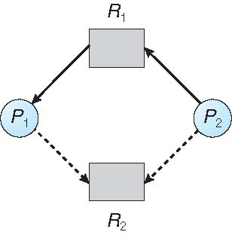
Resource-Allocation Graph
education for life www.rimt.ac.in

Slide 14
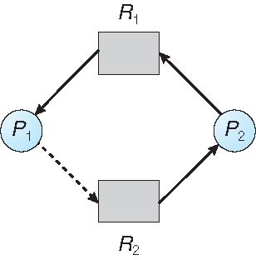
Unsafe State In Resource-Allocation Graph
education for life www.rimt.ac.in

Slide 15
Resource-Allocation Graph Algorithm
Suppose that process P_{i} requests a resource R_{j}
The request can be granted only if converting the request edge to an assignment edge does not result in the formation of a cycle in the resource allocation graph
education for life www.rimt.ac.in

Slide 16
Banker’s Algorithm
Multiple instances
Each process must a priori claim maximum use
When a process requests a resource it may have to wait
When a process gets all its resources it must return them in a finite amount of time
education for life www.rimt.ac.in

Slide 17
Data Structures for the Banker’s Algorithm
Let n = number of processes, and m = number of resources types.
Available: Vector of length m. If available [j] = k, there are k instances of resource type R_{j} available
Max: n x m matrix. If Max [i,j] = k, then process P_{i} may request at most k instances of resource type R_{j}
Allocation: n x m matrix. If Allocation[i,j] = k then P_{i} is currently allocated k instances of R_{j}
Need: n x m matrix. If Need[i,j] = k, then P_{i} may need k more instances of R_{j} to complete its task
Need [i,j] = Max[i,j] – Allocation [i,j]
education for life www.rimt.ac.in

Slide 18
Deadlock Detection
Allow system to enter deadlock state
Detection algorithm
Recovery scheme
education for life www.rimt.ac.in

Slide 19
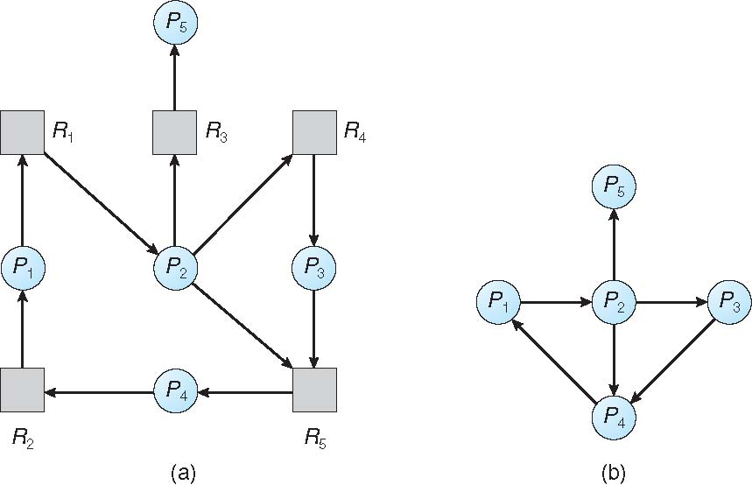
Resource-Allocation Graph and Wait-for Graph
Resource-Allocation Graph
Corresponding wait-for graph
education for life www.rimt.ac.in

Slide 20
Several Instances of a Resource Type
Available: A vector of length m indicates the number of available resources of each type.
Allocation: An n x m matrix defines the number of resources of each type currently allocated to each process.
Request: An n x m matrix indicates the current request of each process. If Request [i][j] = k, then process P_{i} is requesting k more instances of resource type.R_{j}.
education for life www.rimt.ac.in

Slide 21
Recovery from Deadlock: Process Termination
Abort all deadlocked processes
Abort one process at a time until the deadlock cycle is eliminated
In which order should we choose to abort?
Priority of the process
How long process has computed, and how much longer to completion
Resources the process has used
Resources process needs to complete
How many processes will need to be terminated
Is process interactive or batch?
education for life www.rimt.ac.in

Slide 22
Recovery from Deadlock: Resource Preemption
Selecting a victim – minimize cost
Rollback – return to some safe state, restart process for that state
Starvation – same process may always be picked as victim, include number of rollback in cost factor
education for life www.rimt.ac.in

Slide 23
Summary
Methods for Handling Deadlocks
Deadlock Prevention
Deadlock Avoidance
Deadlock Detection
Recovery from Deadlock
education for life www.rimt.ac.in

Slide 24
Topics To Be Next Covered
Background
Swapping
Contiguous Memory Allocation
education for life www.rimt.ac.in

Slide 25
References
Silberschatz and Peter B. Calvin, “Operating System Concepts" Addison Wesley Publishing Company
Dhamdhere, “Systems Programming & Operating Systems Tata McGraw Hill
education for life www.rimt.ac.in

