Slide 1
Web Development/BTCS-2410
Course Name: B.Tech CSE Semester:4th
Prepared by: Ms. Yogesh
education for life www.rimt.ac.in
Department of Computer Science & Engineering

Slide 2
Some HTML Tags
education for life www.rimt.ac.in

Slide 3
Tags Attributes
Tags can have attributes
Attributes specify properties and behavior
Example:
Few attributes can apply to every element:
id, style, class, title
The id is unique in the document
Content of title attribute is displayed as hint when the element is hovered with the mouse
Some elements have obligatory attributes
Attribute alt with value "logo"
<img src="logo.gif" alt="logo" />
education for life www.rimt.ac.in

Slide 4
Headings and Paragraphs
Heading Tags (h1 – h6)
Paragraph Tags
Sections: div and span
<h1>Heading 1</h1>
<h2>Sub heading 2</h2>
<h3>Sub heading 3</h3>
<p>This is my first paragraph</p>
<p>This is my second paragraph</p>
<div style="background: skyblue;">
This is a div</div>
education for life www.rimt.ac.in

Slide 5
Headings and Paragraphs – Example
headings.html
<!DOCTYPE HTML>
<html>
<head><title>Headings and paragraphs</title></head>
<body>
<h1>Heading 1</h1>
<h2>Sub heading 2</h2>
<h3>Sub heading 3</h3>
<p>This is my first paragraph</p>
<p>This is my second paragraph</p>
<div style="background:skyblue">
This is a div</div>
</body>
</html>
education for life www.rimt.ac.in

Slide 6
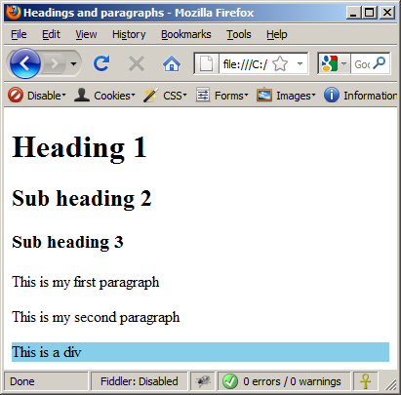
Headings and Paragraphs – Example (2)
headings.html
<!DOCTYPE HTML>
<html>
<head><title>Headings and paragraphs</title></head>
<body>
<h1>Heading 1</h1>
<h2>Sub heading 2</h2>
<h3>Sub heading 3</h3>
<p>This is my first paragraph</p>
<p>This is my second paragraph</p>
<div style="background:skyblue">
This is a div</div>
</body>
</html>
education for life www.rimt.ac.in

Slide 7
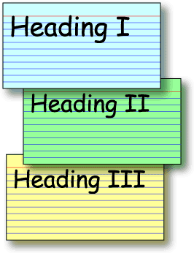
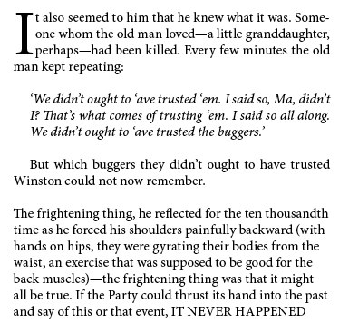
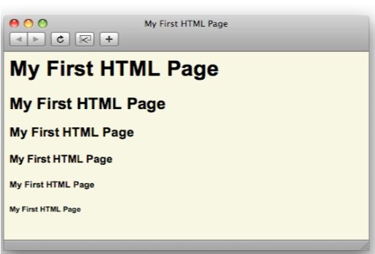
Headings and Paragraphs
Live Demo
education for life www.rimt.ac.in

